Slide 1
Run external program

Slide 2
Learning objectives
External process
How to run from Perl script
Functions for external process
system()
backtick
exec()

Slide 3
Perl wrapper
A wrapper is a script that embeds a system command or utility, that accepts and passes a set of parameters to that command.
Perl can be used as a wrapper around other external software
Create the correct command line to run the other program
Create automatic pipelines
Capture the output of another command line program and then make some decisions based on that output
Use output of one program as input for another program.
Notes:
Complex computational pipelines for high-throughput data are
often implemented as a sequence of relatively simple discrete
steps, which typically read data from an input file, perform a
transformation or calculation and then write an output file that
serves as an input for a subsequent step.

Slide 4
Execute external commands from Perl
External command
system()
exec()
backtick
open()

Slide 5
exec()
Syntax: exec("command arg1 arg2 arg3");
Never returns to the calling program
Exception: failure (the specified command does not exist)
Less popular
Useful in web-servers (CGI-perl)
Perl thread
Extrn. tool
exec

Slide 6
system()
Syntax: system(COMMAND, @ARG_LIST )
run a command with parameters and wait for it to return
Prints the results to the Screen
Does not return values from the external tool
Returns command run status (success/failed)
Perl thread
Extrn. tool
exec

Slide 7
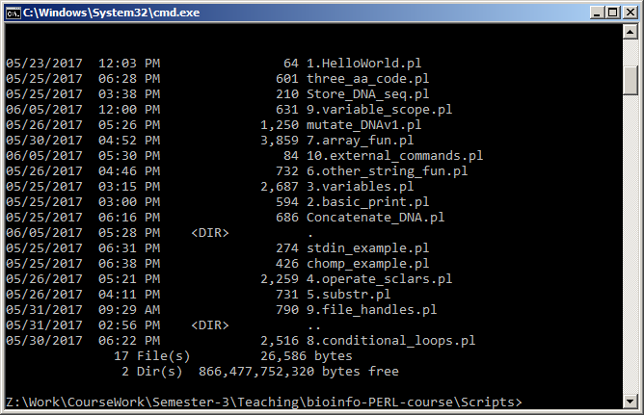
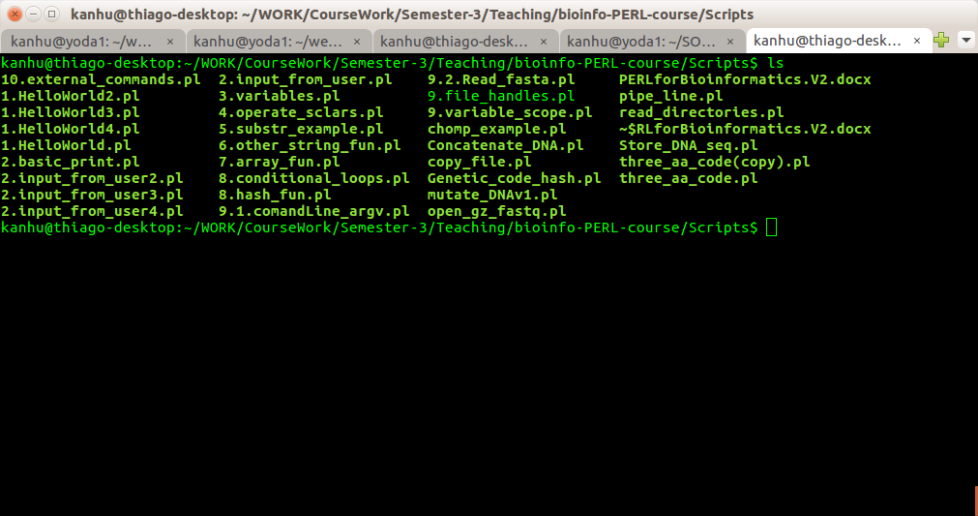
# windows
$cmd = 'dir';
system("$cmd");
# Linux
$cmd = 'ls';
system("$cmd");

Slide 8
system() returns exit status
0 : if the command succeeds
256 : if the command fails
Conventionally 0 is for fail and 1 for success.
Divide the returned value with 256
FAIL: 0/256 =0 and SUCCESS: 256/256 = 1
Updates special variable $?
$? : -1 , means command failed to execute

Slide 9
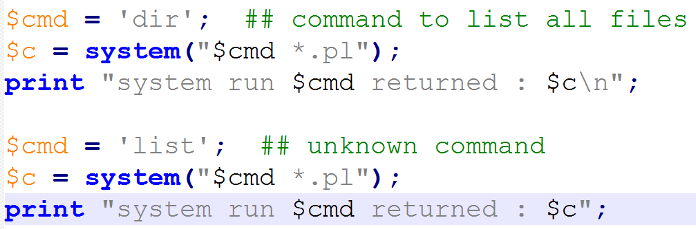
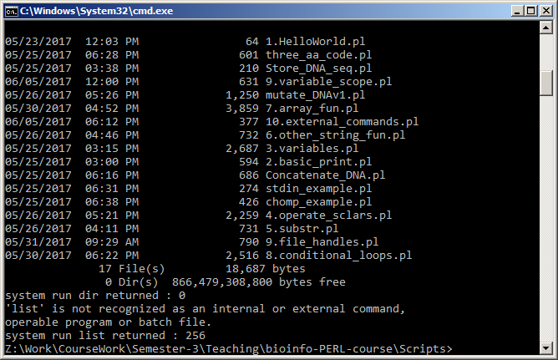

Slide 10
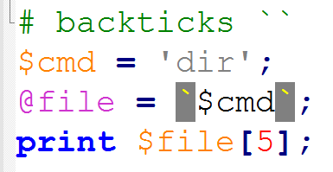

backtick (``)
Similar to system(), except:
Does not print on screen
Returns actual value of the command output
exit status of the executed command is stored in $?

Slide 11
open(): run a command as filehandle
Syntax:
open(PS,"cmd arg1 arg2 |") || die "Failed: $!\n";
capture the data of a command
Useful in reading compressed files, .gz, .bam, .bcf files
Notes:
feed an external command with data generated from the Perl script (syntax: open("| command"))
#-- send an email to user@localhost
open(MAIL, "| /bin/mailx -s test user\@localhost ") || die "mailx failed: $!\n";
print MAIL "This is a test message";

Slide 12
Read a gunzipped FASTQ file
$file = '../../data/SRR1506089.fastq.gz';
open FQ, "gunzip -c $file |"
or die "command failed : $!";
while($line=<FQ>){
print $line;
}
close FQ;

Slide 13
Phylogenetic tree pipeline
Read multiple fasta files from user specified directory
Align sequences in each fasta file using Muscle
Create a phylogenetic tree using FastTree
Open script

Slide 14
Exercise
Write a script to perform blastP search at 10 different e-value cutoff. Report total number of hits predicted in each search.
Write a script to automate BLASTp search, using each of the fasta files in the user defined directory against A.thaliana proteome.

Slide 15
Thank you

