Slide 1
Conditional and loop structure

Slide 2
Learning objectives
Use conditional statements
if() ... else() statements
Nested if()
unless()
Iternative flow of control
goto statements
for(), foreach()
while()
until()
interrupt a loop
last()
next()

Slide 3
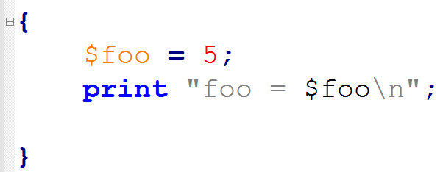
Code Block
A code block consists of on eor more statements
In Perl code-blocks are enclosed by a pair of curly brackets { STATEMENTS... }
They create a separate enviornment for the variables

Slide 4
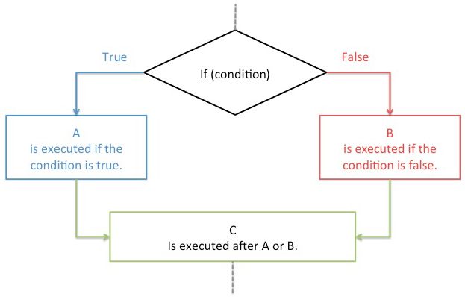
Conditional statements

Slide 5
What is truth
Conditional statements get executed based on whether they are "true" or "false".
Unlike other languages (e.g. R), Perl does not have boolean variable type. (TRUE/FALSE)
What is false
undef : undeclared scalar
“” : empty string
0 : Numeric value zero.
Everyother value is considered as true

Slide 6
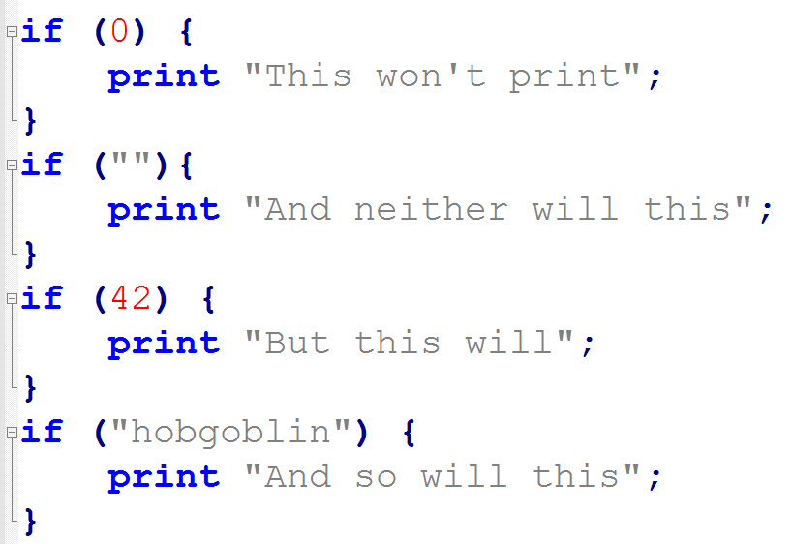

Slide 7
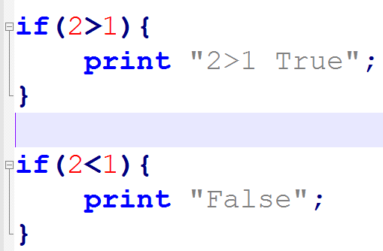
Making comparisons
Comparing Numbers: The simplest type of comparisons to make are numerical comparisons.
$x > $y | Is X is greater than Y?
$x < $y | Is X is less than Y?
$x >= $y | Is X is greater or equals to Y?
$x <= $y | Is X is less or equals to Y?

Slide 8
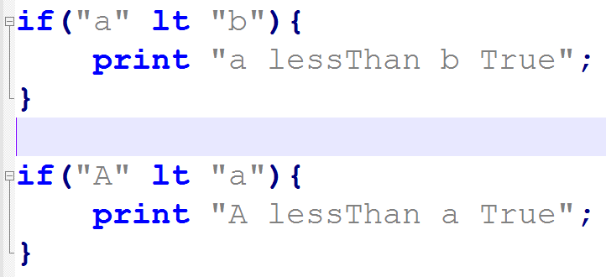
String comparison
test based on their alphabetical order
Uses string comparison operators (lt, gt, ne, le, ge)

Slide 9
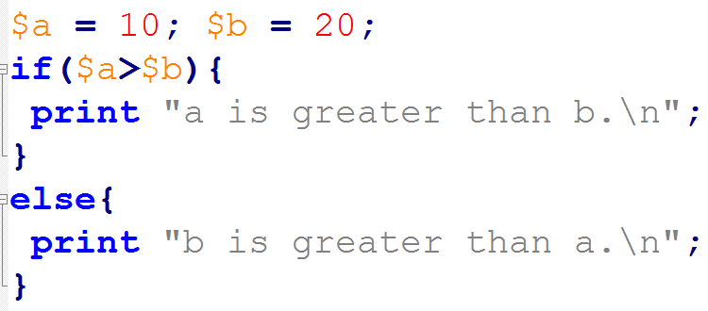
if ... else
An optional block of else{} block can be added next to if block.
Executed when if condition is NOT satisfied.

Slide 10
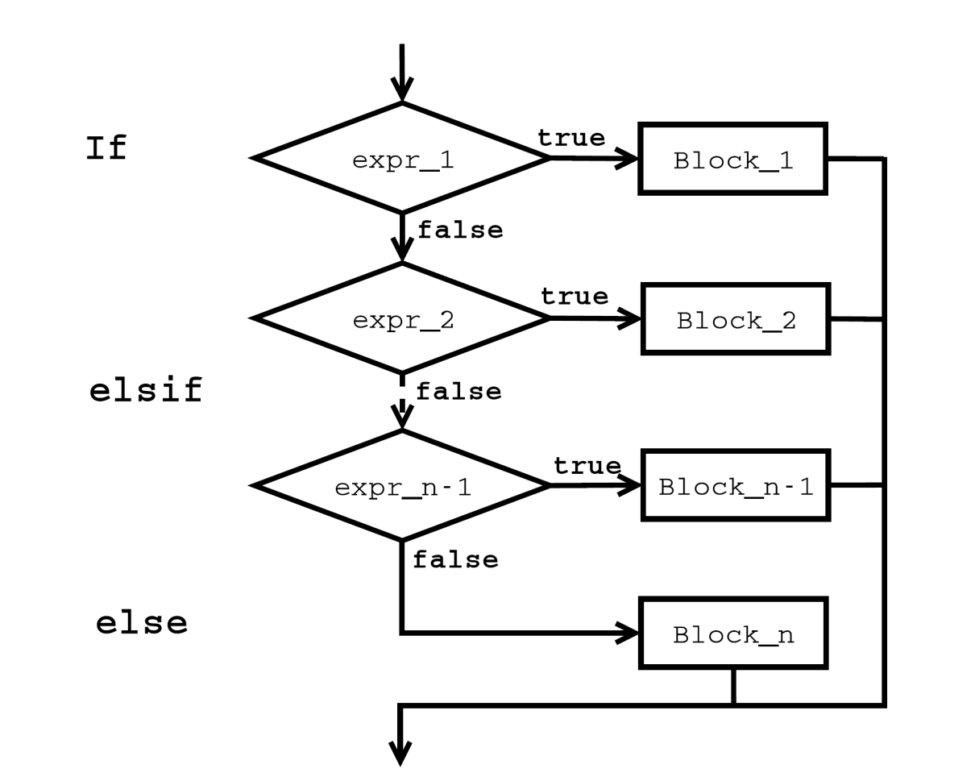
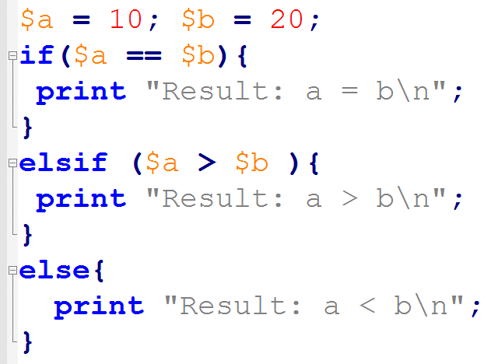
Complex conditions

Slide 11
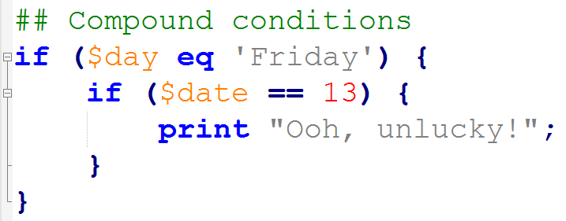
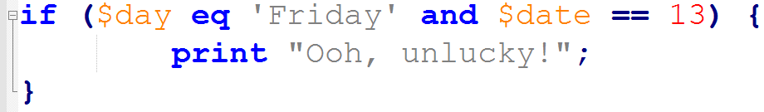
Compound conditions
check more than one condition in an if statement
Use operators : and (&&) , or (||)

Slide 12
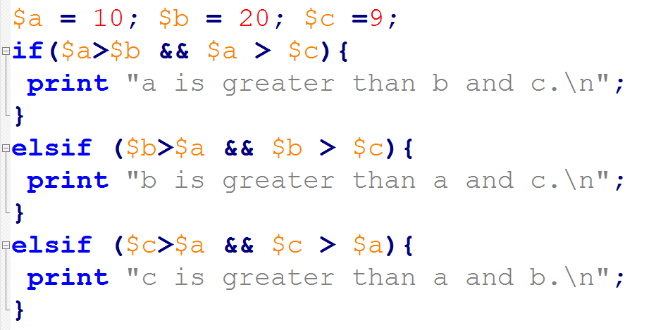

Slide 13
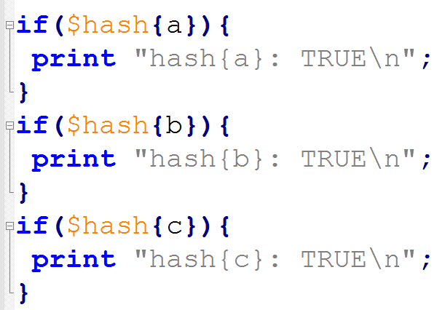
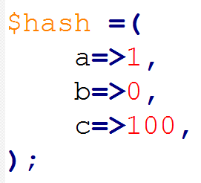
Condition on hash

Slide 14
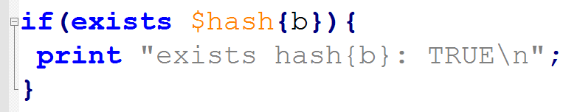
exists $hash{key}
Irrespective of the value.

Slide 15
Bioinfo example

Slide 16
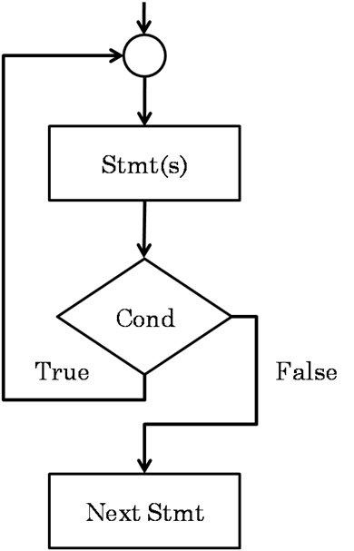
Iterating over statements
for()
foreach()
while()

Slide 17
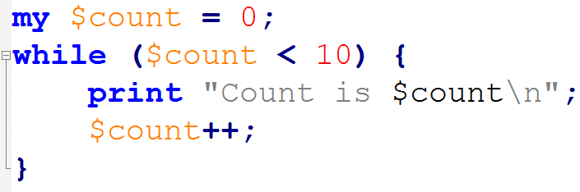
while() loops
Probably the simplest kind of loop is the while loop.
A condition
Code block
Run till condition returns false

Slide 18
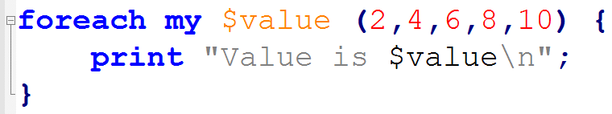
foreach() loop
Iterate through a list of values (or an array)
Code-block which will be run once for each value in the list supplied
The accessed value will be returned to a variable
If no variable is provided it will be stored as $_

Slide 19
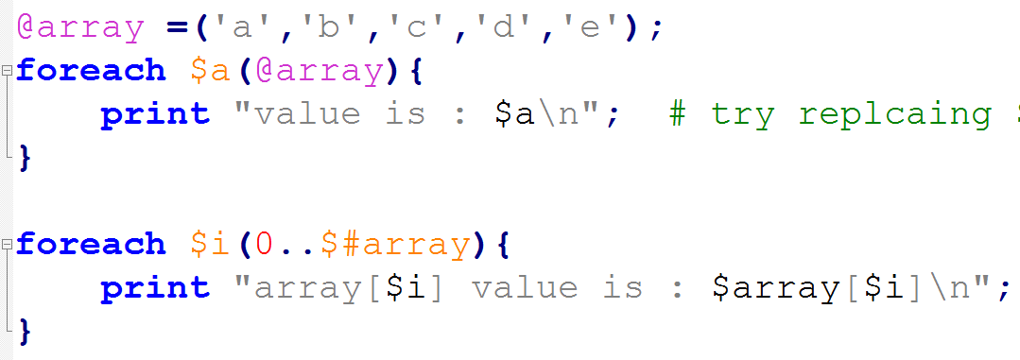
Move through array

Slide 20
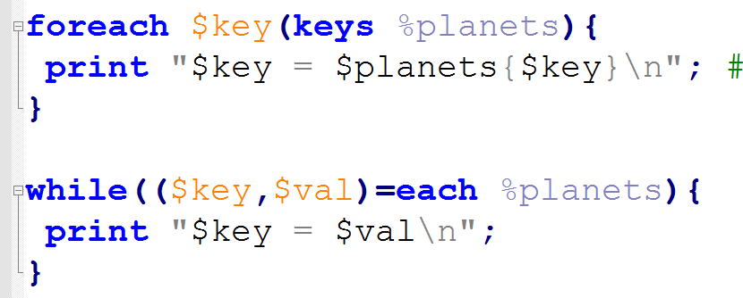
Move through hash

Slide 21
for() loop
for() is just an alias for foreach()
A primitive form, like C.
As use similar like foreach()
for (initialise; condition; continuation)
{
# loop body
}

Slide 22
Complex loops
Nested for() loops
A loop with in another loop

Slide 23
Bioinfo example

Slide 24
Thank you

