Slide 1
Operations on variables

Slide 2
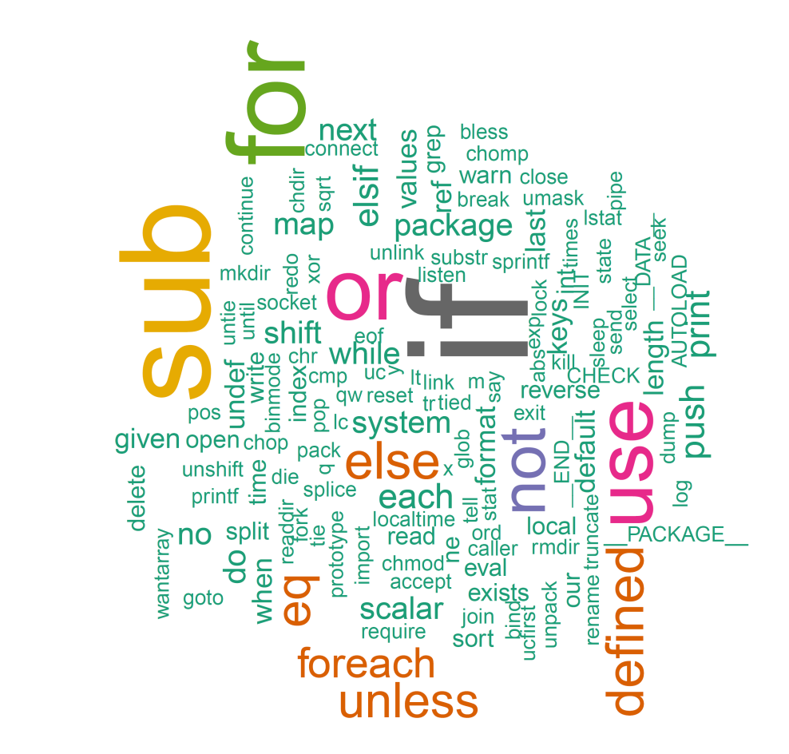
Learning objectives
Perl built-in functions
Functions for scalar variables
Functions for arrays
Functions for hash
More bioinformatics examples

Slide 3
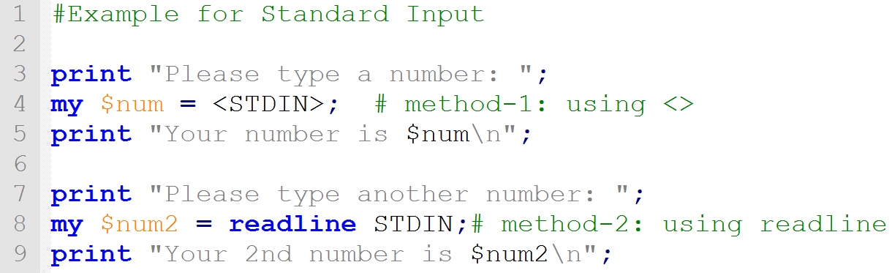
Read input from user
To make the program do something, we need to input data.
The angle bracket operator (<>) or readline tells Perl to expect input, by default from the keyboard. ( STDIN )
Usually this is assigned to a variable

Slide 4
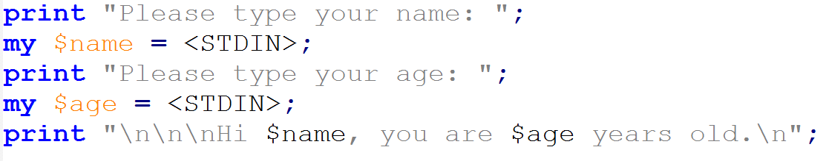

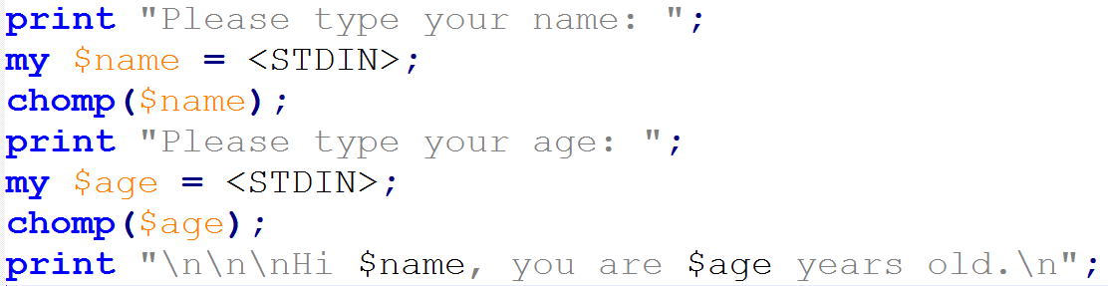

chomp() : remove trailing spaces

Slide 5
Numerical built-in functions
abs #absolute value
sin cos tan #trigonometry
exp log sqrt #exponent, log, square root
int #convert to int
rand #random numbers
$variable=100;
print sqrt($variable);

Slide 6
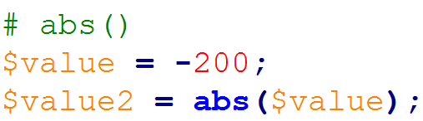
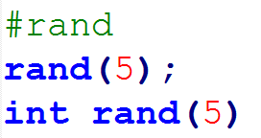
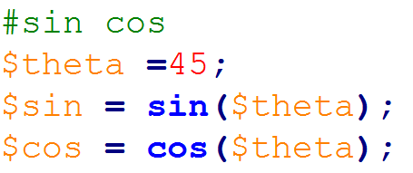
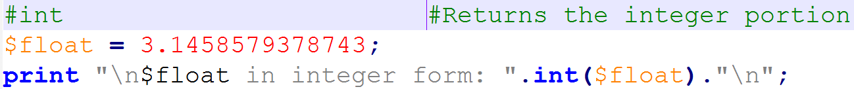

Slide 7
String built-in functions
substr($var, $start, $length) #substring, 0-based
length($var) #length if a string $var
index($var, $str) #position of $str in $var
reverse($var) #reverse string
uc($var) lc($var) #uppercase, lowercase
ord($var) #converts character to its ASCII value
$num = ord("a") #$num is now 97
chr($nvar) #converts int into ASCII character
$char = chr(99) #$char is now

Slide 8
substr()
Syntax: substr EXPR,OFFSET,LENGTH,REPLACEMENT
Extracts a substring out of EXPR
OFFSET : 0-index based start poition
If negative, starts that far back from the end
LENGTH : from OFFSET how much length to return
If omitted, returns everything through the end
If negative, leaves that many characters off the end.
REPLACEMENT : optionally replace with PROVIDED string

Slide 9
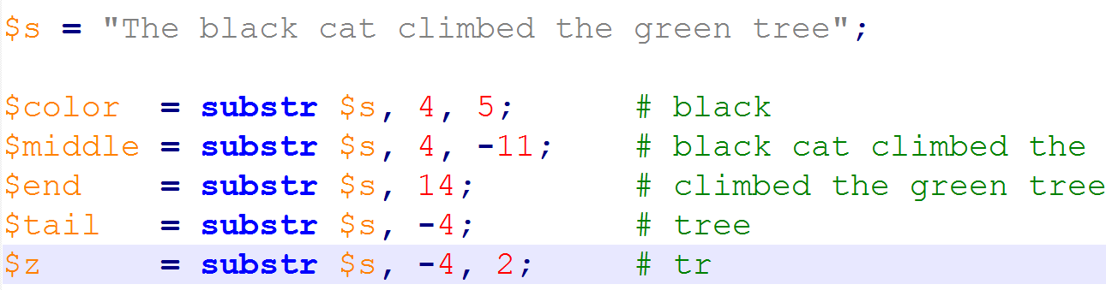

Slide 10
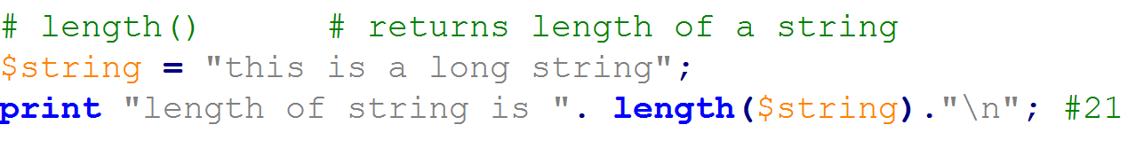
length()
Syntax: length EXPR
Returns the length in characters of the value of EXPR.

Slide 11
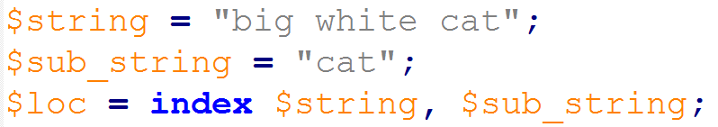
index()
Syntax: index STR,SUBSTR
returns the position of the first occurrence of SUBSTR in STR
If the substring is not found, index returns -1

Slide 12
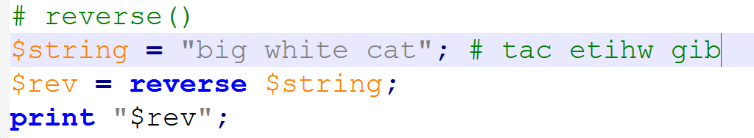
reverse()
Syntax : reverse EXPR
returns a list value consisting of the elements of LIST in the opposite order.

Slide 13
uc() AND lc()
Syntax: uc EXPRS
Returns the string as UPPER CASE string
Syntax: lc EXPRS
Returns the string as LOWER CASE string

Slide 14
Write a program to mutate a DNA

Slide 15
split()
Syntax: split /PATTERN/,EXPR
Splits the string EXPR into a list of strings and returns the list in list context
Convert a string (scalar) into an array using a separator.
TGATGCCAATGCCAGATGCAG
@arr = split /ATG/,’TGATGCCAATGCCAGATGCAG’
TG | CCA | CCAG | CAG
0 | 1 | 2 | 3

Slide 16
scalar()
Syntax: scalar EXPR
Forces EXPR to be interpreted in scalar context and returns the value of EXPR
Commonly used to get length of an array
$len = scalar @arr; # 4
TG | CCA | CCAG | CAG
0 | 1 | 2 | 3

Slide 17
join()
Syntax: join EXPR, LIST
Joins the separate strings of LIST into a single string with fields separated by the value of EXPR, and returns that new string
$dna = join `|`,@arr;
TG | CCA | CCAG | CAG
0 | 1 | 2 | 3
`TGCCACCAGCAG`

Slide 18
Array manipulative functions
Syntax:
shift ARRAY
unshift ARRAY, LIST
push ARRAY, LIST
pop ARRAY
shift()
push()
TG | CCA | CCAG | CAG
0 | 1 | 2 | 3
unshift()
pop()
Notes:
Advaned: map(): executes a given code block for each list element, and the results evaluated are combined
to form an array.

Slide 19
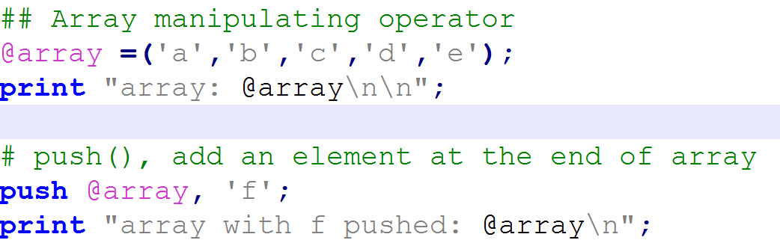


Slide 20
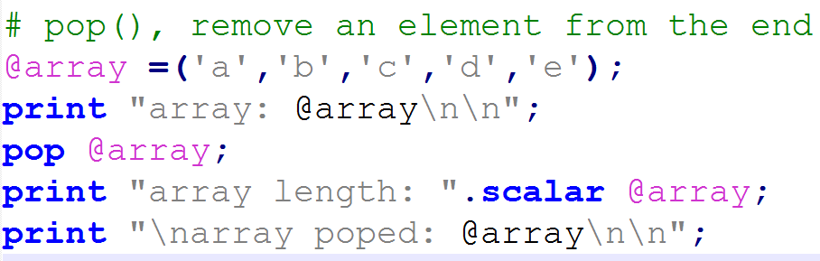


Slide 21
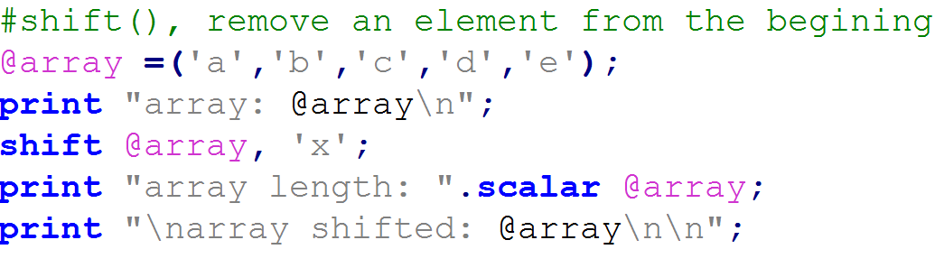


Slide 22
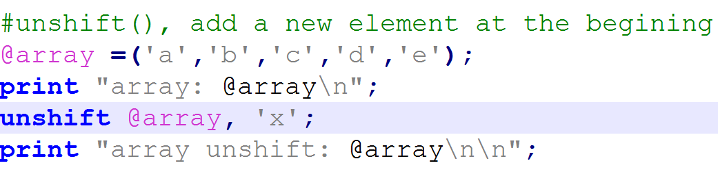


Slide 23
sort()
Syntax: sort ARRAY
Sorts the LIST and returns the sorted array value.
Sorting
Alphanumeric (111, 11, 100, 10, 1)
Numeric (111, 100, 11, 10, 1)
extremely useful :
<=> for numeric
Cmp : for alphanumeric

Slide 24
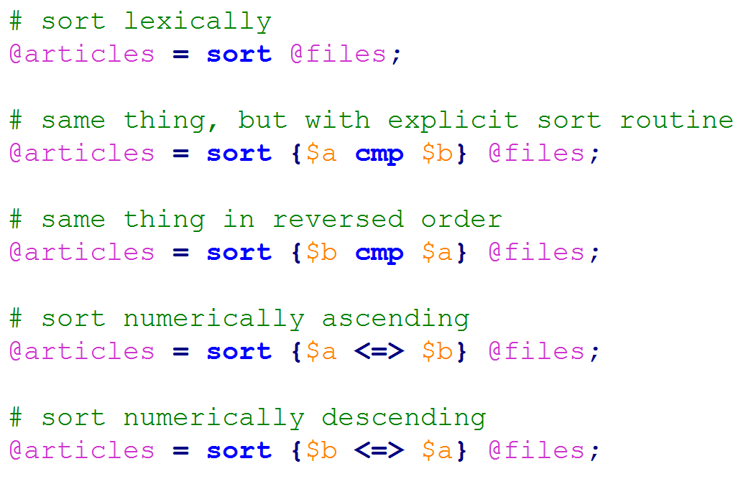
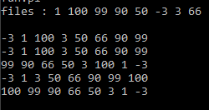

Slide 25
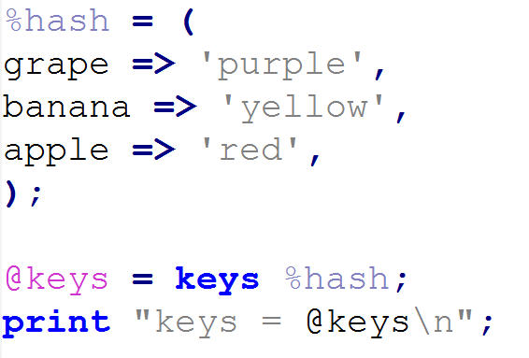
keys()
Syntax: keys HASH
returns a list consisting of all the keys of the named hash

Slide 26
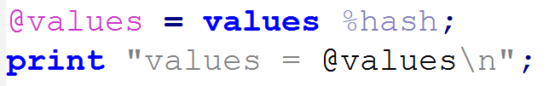
values()
Syntax: values HASH
returns a list consisting of all the values of the named hash

Slide 27
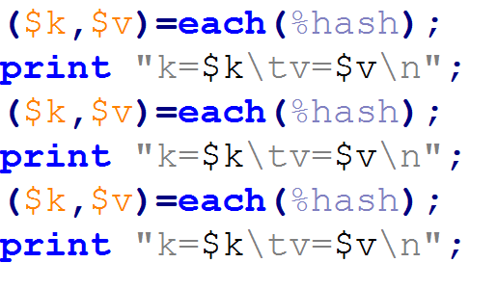

each()
Syntax: each HASH
returns a 2-element list consisting of the key and value for the next element of a hash

Slide 28
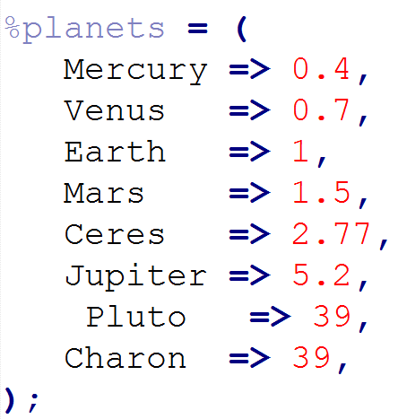

exists()
Syntax: exists $HASH{key}
returns true if the specified element in the hash has ever been initialized, even if the corresponding value is undefined

Slide 29
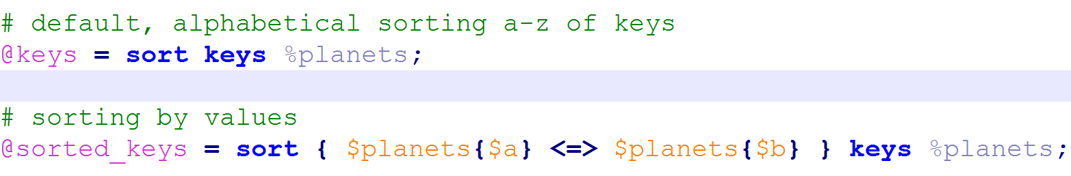
sort() on HASH
Syntax: sort keys HASH
Applying sort on keys output on the hash.

Slide 30
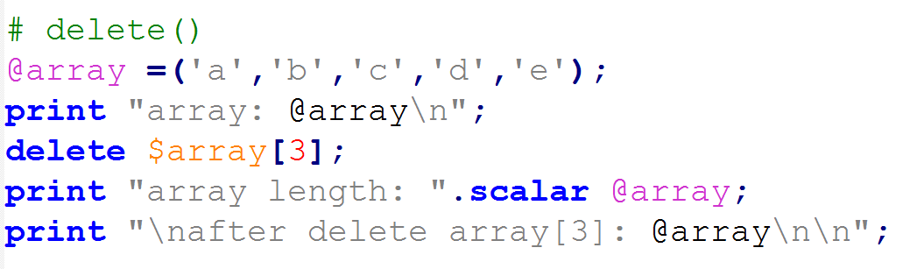
delete()
Syntax: delete ARRAY / HASH{key}
Assigns that index with NULL value
If index is last element, removes
deletes the specified elements from that hash

Slide 31
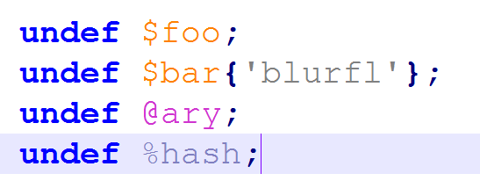
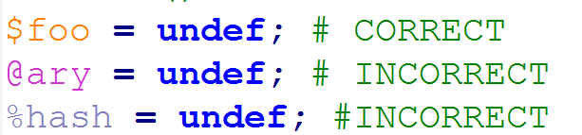
undef()
Syntax: undef EXPR
Undefines the value of EXPR

Slide 32
Thank you

