Slide 1
NLP PROJECT TITLE : SPEECH EMOTION RECOGNITION
Presented by:
KANISHKA R
NIVETHA A
KARTHIGA N

Slide 2
Introduction:
Speech Emotion Recognition (SER) aims to identify and classify human emotions (such as happiness, sadness, anger, etc.) based on speech signals. Current models often struggle with accuracy and generalization due to the variability in speech patterns, background noise, and limited labeled data.
Additionally, the challenges of speaker variability and the environmental context further complicate accurate emotion detection. This project focuses on developing a robust model that can reliably detect emotions across different speakers, accents, and noisy conditions, ensuring a higher level of accuracy and generalization in real-world scenarios.

Slide 3
License and version:
Software / Library | Version | License
Python | 3.10 | PSF License
TensorFlow | 2.12.0 | Apache License 2.0
Keras | 2.12.0 | Apache License 2.0
Flask | 2.3.3 | BSD-3-Clause
NumPy | 1.23.5 | BSD-3-Clause
Pandas | 1.5.3 | BSD-3-Clause
Matplotlib | 3.7.1 | Matplotlib License (PSF-based)
Scikit-learn | 1.2.2 | BSD-3-Clause
librosa | 0.10.0 | ISC License
sounddevice | 0.4.6 | MIT License
SpeechRecognition | 3.10.0 | BSD License
Transformers (Hugging Face) | 4.30.0 | Apache License 2.0
DialoGPT (Hugging Face) | small/medium | MIT License
Flan-T5 (google/flan-t5-base) | base | Apache License 2.0
wavio | 0.0.7 | MIT License
soundfile (pysoundfile) | 0.12.1 | BSD License

Slide 4
Where this tool used:
Tool / Library | Where Used in SER Project
TensorFlow | Training and running the speech emotion recognition model
Keras | Building and training the SER neural network
Flask | Serving the SER model as a web application/API
NumPy | Numerical computations for audio features and model inputs
Pandas | Dataset handling and preprocessing for SER
Matplotlib | Plotting accuracy, loss graphs, and emotion detection results
Scikit-learn | Preprocessing, train-test split, and evaluation metrics
librosa | Extracting MFCCs and other audio features from speech
sounddevice | Recording real-time audio for SER input
SpeechRecognition | Converting recorded speech to text
Transformers (Hugging Face) | Loading NLP models for text emotion analysis
DialoGPT | Generating conversational responses with emotional context
Flan-T5 | Text-to-text understanding (summarization, intent recognition)
wavio | Saving recorded speech as .wav files
soundfile (pysoundfile) | Reading and writing audio files during processing

Slide 5
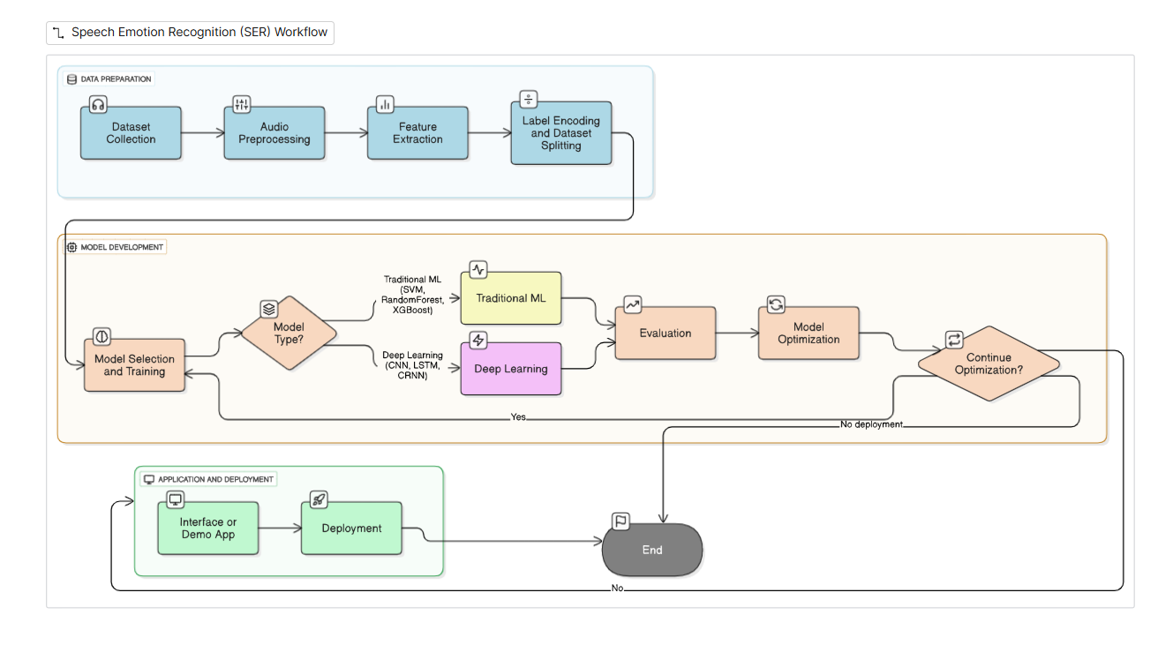
METHODOLOGY DIAGRAM

Slide 6
Advantages:
Existing Limitation | How SER Overcomes It
Only text-based emotion detection (ignores tone) | Analyzes voice tone, pitch, and prosody for accurate emotion recognition
Chatbots/assistants respond in a robotic way | SER enables empathetic and context-aware responses
No real-time emotional adaptation | Detects and responds to emotions instantly during conversations
Misclassification of sarcasm, stress, or anger | Uses audio features (MFCCs, pitch, energy) for improved accuracy
One-size-fits-all human–machine interaction | Provides personalized and adaptive user experience
Limited support for people with speech/communication issues | Recognizes emotions from speech tone, improving accessibility
Isolated emotion analysis (only text or only facial cues) | Allows multimodal integration (speech + text + facial) for robustness

Slide 7
Problem Statement:
Existing systems analyze only words, ignoring emotions
Leads to robotic and insensitive interactions
Lack real-time emotional adaptation
Need for SER system to detect emotions from voice (tone, pitch, prosody)
Enables empathetic, personalized, and human-like responses

Slide 8
Tech Stack:
Layer | Technology / Tool | Purpose in SER Project
Machine Learning / Deep Learning | TensorFlow, Keras, Scikit-learn | Model training, evaluation, and classification
Audio Processing | librosa, sounddevice, SpeechRecognition, wavio, soundfile | Feature extraction, recording, speech-to-text, and audio handling
NLP Models | Hugging Face Transformers (DialoGPT, Flan-T5) | Conversational AI and text-based emotion understanding
Backend / API | Flask | Serving the SER model as a web application/API
Data Handling | NumPy, Pandas | Numerical computations and dataset preprocessing
Visualization | Matplotlib | Plotting accuracy, loss curves, and results
Deployment | Flask + Local/Cloud | Deploying the SER system for user access

Slide 9
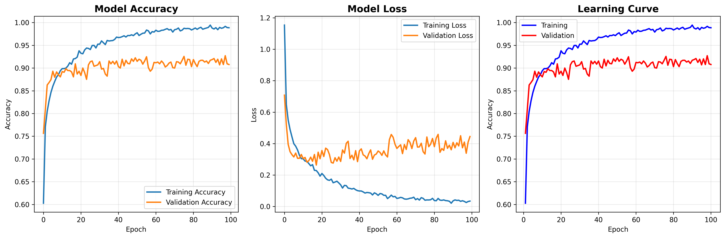
Output :

Slide 10
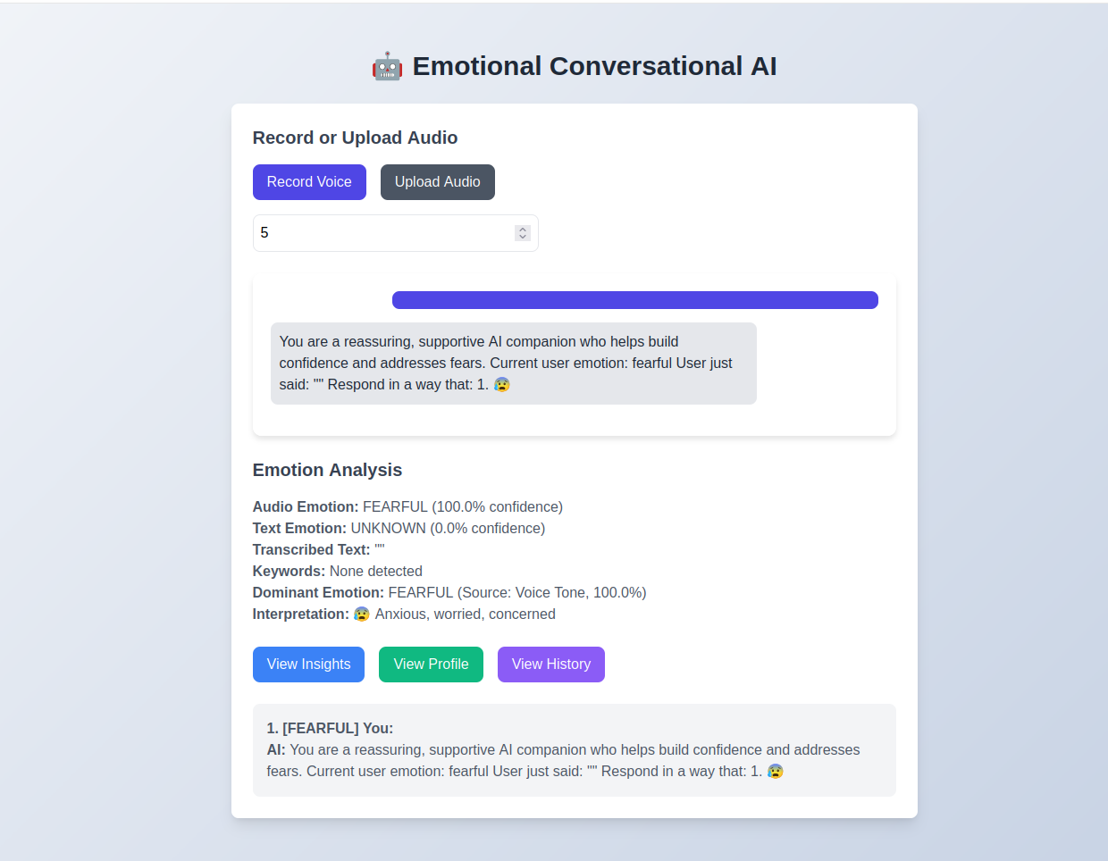
Output :

