Slide 1
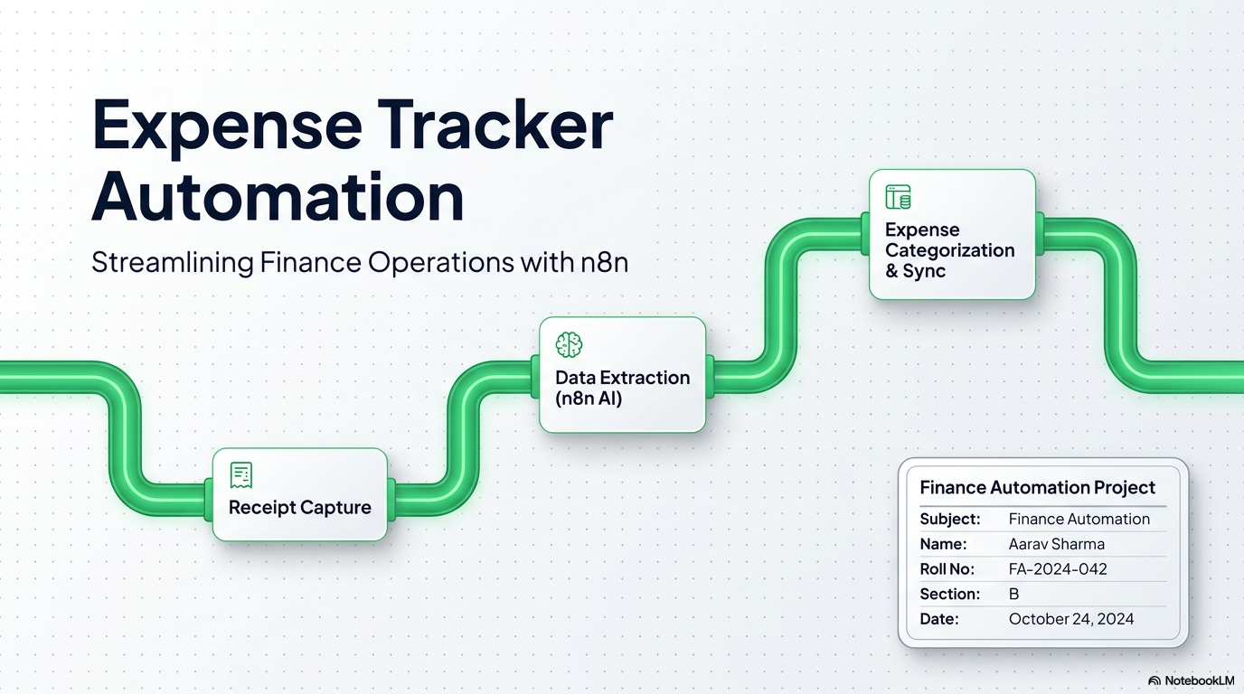

Mayank Garg
Name | Roll No
Japneet Kaur | 2520982601
Lovegeet Kaur | 2520982626
Mayank Garg | 2520982644
Kanica | 2520982607
Priyanshi | 2520982689

Slide 2
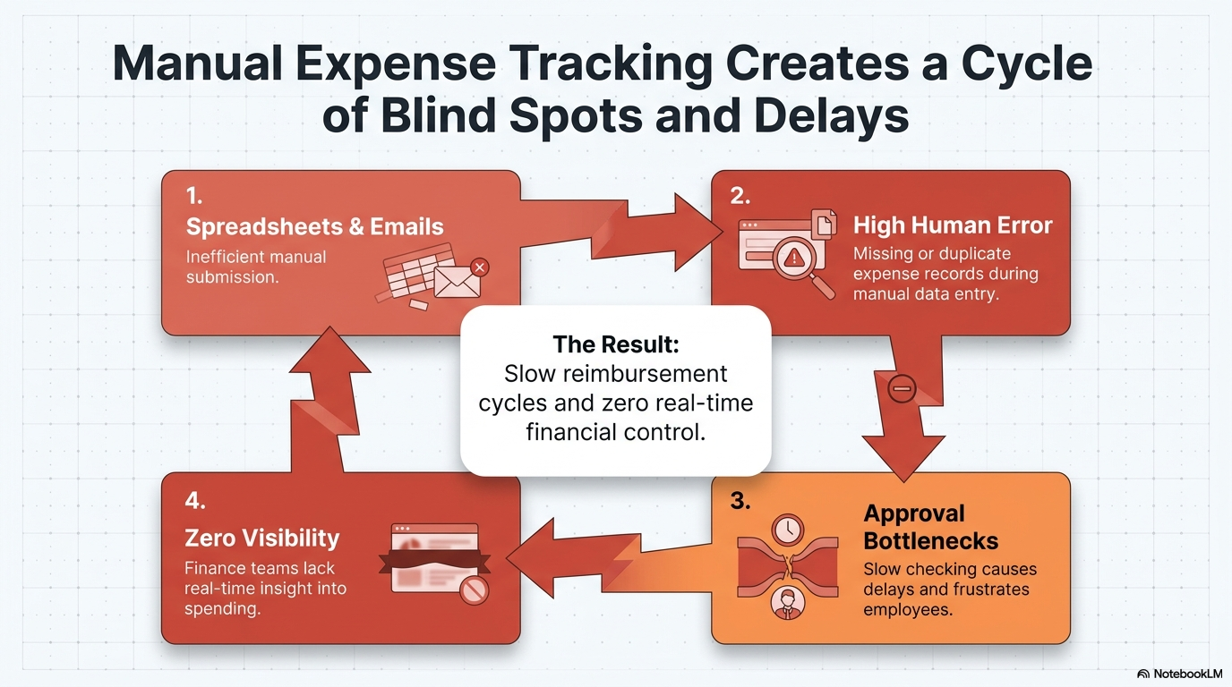
Mayank Garg

Slide 3
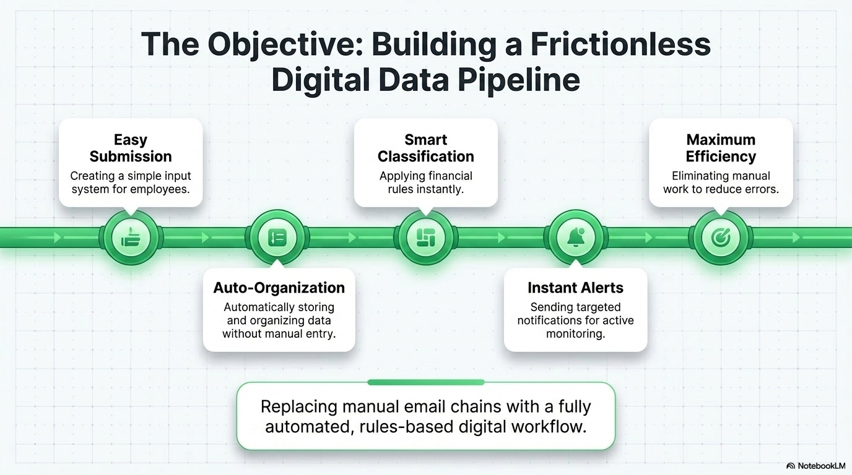
Japneet Kaur

Slide 4
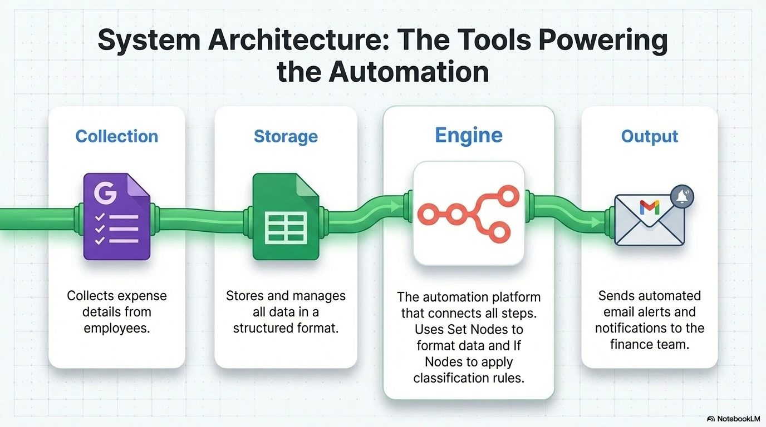
Japneet Kaur

Slide 5
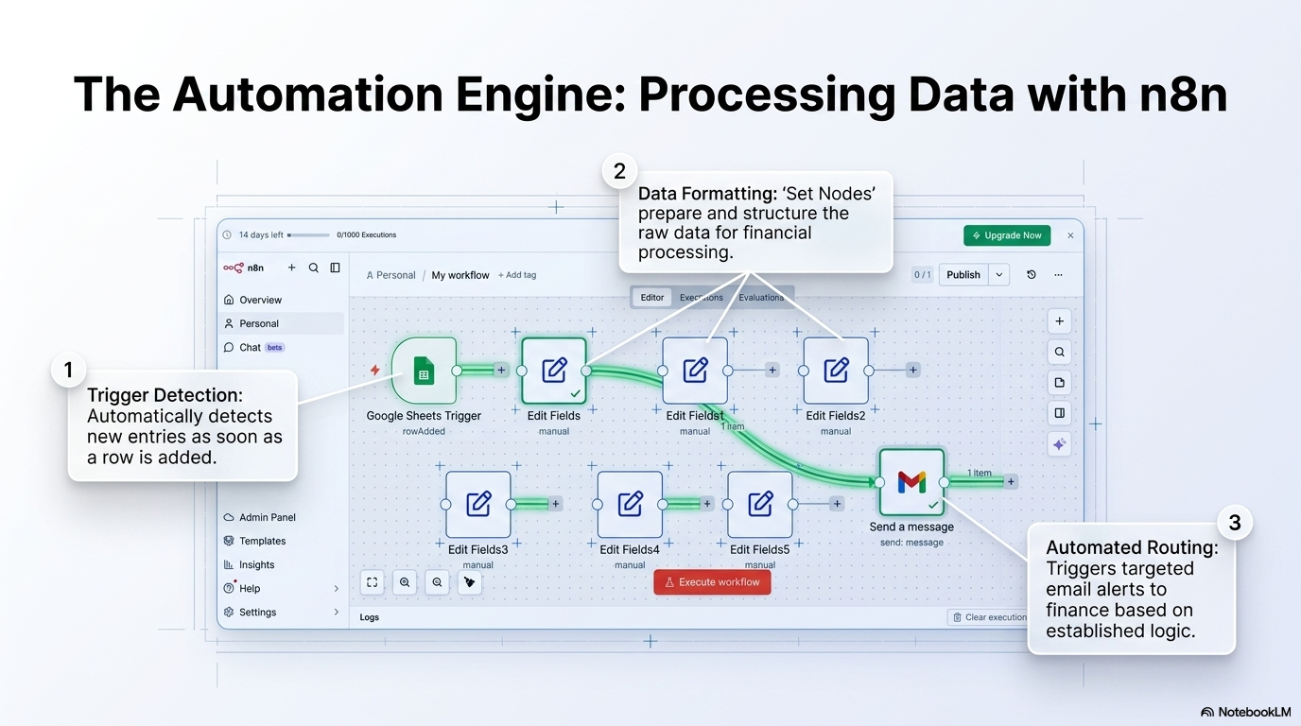
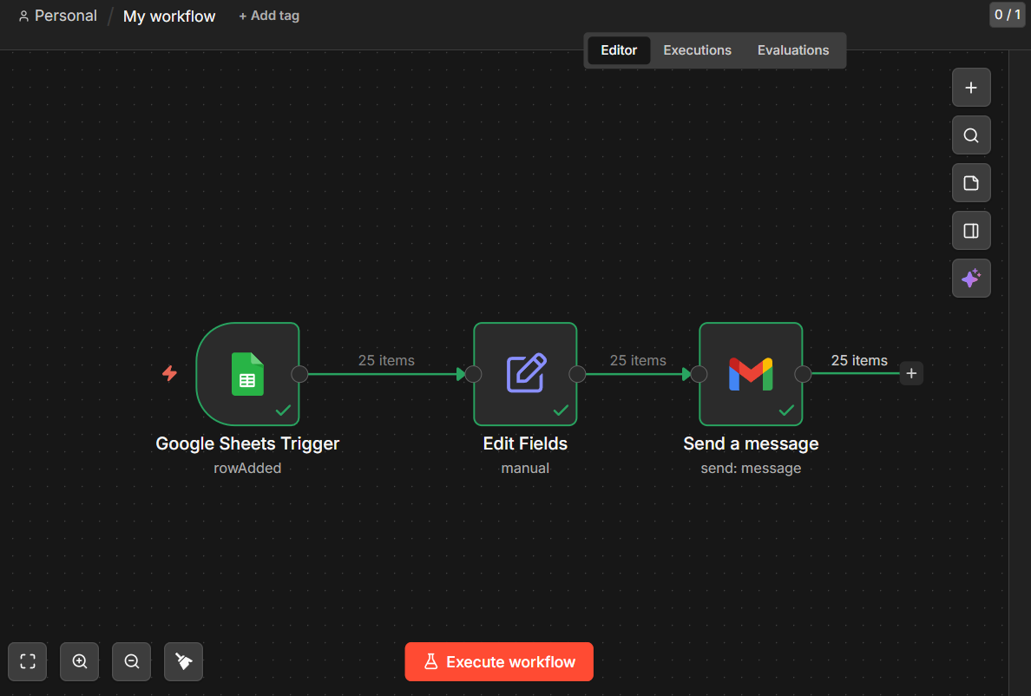
Lovegeet Kaur

Slide 6
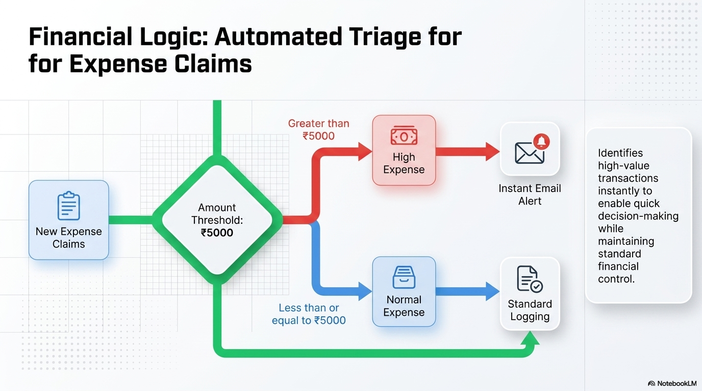
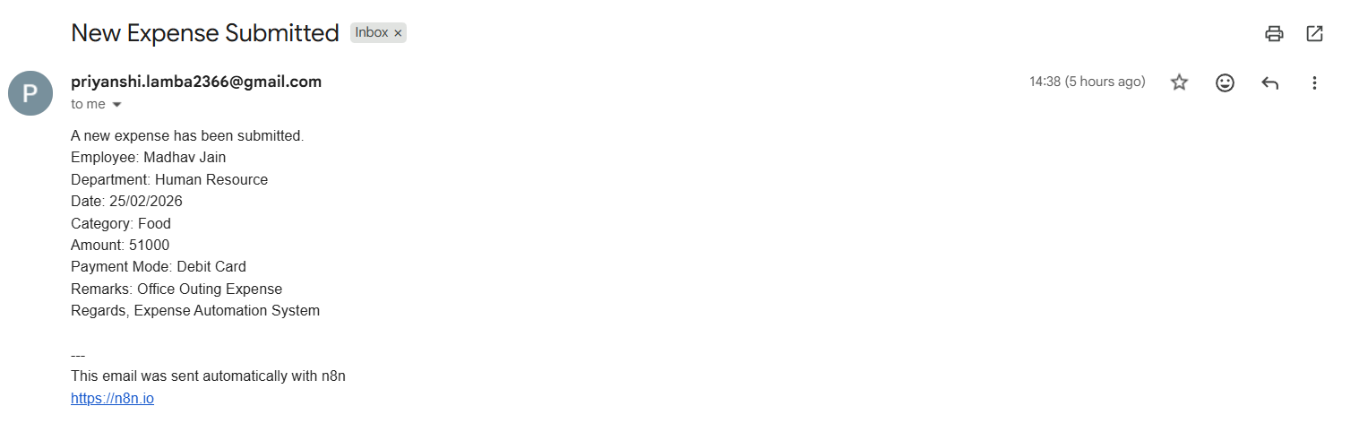
Lovegeet Kaur

Slide 7
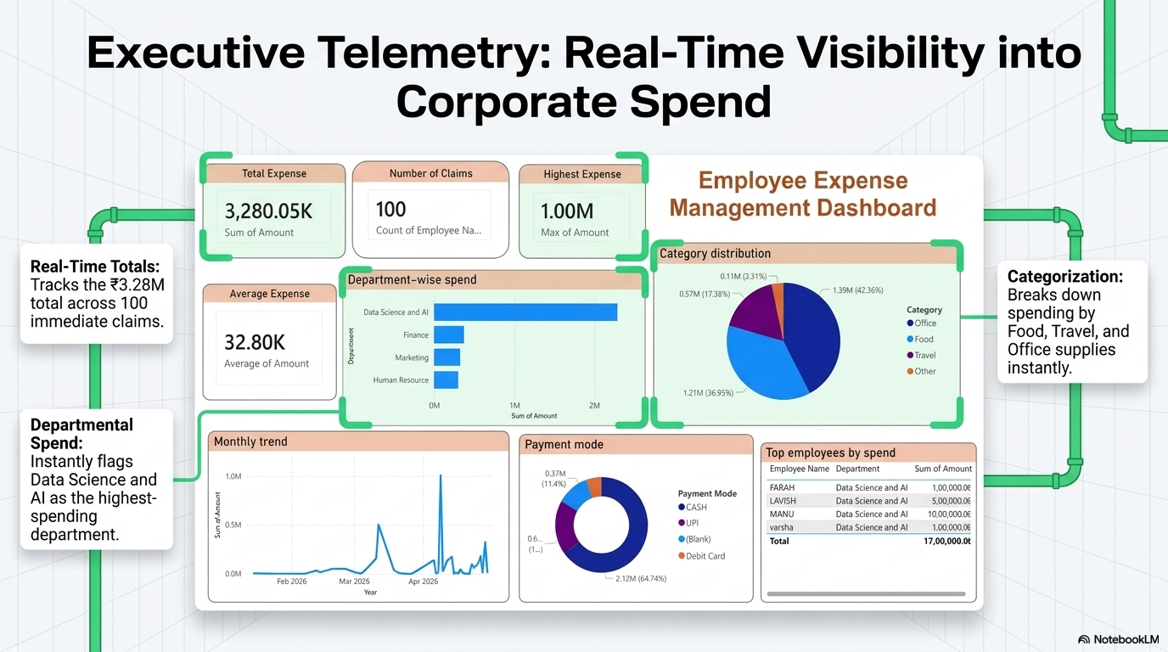
Priyanshi Lamba

Slide 8

Priyanshi Lamba

Slide 9
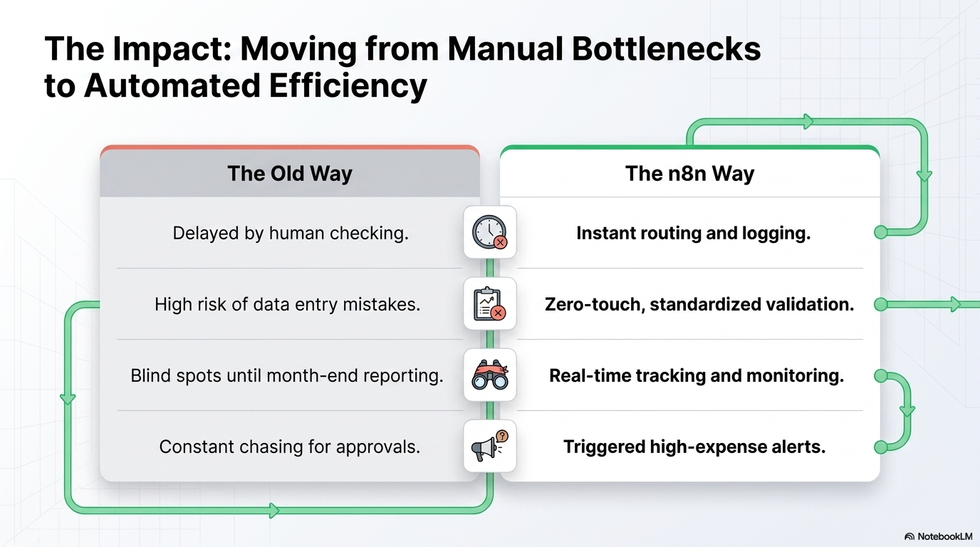
Kanica

Slide 10

Kanica

