Slide 1
RESTAURANT DATA ANALYSIS

Slide 2
1. Many restaurants have no rating (0) – There are 2148 restaurants without a rating. This is a big number.
2. Very few restaurants have low ratings (1-2) – Only 10 restaurants have ratings between 1 and 2, meaning very few places are rated poorly.
3. Most restaurants have ratings between 3.1 and 4 – The highest count (4388 restaurants) falls in this range, meaning most places are rated as "good."
4. Fewer restaurants have the highest ratings (4.1-5) – Only 1114 restaurants have top ratings, so very few are considered "excellent."
5. Restaurants with moderate ratings (2.1-3) are also common – There are 1891 restaurants in this range, showing a mix of average-rated places.

Slide 3
The pivot table shows that Inner City (4.9) has a slightly higher average rating than Quezon City (4.8). The difference is small, meaning both cities have well-rated restaurants. The bar chart visually confirms this, with Inner City having a slightly taller bar

Slide 4
1. Ratings are mostly between 3 and 5, meaning most restaurants have decent to good ratings.
2. Different cuisines are present, but no clear trend about which cuisine has the highest rating.
3. Cities have similar average ratings, with no extreme variations.
4. No city has a very low average rating, suggesting most restaurants provide good service.

Slide 5
1. Most popular cuisine: "North Indian, Mughlai" has the highest votes (53,747), followed by "North Indian" (46,241).
2. North Indian food is loved: Many top cuisines include North Indian, showing high demand.
3. Least popular cuisine: "Italian" has the lowest votes (14,799).
4. More variety gets more votes: Multi-cuisine options (like "North Indian, Chinese") have more votes.
5. Trend: Votes increase from Italian to North Indian-Mughlai in the chart.

Slide 6
1. North Indian is the most popular: "North Indian, Chinese" (936 votes) and "North Indian" (511 votes) have the highest votes, showing strong preference.
2. North Indian dominates: Multiple combinations like "North Indian, Mughlai" (334) and "North Indian, Mughlai, Chinese" (197) also have good votes.
3. Chinese and Fast Food are equally liked. Both have 354 votes, showing similar demand.
4. Cafe is more preferred than Bakery: Cafe (299) has more votes than Bakery (219).
5. Street Food is least popular: It has the lowest votes (149), meaning it is not as preferred.

Slide 7
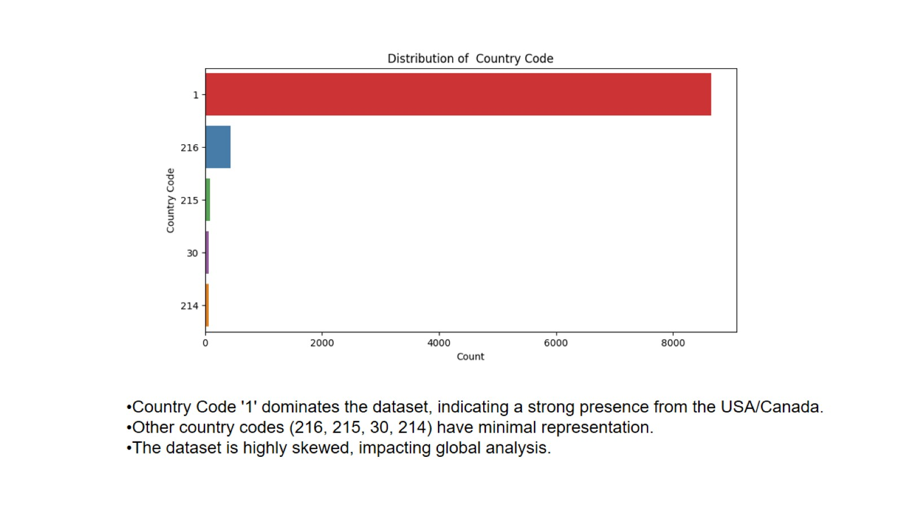
Country Code '1' dominates the dataset, indicating a strong presence from the USA/Canada.
Other country codes (216, 215, 30, 214) have minimal representation.
The dataset is highly skewed, impacting global analysis.

Slide 8
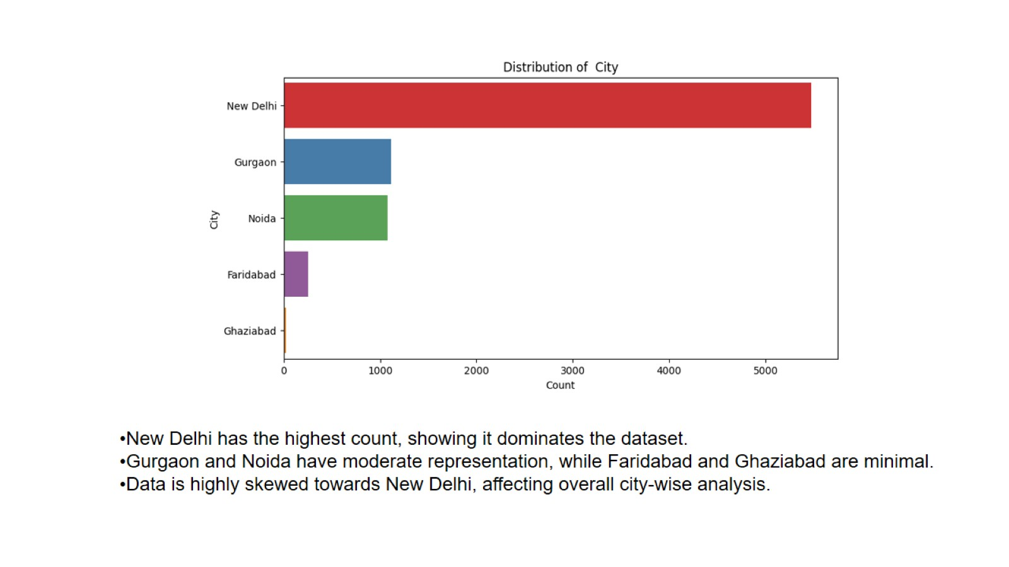
New Delhi has the highest count, showing it dominates the dataset.
Gurgaon and Noida have moderate representation, while Faridabad and Ghaziabad are minimal.
Data is highly skewed towards New Delhi, affecting overall city-wise analysis.

Slide 9
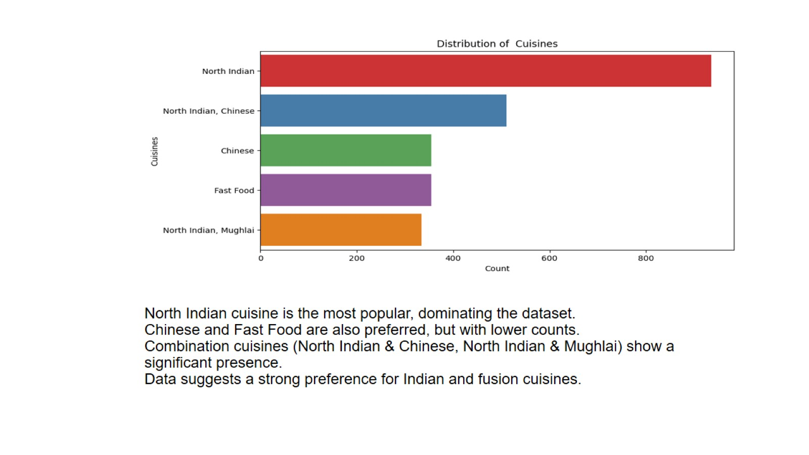
North Indian cuisine is the most popular, dominating the dataset. Chinese and Fast Food are also preferred, but with lower counts. Combination cuisines (North Indian & Chinese, North Indian & Mughlai) show a significant presence. Data suggests a strong preference for Indian and fusion cuisines.

Slide 10
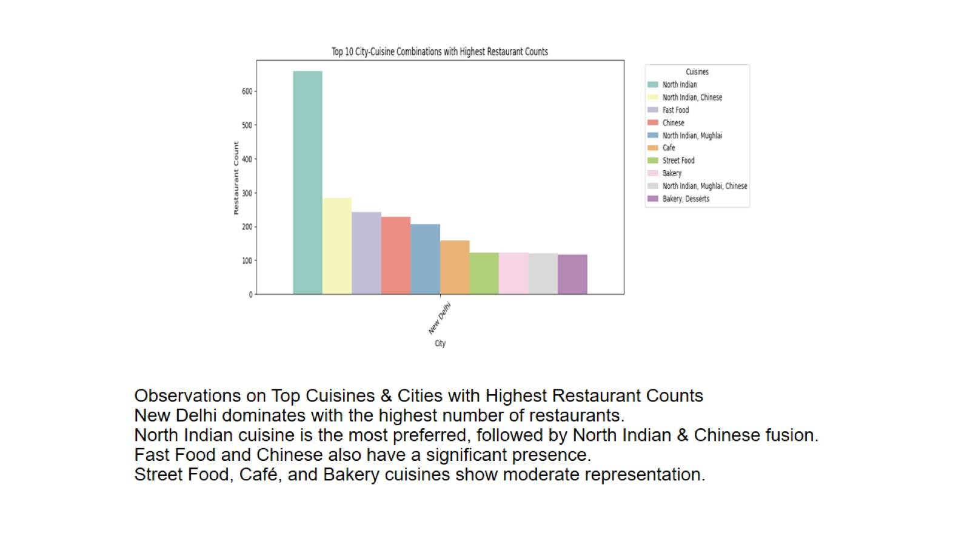
Observations on Top Cuisines & Cities with Highest Restaurant Counts New Delhi dominates with the highest number of restaurants. North Indian cuisine is the most preferred, followed by North Indian & Chinese fusion. Fast Food and Chinese also have a significant presence. Street Food, Café, and Bakery cuisines show moderate representation.

Slide 11
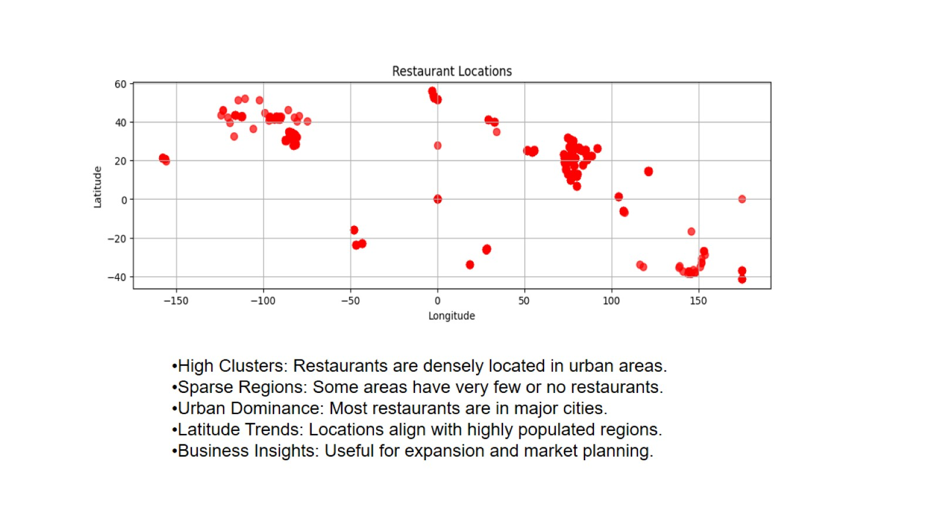
High Clusters: Restaurants are densely located in urban areas.
Sparse Regions: Some areas have very few or no restaurants.
Urban Dominance: Most restaurants are in major cities.
Latitude Trends: Locations align with highly populated regions.
Business Insights: Useful for expansion and market planning.

Slide 12
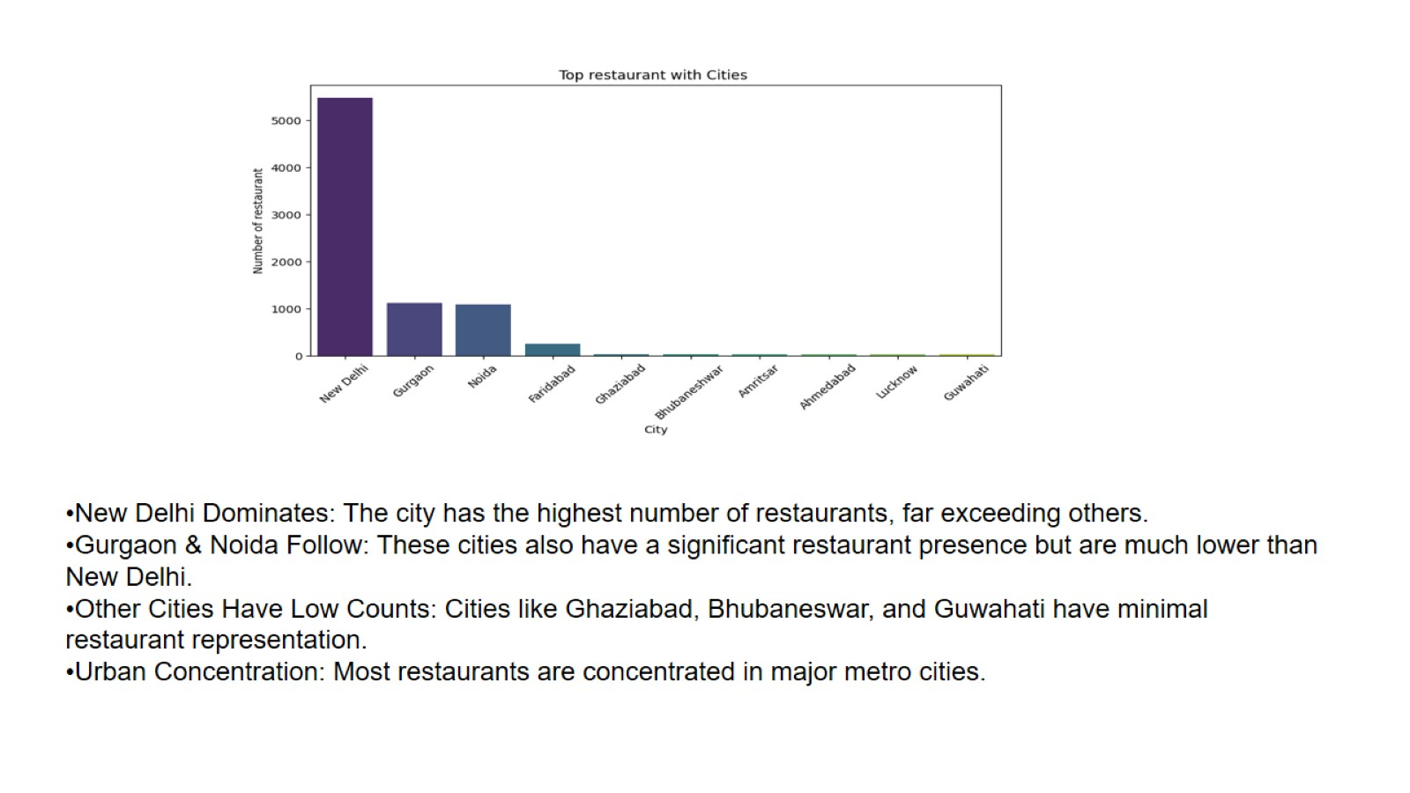
New Delhi Dominates: The city has the highest number of restaurants, far exceeding others.
Gurgaon & Noida Follow: These cities also have a significant restaurant presence but are much lower than New Delhi.
Other Cities Have Low Counts: Cities like Ghaziabad, Bhubaneswar, and Guwahati have minimal restaurant representation.
Urban Concentration: Most restaurants are concentrated in major metro cities.

Slide 13
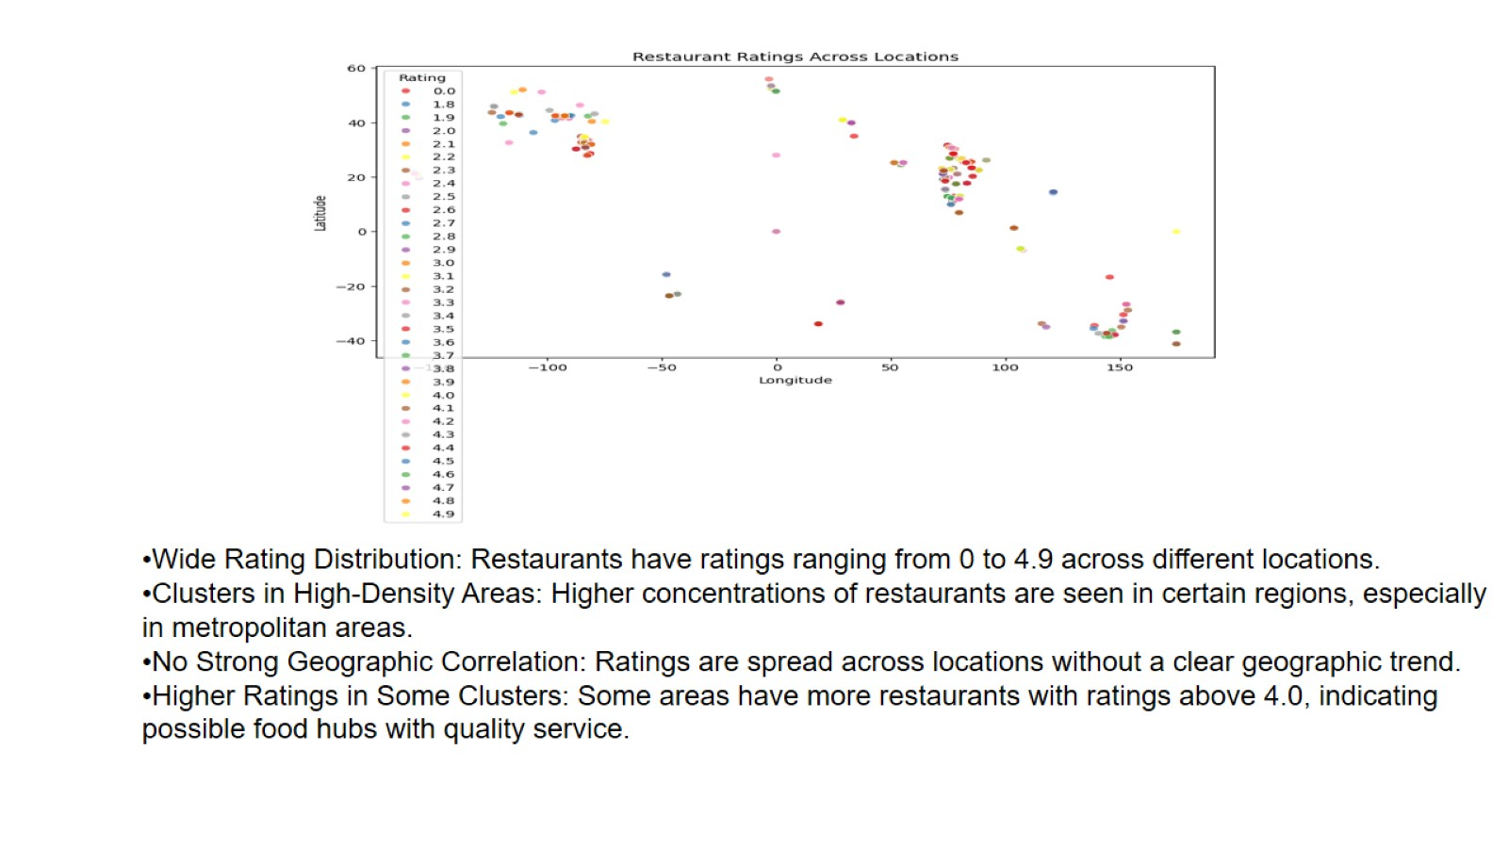

Slide 14
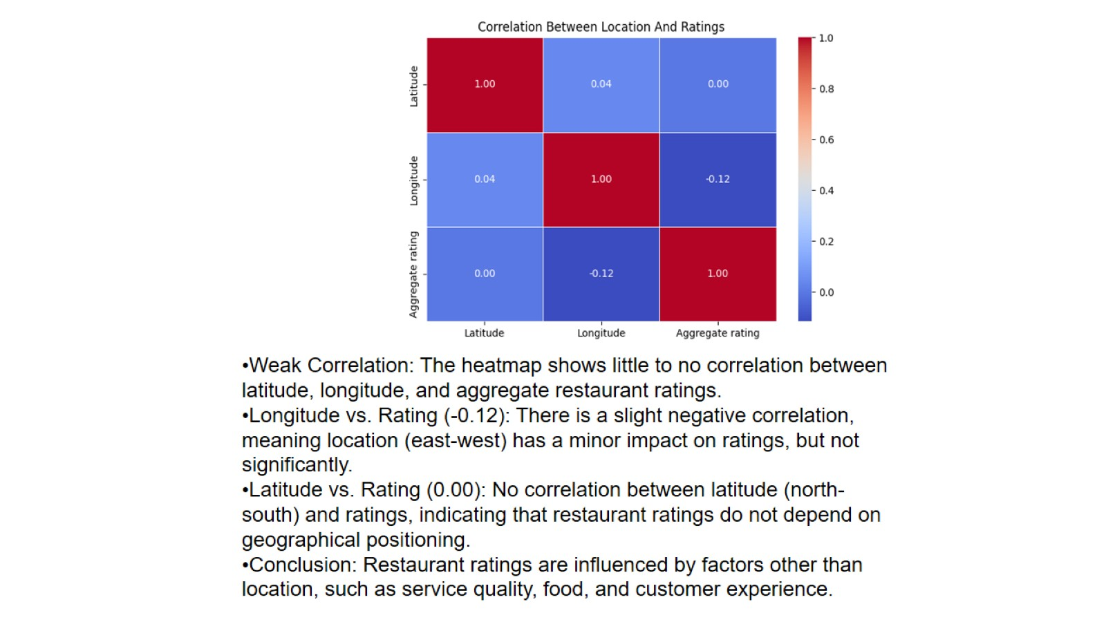

Slide 15
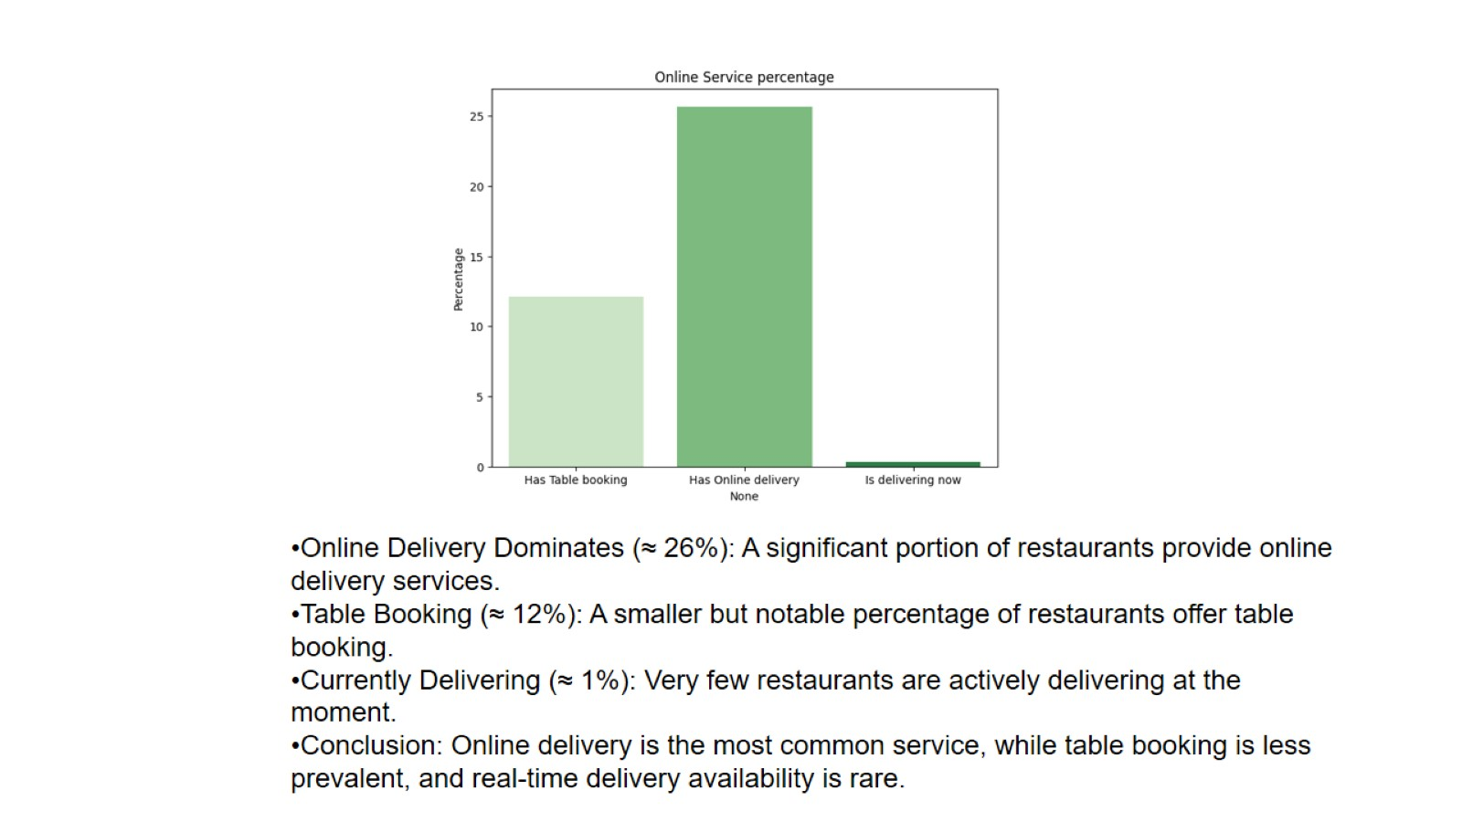
Online Delivery Dominates (≈ 26%): A significant portion of restaurants provide online delivery services.
Table Booking (≈ 12%): A smaller but notable percentage of restaurants offer table booking.
Currently Delivering (≈ 1%): Very few restaurants are actively delivering at the moment.
Conclusion: Online delivery is the most common service, while table booking is less prevalent, and real-time delivery availability is rare.

Slide 16
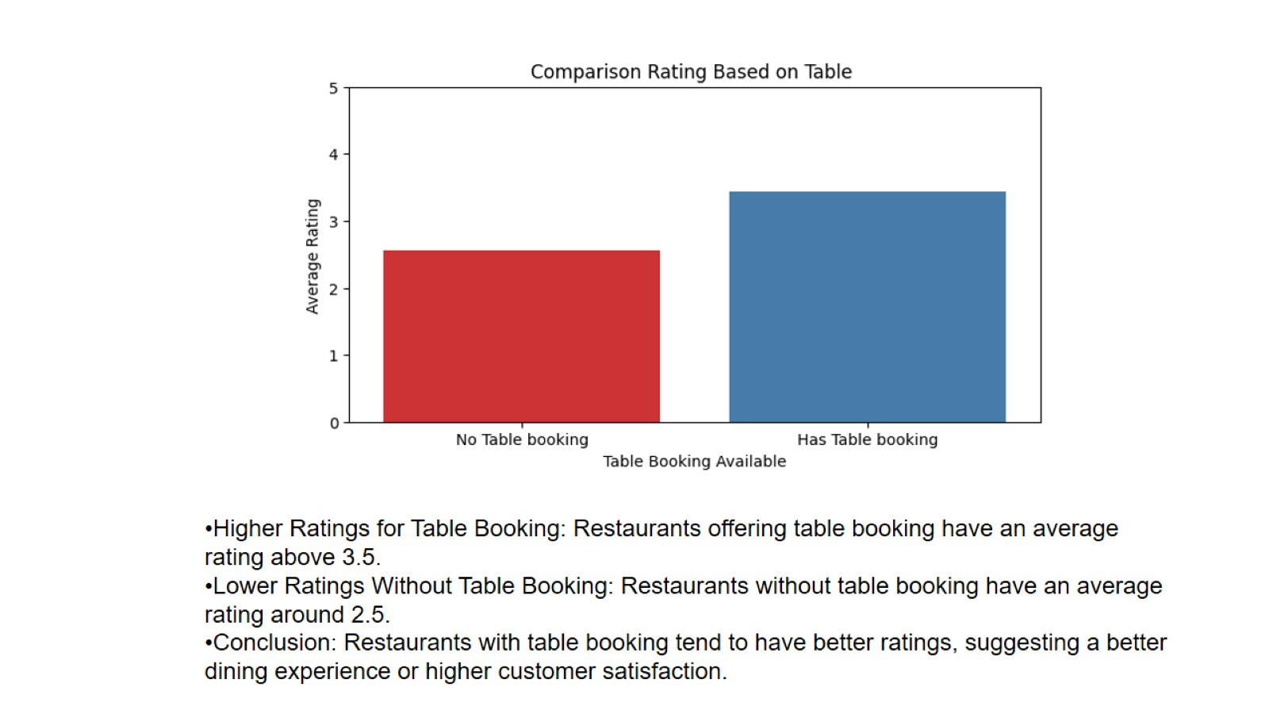
Higher Ratings for Table Booking: Restaurants offering table booking have an average rating above 3.5.
Lower Ratings Without Table Booking: Restaurants without table booking have an average rating around 2.5.
Conclusion: Restaurants with table booking tend to have better ratings, suggesting a better dining experience or higher customer satisfaction.

Slide 17
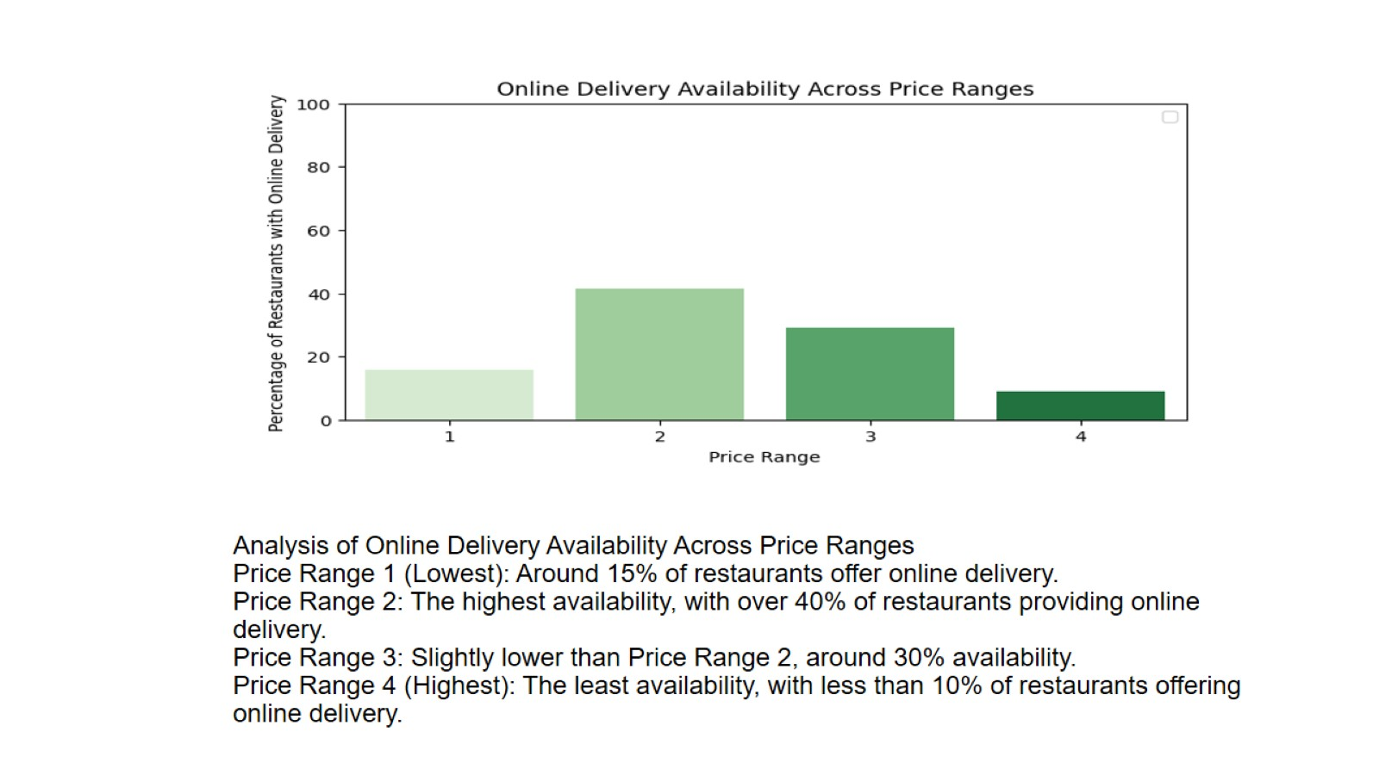
Analysis of Online Delivery Availability Across Price Ranges Price Range 1 (Lowest): Around 15% of restaurants offer online delivery. Price Range 2: The highest availability, with over 40% of restaurants providing online delivery. Price Range 3: Slightly lower than Price Range 2, around 30% availability. Price Range 4 (Highest): The least availability, with less than 10% of restaurants offering online delivery.

Slide 18
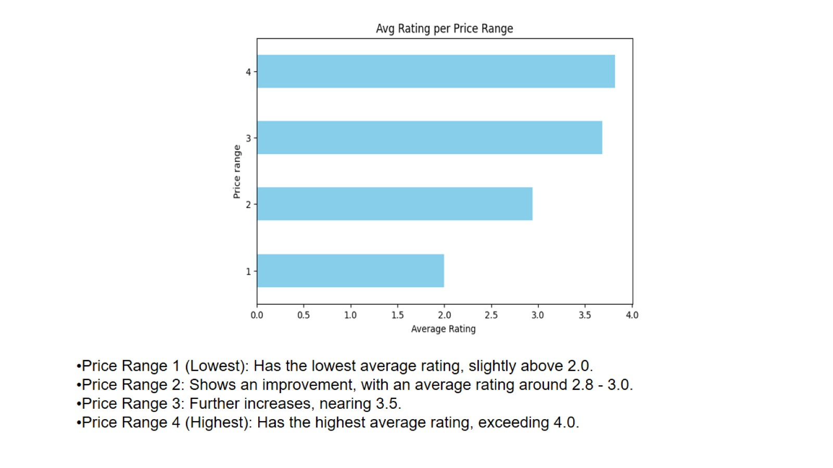
Price Range 1 (Lowest): Has the lowest average rating, slightly above 2.0.
Price Range 2: Shows an improvement, with an average rating around 2.8 - 3.0.
Price Range 3: Further increases, nearing 3.5.
Price Range 4 (Highest): Has the highest average rating, exceeding 4.0.

Slide 19
THANK YOU

