Slide 1
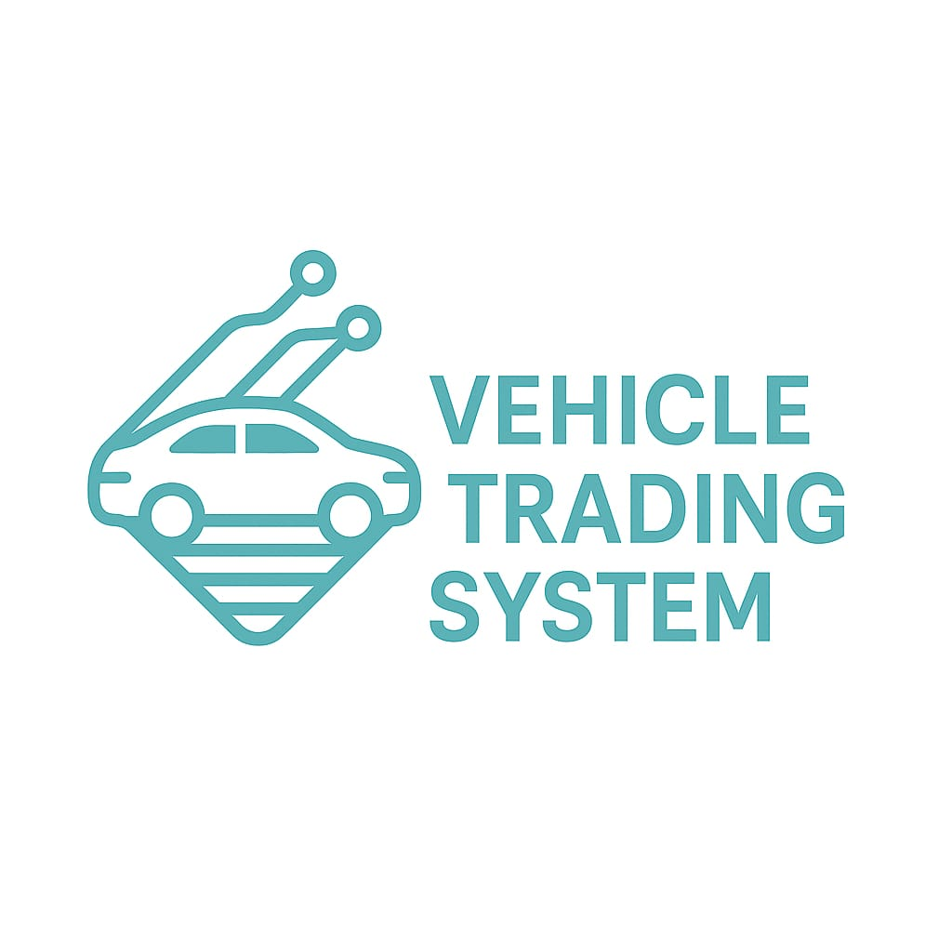
Vehicle Trading System
Kani GÜL - B2205.010117

Slide 2

Project Overview
This application allows a car dealership to manage vehicle inventory digitally.
Users can add, remove, and sell cars via a user-friendly graphical interface.
Customer details are recorded during the sale.
Sold and unsold cars are tracked separately.
The goal is to simplify and digitalize dealership operations.

Slide 3

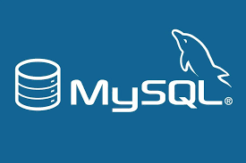
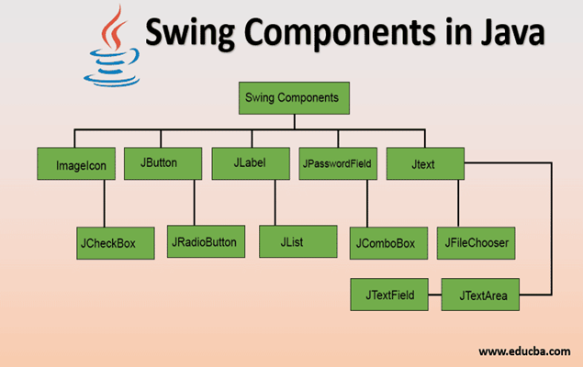
Technologies Used
Programming Language: Java
GUI Library: Swing
Database: MySQL
Database Access: JDBC (DAO Pattern)
IDE: Eclipse
File Handling: JFileChooser for image selection

Slide 4



Key Features
User Login
User authentication with login screen.
Add Car
Add cars with brand, model, mileage, condition, price, and image.
Search & Filter
Filter cars by brand, model, price, or condition.
Delete Car
Remove cars with confirmation prompt.
View Details
Show full car details and image in a separate dialog.
Sell Car
Enter customer info (name, email, phone, sale price) to complete a sale.
Sold Cars
Display sold cars in a separate table with sale history.
Extras
Role-based access (Admin/Sales)
Database integration

Slide 5
APPLICATION SCREENSHOTS
Login Page
Main Panel with car table and buttons
Add Car Dialog
Sell Car Dialog
Sold Cars List

Slide 6
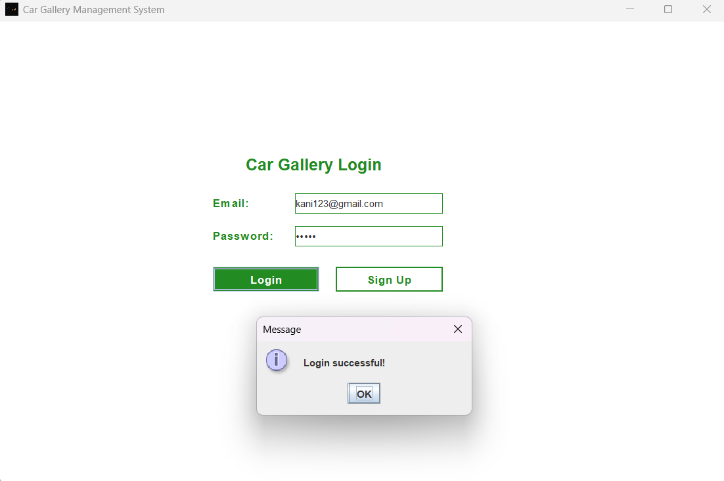
Logın page

Slide 7
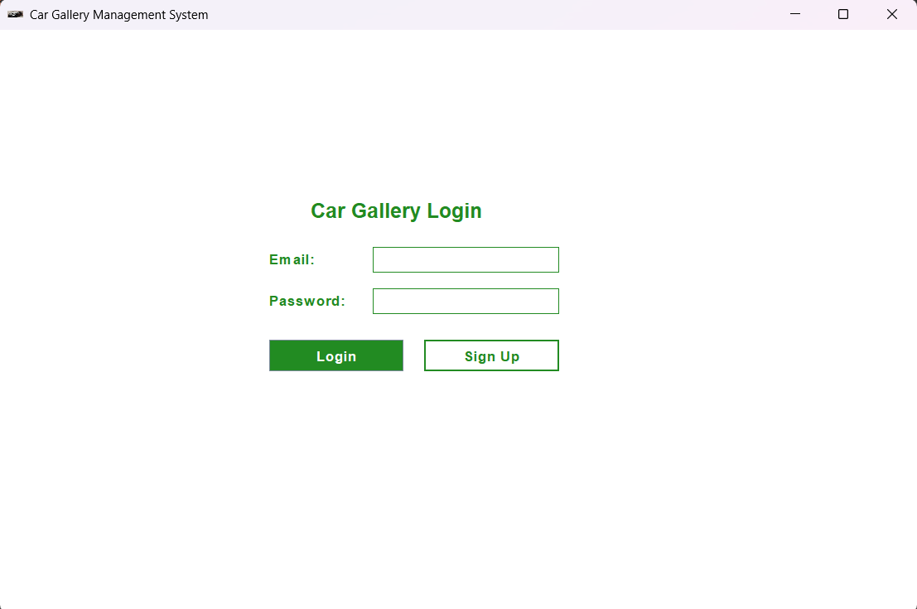
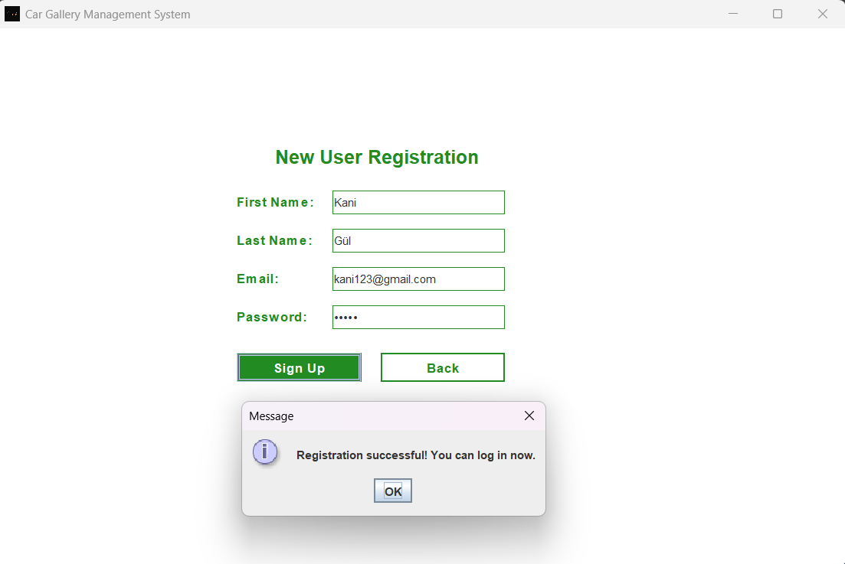
Sıgn up page

Slide 8
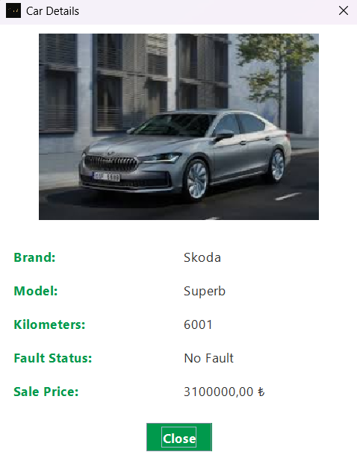
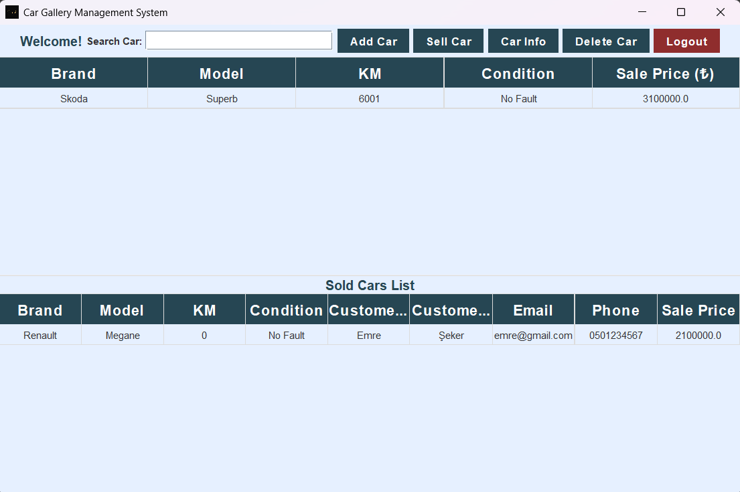
Maın panel

Slide 9
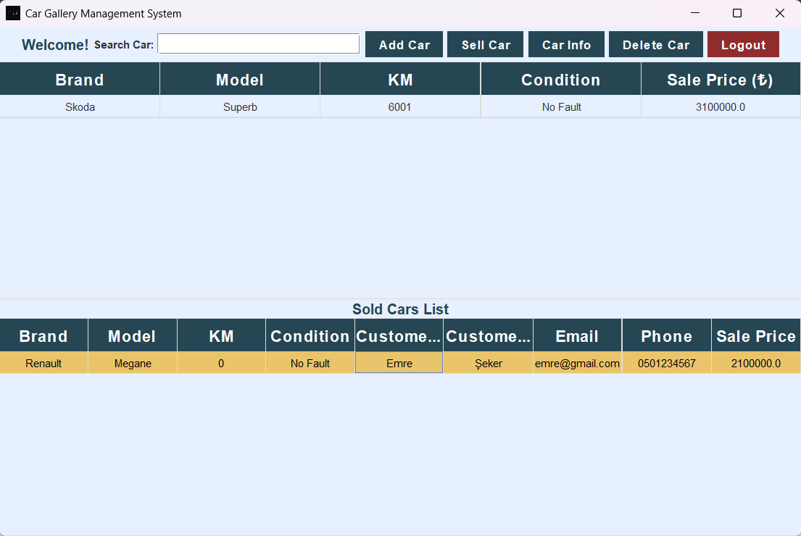
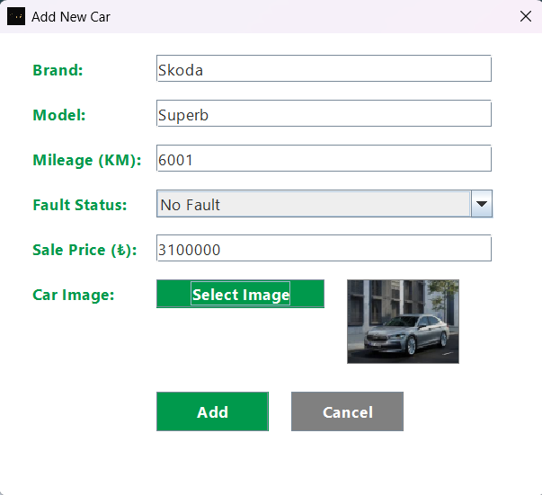
Addıng a car

Slide 10
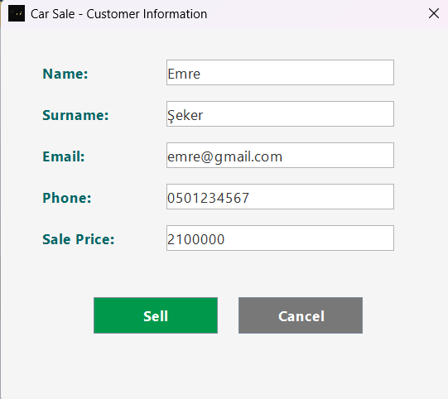
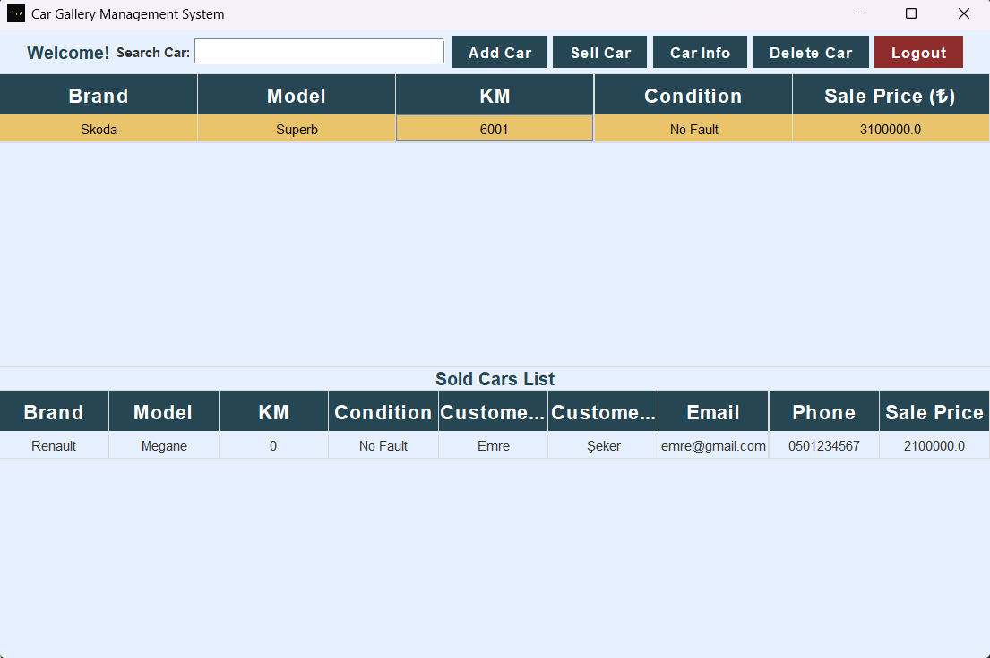
Sellıng a car

Slide 11
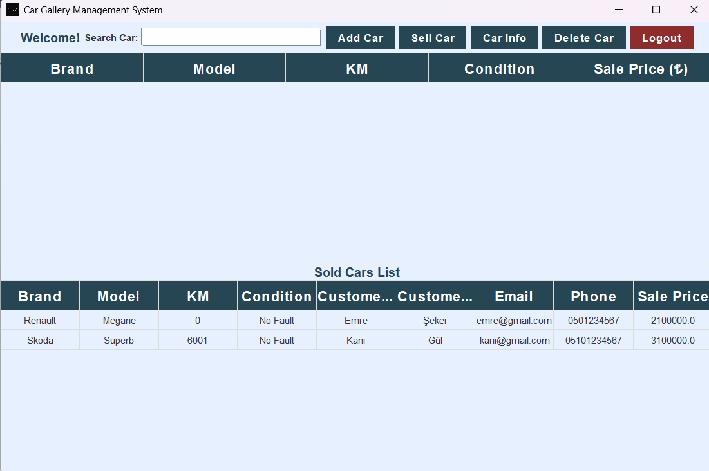
Sold cars lıst

Slide 12
CLASS STRUCTURE
Class Name | Responsibility
MainFrame | Main application frame
MainPanel | Core panel with all features and tables
AddCarDialog | Dialog window to add a new car
SellCarDialog | Dialog window to complete a car sale
Car | Data model representing a car
SoldCar | Data model for a sold car with customer info
Customer | Holds buyer’s personal details
CarDAO | Handles database operations for cars
SoldCarDAO | Handles DB operations for sold cars

Slide 13
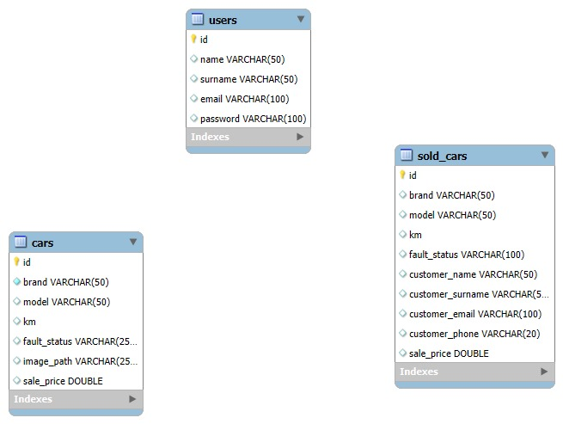
Database schema

Slide 14
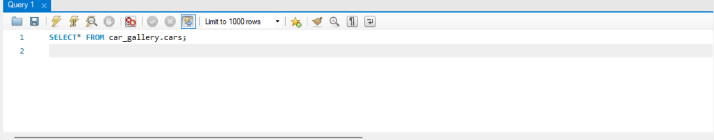
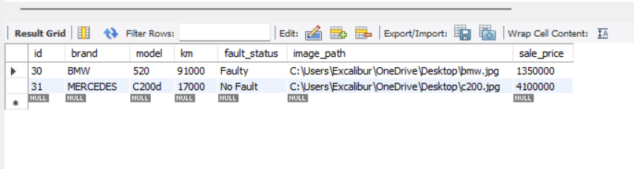
TABLE : CARS
id (INT, PK)
brand (VARCHAR)
model (VARCHAR)
km (INT)
fault_status
(VARCHAR)
sale_price (DOUBLE)
image_path (VARCHAR)

Slide 15
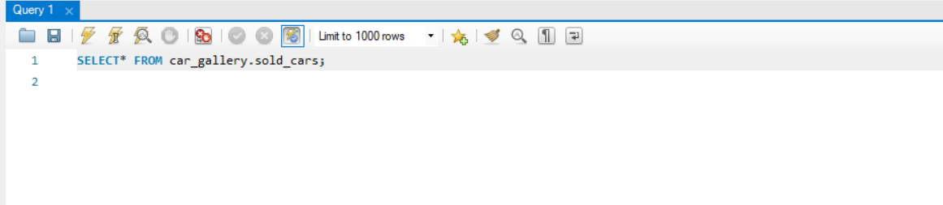
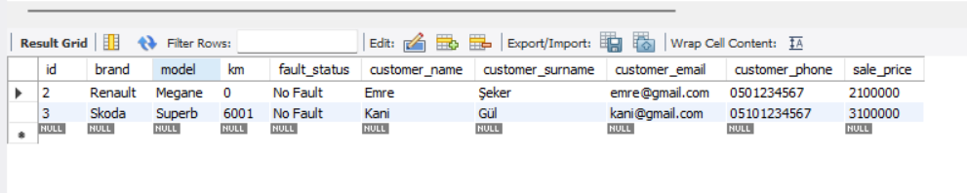
TABLE: SOLD CARS
id (INT, PRIMARY KEY)
brand (VARCHAR)
model (VARCHAR)
km (INT)
fault_status (VARCHAR)
customer_name (VARCHAR)
customer_surname (VARCHAR)
email (VARCHAR)
phone (VARCHAR)
sale_price (DOUBLE)

Slide 16
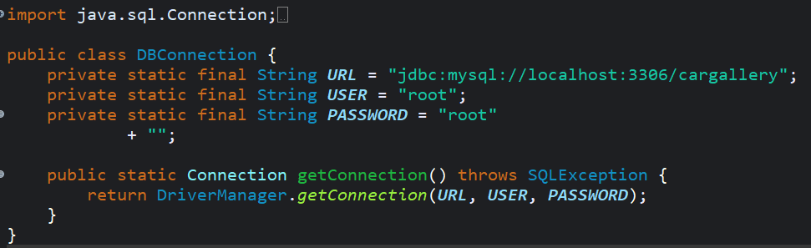
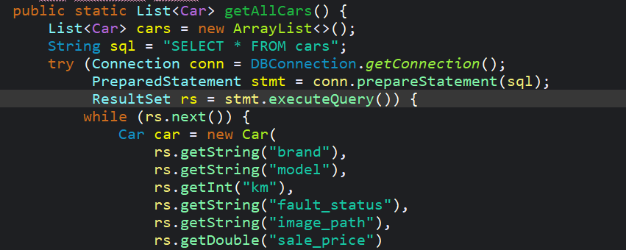
SAMPLE CODE SNIPPERTS
All database operations in the application are initiated through this connection method.
Retrieves all vehicles from the cars table.
Converts a row from SQL into a Java object (ORM logic).

Slide 17
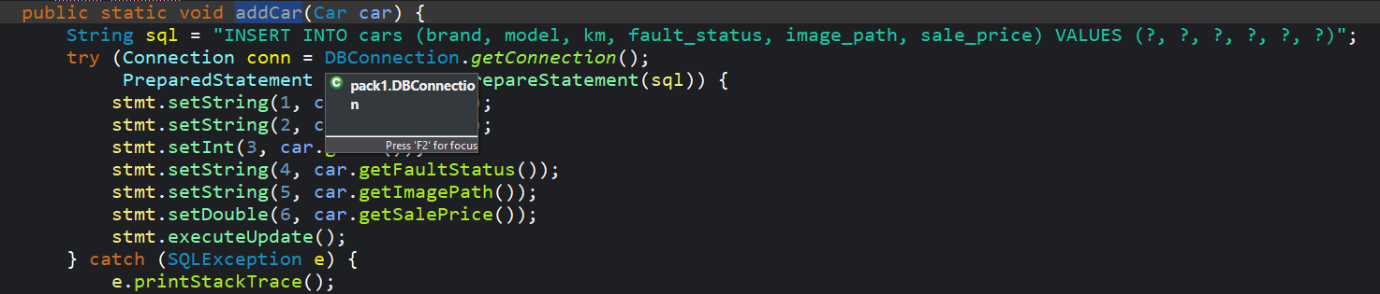

SAMPLE CODE SNIPPERTS
Add New Vehicle (INSERT)
SQL injection is prevented by using a parameterized query.
Description: Values received from the user are safely inserted into SQL.
Deletes the selected vehicle from the database.
Lists all sold vehicles from the sold_cars table.

Slide 18
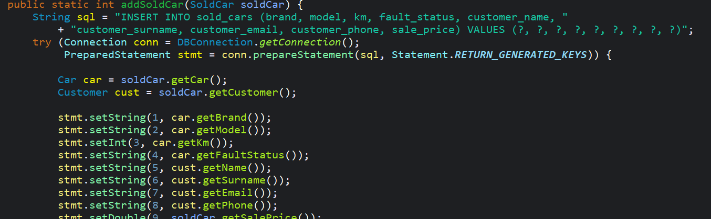

SAMPLE CODE SNIPPERTS
When a vehicle is sold, the sales information is recorded in a separate table.
Both vehicle and customer information are recorded in the sold_cars table.
Data retrieved from the database is transferred to the JTable.
Description: Used to reload the table from scratch each time.
The sold vehicle is removed from the active vehicle list.

Slide 19
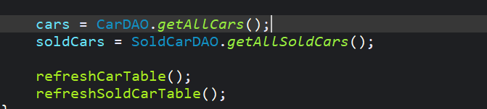
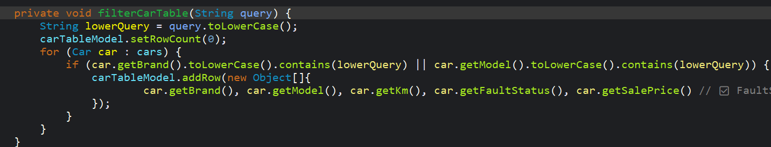
SAMPLE CODE SNIPPERTS
When the database changes, the GUI is updated automatically.
Filtering is performed based on brand or model search.

Slide 20
CHALLANGES FACED
1-Understanding how Java connects to a database for the first time
It was difficult at first to understand how JDBC works, especially how connections, statements, and results interact
with each other.
2-Balancing between GUI design and database logic
Designing a clean and functional GUI using Swing while also managing database access behind the scenes was a new
kind of multitasking.
3-Using JTable for dynamic data
JTable looked simple at first, but rendering custom headers, updating data after every change,and making it non-editable required a lot of trial and error.
4-Inserting and retrieving images
Handling image paths, showing selected images, and displaying them inside the GUI took some time to figure out.
5-DAO structure and separating logic
Learning to write database logic separately in DAO classes instead of mixing it with GUI code was a bit challenging
but very educational.
6-Keeping everything synchronized
Making sure that when something is sold or deleted, the tables, lists, and database are all updated correctly without bugs.
7-Debugging small mistakes that caused big problems
Sometimes a missing column name or forgetting to update the table model led to hours of debugging.

Slide 21
CONCLUSIONS & FUTURE IMPROVEMENTS
Project successfully manages core dealership operations
User interface is functional and clean
Possible future upgrades:
Date filtering (added/sold date)
Login role management (admin/user)
Export reports (PDF/Excel)
Convert to a web-based application (Spring Boot + React)

Slide 22
LIVE DEMOSTRATION
Open and run the project live
Show the full flow: register and login → add car → sell car → see sold cars

