Slide 1

TELECOM CHURN PREDICTION
Internship Project — Predictive Analytics on Customer Retention
BUSINESS PROBLEM
Telecom companies lose steady revenue when customers cancel service (churn).
Acquiring a new customer costs far more than keeping an existing one.
Goal: predict which customers are likely to churn, so the retention team can step in before they leave.
By — Kanika Joshi | Data Science

Slide 2

Data Loading & Dataset Overview
7,043
21
26.5%
Customer records
Columns / features
Overall churn rate
Source
What the data covers
Kaggle — Telco Customer Churn dataset
File: WA_Fn-UseC_-Telco-Customer-Churn.csv
One row per customer
Customer demographics (gender, senior citizen, partner, dependents)
Account info (tenure, contract type, payment method, charges)
Services subscribed (internet, phone, streaming, tech support)
Target column: Churn (Yes / No)
Loaded with pandas as a single DataFrame — this became the base for cleaning, EDA, and modeling.
Telecom Churn Prediction
2

Slide 3

Data Cleaning
Duplicate rows
Checked for duplicates — none found (0 rows)
1
Dropped customerID
Just an identifier, no predictive value
2
Fixed TotalCharges
Was stored as text; converted to numeric — found 11 missing values, filled with 0
3
Encoded target
Churn column mapped: "Yes" → 1, "No" → 0
4
Telecom Churn Prediction
3

Slide 4

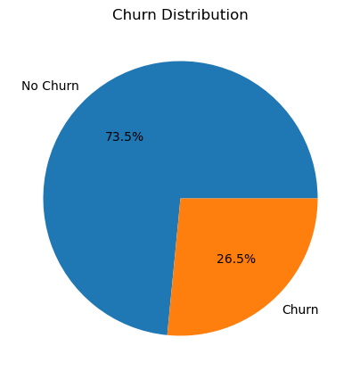
Exploratory Data Analysis — Overview
Key observations
About 1 in 4 customers (26.5%) has churned — a meaningful and costly share of the base
Month-to-month contracts churn far more: 42.7%, vs 11.3% (one year) and 2.8% (two year)
Fiber optic customers churn more (41.9%) than DSL (19.0%) or no-internet customers (7.4%)
Contract length and internet type stand out early as strong churn signals
Telecom Churn Prediction
4

Slide 5
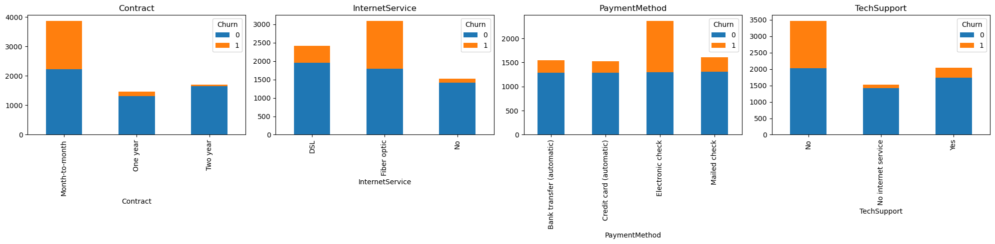
EDA — Where Churn Concentrates
Electronic check payers show the highest churn share of any payment method
Customers with no tech support churn noticeably more than those with it
These categorical patterns fed directly into feature engineering next
Telecom Churn Prediction
5

Slide 6

Feature Engineering
tenure_group
Bucketed tenure into ranges: 0–1yr, 1–2yr, 2–4yr, 4–5yr, 5yr+
num_services
Count of add-on services each customer subscribes to (security, backup, tech support, streaming, etc.)
avg_monthly_spend
TotalCharges ÷ tenure — a normalized spend measure per customer
no_support_services
Flag for customers with neither online security nor tech support
Telecom Churn Prediction
6

Slide 7

Preprocessing & Train-Test Split
Encoding
Categorical columns converted with one-hot encoding (get_dummies) — final feature count: 36
Multicollinearity fix
Dropped TotalCharges (redundant with tenure x MonthlyCharges); avg_monthly_spend already captures that ratio
Train-test split
80% train / 20% test, stratified on Churn, random_state = 42
Scaling
StandardScaler fit on train, applied to test (no leakage)
Class imbalance — SMOTE
Applied only to training data, after the split. Balanced train churn rate to 50% (8,278 rows). Test set left untouched — a real, honest sample
Telecom Churn Prediction
7

Slide 8

Model Building & Comparison
Three classifiers trained on the SMOTE-balanced training set, tested on the untouched test set:
Model | Accuracy | Precision | Recall | F1 | ROC-AUC
Gradient Boosting | 0.780 | 0.571 | 0.684 | 0.623 | 0.842
Logistic Regression | 0.739 | 0.505 | 0.781 | 0.613 | 0.840
Random Forest | 0.774 | 0.577 | 0.551 | 0.564 | 0.820
Gradient Boosting gave the best balance of precision and recall, with the strongest ROC-AUC — selected for tuning.
Telecom Churn Prediction
8

Slide 9

Tuning & Final Evaluation
Hyperparameter Tuning (GridSearchCV, 5-fold, scoring = ROC-AUC)
Best params: n_estimators = 200, learning_rate = 0.1, max_depth = 4
Best CV ROC-AUC (resampled train): 0.939
0.784
0.837
0.591
Accuracy
ROC-AUC
F1 Score
5-fold CV ROC-AUC on real training data: 0.834 ± 0.014 — consistent, no overfitting
Top Features Driving Churn Predictions
no_support_services
0.258
tenure
0.130
Contract: Two year
0.088
Contract: One year
0.070
Payment: Electronic check
0.068
Internet: Fiber optic
0.061
Telecom Churn Prediction
9

Slide 10

Thank You
Telecom Churn Prediction — Internship Project
By – Kanika Joshi
Course – Data Science

