Slide 1
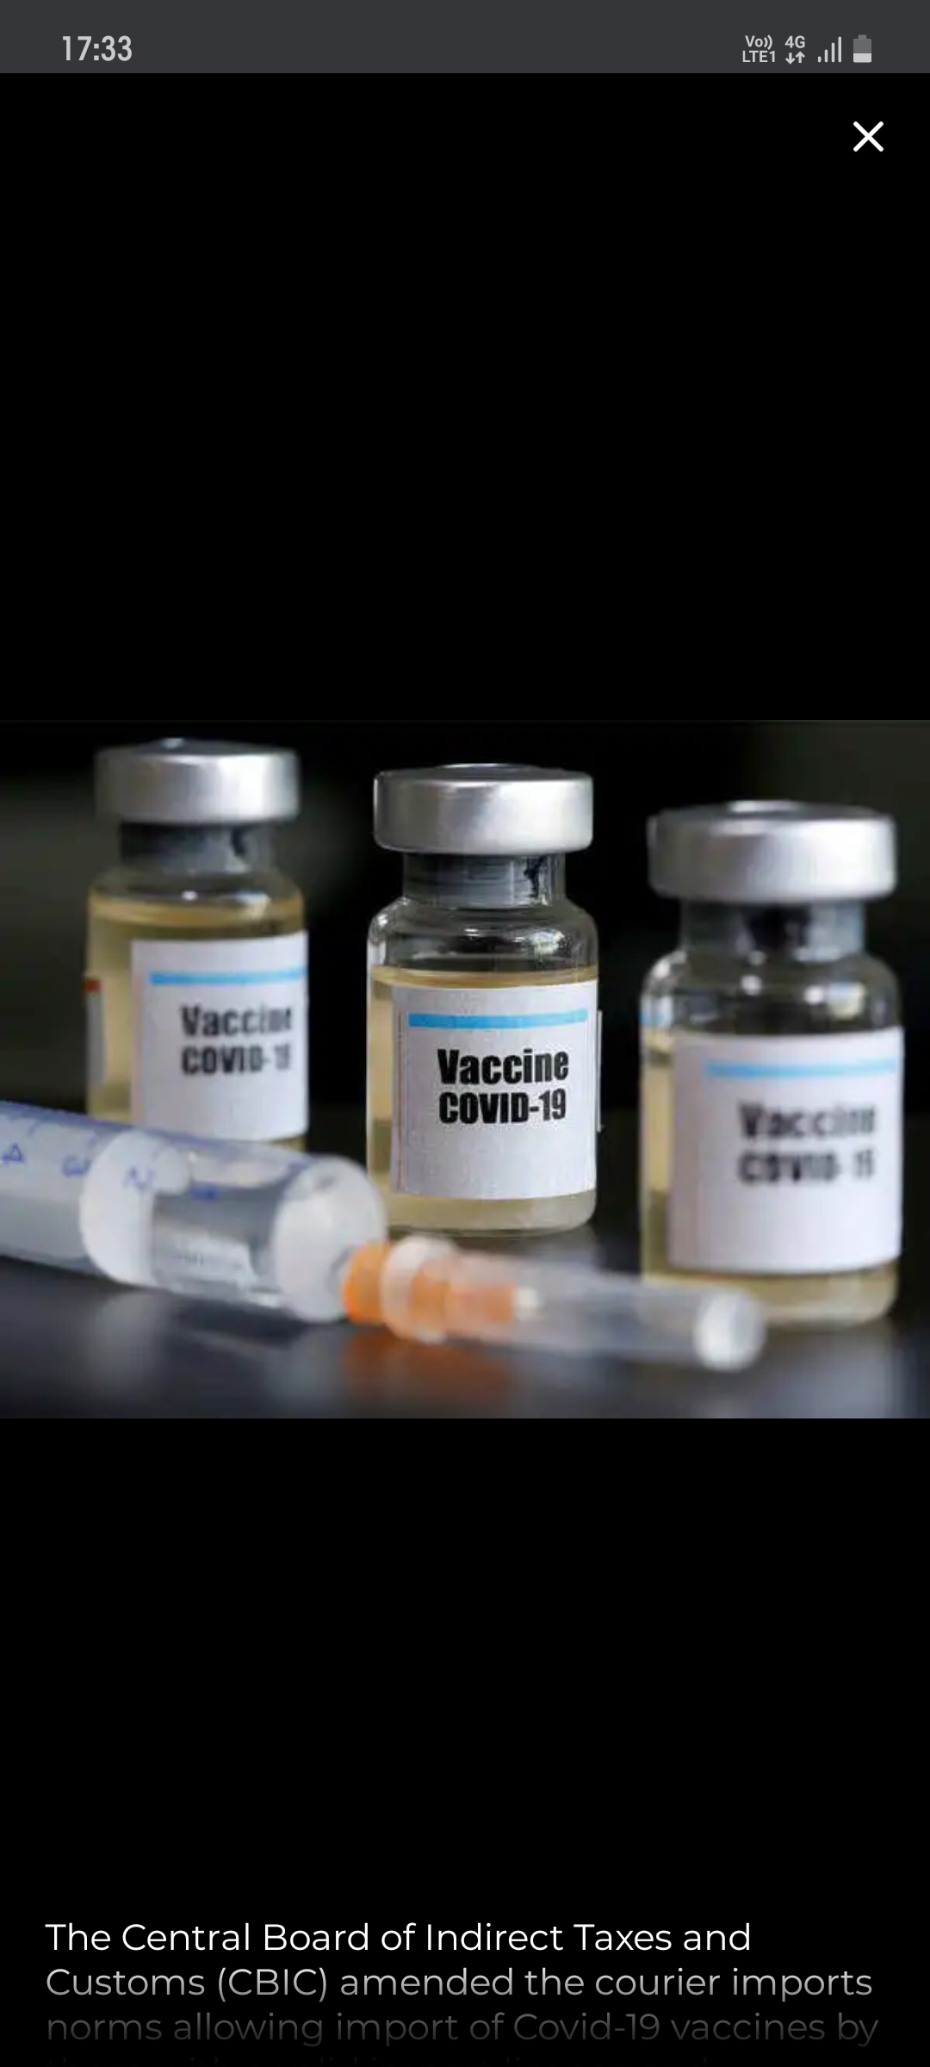
vaccine
All the vaccine available in india about other vaccines which are in trials(which phase is going on)which are available to everyone and how many vaccinated and how many are yet to get vaccinated and which phase of vaccination is going on like frontline workers are first than senior citizens and so on.

