Slide 1
Go-Safe-go-shopping
Ascenders
Kanika, Reshma, Surbhi

Slide 2
abstract
Got stuck in Bangalore traffic and got nothing better to do. We made an app which makes cab travel safe and fun. Check out exciting shopping discounts while keeping an eye on the driver.
App uses real time eye detection for checking whether driver dozes off during driving. Upon detection it alerts user by triggering alarm.
Browse through real time discounts and offers on shops you pass by. Check out ratings and reviews of others and get heat map of shopping areas based on frequent users.
It helps local shop owners in promoting their business too.

Slide 3
Technology / Language / Tools
Machine Learning
Data Science
GPS
Camera
Google API
Android
Python

Slide 4
motivation
Drowsiness and fatigue of automobile drivers reduce the drivers’ abilities of vehicle control, natural reflex, recognition and perception. Such diminished vigilance level of drivers is observed at night driving or overdriving, causing accident and pose severe threat to mankind and society. Therefore it is very much necessary in this recent trend in automobile industry to incorporate driver assistance system that can detect drowsiness and fatigue of the drivers
Online shopping apps and malls have eaten up the business of small shop owners. On the other hand consumer also can’t search through entire array of shops in his vicinity. This app will be a win-win situation for both the parties

Slide 5
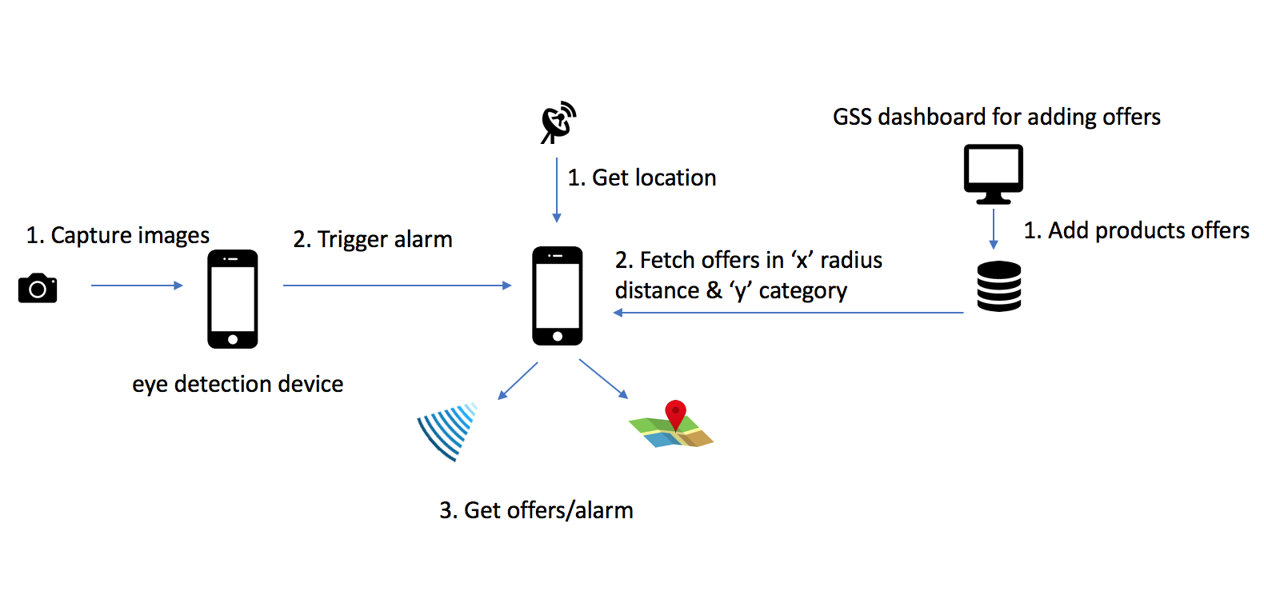
architecture

Slide 6
results

Slide 7
conclusion
We succeeded in achieving detecting driver’s current state. We also built a sample app which finds the current location of user and displays offers & discounts on a map.
Future work
Generate a heatmap of shops based on rating or frequent customers
Display advertisements based on age and mood of user
Reduce GPS usage by storing offline maps
Create a dashboard for shop owners

