Slide 1

Smart Fire Evacuation System
The Gradient Ascenders
Kanika Narang (MT2016069)
Meghna Srivastava(MT2016082)
Shivani Naik(MT2016088)

Slide 2
Motivation
Incapability of humans to make correct decision at the time of emergency.
Panic stricken people leads to chaos during evacuation.
They ignore evacuation protocols and make wrong decisions leading to a huge loss of lives.

Slide 3
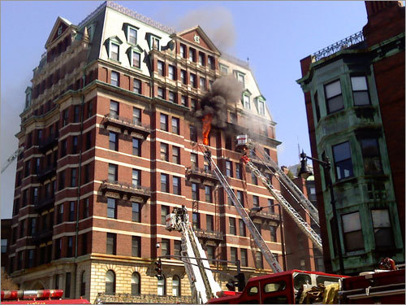

Slide 4
Idea: Introduction
Detect location of fire.
Map out the safe evacuation path to the exits.
Control the panic state of people.
Reducing the number of casualities.
Making big buildings more safe with this kind of disaster management system.

Slide 5
Strategy
Detect fire.
Trigger fire alarm.
Inform the authorities.
Give notification to the occupants to use the application.
Application will show the shortest and safest path to the exit.

Slide 6
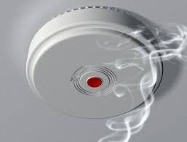
Sensors To Be Used
Smoke Detector:- It detects the smoke due to fire in initial stage.
Thermal Detector:-Detects fluctuation of temperature.

Slide 7

Sensors To Be Used
Flame Detector:- They operate on infrared and/or UV. They recognize heat signature of objects.

Slide 8
Data Analysis
Data collected from various sensors throughout the building is analyzed.
This data will be mapped to inform the fire locations which will be eliminated from safe routes.
Safe routes will be calculated using the nearest path algorithm.

Slide 9
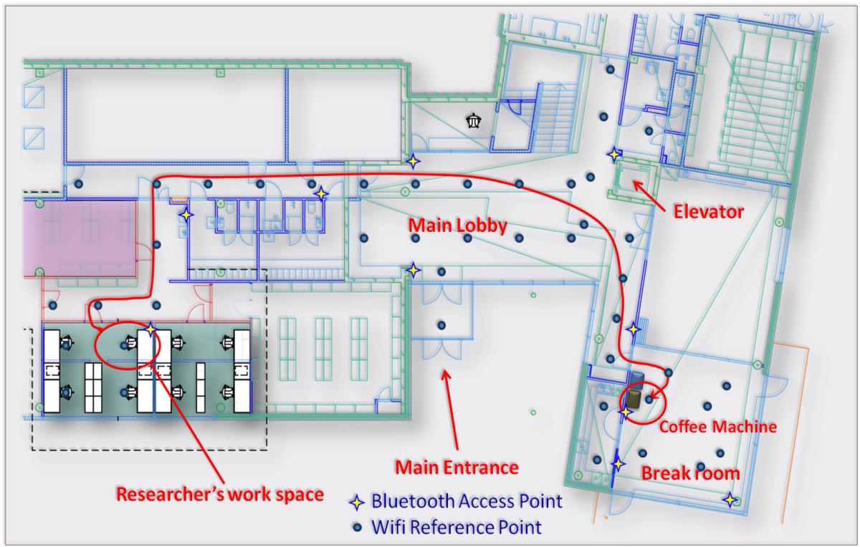

Slide 10
Indoor Positioning System
It locates objects or people inside the building.
It uses magnetic fields, light, bluetooth and WiFi signals.
Various APIs are available for this mapping.
It could also detect blocked people inside the building.
Proposed Technology:
Google Maps Indoor API.

Slide 11
Things to be done
Adding floor plans to Google Maps.
Sending alerts to authorities and building occupants.
Getting all exit paths and plotting them on the map.
Updating this information according to data obtained from various servers.

Slide 12
Conclusion
This application will be making accurate decisions of the safest routes.
It will provide hassle free evacuation leading to lesser loss of lives.

