Slide 1
External PII Test — Body
TC01 Contact: Jordan Example
TC02 Email: jordan.example@example.com
TC03 Employee ID: EMP-00042
TC04 Phone: +1 202-555-0147
TC05 Documentation IP: 192.0.2.15
TC06 Date: 2026-10-13 (not a phone number)
TC16 Negative: The quarterly review is complete.

Slide 2
Table Boundary Cases
PII is stored inside table cells; pass table header context.
Case | Name | Email | Identifier
TC07 | Avery Morgan | avery.morgan@example.org | EMP-00041
TC09 | — | — | TEST-ID-AB-123456
TC10 | Riley Q. Example | riley.q@example.net | EMP0007

Slide 3
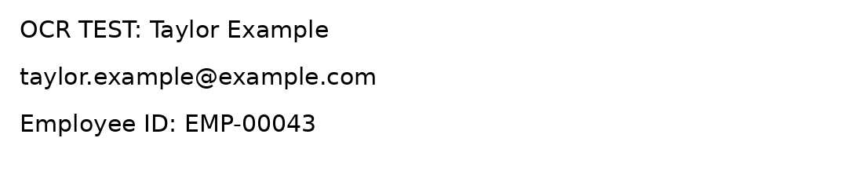
OCR / Notes Boundary
The image below contains PII-like text as pixels.
Validate speaker notes and hidden content if supported.
Notes:
Notes test: Casey Example | casey@example.com | EMP-00044

