Slide 1
Incident Briefing: Credential Phishing
INC-2026-0712 | Risk Committee | 9 October 2026

Slide 2
What Happened
On 6 October 2026 a phishing email reached 214 mailboxes.
Two staff entered their passwords: Lena Fischer and Tomasz Kowal.
The attacker signed in from 198.51.100.77 and 203.0.113.140.
No customer data was exported; three forwarding rules were removed.
Notes:
Rohan Kapoor (SOC analyst, +44 20 7946 0321) can answer technical questions.

Slide 3
Affected Accounts
Name | Employee ID | Email | Last sign-in IP | Action
Lena Fischer | EMP-55871 | lena.fischer@example.com | 198.51.100.77 | Password reset
Tomasz Kowal | EMP-56002 | tomasz.kowal@example.com | 203.0.113.140 | Password reset, MFA re-enrolled
Notes:
Do not share this slide outside the committee: it lists staff by name.

Slide 4
Financial Exposure
A finance mailbox held one unencrypted card number, 4000 0566 5566 5556; the card was cancelled.
The cardholder, Hélène Lefèvre, was told on 7 October 2026.
A remittance advice in the same mailbox showed the bank account number 41926837 of a contractor, Femi Adebayo.
Payment run PR-2026-41 was checked: no bank details were changed.

Slide 5
Timeline
06 Oct 09:14 - first phishing email delivered
06 Oct 09:52 - first password entered
06 Oct 11:30 - SOC blocked the sender domain
07 Oct 08:00 - all affected passwords reset

Slide 6
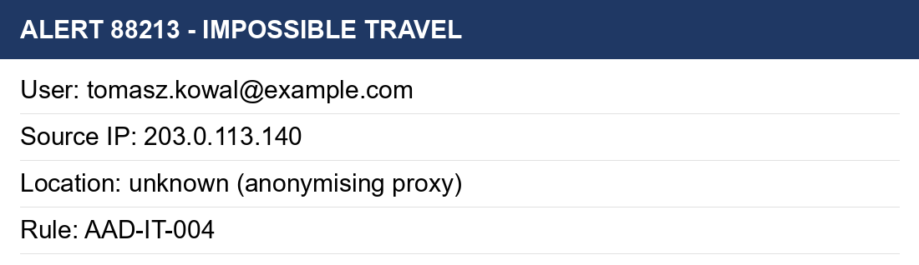
Evidence: SIEM Alert

