Slide 1
Third-Party Risk Management: Analyst Training
Presented by Nkechi Adeyemi, TPRM Lead | September 2026

Slide 2
Your TPRM Contacts
Programme lead: Nkechi Adeyemi (nkechi.adeyemi@example.com)
Assessment queries: Oliver Brandt, +1 (646) 555-0127
OneTrust administrator: Mei Lin Zhou, mei.zhou@example.com
Escalations go to the Third-Party Risk Committee, which meets monthly
Notes:
If Oliver Brandt is away, assessment queries go to his deputy Ama Owusu on +44 7700 900311.

Slide 3
Risk Tiers and Review Cadence
Tier | Criteria | Review cadence | Example vendor
Tier 1 | Critical service or access to customer data | Every 12 months | Fabrikam Payroll Services
Tier 2 | Important service, limited data access | Every 24 months | Contoso Facilities
Tier 3 | Low risk, no data access | At renewal | Northwind Stationery

Slide 4
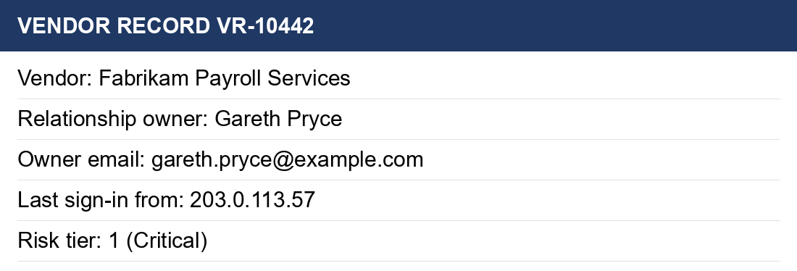
Worked Example: Vendor Record
Screenshot from the OneTrust training tenant
Notes:
Point out that the relationship owner's details are visible in the screenshot, which is why exports must be redacted.

Slide 5
Handling Evidence
Do: request evidence through the OneTrust portal and check it against the questionnaire.
Don't: paste passport scans or bank letters into tickets or chat.
Retention: evidence is kept for 7 years after the contract ends (POL-TPRM-002).

