Slide 1



HYBRID CRYPTOGRAPHIC PROTOCOL
Secure Device Pairing & Proximity Exchange
A hybrid classical + post-quantum cryptographic pairing protocol
X25519
ML-KEM-768
HKDF-SHA256
ASCON-128a
DEVICE A
DEVICE B

Slide 2



02 · THE PROBLEM
Three adversaries, one pairing channel
PASSIVE
ACTIVE
FUTURE
Eavesdropper
Man-in-the-Middle
Quantum Adversary
Records all network traffic, hoping to read the data now or decrypt it later.
Sits between the two devices and substitutes its own keys so each side unknowingly talks to the attacker.
Uses a quantum computer to break classical crypto — including traffic recorded years earlier.
Solving all three requires more than one algorithm.

Slide 3

03 · THE CRYPTO STACK
Four primitives, layered
4
ASCON-128a
Defends against snooping and tampering — the message stays private and any modification is detected.
Encrypts and authenticates data with the session key
Defense in depth
3
HKDF-SHA256
Defends against a single broken input — the session key stays strong while either secret holds.
Breaking X25519 alone is not enough.
Combines both secrets into one key
An attacker must break both X25519 and ML-KEM-768 simultaneously to recover the session key.
2
ML-KEM-768
Defends against quantum adversaries — lattice math that Shor’s algorithm cannot shortcut.
Post-quantum key encapsulation
X25519
AND
ML-KEM
1
X25519
Defends against today’s attackers with fast, mature elliptic-curve Diffie-Hellman.
Classical key agreement
bottom → top: key agreement → key derivation → encryption

Slide 4



04 · X25519
Elliptic Curve Diffie-Hellman
Curve25519
THE MATH
An elliptic curve over the prime field 2²⁵⁵ − 19, designed by Daniel J. Bernstein. X25519 is Diffie-Hellman key agreement on this curve.
Alice generates: a (private scalar)
A = a·G (public key)
Bob generates: b (private scalar)
B = b·G (public key)
Shared secret: S = a·B = b·A = ab·G
G = base point of Curve25519
Speed
Constant-time Montgomery ladder — fast even on phones and embedded chips.
Side-channel resistant
No secret-dependent branches or memory lookups to leak timing.
No weak parameters
KEY INSIGHT
Rigid, fully explained constants — nothing hidden, every 32-byte key is valid.
An eavesdropper sees A and B but cannot compute ab·G — the Elliptic Curve Discrete Logarithm Problem.

Slide 5


05 · ML-KEM-768
Post-Quantum Key Encapsulation
Why X25519 breaks
MODULE LEARNING WITH ERRORS (MLWE)
Public key: (A, b = A·s + e)
A = random matrix, s = secret, e = small error
Encapsulate: ciphertext c, shared secret K
c = (A·r + e₁, b·r + e₂ + ⌊q/2⌋·m)
Decapsulate: recover m from c using private s
→ same K derived from m
Shor’s algorithm solves the elliptic-curve discrete log problem in polynomial time on a quantum computer.
Traffic recorded today can be decrypted once such a machine exists.
KEY SIZES
1184
1088
32
No known quantum algorithm breaks MLWE efficiently.
Standardised as NIST FIPS 203 (2024).
bytes
public key
bytes
ciphertext
bytes
shared secret

Slide 6
06 · HKDF-SHA256
Combining Two Secrets Into One Key
X25519 secret
HKDF
session key
32 bytes · single, uniform key
ML-KEM secret
EXTRACT, THEN EXPAND
SECURITY PROPERTY
PRK = HMAC-SHA256(salt, X25519_secret ∥ ML-KEM_secret)
session_key = HMAC-SHA256(PRK, info ∥ 0x01)
Even if one input secret is weak or compromised, the output key is still as strong as the other input.
info is a domain-separation string (e.g. "pairing-v1") so keys derived for different purposes are always distinct.

Slide 7



07 · ASCON-128a
Authenticated Encryption
Encrypt
Transmit
Decrypt + Verify
Sender seals plaintext with key + fresh nonce; KEM ciphertext bound as AD
Only nonce, ciphertext and tag cross the untrusted network
Receiver checks the tag first — any altered byte means rejection
1
Confidentiality
Ciphertext reveals nothing about the plaintext.
Encrypt: (ciphertext, tag) = ASCON(key, nonce, plaintext, AD)
Decrypt: plaintext = ASCON⁻¹(key, nonce, ciphertext, AD)
← FAILS if tag doesn’t match (tamper detected)
2
Integrity
The authentication tag detects any tampering in transit.
3
Associated data
The KEM ciphertext is authenticated without being encrypted — any modification is caught.
Nonce must never repeat with the same key — a fresh random nonce is generated for every message.
ASCON won the NIST Lightweight Cryptography competition (2023).

Slide 8
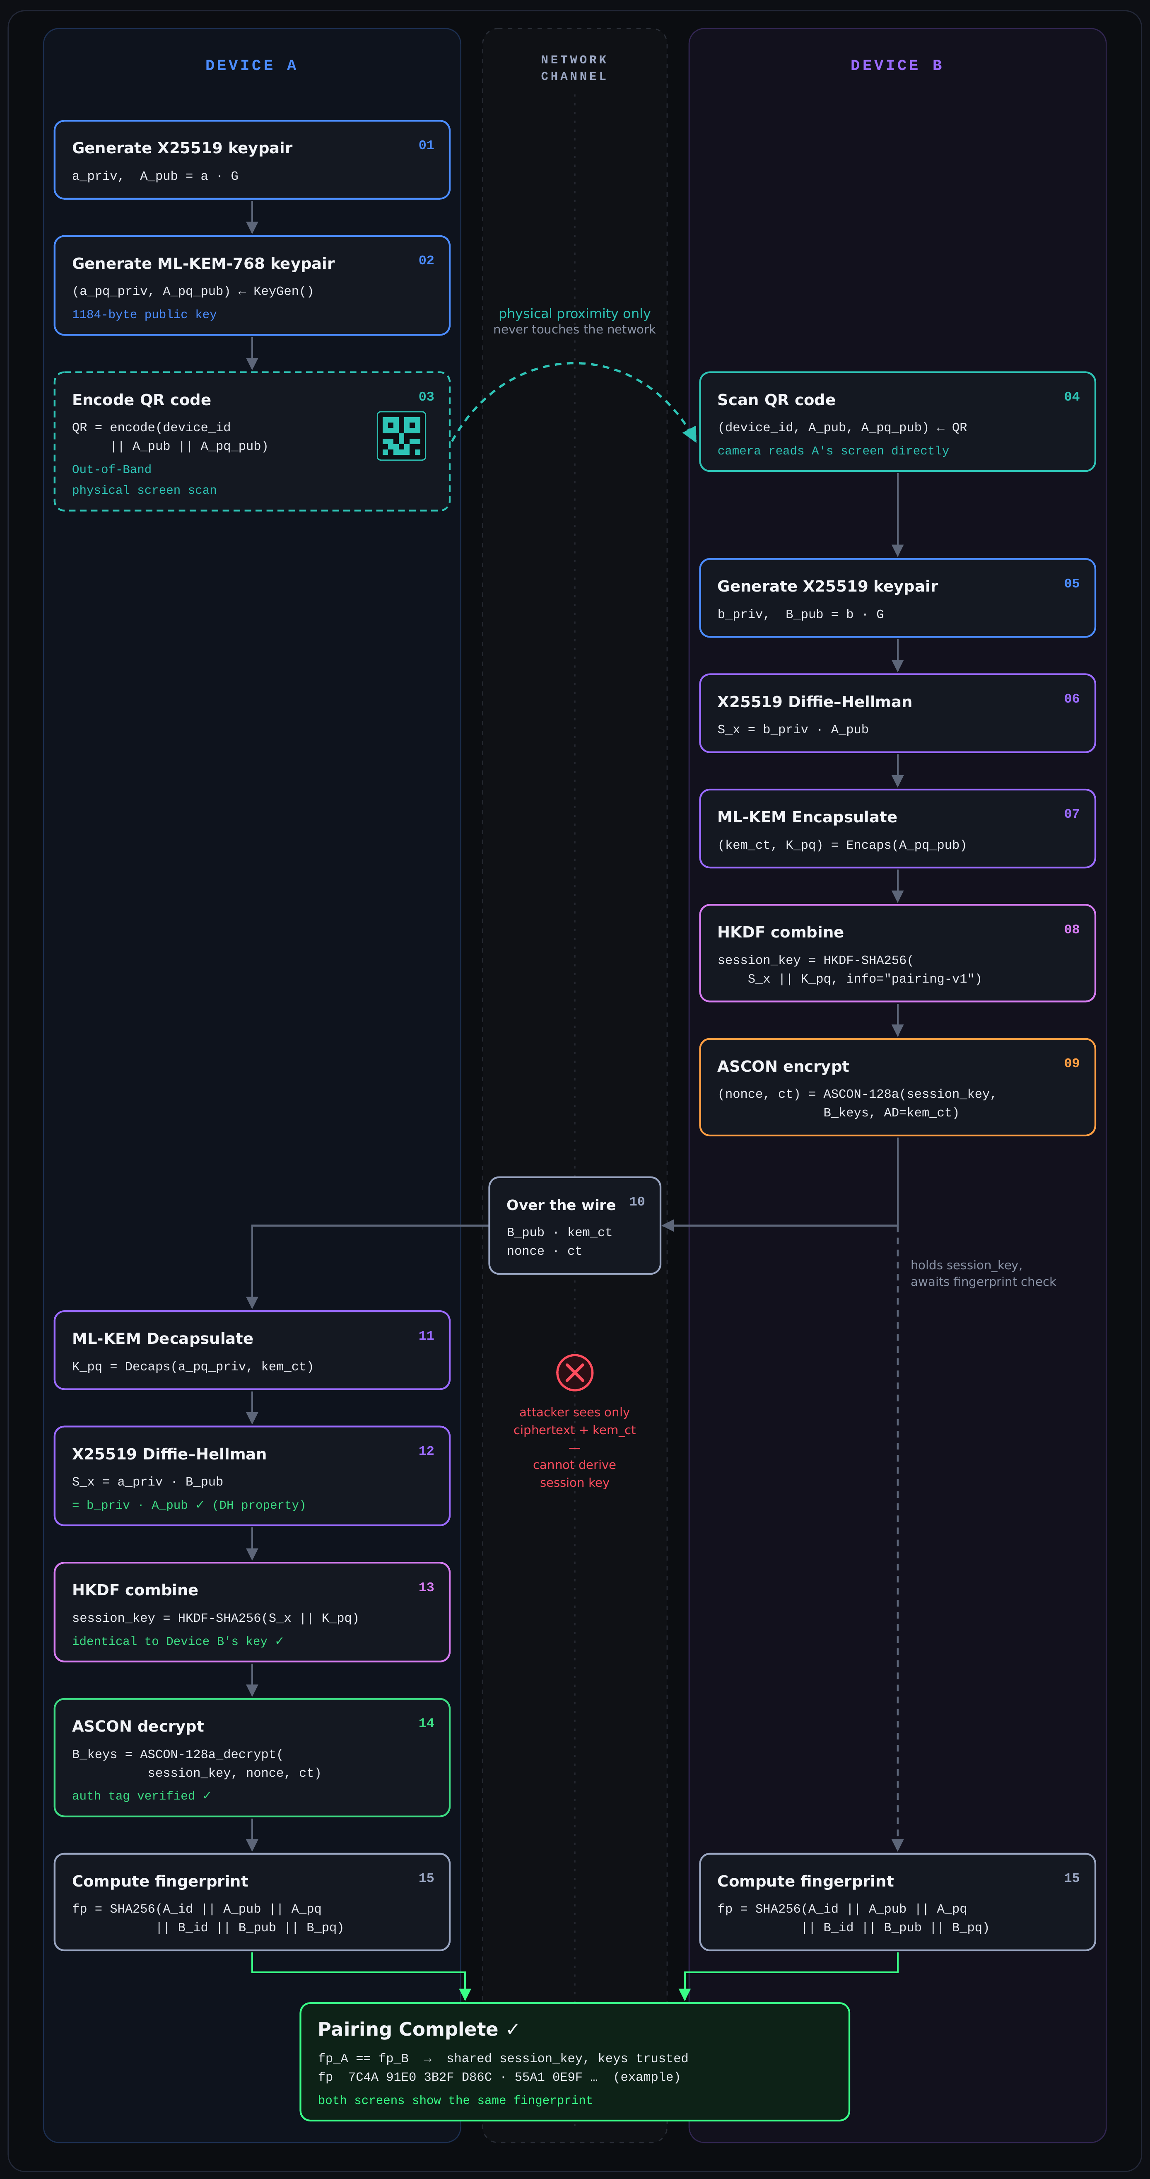
08 · FULL DEVICE PAIRING
Secure pairing protocol
Device A publishes its public keys out-of-band via QR. Device B derives a hybrid session key and sends back one encrypted message. The session key never crosses the network.
01–03
Device A
Generates X25519 + ML-KEM-768 keypairs and shows them as a QR code
04
Out-of-band
Device B scans the QR from A’s screen — never over the network
05–09
Device B
DH + Encaps → HKDF session key → ASCON-encrypts its own keys
10
Over the wire
Only B_pub, kem_ct, nonce and ct — useless without a private key
11–14
Device A
Decaps + DH → identical session key → decrypts, tag verified
15
Fingerprint
Both screens show the same SHA-256 fingerprint → pairing complete

Slide 9
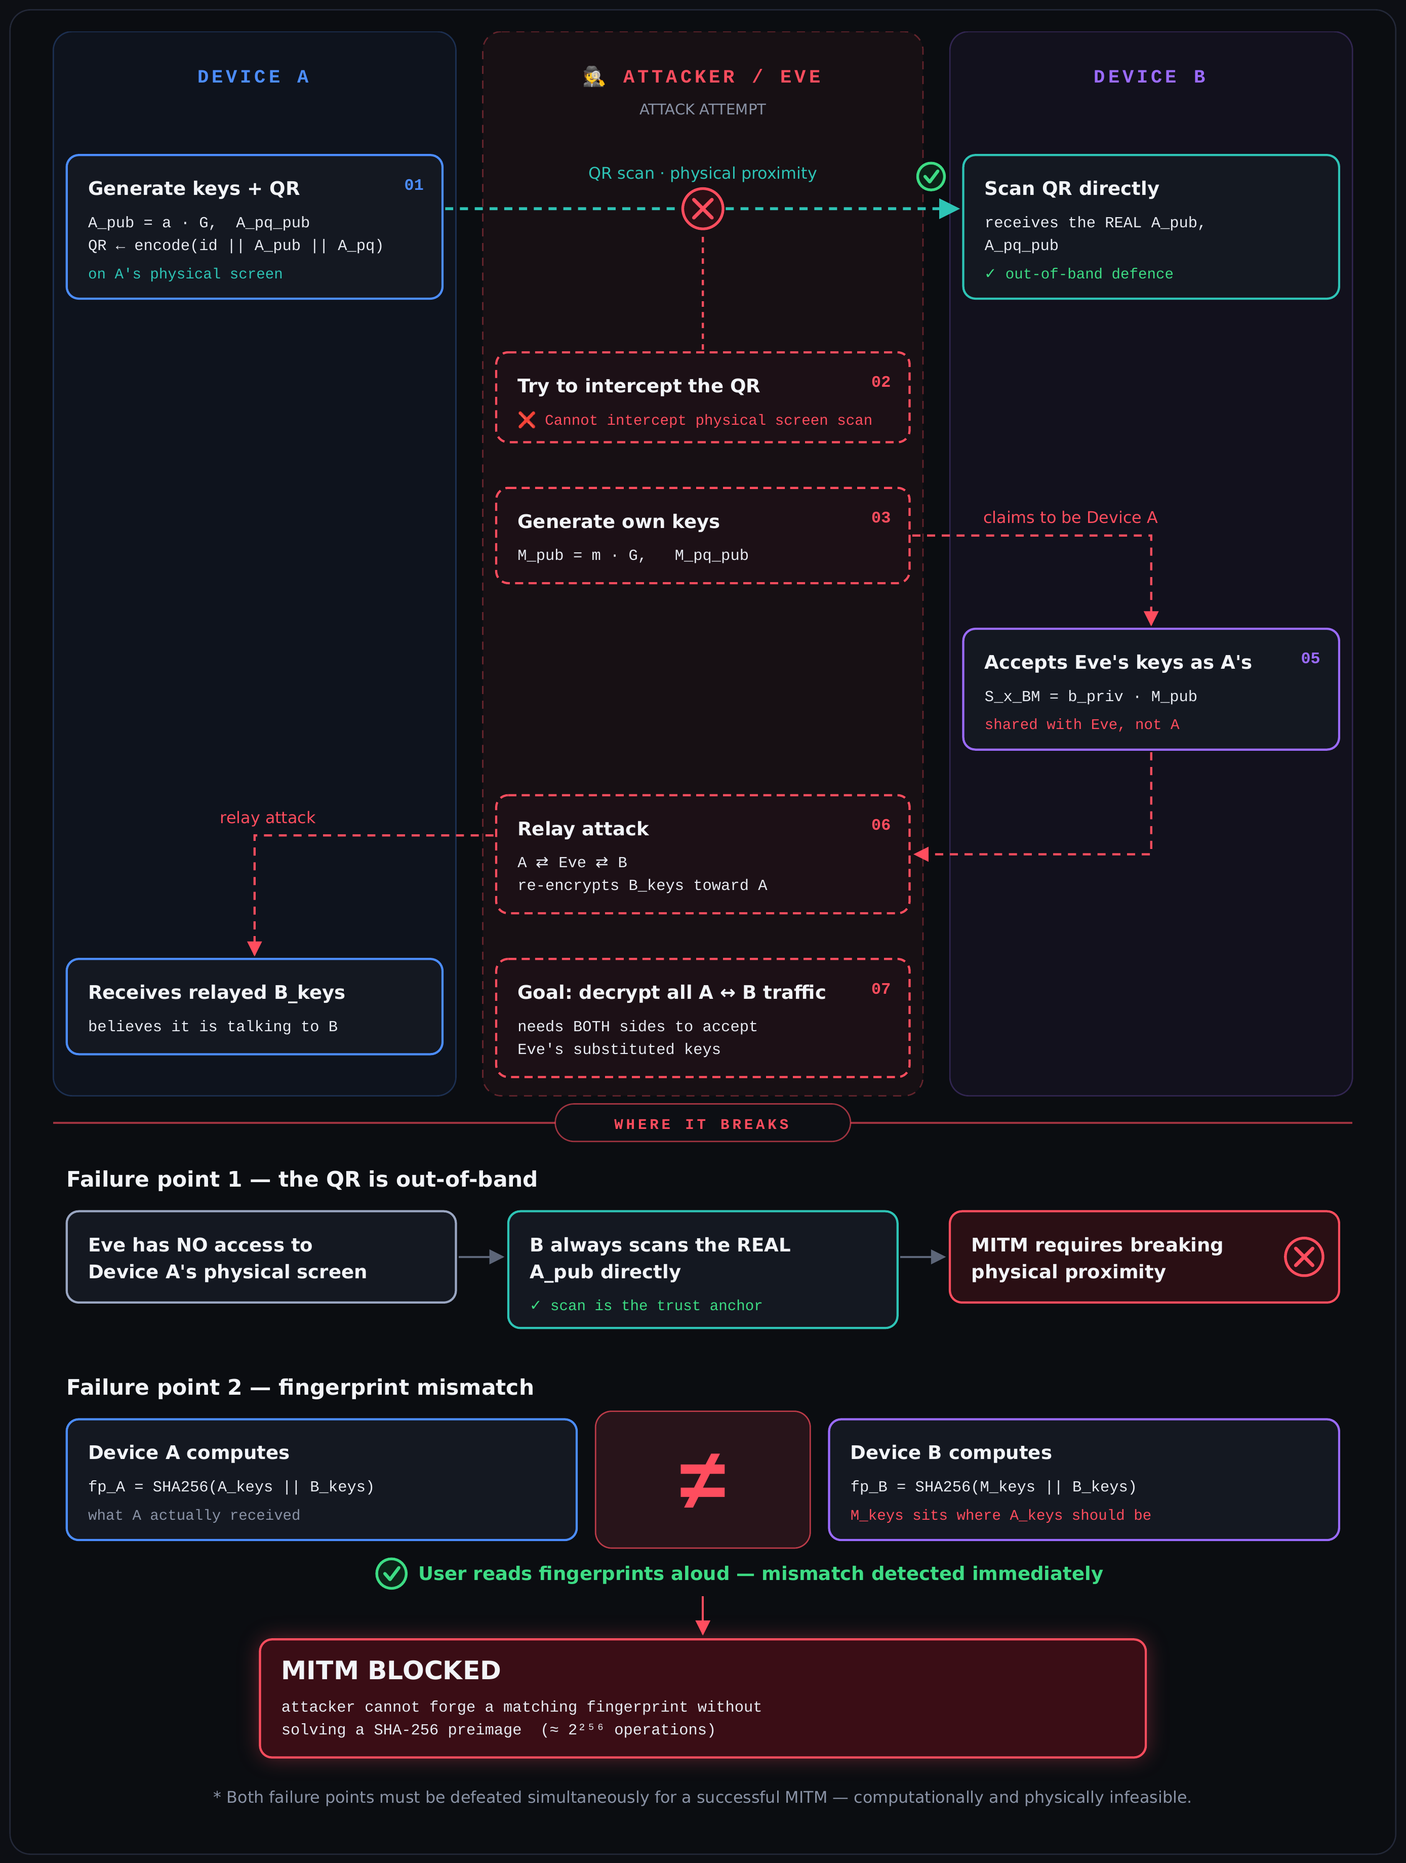
09 · MITM ATTACK
MITM attack & why it fails
Eve tries to swap in her own keys and relay traffic between the devices. Two independent defences stop her.
1
The QR is out-of-band
Eve has no access to Device A’s physical screen. B always scans the real A_pub directly — the scan is the trust anchor.
2
Fingerprint mismatch
If keys were substituted, fp_A ≠ fp_B. Reading the fingerprints aloud exposes the attack immediately.
MITM blocked: both defences must be defeated at once — physically and computationally infeasible.

Slide 10


10 · OUT-OF-BAND CHANNEL
The QR code never touches the network
ATTACK SURFACE
Network channel
Attacker can read, modify, replay
NOT OVER NETWORK
QR scan
Requires physical proximity and line-of-sight
scanning…
Why this is sufficient
The network carries only ciphertext and KEM encapsulations. The keys themselves are bootstrapped entirely through the QR, so an attacker with no physical access cannot substitute keys.
Device A
Device B
physical proximity · line-of-sight

Slide 11

11 · FORWARD SECRECY & PROXIMITY RECONNECT
Fresh keys every encounter
THE SOLUTION · EPHEMERAL KEYS, EACH ENCOUNTER
Device A generates fresh: eph_x_priv, eph_x_pub (X25519)
eph_pq (ML-KEM)
session_key = HKDF(eph_x_priv·B_eph_pub ∥ Encaps(eph_pq_pub))
Keys discarded after session ends.
The problem with long-term keys
If the same key is used every session and later leaked, every past session is decryptable.
But how does Device B know it’s talking to the real Device A?
S1
S2
S3
S4
MAC = HMAC-SHA256( HKDF(long_term_X25519_secret),
device_id ∥ eph_x_pub ∥ eph_pq_pub )
↑ one leaked key → all sessions exposed
Only a device that completed the original QR pairing knows the long-term secret needed to produce a valid MAC.

Slide 12


12 · TRUST FRAMEWORK
Device recognition & the trust store
Trust store on Device B
device_id | X25519 public key | ML-KEM public key | long-term secret
device-a | 9f3c…7a21 (32 B) | b41e…c90d (1184 B) | HKDF(b_priv · A_pub)
laptop-7 | 2d88…14ef (32 B) | 77ac…0b3a (1184 B) | HKDF(b_priv · L_pub)
Happy path
Failure path
1
Device B receives a connection request from device-a
1
Unknown device sends a request
2
Looks up device-a in trust store → FOUND
2
Trust store lookup → NOT FOUND
3
Recomputes the expected MAC with the stored long-term key
3
Silent rejection — no response, no error, no information leak
4
HMAC-compare(expected, received) → match ✓ (constant-time)
4
MAC would also fail independently (defense in depth)
5
Proceeds to the ephemeral key exchange
Constant-time comparison (hmac.compare_digest) prevents timing side-channels that could leak whether the MAC was close to correct.

Slide 13


13 · STRANGER ATTACK
A stranger tries to connect
1
2
3
4
Stranger generates an identity and ephemeral keys
Has no pairing secret with Device B → uses a random 32-byte key to compute a fake MAC
Sends (device_id="stranger-007", eph_keys, fake_mac) to Device B
Device B: trust store lookup for stranger-007 → NOT FOUND → silent drop
EVEN IF DEVICE B CHECKED THE MAC ANYWAY
SECURITY PROPERTY
Expected = HMAC-SHA256(HKDF(b_priv · A_pub), stranger_data)
Received = HMAC-SHA256(random_key, stranger_data)
Expected ≠ Received
P(collision) ≈ 1/2²⁵⁶
Without the original QR pairing, an attacker cannot forge a valid MAC for any device in the trust store — the long-term secret was never transmitted.

Slide 14
14 · SECURITY PROPERTIES
Every threat, a matching mechanism
Property | Mechanism | Threat Defeated
Confidentiality | ASCON-128a encryption | Passive eavesdropper
Integrity | ASCON authentication tag | Ciphertext tampering
MITM resistance | QR out-of-band + fingerprint | Active MITM
Post-quantum security | ML-KEM-768 (MLWE) | Quantum computer
Forward secrecy | Ephemeral keys per session | Key compromise after session
Identity authentication | HMAC-SHA256 long-term MAC | Impersonation
Stranger rejection | Trust store + silent drop | Unsolicited connections
Timing attack resistance | hmac.compare_digest | MAC oracle side-channel

Slide 15
15 · ARCHITECTURE & LIVE DEMO
From primitives to a live visualizer
website/
localhost:8000 · pairing visualizer
scenario buttons
FastAPI + WebSocket backend, live visualizer frontend
Pair
MITM
Stranger
Reconnect
DEVICE A
DEVICE B
x25519_pub 9f3c…7a21
mlkem_pub b41e…c90d
shared_S_x e07b…1f44
session_key 5ac2…9d10
ct_kem
x25519_pub 9f3c…7a21
mlkem_pub b41e…c90d
shared_S_x e07b…1f44
session_key 5ac2…9d10
pairing/
proximity/
Identity generation, QR encoding, fingerprint
Reconnect protocol, MAC authentication
ct
wire divider
device panels
1 keygen
2 QR
3 encaps
4 HKDF
5 verify
core/
X25519 · ML-KEM · HKDF · ASCON primitives
step cards
Every cryptographic operation shown in the demo is real — the keys, ciphertexts, and shared secrets are computed live, not simulated.

