Slide 1



HYBRID CRYPTOGRAPHIC PROTOCOL
Secure Device Pairing & Proximity Exchange
A hybrid classical + post-quantum cryptographic pairing protocol
X25519
ML-KEM-768
HKDF-SHA256
ASCON-128a
DEVICE A
DEVICE B

Slide 2
02 · PROBLEM STATEMENT
Pairing devices securely — today and after quantum
PROBLEM STATEMENT
Design a lightweight protocol that lets two devices with no prior trust establish a shared session key over an untrusted network — resisting passive eavesdroppers, active man-in-the-middle attackers and future quantum adversaries — and lets paired devices reconnect by proximity without ever reusing a session key.
Harvest now, decrypt later
No trustworthy key exchange
Long-term keys on reconnect
Classical-only pairing (ECDH) protects traffic today, but recorded sessions become readable once a large quantum computer exists.
Keys exchanged over the network itself can be silently swapped by a man-in-the-middle unless there is an independent trust anchor.
Reusing the same key every time devices reconnect means one leaked key exposes every past session.
Why it matters: phones, wearables and IoT devices pair constantly — a single weak link exposes everything that follows.

Slide 3
03 · OBJECTIVES
What this project sets out to achieve
1
Hybrid key agreement
2
Out-of-band trust
3
Lightweight authenticated encryption
Combine X25519 and ML-KEM-768 so the session key stays secure unless both are broken.
Bootstrap public keys through a QR scan so an attacker on the network cannot substitute keys.
Use ASCON-128a to keep data private and detect any tampering, even on constrained devices.
4
Forward-secret reconnect
5
Reject strangers
6
Make it observable
Generate fresh ephemeral keys on every proximity encounter, authenticated by a MAC from the long-term secret.
Maintain a trust store of paired devices and silently drop requests from unknown devices.
Build a live visualizer that shows every real cryptographic operation as it happens.

Slide 4
04 · LITERATURE SURVEY
Summary of existing work
Work | Approach | Limitation
Bluetooth LE Secure Connections (Bluetooth SIG, v4.2) | ECDH on P-256 with numeric comparison or passkey entry | Classical only; "Just Works" mode has no MITM protection
Seeing-is-Believing (McCune, Perrig & Reiter, IEEE S&P 2005) | Camera reads a 2D barcode as a visual out-of-band channel to authenticate keys | Pre-quantum; no secure reconnect or forward secrecy
Wi-Fi Easy Connect / DPP (Wi-Fi Alliance, 2018) | QR-code bootstrapping of elliptic-curve public keys | Classical ECC only; limited to Wi-Fi network onboarding
Signal PQXDH (Signal, 2023) | Hybrid X25519 + Kyber key agreement for messaging | Built for asynchronous chat, not proximity device pairing
Hybrid TLS 1.3 — X25519MLKEM768 (IETF draft, browsers 2024) | Hybrid classical + post-quantum key exchange in the TLS handshake | Relies on certificate PKI; not peer-to-peer
NIST FIPS 203 (ML-KEM, 2024) NIST LWC — ASCON (2023) | Standardised post-quantum KEM and lightweight AEAD | Building blocks only; no pairing protocol

Slide 5
05 · RESEARCH GAP
What existing work leaves open
GAPS IDENTIFIED
THIS PROJECT FILLS IT
1
No pairing protocol combines hybrid post-quantum key exchange with a physical out-of-band trust anchor.
X25519 + ML-KEM-768
hybrid key agreement
2
Proximity pairing in use today is classical-only — recorded sessions are exposed to future quantum attacks.
QR scan
physical out-of-band trust anchor
HKDF-SHA256
one key from both secrets
3
Reconnection after pairing often reuses long-term keys, so there is no forward secrecy between encounters.
ASCON-128a
lightweight authenticated encryption
4
Lightweight AEAD (ASCON) is rarely paired with a post-quantum KEM for constrained devices.
Ephemeral keys + MAC
forward-secret proximity reconnect
5
Few implementations make the protocol observable — there is no live view of the real cryptography for teaching or verification.
Live visualizer
every operation shown in real time
Gap in one line: secure, post-quantum, proximity-based pairing with forward secrecy — built for small devices.

Slide 6



06 · THE PROBLEM
Three adversaries, one pairing channel
PASSIVE
ACTIVE
FUTURE
Eavesdropper
Man-in-the-Middle
Quantum Adversary
Records all network traffic, hoping to read the data now or decrypt it later.
Sits between the two devices and substitutes its own keys so each side unknowingly talks to the attacker.
Uses a quantum computer to break classical crypto — including traffic recorded years earlier.
Solving all three requires more than one algorithm.

Slide 7

07 · THE CRYPTO STACK
Four primitives, layered
4
ASCON-128a
Defends against snooping and tampering — the message stays private and any modification is detected.
Encrypts and authenticates data with the session key
Defense in depth
3
HKDF-SHA256
Defends against a single broken input — the session key stays strong while either secret holds.
Breaking X25519 alone is not enough.
Combines both secrets into one key
An attacker must break both X25519 and ML-KEM-768 simultaneously to recover the session key.
2
ML-KEM-768
Defends against quantum adversaries — lattice math that Shor’s algorithm cannot shortcut.
Post-quantum key encapsulation
X25519
AND
ML-KEM
1
X25519
Defends against today’s attackers with fast, mature elliptic-curve Diffie-Hellman.
Classical key agreement
bottom → top: key agreement → key derivation → encryption

Slide 8



08 · X25519
Elliptic Curve Diffie-Hellman
Curve25519
THE MATH
An elliptic curve over the prime field 2²⁵⁵ − 19, designed by Daniel J. Bernstein. X25519 is Diffie-Hellman key agreement on this curve.
Alice generates: a (private scalar)
A = a·G (public key)
Bob generates: b (private scalar)
B = b·G (public key)
Shared secret: S = a·B = b·A = ab·G
G = base point of Curve25519
Speed
Constant-time Montgomery ladder — fast even on phones and embedded chips.
Side-channel resistant
No secret-dependent branches or memory lookups to leak timing.
No weak parameters
KEY INSIGHT
Rigid, fully explained constants — nothing hidden, every 32-byte key is valid.
An eavesdropper sees A and B but cannot compute ab·G — the Elliptic Curve Discrete Logarithm Problem.

Slide 9


09 · ML-KEM-768
Post-Quantum Key Encapsulation
Why X25519 breaks
MODULE LEARNING WITH ERRORS (MLWE)
Public key: (A, b = A·s + e)
A = random matrix, s = secret, e = small error
Encapsulate: ciphertext c, shared secret K
c = (A·r + e₁, b·r + e₂ + ⌊q/2⌋·m)
Decapsulate: recover m from c using private s
→ same K derived from m
Shor’s algorithm solves the elliptic-curve discrete log problem in polynomial time on a quantum computer.
Traffic recorded today can be decrypted once such a machine exists.
KEY SIZES
1184
1088
32
No known quantum algorithm breaks MLWE efficiently.
Standardised as NIST FIPS 203 (2024).
bytes
public key
bytes
ciphertext
bytes
shared secret

Slide 10
10 · HKDF-SHA256
Combining Two Secrets Into One Key
X25519 secret
HKDF
session key
32 bytes · single, uniform key
ML-KEM secret
EXTRACT, THEN EXPAND
SECURITY PROPERTY
PRK = HMAC-SHA256(salt, X25519_secret ∥ ML-KEM_secret)
session_key = HMAC-SHA256(PRK, info ∥ 0x01)
Even if one input secret is weak or compromised, the output key is still as strong as the other input.
info is a domain-separation string (e.g. "pairing-v1") so keys derived for different purposes are always distinct.

Slide 11



11 · ASCON-128a
Authenticated Encryption
Encrypt
Transmit
Decrypt + Verify
Sender seals plaintext with key + fresh nonce; KEM ciphertext bound as AD
Only nonce, ciphertext and tag cross the untrusted network
Receiver checks the tag first — any altered byte means rejection
1
Confidentiality
Ciphertext reveals nothing about the plaintext.
Encrypt: (ciphertext, tag) = ASCON(key, nonce, plaintext, AD)
Decrypt: plaintext = ASCON⁻¹(key, nonce, ciphertext, AD)
← FAILS if tag doesn’t match (tamper detected)
2
Integrity
The authentication tag detects any tampering in transit.
3
Associated data
The KEM ciphertext is authenticated without being encrypted — any modification is caught.
Nonce must never repeat with the same key — a fresh random nonce is generated for every message.
ASCON won the NIST Lightweight Cryptography competition (2023).

Slide 12
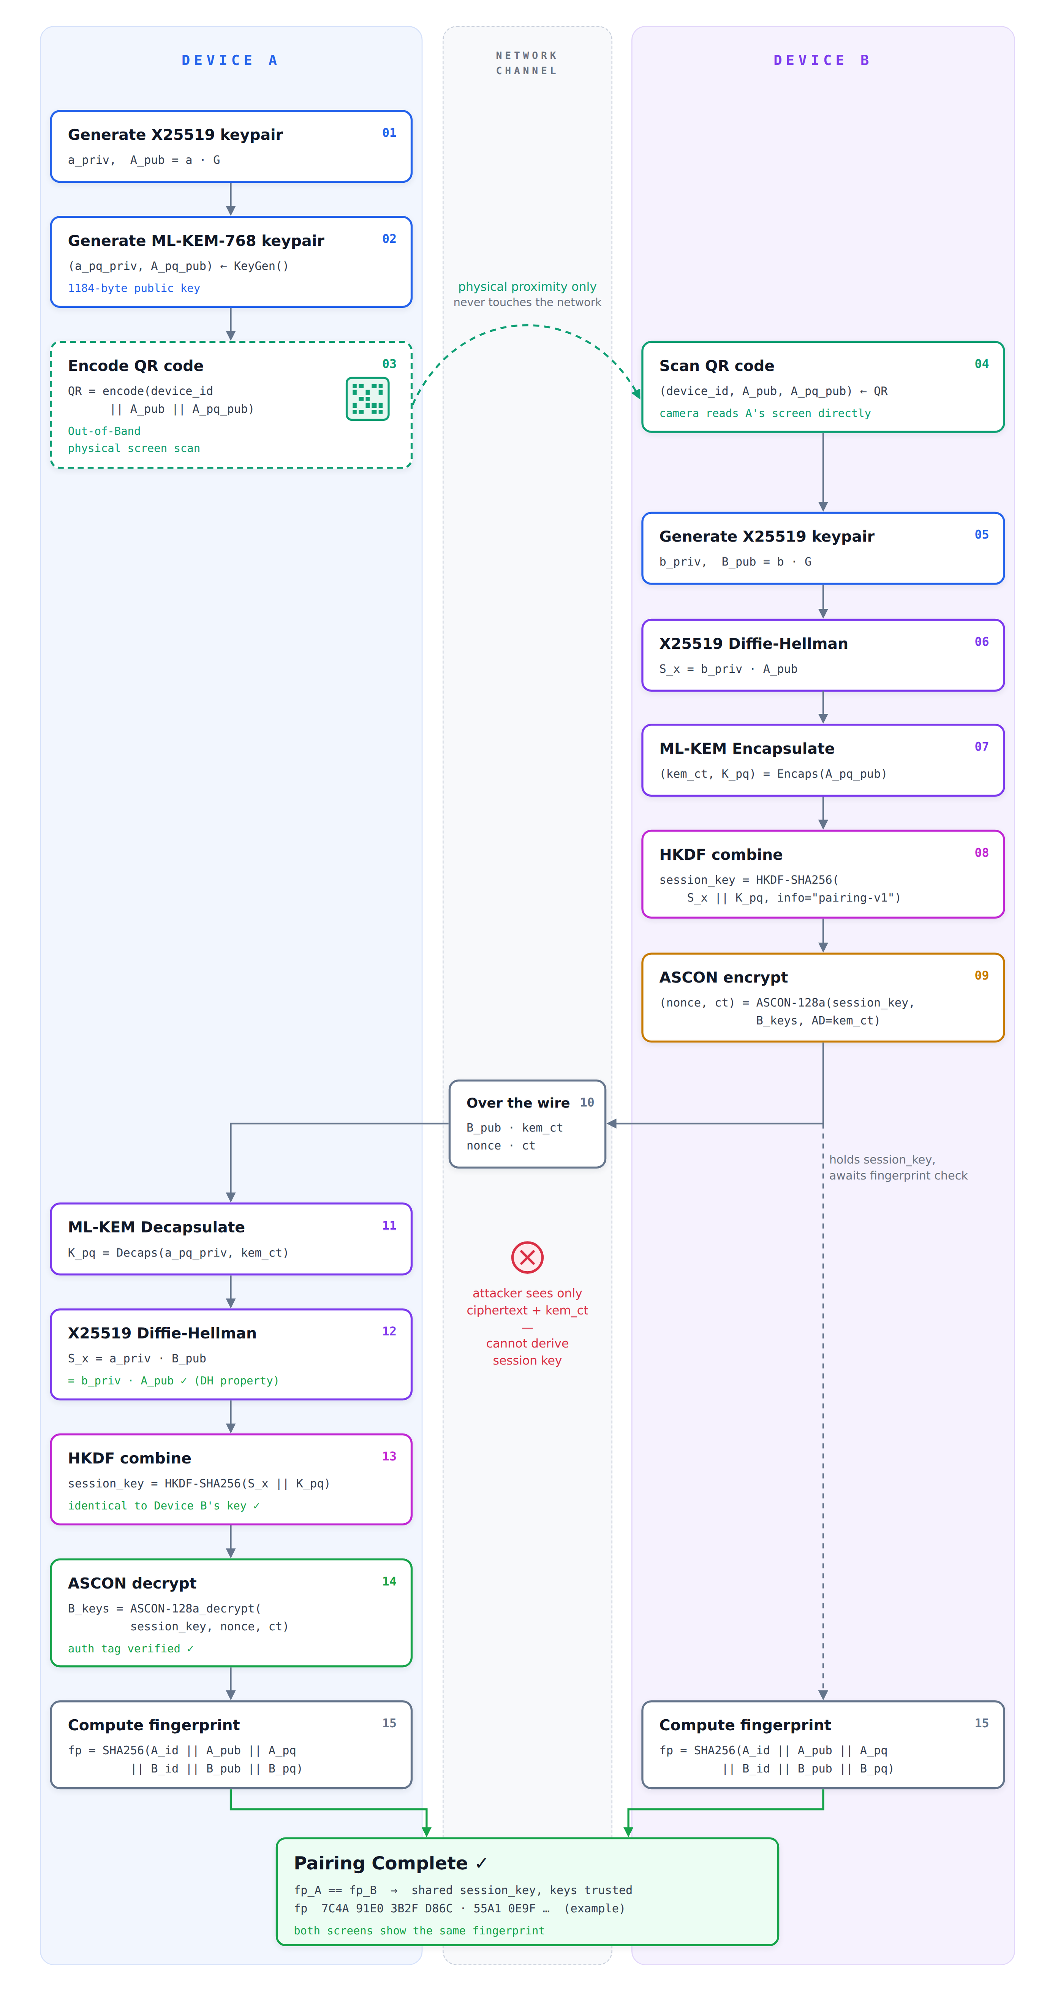
12 · FULL DEVICE PAIRING
Secure pairing protocol
Device A publishes its public keys out-of-band via QR. Device B derives a hybrid session key and sends back one encrypted message. The session key never crosses the network.
01–03
Device A
Generates X25519 + ML-KEM-768 keypairs and shows them as a QR code
04
Out-of-band
Device B scans the QR from A’s screen — never over the network
05–09
Device B
DH + Encaps → HKDF session key → ASCON-encrypts its own keys
10
Over the wire
Only B_pub, kem_ct, nonce and ct — useless without a private key
11–14
Device A
Decaps + DH → identical session key → decrypts, tag verified
15
Fingerprint
Both screens show the same SHA-256 fingerprint → pairing complete

Slide 13
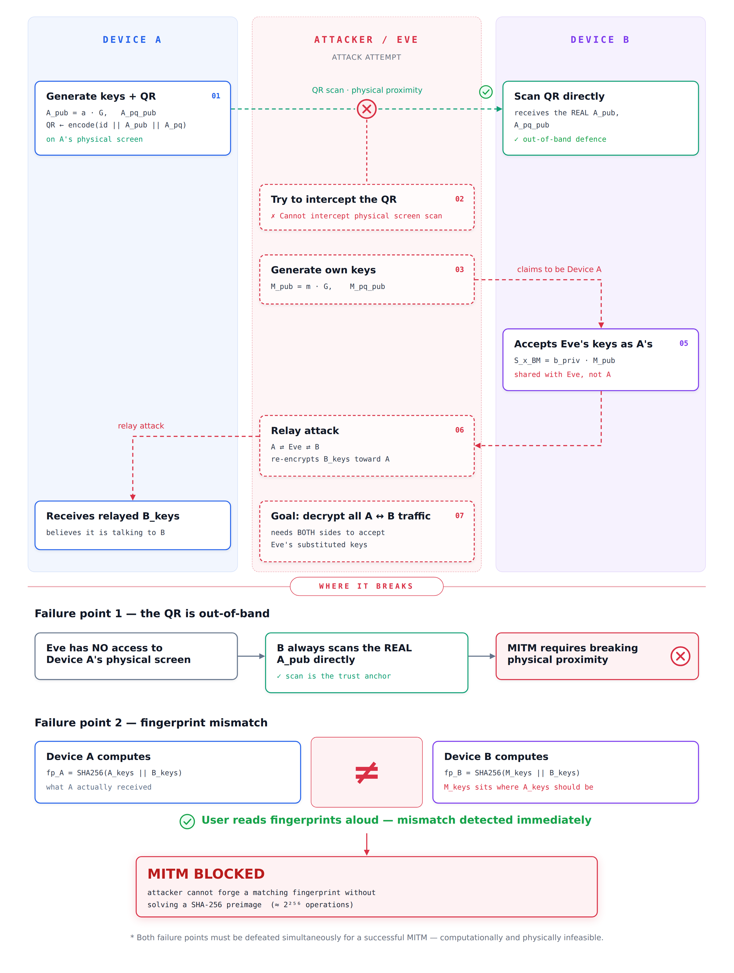
13 · MITM ATTACK
MITM attack & why it fails
Eve tries to swap in her own keys and relay traffic between the devices. Two independent defences stop her.
1
The QR is out-of-band
Eve has no access to Device A’s physical screen. B always scans the real A_pub directly — the scan is the trust anchor.
2
Fingerprint mismatch
If keys were substituted, fp_A ≠ fp_B. Reading the fingerprints aloud exposes the attack immediately.
MITM blocked: both defences must be defeated at once — physically and computationally infeasible.

Slide 14


14 · OUT-OF-BAND CHANNEL
The QR code never touches the network
ATTACK SURFACE
Network channel
Attacker can read, modify, replay
NOT OVER NETWORK
QR scan
Requires physical proximity and line-of-sight
scanning…
Why this is sufficient
The network carries only ciphertext and KEM encapsulations. The keys themselves are bootstrapped entirely through the QR, so an attacker with no physical access cannot substitute keys.
Device A
Device B
physical proximity · line-of-sight

Slide 15

15 · FORWARD SECRECY & PROXIMITY RECONNECT
Fresh keys every encounter
THE SOLUTION · EPHEMERAL KEYS, EACH ENCOUNTER
Device A generates fresh: eph_x_priv, eph_x_pub (X25519)
eph_pq (ML-KEM)
session_key = HKDF(eph_x_priv·B_eph_pub ∥ Encaps(eph_pq_pub))
Keys discarded after session ends.
The problem with long-term keys
If the same key is used every session and later leaked, every past session is decryptable.
But how does Device B know it’s talking to the real Device A?
S1
S2
S3
S4
MAC = HMAC-SHA256( HKDF(long_term_X25519_secret),
device_id ∥ eph_x_pub ∥ eph_pq_pub )
↑ one leaked key → all sessions exposed
Only a device that completed the original QR pairing knows the long-term secret needed to produce a valid MAC.

Slide 16


16 · TRUST FRAMEWORK
Device recognition & the trust store
Trust store on Device B
device_id | X25519 public key | ML-KEM public key | long-term secret
device-a | 9f3c…7a21 (32 B) | b41e…c90d (1184 B) | HKDF(b_priv · A_pub)
laptop-7 | 2d88…14ef (32 B) | 77ac…0b3a (1184 B) | HKDF(b_priv · L_pub)
Happy path
Failure path
1
Device B receives a connection request from device-a
1
Unknown device sends a request
2
Looks up device-a in trust store → FOUND
2
Trust store lookup → NOT FOUND
3
Recomputes the expected MAC with the stored long-term key
3
Silent rejection — no response, no error, no information leak
4
HMAC-compare(expected, received) → match ✓ (constant-time)
4
MAC would also fail independently (defense in depth)
5
Proceeds to the ephemeral key exchange
Constant-time comparison (hmac.compare_digest) prevents timing side-channels that could leak whether the MAC was close to correct.

Slide 17


17 · STRANGER ATTACK
A stranger tries to connect
1
2
3
4
Stranger generates an identity and ephemeral keys
Has no pairing secret with Device B → uses a random 32-byte key to compute a fake MAC
Sends (device_id="stranger-007", eph_keys, fake_mac) to Device B
Device B: trust store lookup for stranger-007 → NOT FOUND → silent drop
EVEN IF DEVICE B CHECKED THE MAC ANYWAY
SECURITY PROPERTY
Expected = HMAC-SHA256(HKDF(b_priv · A_pub), stranger_data)
Received = HMAC-SHA256(random_key, stranger_data)
Expected ≠ Received
P(collision) ≈ 1/2²⁵⁶
Without the original QR pairing, an attacker cannot forge a valid MAC for any device in the trust store — the long-term secret was never transmitted.

Slide 18
18 · SECURITY PROPERTIES
Every threat, a matching mechanism
Property | Mechanism | Threat Defeated
Confidentiality | ASCON-128a encryption | Passive eavesdropper
Integrity | ASCON authentication tag | Ciphertext tampering
MITM resistance | QR out-of-band + fingerprint | Active MITM
Post-quantum security | ML-KEM-768 (MLWE) | Quantum computer
Forward secrecy | Ephemeral keys per session | Key compromise after session
Identity authentication | HMAC-SHA256 long-term MAC | Impersonation
Stranger rejection | Trust store + silent drop | Unsolicited connections
Timing attack resistance | hmac.compare_digest | MAC oracle side-channel

Slide 19
19 · ARCHITECTURE & LIVE DEMO
From primitives to a live visualizer
website/
localhost:8000 · pairing visualizer
scenario buttons
FastAPI + WebSocket backend, live visualizer frontend
Pair
MITM
Stranger
Reconnect
DEVICE A
DEVICE B
x25519_pub 9f3c…7a21
mlkem_pub b41e…c90d
shared_S_x e07b…1f44
session_key 5ac2…9d10
ct_kem
x25519_pub 9f3c…7a21
mlkem_pub b41e…c90d
shared_S_x e07b…1f44
session_key 5ac2…9d10
pairing/
proximity/
Identity generation, QR encoding, fingerprint
Reconnect protocol, MAC authentication
ct
wire divider
device panels
1 keygen
2 QR
3 encaps
4 HKDF
5 verify
core/
X25519 · ML-KEM · HKDF · ASCON primitives
step cards
Every cryptographic operation shown in the demo is real — the keys, ciphertexts, and shared secrets are computed live, not simulated.

Slide 20
20 · CONTRIBUTIONS
Who built what
VK
Vikram
KA
Kanika
Protocol design and threat model (eavesdropper, MITM, quantum)
proximity/ — ephemeral-key reconnect and MAC authentication
core/ — X25519, ML-KEM-768, HKDF-SHA256 and ASCON-128a primitives
Trust store, device recognition and stranger-attack rejection
pairing/ — key generation, QR encoding and fingerprint verification
website/ — FastAPI + WebSocket backend and live visualizer
MITM attack analysis and security-properties mapping
Testing of attack scenarios (MITM, stranger, reconnect)
Together: integration of the full pairing flow, end-to-end testing, documentation and this presentation.

