Slide 1

SAMSUNG PRISM
Generative AI
Hackathon
3rd Edition 2026 – 27
Theme ID - (Theme 1: Agentic Code Intelligence)
Team Name - Code Alchemist
College Name - Thapar Institute Of Engineering and Technology
Member Name & Email 1- Kanika Sahni , ksahni_be24@thapar.edu
Member Name & Email 2- Abhinandan Wadhwa , awadhwa_be24@thapar.edu
Submission Github link - https://github.com/kanika190905/litmus
Project - Litmus: execution-verified, version-aware code retrieval

Slide 2
Theme
Theme 1 - Agentic Code Intelligence: agents must find the right code before they can fix or extend it
Task: given a code library and a natural-language query, rank the code snippets by relevance (retrieval only - generation is out of scope)
P0 Retrieval accuracy: screened on the CoIR-apps test split with NDCG@10 and MRR (MTEB AppsRetrieval)
P1 Retrieval across versions: rebuild indexes / caches for any version in reasonable time
Bonus Evolutionary retrieval: rank across all versions, where snippets are near-identical
Constraint: CPU, minimal GPU; faster than an LLM
What the benchmark really looks like
3,765 test queries = full competitive-programming statements (median 458 tokens; 17 in Russian)
8,765 Python solutions (5,000 belong to train problems = distractors)
exactly 1 relevant snippet per query; identifiers carry almost no signal
Key observation: 98.4% of test queries contain sample tests (Input -> Output)
-> a candidate can be executed and checked, not just compared

Slide 3
Existing Solutions & Gaps
Approach (published MTEB AppsRetrieval) | NDCG@10 | Gap
BM25 (lexical) | 0.048 | problem text and code share almost no words
General text embedders (OpenAI-3-large / e5-mistral-7B) | 0.285 / 0.235 | not trained for NL -> code semantics
Code-aware embedders, CPU-size (F2LLM-v2-0.6B) | 0.905 | ranks by similarity: a one-token bug looks identical
Large embedders / APIs (F2LLM-v2-8B, Gemini-embedding-2) | 0.964 / 0.986 | 4-14B params or cloud API - not CPU / on-device
LLM re-ranking | - | slow, context-limited, needs GPU (per the theme brief)
Litmus (ours): F2LLM-v2-0.6B + execution verification, CPU | 0.967 | official run; above every published model up to 8B
Common gap: every approach ranks by similarity only - none checks whether a snippet actually does what the query asks
Versions: near-duplicate snippets (Bonus) are indistinguishable to embeddings; indexes are usually rebuilt from scratch per version (P1)
Source: public MTEB results repository (embeddings-benchmark/results), AppsRetrieval test split.

Slide 4
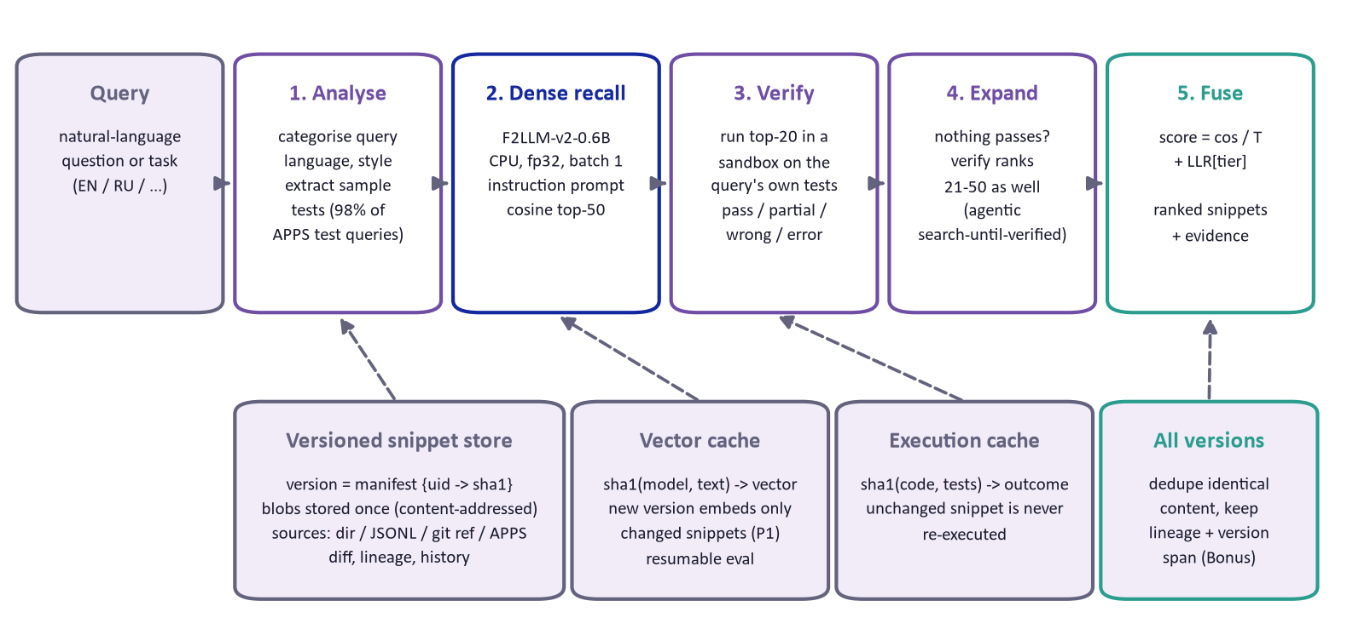
Our Solutions & Architecture Diagram
Search, then verify: dense recall finds candidates; executing them on the query's own sample tests decides the ranking. Every vector and execution result is content-addressed, so versions share work.

Slide 5
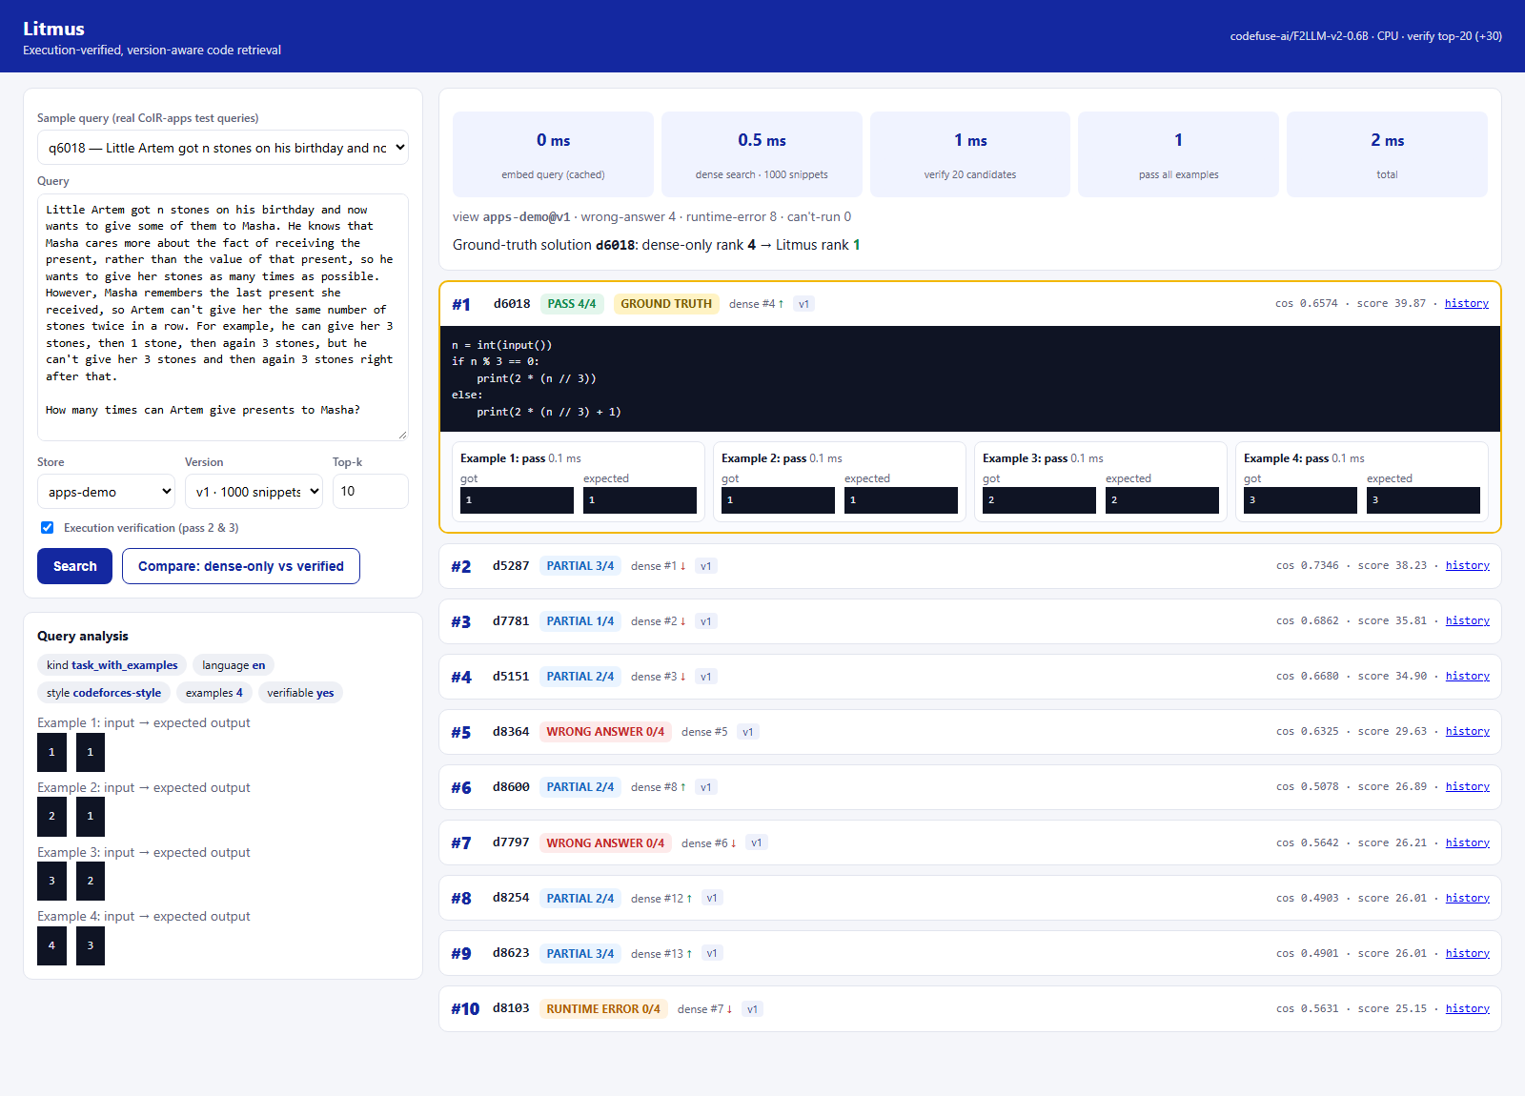
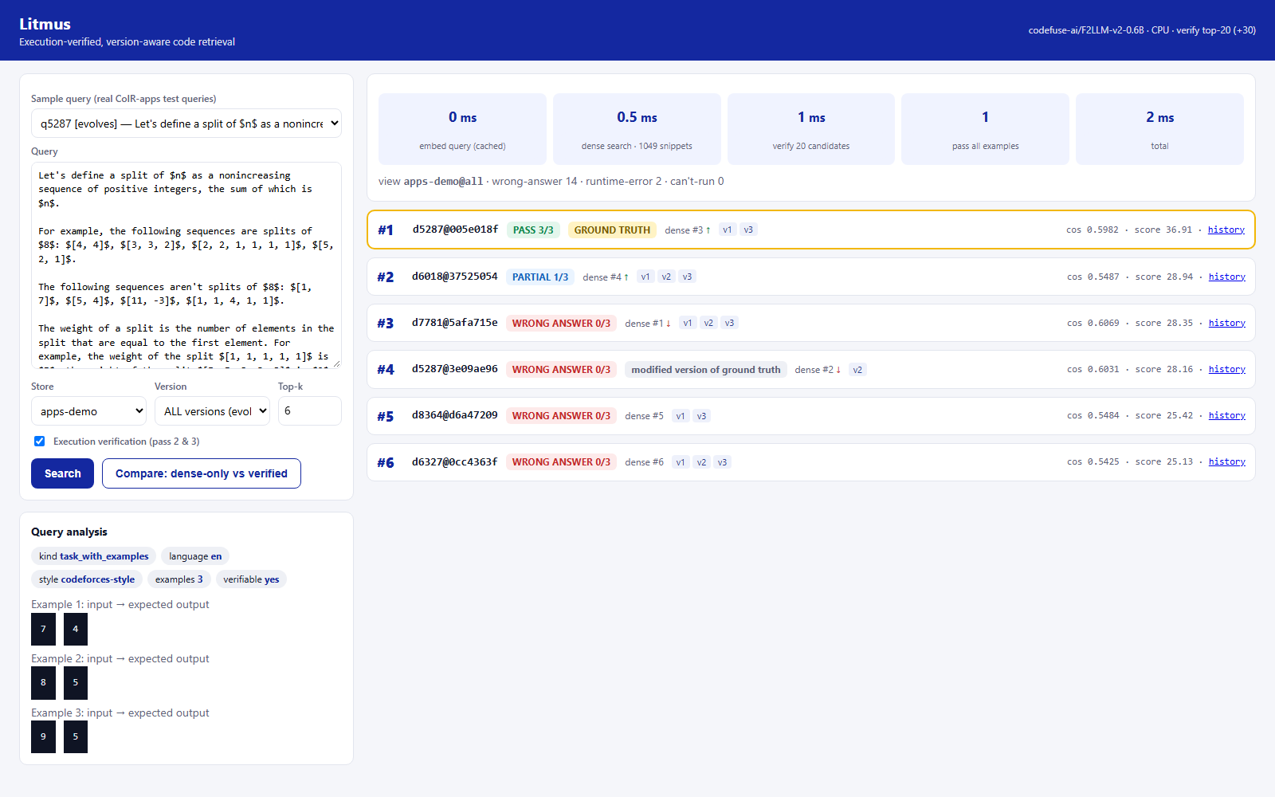
Demo & Product Walkthrough
Across all versions (Bonus)
q5287: v2 regression 'n // 2' -> 'n // 3' is dense #2; it fails 0/3 examples and drops to #4.
The correct content (identical in v1 and v3) ranks #1 with 3/3 passing.
Real test query q6018: dense retrieval ranks the ground truth #4; it is the only candidate that reproduces all 4 sample outputs -> Litmus #1 (20 candidates verified in ~20 ms).
Run: litmus serve -> http://127.0.0.1:8000 | CLI: litmus search @demo/queries/q5287.txt --store apps-demo --version all

Slide 6
Tools and tech stack used
Retrieval model
codefuse-ai/F2LLM-v2-0.6B (Apache-2.0)
sentence-transformers + PyTorch CPU fp32
batch-1 CPU inference (2.7x faster)
Evaluation
MTEB 2.21 - AppsRetrieval
HF datasets (CoIR-apps, pinned revision)
own NDCG / MRR / Recall checks
Execution sandbox
persistent Python worker pool
PEP 578 audit hooks, fd redirection
Job Objects / RLIMIT_AS, watchdog
Versioned storage
content-addressed SQLite caches
JSON manifests (git-tree style)
ingest: dir, JSONL, git ref, AST chunks
Product
FastAPI + Uvicorn API
single-page web UI (no build step)
`litmus` CLI
Engineering
pytest suite (fake embedder)
Python 3.12, Windows + Linux
Kaggle GPU for the one-off official benchmark run

Slide 7
Impact & Use case
AI coding agents: fetch code that is proven to behave as asked before editing it - fewer wrong-file edits
Regression hunting: 'which version still passes this failing example?' - search across versions by behaviour
On-device / air-gapped code search: CPU only, no code leaves the machine - fits internal code bases
Incremental indexing for fast-moving repos: a commit costs only the changed functions
Explainable ranking: every result shows the evidence (outputs vs expected), not just a score
0.903 -> 0.967
official NDCG@10 on the full test split: same 0.6B model alone -> with Litmus
30.0% -> 10.0%
buggy version ranked above the correct one (all-versions search)
50 of 995
snippets re-embedded to index a new version (only the changed ones)

Slide 8
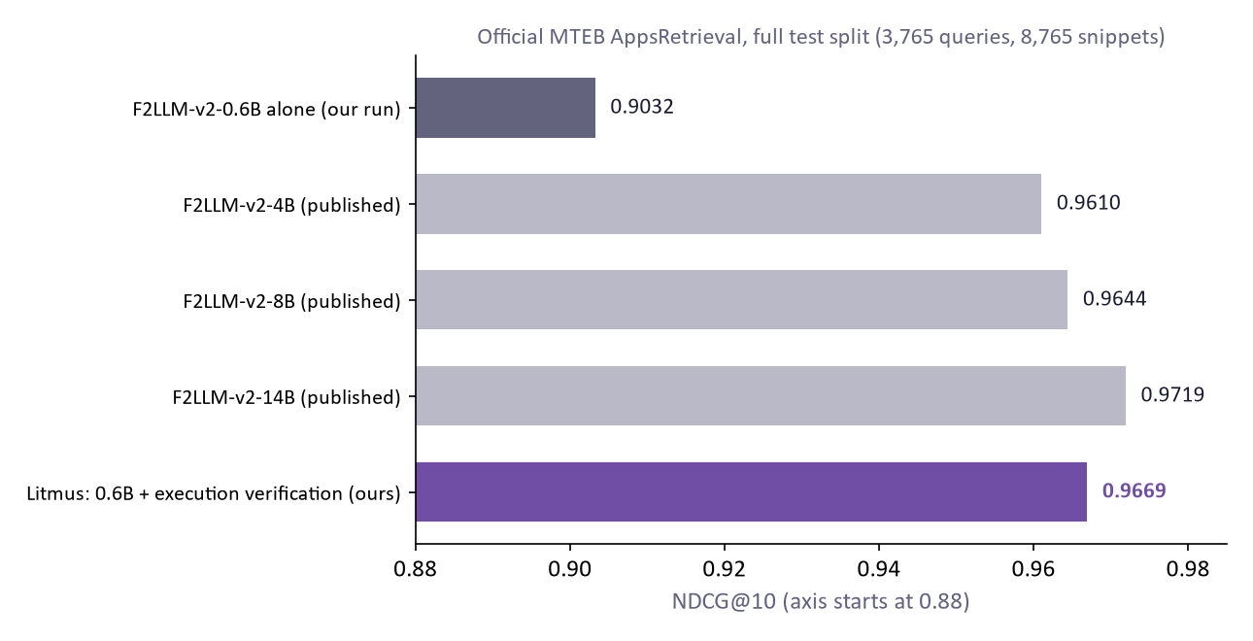
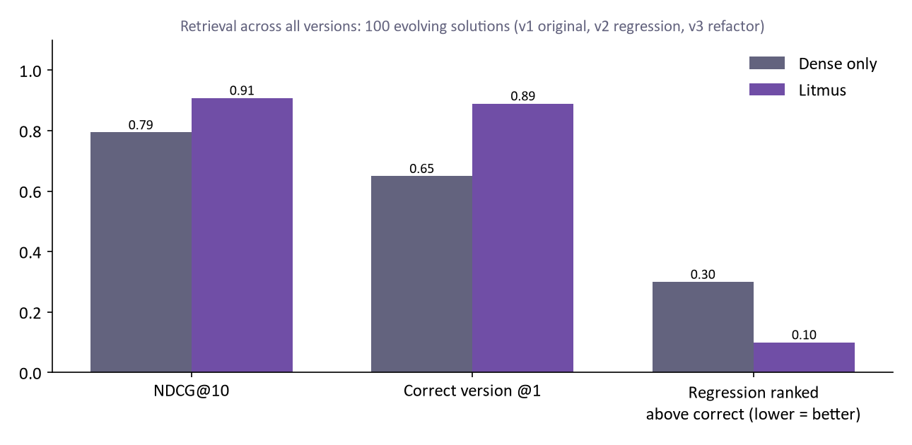
Innovation highlights, results and limitations
Limitations (honest)
Official full test split: NDCG@10 0.9669 / MRR@10 0.9604 (dense-only 0.9032). Embedding for this one-off run used a Kaggle GPU; same fp32 model, the system itself runs on CPU
Leaderboard models are search-only; Litmus adds a verification step, so it is a pipeline, not a single embedding model
Fusion weights are hand-set priors (not fitted); queries without sample tests fall back to dense ranking

Slide 9
What’s next
Multiple-answer problems: task-specific checkers so 'print any valid answer' solutions can pass
Learned fusion: fit the evidence weights on the CoIR train split (5,000 queries) instead of hand-set priors
More evidence: function-level harnesses (Solution().method calls) and generated extra test inputs
Diff-aware queries: 'which commit changed the parsing of X?' using version deltas
Scale-out: HNSW index, OpenVINO / ONNX int8 with calibration, container sandbox (gVisor)
IDE / agent integration: expose search + verify as a tool for coding agents

Slide 10
Brownie points slide( differentiation)
Verify, don't just match
Executes candidates on the query's own examples. Gold solution passes all its examples in 90.8% of 600 sampled test queries; 1 of 3,000 random snippets do.
Versions by construction
Git-tree-like manifests + content-addressed vectors and execution results: a new version costs only what changed; reverts cost nothing.
Evolution-aware ranking
Near-identical versions are separated by behaviour, not text; regressions drop below correct versions.
CPU-first, measured
bf16 -> fp32, batch-1 (2.7x), persistent sandbox workers (ms per check); int8 rejected on measured fidelity.
Robust to real data
Russian statements, AtCoder/Codeforces/CodeChef formats, Python-2 and function-body snippets, numpy.
Honest and reproducible
Official MTEB path (AbsEncoder + SearchProtocol), every number scripted, pending items labelled, AI disclosure.

Slide 11
Checklist- Updated on Public GitHub
Working prototype code — public or shared GitHub repo (Y/N) -> Y - https://github.com/kanika190905/litmus
README with reproducible setup instructions (Y/N) -> Y
Demo video, max 5 minutes (YouTube or Drive link) -> https://github.com/kanika190905/litmus/blob/main/demo/Video%20Project.mp4
Presentation file (PPT or PDF) (Y/N) -> Y
AI disclosure (AI_DISCLOSURE.md) -> Y
APK / SDK -> N/A - Python package + web app, no mobile component
Release v1.0.0 + MTEB result JSON -> Y - results/appsretrieval_results.json

Slide 12
Thank you
Organised by the Language AI Team and the PRISM Team, Samsung R&D Institute India
Notes:
Closing slide. Add the Google Form URL and a contact email before sharing. Edition 2 organising team for reference: Language AI - Sourabh Tiwari, Gaurav, Sanjeeth Pothireddy, Gorang Maniar; PRISM - Binny Lakra, Prakhar Chandrakar, Vishu Kumar; Kick-off and mentors - Giridhar Jakki, Deepraj Prabhakar Patkar (Language AI), Srimanu Prasad Nagaraju, Ashish Kumar (Tech Strategy).

