Slide 1
BDAT -1004
DATA PROGRAMMING
FINAL PROJECT
GROUP -4

Slide 2
ABOUT US
KANIKA KHURANA (Team Leader)
B.Tech (Computer Science)
Artificial Intelligence (PG-Diploma)
NAVNEET SINGH (Developer)
B.Sc (Non-Medical)
PRINCE SINGLA (Business Analyst)
B.Sc (Non-Medical)
SAMARJEET SINGH (Data Analyst)
B.Sc (Non-Medical)
GURSHARAN SINGH SIBIA (Project Manager)
B.Sc (Non-Medical)

Slide 3
Project Data
01
Get the CSV data using requests library.
02
Store the data in a mongoDB cloud cluster.
03
Perform DataVisualisation and analysis using matplotlib and seaborn.
04
Build a WebApp using Python and Django

Slide 4
Data Fetching

Slide 5
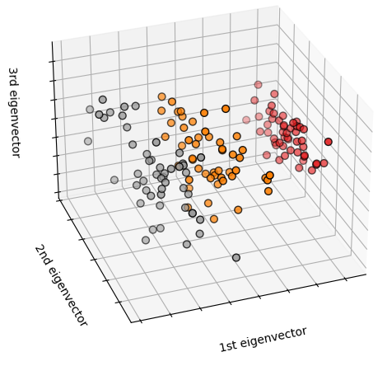
IRIS dataset
This data sets consists of 3 different types of irises’ (Setosa, Versicolour, and Virginica) petal and sepal length.
The size of the dataset is 149x5.
The rows being the samples and the columns be being: Sepal Length, Sepal Width, Petal Length and Petal Width and Category.
It contains 149 rows to iris flower data.
We will use python request library to get the dataset.

Slide 6
Clean Dataset for Usage
Use the Pandas library to gain details about the data.
Check for null values in the rows.
Check for repetition of rows.
Check for outliers in the data.
Delete the repeated rows and rows with null values
Delete the rows containig outliers.

Slide 7
Data Storage

Slide 8
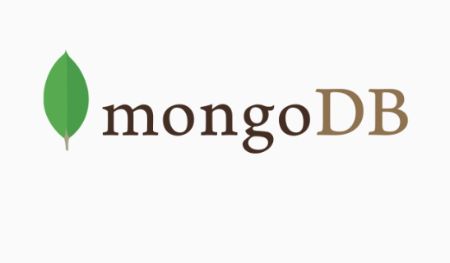
Cloud Storage
Why MongoDB
It supports ad hoc queries and indexing
It has an automatic load balancing configuration
MongoDB supports Master Slave replication.
Supports map reduce and aggregation tools.
Uses JavaScript instead of Procedures.
It is a schema-less database written in C++.
Provides high performance.
Stores files of any size easily without complicating your stack.
Easy to administer in the case of failures.

Slide 9
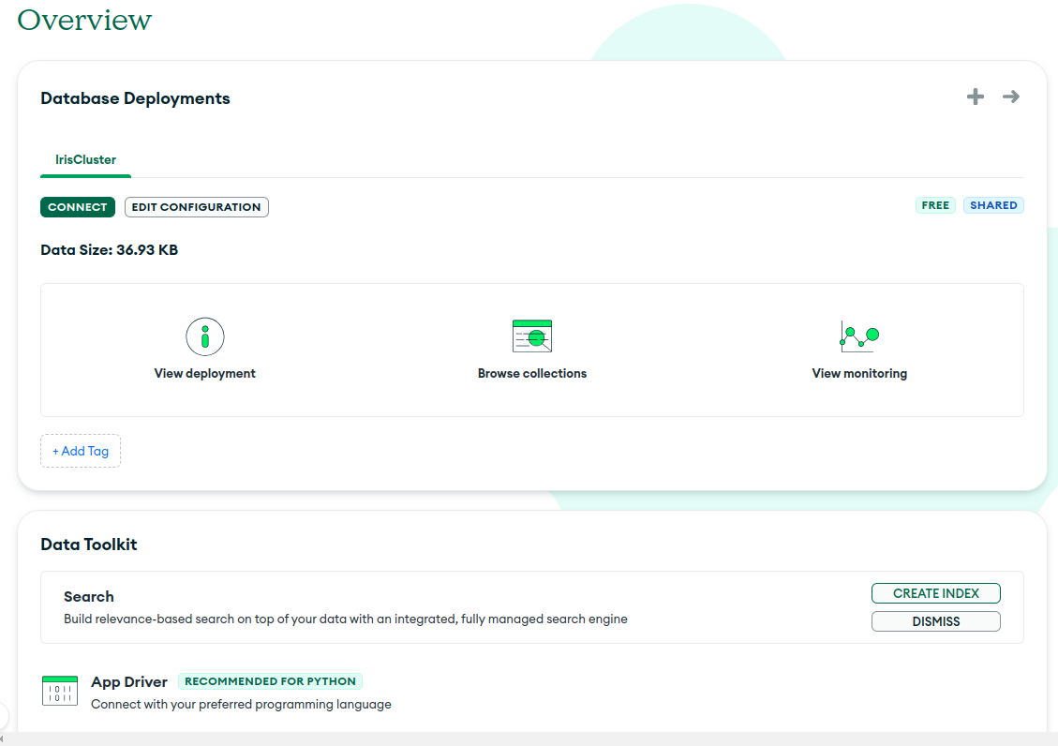
Store data in a cloud cluster
Create a MongoDB account
Select a cloud provider and a region.
Specify a cluster name and create a cluster
Now a cluster will be created
Create a user to grant access to data base
Select “Connect Your Application.”
Choose a driver eg. python or nodejs
Get the connection string
Create a Database and a collection to store data

Slide 10
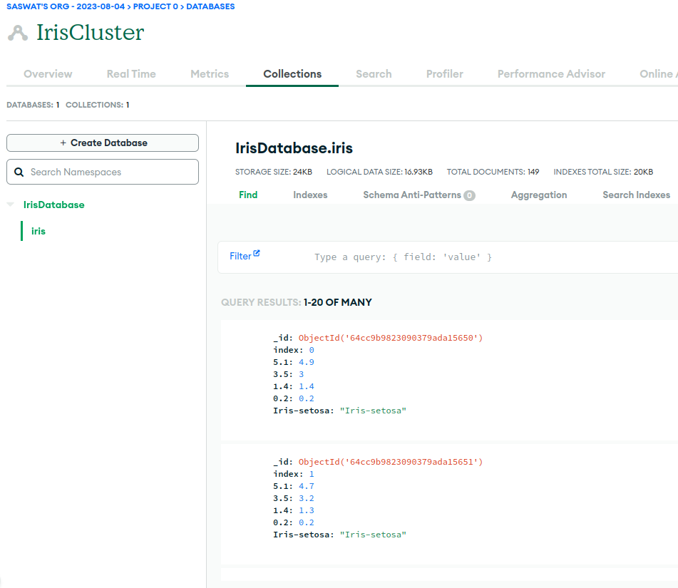
Connection and Data Insertion
Use Pandas to read the csv file
Connect to MongoDB using the connection string
Specify your username and password in the
connection string
Use the database and collections name to
access the collection
Convert the dataframe to a dictionary format
using to_dict() function
Insert into the collection using the insert_many() function.

Slide 11
Data Visualisation

Slide 12
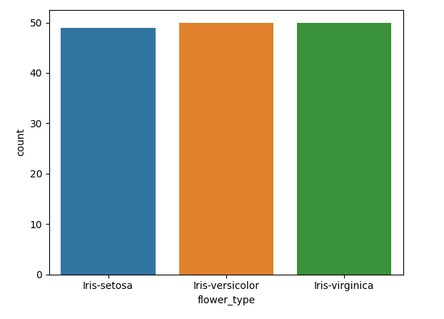
CountPlot
The dataset contain 3 varieties of flower species
Iris-Setosa – 49 counts
Iris-Versicolor – 50 counts
Iris-Virginica – 50 counts

Slide 13
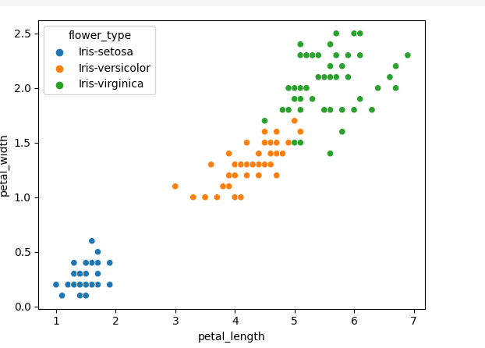
ScatterPlot
Species Setosa has smaller petal lengths and widths.
Versicolor Species lies in the middle of the other two species in terms of petal length and width
Species Virginica has the largest of petal lengths and widths.

Slide 14
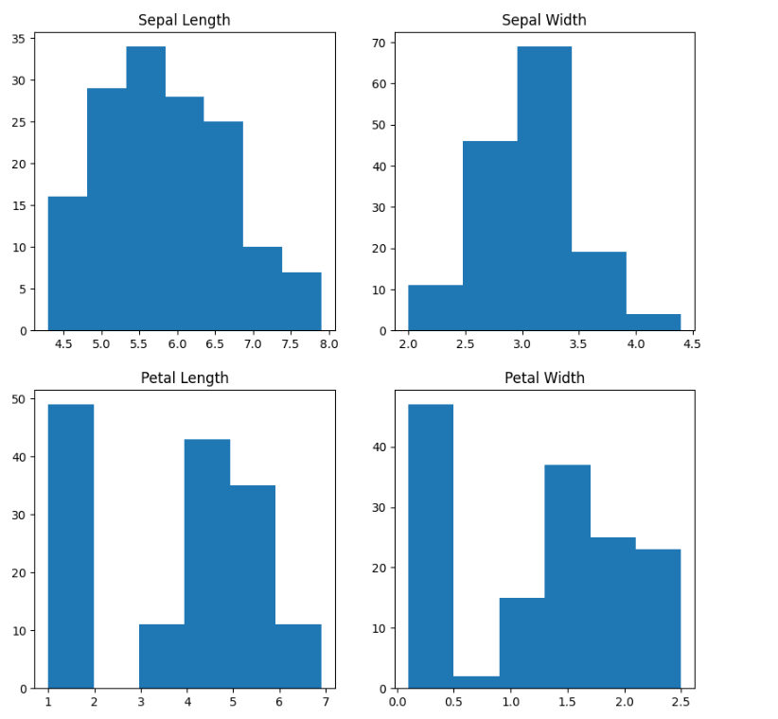
Histogram
The highest frequency of the sepal length is between 30 and 35 which is between 5.5 and 6
The highest frequency of the sepal Width is around 70 which is between 3.0 and 3.5
The highest frequency of the petal length is around 50 which is between 1 and 2
The highest frequency of the petal width is between 40 and 50 which is between 0.0 and 0.5

Slide 15
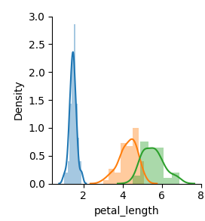
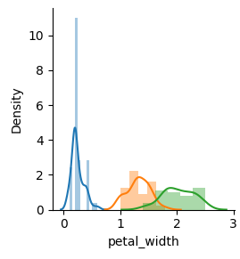

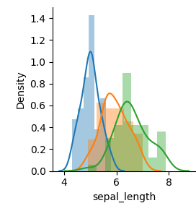
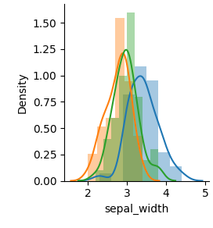
Histogram with DistPlot
In the case of Sepal Length, there is a huge amount of overlapping.
In the case of Sepal Width also, there is a huge amount of overlapping.
In the case of Petal Length, there is a very little amount of overlapping.
In the case of Petal Width also, there is a very little amount of overlapping.

Slide 16
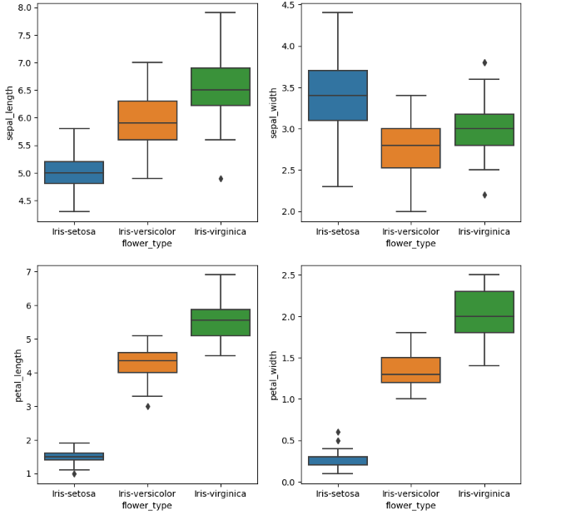
BoxPlot
Species Sentosa has the smallest features and less distributed with some outliers.
Species Versicolor has the average features.
Species Virginica has the highest features

Slide 17


Django WebApp
Install Django in your local machine and start a new django project
01
Create a superuser and migrate changes into default sqlite database.
02
Crete a table to store iris data, register it in admin and migrate changes
03
Configure URL and write the logic inside a view function to fetch data from model and render it in a template.
04
Go to localhost:8000 to see the rendered content. You can go to localhost:8000/admin to manage the webapp as an adminstrator.
05

Slide 18
Thank you

