Slide 1
Capstone Project
ML PROJECT-CLASSIFICATION
(CREDIT CARD DEFAULT PREDICTION)
By
Kanika Raj

Slide 2
What is a credit card?
A credit card is a payment card issued to users (cardholders) to enable the cardholder to pay a merchant for goods and services based on the cardholder's accrued debt (i.e., a promise to the card issuer to pay them for the amounts plus the other agreed charges). The card issuer (usually a bank or credit union) creates a revolving account and grants a line of credit to the cardholder, from which the cardholder can borrow money for payment to a merchant or as a cash advance. There are two credit card groups: consumer credit cards and business credit cards. Most cards are plastic, but some are metal cards (stainless steel, gold, palladium, titanium, and a few gemstone-encrusted metal cards).
In short, we can say that a credit card is a financial instrument issued by banks with a pre-set credit limit that helps you make cashless transactions. The card issuer determines the credit limit based on your credit score, credit history, and income.

Slide 3
Benefits to Credit Cardholders
The main benefit to the credit cardholder is convenience. Compared to debit cards and checks, a credit card allows small short-term loans to be quickly made to a cardholder who need not calculate the balance remaining before every transaction, provided the total charges do not exceed the maximum credit line for the card.
One financial benefit is that no interest is charged when the balance is paid in full within the grace period. Different countries offer different levels of protection.
Many credit cards offer benefits to cardholders. Some benefits apply to products purchased with the card, like extended product warranties, reimbursement for decreases in price immediately after purchase (price protection), and reimbursement for theft or damage to recently purchased products (purchase protection). Other benefits include various types of travel insurance, such as rental car insurance, travel accident insurance, baggage delay insurance, and trip delay or cancellation insurance.
Credit cards may also offer a loyalty program, where each purchase is rewarded based on the price of the purchase. Typically, rewards are either in the form of cashback or points. Points are often redeemable for gift cards, products, or travel expenses like airline tickets. Some credit cards allow the transfer of accrued points to hotel and airline loyalty programs.

Slide 4
How credit card default happens?
Whenever you accept a credit card, you agree to certain terms and conditions including making your minimum payment by the due date listed on your credit card statement.
When you miss the minimum payment by 6 months or more in a row, your credit card will be in default. In such situations, your credit card issuer will first send several notices via email or SMS and call you asking to make the payment. If you do not make the payment after a stipulated period, they will close your account and report the default to the credit bureaus.
This tends to impact your credit score, and it will be difficult for you to get approved for loans in the future. Once you are listed as a credit card defaulter, you become a risk for any credit obligation.

Slide 5
Problem Statement
This project is aimed at predicting the case of customers default payments in Taiwan.
From the perspective of risk management, the result of predictive accuracy of the estimated probability of default will be more valuable than the binary result of classification; 'credible' or 'not credible' clients.
We can use the K-S chart to evaluate which customers will default on their credit card payments.

Slide 6
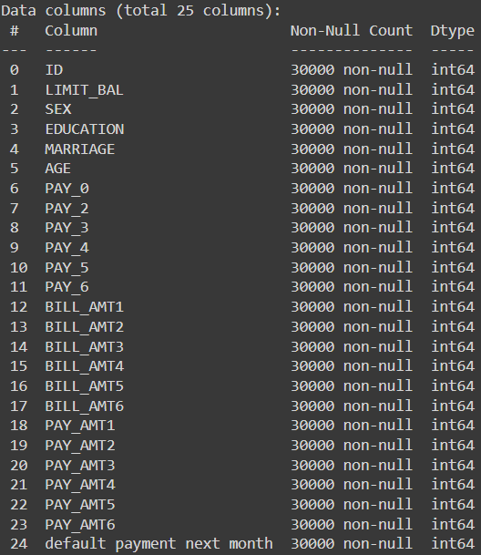
Data Description.
In this table we can see that our dataset has 25 columns in which there are 24 independent variables and 1 target variable.
We can see that data type of each column is int64.
‘default payment next month’ is our target variable.

Slide 7
Data Pipeline
Exploratory Data Analysis (EDA): In this part we have done some EDA on the features to see the trend.
Data Pre-Processing: In this part we went through each attributes and encoded the categorical features.
Model Creation: Finally in this part we created the various models.
These various models are being analysed and we tried to study various models to get the best performing model for our project.

Slide 8
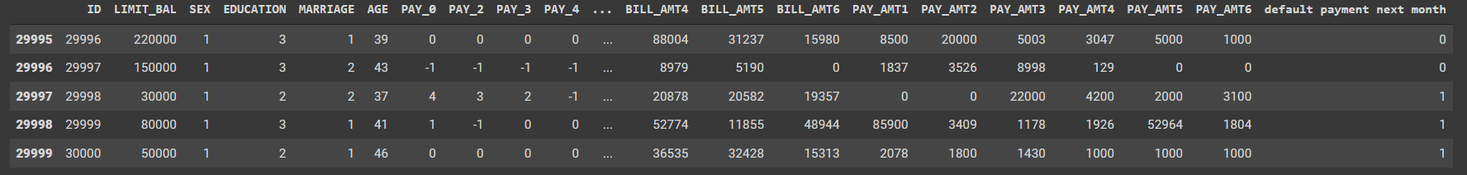
DATA SUMMARY & INSIGHTS
This dataset contains 30,000 rows with 25 numerical columns.
There are No Missing, Duplicate and null Values present in the Dataset.
The column ‘LIMIT_BAL’ shows the remaining credit limit of the user in their credit card.
We also renamed the column such as: PAY_0:PAY_SEPT,PAY_2:PAY_AUG,PAY_3:PAY_JUL,PAY_4:PAY_JUN, PAY_5:PAY_MAY,PAY_6:PAY_APR,BILL_AMT1:BILL_AMT_SEPT,BILL_AMT2:'BILL_AMT_AUG,BILL_AMT3:BILL_AMT_JUL,BILL_AMT4:BILL_AMT_JUN,
BILL_AMT5:BILL_AMT_MAY,BILL_AMT6:BILL_AMT_APR,PAY_AMT1:PAY_AMT_SEPT,PAY_AMT2:PAY_AMT_AUG,PAY_AMT3:PAY_AMT_JUL,PAY_AMT4
PAY_AMT_JUN,PAY_AMT5:PAY_AMT_MAY,PAY_AMT6:PAY_AMT_APR, SEX:GENDER,
default payment next month:default_payment_next_month.
We did one hot encoding on the following columns-’EDUCATION’, ’MARRIAGE’,’SEX’ to an alphabetical data.
And ﬁnally we have ‘default payment next month’ variable which we need to predict for new observations.

Slide 9
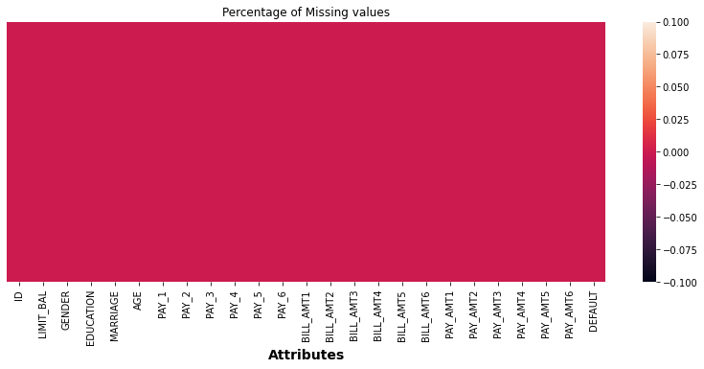
EDA ANALYSIS OF THE DATASET
Visualizing missing Values
As we can visualize from this heatmap that there is no missing values in this dataset

Slide 10
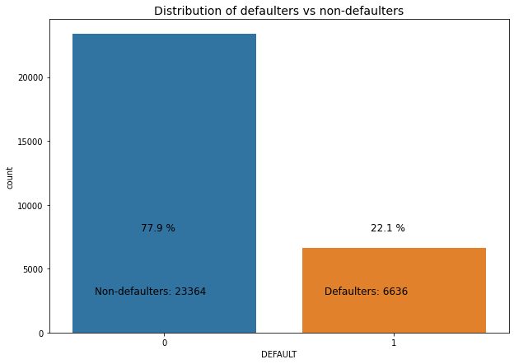
Defaulters vs non-defaulters
The above bar graph depicts that there are total 23,364(77.9%) non-defaulters and 6,636 (22.1%) defaulters in our dataset.

Slide 11
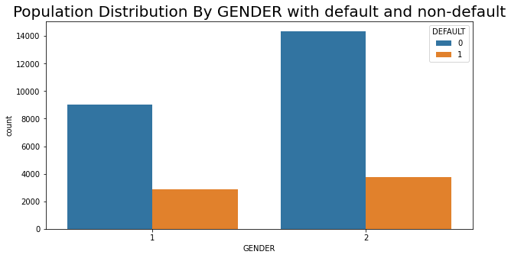
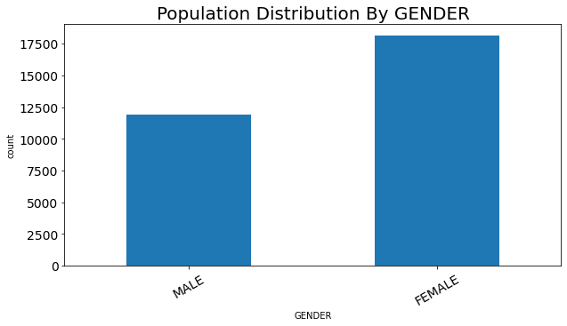
Population Distribution by Gender
0- Non-default
1- Default
The bar graph comparison represents that there are more number of female credit card holders in comparison with male and hence the number of defaulters are also more from the female category.

Slide 12
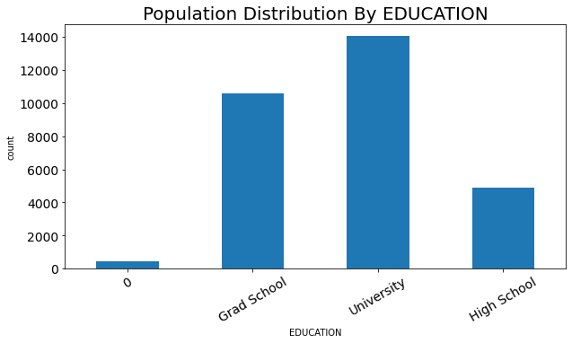
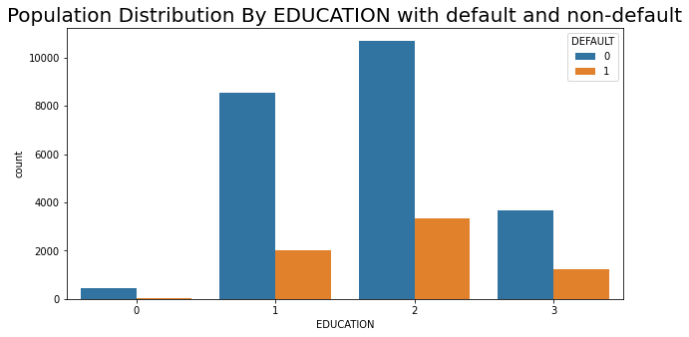
Population Distribution by Education
The above columns shows 4 different categories in which we can see that credit card users are the highest from the university, and most number of the defaulters are also from the same.
The ‘0’ category involves high paying job individuals and business man by which it becomes easy for them to repay their bills on time. This is why this column has the lowest number of defaulters.

Slide 13
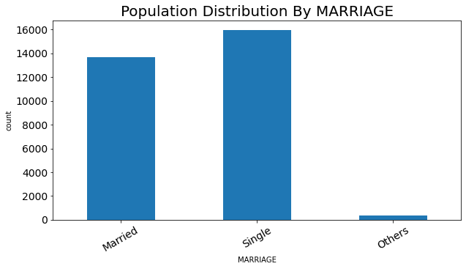
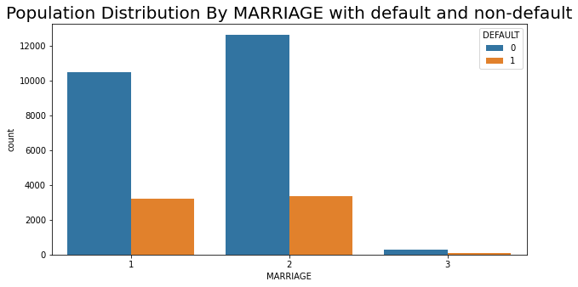
Population Distribution by Marriage
Married people have higher default proportions than single folks. While there are intuitive arguments for and against it, closer inspection is needed. For example, is there a difference between married men and married women?
Also, we notice that there is a marriage category with value 0. Like earlier, since there is an Others category, we will cluster these points with that category.

Slide 14
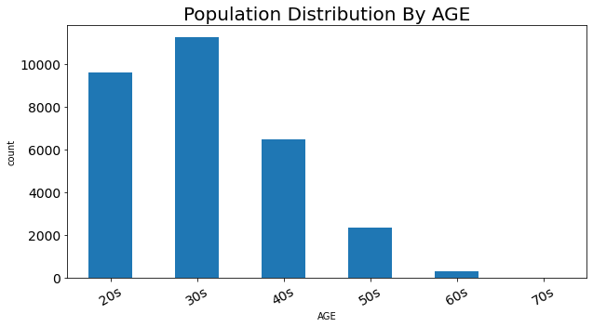
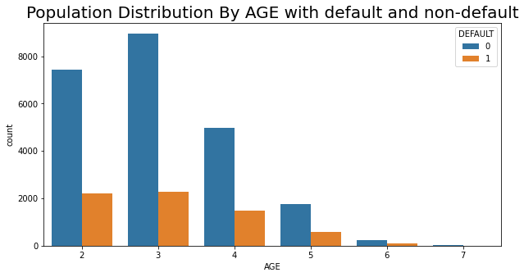
Population Distribution by Age
People in their 20s and 30s holds the highest number of credit cards and slowly decreases with age.
Although there is no monotonic trend in the default rate, there is some change.
we look closer into the numeric values. It is easy to see that default value is
lowest for people in their 40s and then steadily decreases with age.

Slide 15
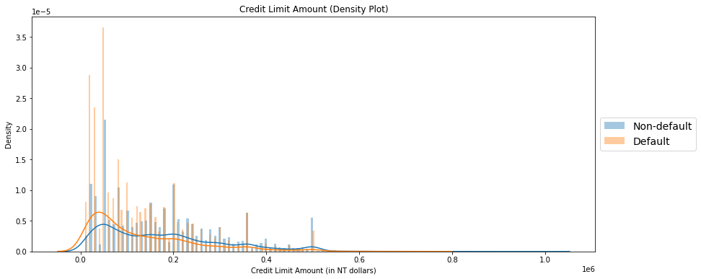
Credit Limit Visualization
Looking at the density plot, it seems that people with higher credit limit have significantly lower default proportion. Again, intuitively that is not surprising because the people who have higher credit limits must have displayed long periods of fiscal responsibility to reach that place.

Slide 16
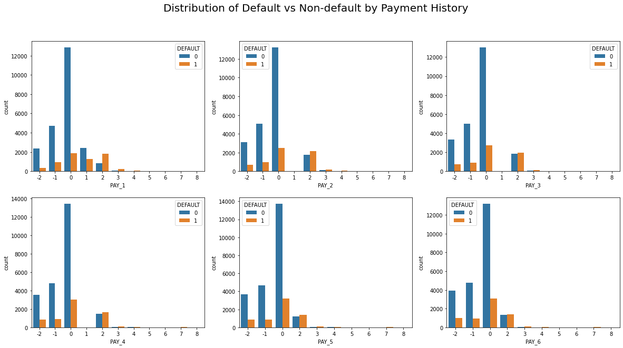
Distribution by their Payment History
As remarked earlier, we notice that if the person has defaulted for 2 months or more in the past two months, there is a very high chance of them defaulting.
A remark about the values of the payment history features. The data description mentioned that it would be taking values 1 and 1 to 9. However, I see that it takes values from 2 to 8, which is surprising.

Slide 17
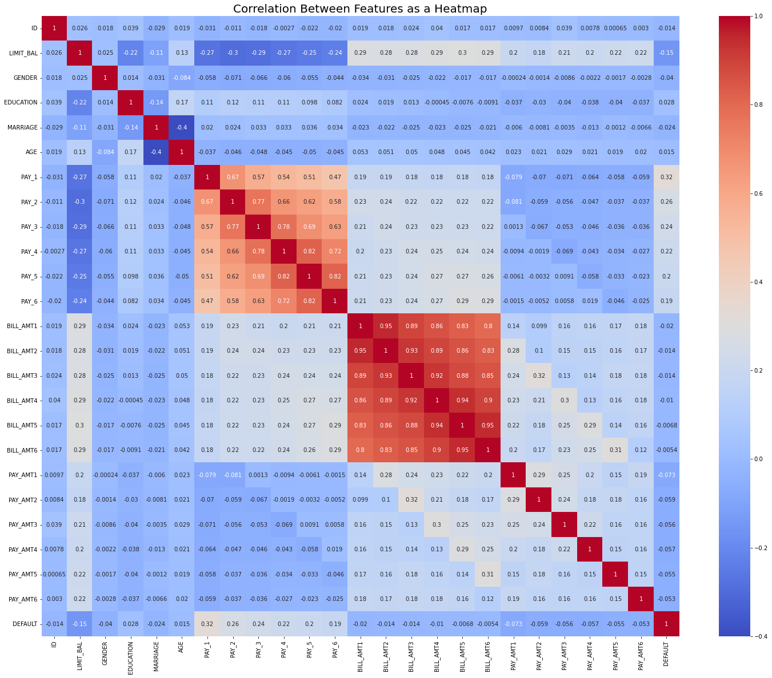
Checking Correlation With the Heatmap
What stands out are the high correlation among the payment history features and the bill amount features. Here the ‘Bill_Amt’ variable refers to their total bill for the month.

Slide 18
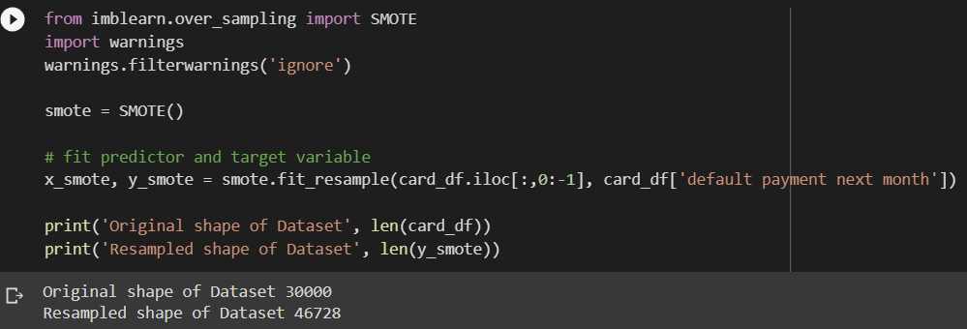
SMOTE
(Synthetic Minority Oversampling Technique)
SMOTE is an algorithm that performs data augmentation by creating synthetic data points based on the original data points. SMOTE can be seen as an advanced version of oversampling, or as a specific algorithm for data augmentation. Our dataset was also imbalanced but after implementing SMOTE technique we can see that our sample increased from 30,000 to 46,728.

Slide 19
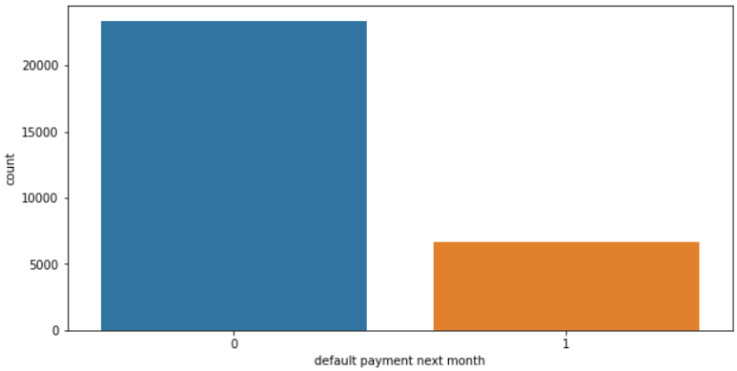
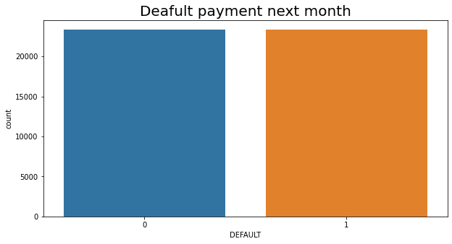
Comparison of Target Variable
Before SMOTE
After SMOTE
As we can see from above comparison that after applying SMOTE technique we can see that our imbalanced dataset is now balanced.

Slide 20
Models Used For The Dataset:
1. Logistic Regression
2. Random Forest classifier
3. XG Boost classifier
4. Decision Tree classifier
With their-:
Classification report.
Confusion matrix.
ROC-AUC Curve analysis.

Slide 21
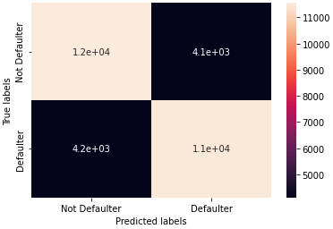
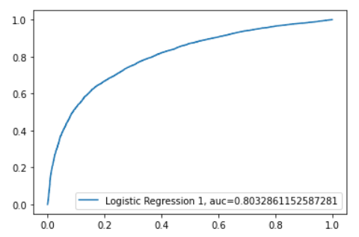
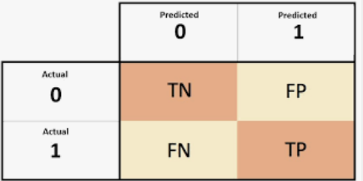
LOGISTIC REGRESSION
It is used for predicting the categorical dependent variable using a given set of independent variables.
Logistic regression predicts the output of a categorical dependent variable.
Classification Report
Confusion Matrix
ROC-AUC Curve
Receiver Operating Characteristics
Area under the curve

Slide 22
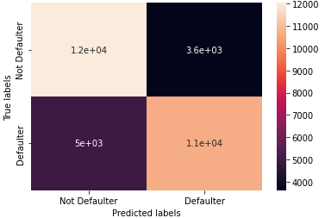
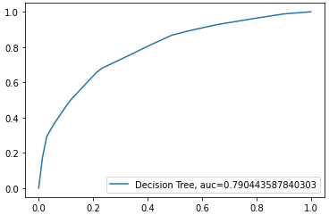
DECISION TREE
The goal of using a Decision Tree is to create a training model that can use to predict the class or value of the target variable by learning simple decision rules inferred from prior data(training data).
Classification Report
Confusion Matrix
ROC-AUC Curve

Slide 23
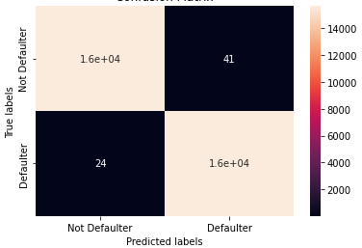
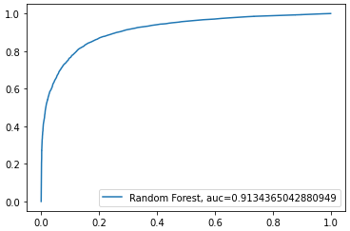
RANDOM FOREST
Random Forest is a classifier that contains a number of decision trees on various subsets of the given dataset and takes the average to improve the predictive accuracy of that dataset.
Classification Report
Confusion Matrix
ROC-AUC Curve

Slide 24
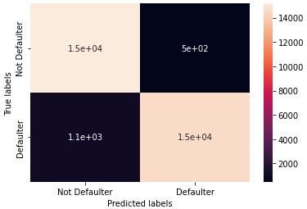
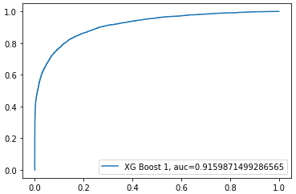
XG BOOST
XGBoost stands for “Extreme Gradient Boosting”. XGBoost is an optimized distributed gradient boosting library designed to be highly efficient, flexible and portable. It implements Machine Learning algorithms under the Gradient Boosting framework. It provides a parallel tree boosting to solve many data science problems in a fast and accurate way.
Classification Report
Confusion Matrix
ROC-AUC Curve

Slide 25
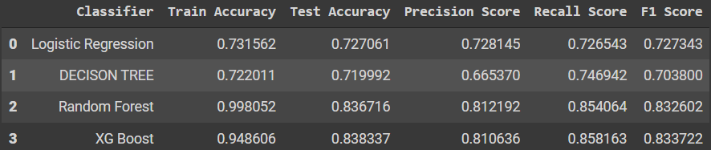
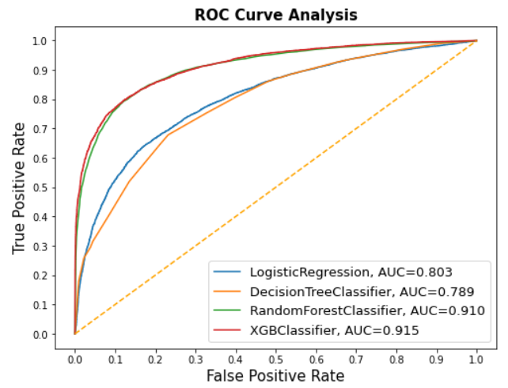
Overall Evaluation of models with ROC-AUC curve
Classification Report
ROC-AUC Curve
After looking at classification report and AUC-ROC score of all the models we can say that all the models except random forest classifier are performing well on our dataset.

Slide 26
CHALLENGES
Large dataset to handle.
Visualization and comparison of variables
Feature Engineering
Study of confusion matrix
Building of ROC-AUC curve
Required to hyperparameter tune models with Random Search cross validation.
Optimising the model for better accuracy.

Slide 27
CONCLUSION
After performing the various model we get the best accuracy form the all the models except random forest.
Random Forest is the least accurate as compared to other models as it shows overfitting of the model.
XG boost and Logistic regression has the best precision and recall Balance.
Higher recall can be achieved if low precision is acceptable.
We can deploy the model and can be served as an aid to human decision.
Model can be improved with more data and computational resources.

Slide 28
CONCLUSION continue..
The credit limit is a good indicator of financial stability. Whatever mechanism the bank is currently using works well and some of the features that go into choosing the credit line can be used directly in the model for default prediction.
It is important to have models deployed on the cloud with live customer interaction through app or mobile phone so that suspicious activities/a missed payment can be verified real-time with a text message or a push notification.
The precision-recall trade-off is something that will need to be closely looked at. We could improve our recall but that would come at cost of precision. It might be worth treating this as a regression problem to model the total amount of money lost by the bank instead of a binary classification problem.

Slide 29


