Slide 1

Capstone Project- 2
Supervised ML-Regression (Bike Sharing Demand Prediction)
By Team GodSpeed
Kanika Raj

Slide 2
CONTENTS
❏ BUSINESS UNDERSTANDING
❏ DATA SUMMARY
❏ FEATURE ANALYSIS
❏ EXPLORATORY DATA ANALYSIS
❏ DATA PREPROCESSING
❏ IMPLEMENTING ALGORITHMS
❏ CHALLENGES
❏ CONCLUSIONS

Slide 3
BUSINESS UNDERSTANDING
Bike rentals have become a popular service in recent years, and it seems like people are using them more often. With relatively cheaper rates and the ease of pick-up and drop-off at people's convenience, this is what makes this business thrive.
This service is mostly used by those who have no personal vehicles.
And also, some people prefer rental bikes to avoid congested public
transport.
Therefore, for the business to strive and profit more, it has to always be ready to supply an adequate number of bikes at various locations to meet the demand.
Our project goal is to pre-plan the prediction of bike count values that can be a handy solution to meet all the demands.

Slide 4
Problem Statement
Currently Rental bikes have been introduced in many urban cities for the enhancement of mobility and comfort. It is important to make the rental bikes available and accessible to the public at the right time, as it lessens the waiting time. Eventually, providing the city with a stable supply of rental bikes becomes a major concern. The crucial part is the prediction of the bike count required at each hour for the stable supply of rental bikes.

Slide 5
Data Pipeline
Exploratory Data Analysis (EDA): In this part we have done some EDA on the features to see the trend.
Data Preprocessing: In this part we went through each attributes and encoded the categorical features.
Model Creation: Finally in this part we created the various models.
These various models are being analysed and we tried to study various models to get the best performing model for our project.

Slide 6
Data Description:
Independent variables:
Date : year-month-day
Hour - Hour of the day
Temperature-Temperature in Celsius
Humidity - %
Windspeed - m/s
Visibility - 10 m
Dew point temperature - Celsius
Solar radiation - MJ/m2
Rainfall - mm
Snowfall - cm
Seasons - Winter, Spring, Summer, Autumn
Holiday - Holiday/No holiday
Functional Day – No Func(Non Functional Hours), Fun(Functional hours)
Dependent variable:
Rented Bike count - Count of bikes rented at each hour

Slide 7
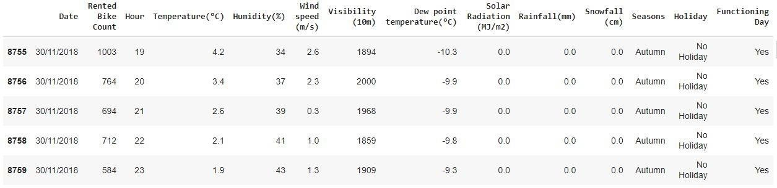
DATA SUMMARY
This Dataset contains 8760 lines and 14 columns.
Three categorical features ‘Seasons’, ‘Holiday’, & ‘Functioning Day’.
One Datetime features ‘Date’.
We have some numerical variables such as temperature, humidity, wind, visibility, dew point temperature, solar radiation, rainfall, snowfall, which describe the environmental conditions at that particular hour of the day.

Slide 8
INSIGHTS FROM OUR DATASET
There are No Missing, Duplicate and null Values present in the SeoulBike Dataset.
And ﬁnally we have 'rented bike count' variable which we need to predict for
new observations.
The dataset SeoulBike shows hourly rental data for one year i.e. 1 Dec 2017 to 31 Nov 2018 (365 days).we consider this as a single year data.
So we convert the "date" col. into 3 different columns i.e. Year, month, day.
We change the name of some features for our convenience, they are as below:
'Rented_Bike_Count', 'Hour', 'Temperature', 'Humidity', 'Wind_speed',
'Visibility', ‘Dew_point_temperature', 'Solar_Radiation', 'Rainfall', 'Snowfall', 'Seasons', 'Holiday', 'Functioning_Day', 'month','weekdays_weekend’.

Slide 9
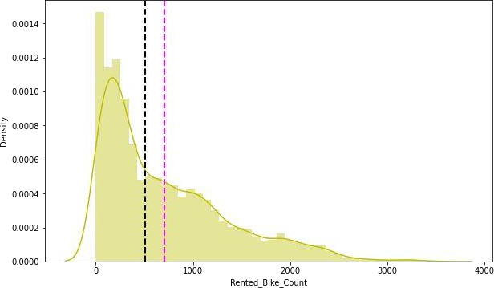
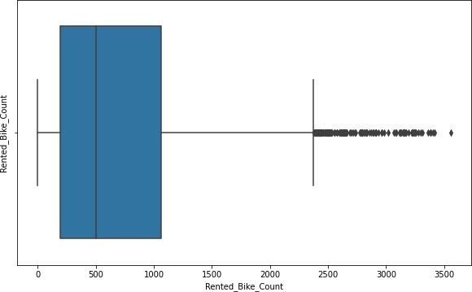
ANALYSIS OF RENTED BIKE COLUMN
The above graph shows that Rented Bike Count has moderate right skewness.
The above right side boxplot shows that we have detected outliers in Rented Bike Count column.
Since the assumption of linear regression is that 'the distribution of dependent variable has to be normal', so we should perform Square root operation to make it normal.

Slide 10
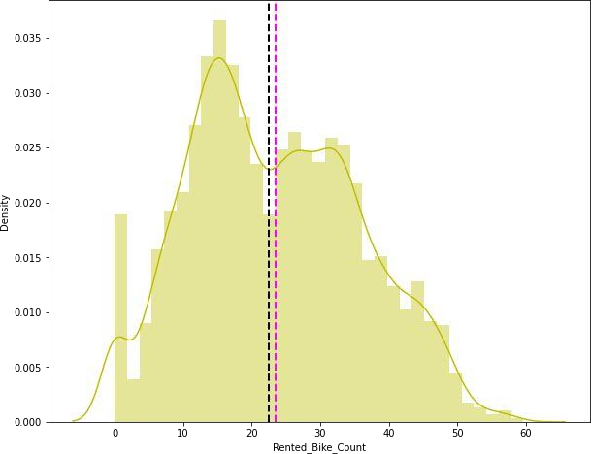
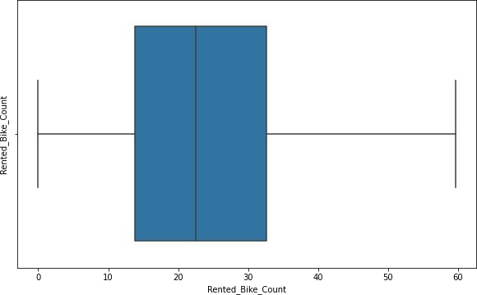
ANALYSIS OF RENTED BIKE COLUMN
As we can see in the histogram graph, after applying Square root to the skewed Rented Bike Count, we get an almost normal distribution.
After applying Square root operation, there are no outliers present in the Rented Bike Count column as shown above in right-side box plot.

Slide 11
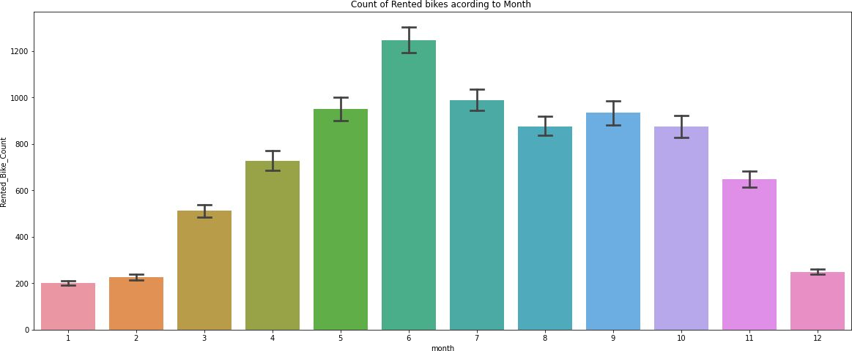
ANALYSIS OF MONTH VARIABLE
From the above bar plot, we can clearly show that the demand for the rented bike is high from the 5th to the 10th month as compared to other months, and these months represent the summer season.

Slide 12
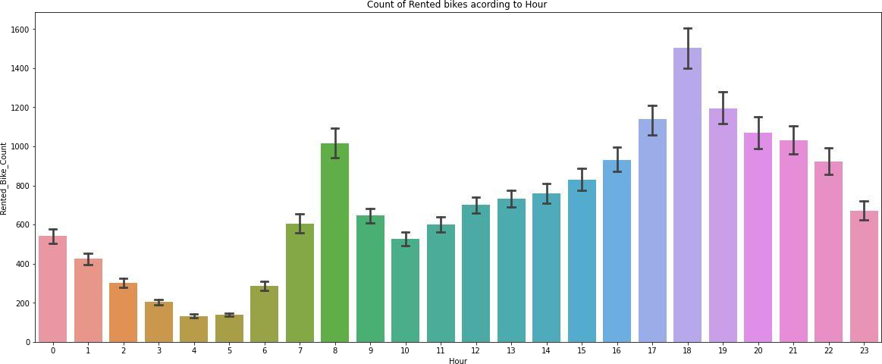
ANALYSIS OF HOUR VARIABLE
The above bar plot describes the use of rented bike count according to the ‘hour’ and the data shown for a year or 365 days.
It is clear from the graph that generally people use rented bikes
during their working hours from 7 am to 9 am and 5 pm to 7 pm.

Slide 13
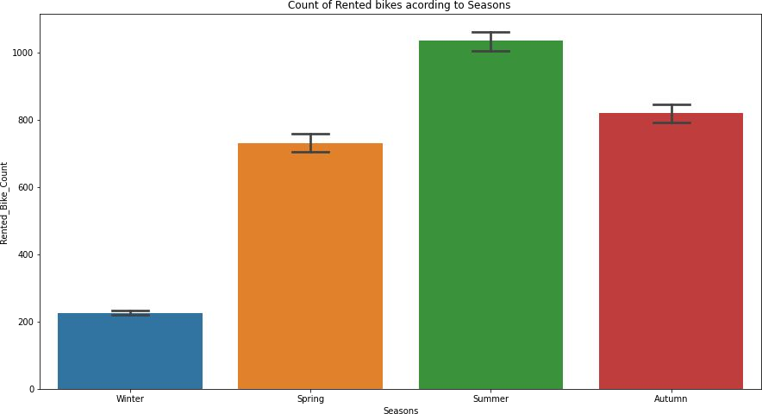
ANALYSIS OF SEASON VARIABLE
The above bar plot shows the distribution of rented bike counts seasonally.
And we can see that most people prefer to ride bikes in the summer and autumn seasons.
Conversely, the winter season has the lowest number of rented bikes, and it may be
because of heavy snowfall.

Slide 14
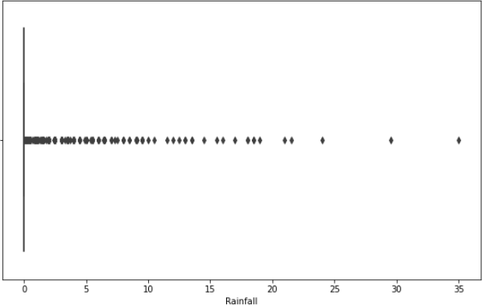
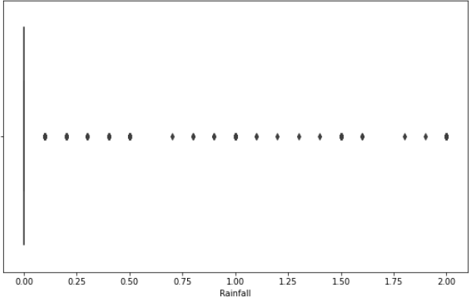
Detection and Treatment of outliers on numerical columns.
After Trimming
Trimming is one of the techniques for treating outliers in which we trim the outliers equal to the normal values of the column.
In the above plot, we can see that column 'Rainfall' has many outliers reaching a maximum point of 35, but after trimming them we can see that the outliers' maximum range is capped to 2.

Slide 15
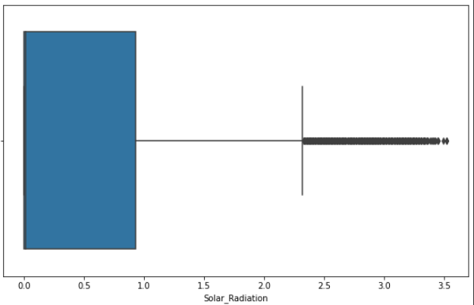
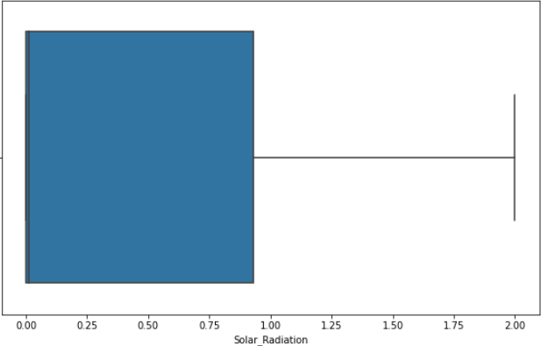
Detection and Treatment of outliers on numerical columns.
After Trimming
Trimming technique on 'Solar_Radiation' column.
In the above plot, we can see that column 'Solar_Radiation' has many outliers reaching a maximum point of 3.5, but after trimming them we can see that there are no more outliers.

Slide 16
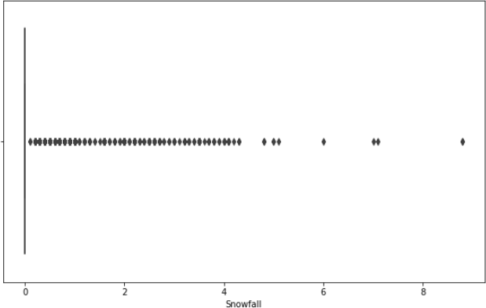
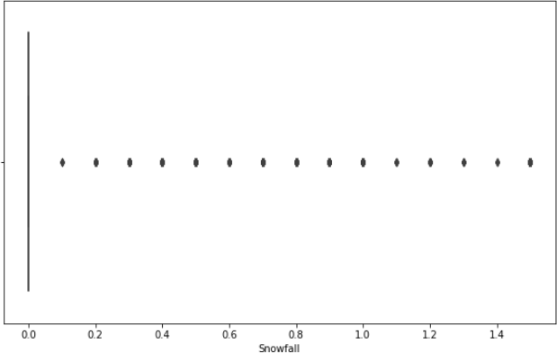
Detection and Treatment of outliers on numerical columns.
After Trimming
Trimming technique on 'Snowfall' column.
In the above plot, we can see that column 'Snowfall' has many outliers reaching a maximum point of 8.5, but after trimming them we can see that the outliers are now capped to 1.5.

Slide 17
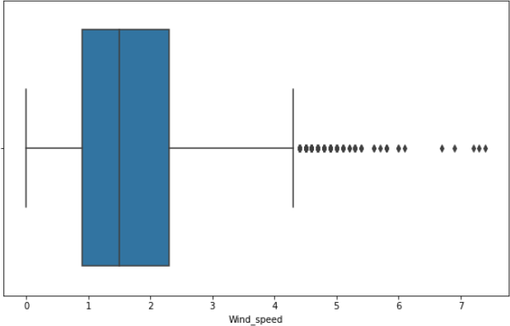
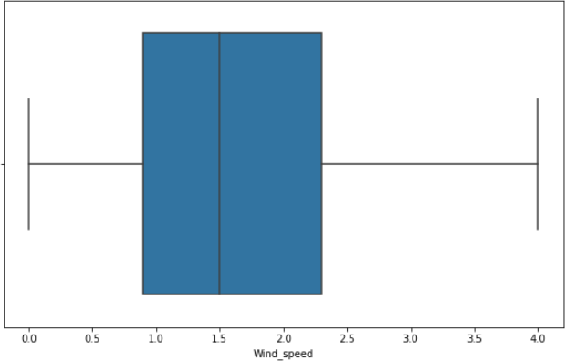
Detection and Treatment of outliers on numerical columns.
After Trimming
Trimming technique on ‘Wind_speed’ column.
In the above plot, we can see that column ‘Wind_speed’ has many outliers reaching a maximum point of 7.5, but after trimming them we can see that there are no more outliers.

Slide 18
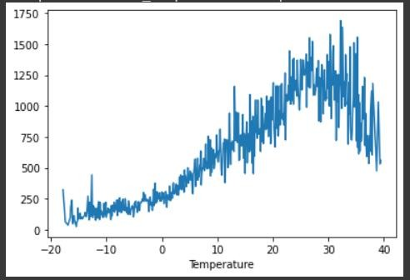
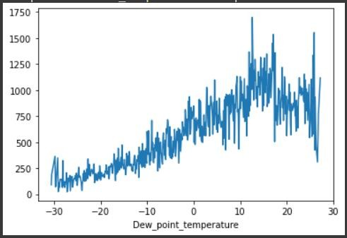
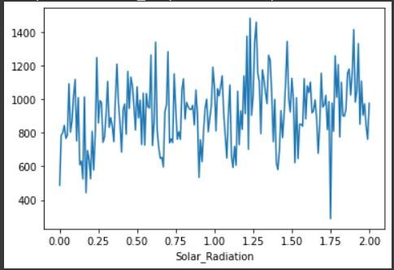
NUMERICAL VS RENTED BIKE COUNT
The above plot shows the comparison between 'Temperature', 'Dew_point_temperature', and 'Solar_Radiation' and it shows that people like to ride bikes when it is pretty hot, around 25°C to 30°C on average.
Also, 'Dew_point_temperature' is almost the same as the 'Temperature' because of the similar
nature of the data.
From the above graph, we see that the number of rented bikes is uniformly distributed when there is solar radiation.

Slide 19
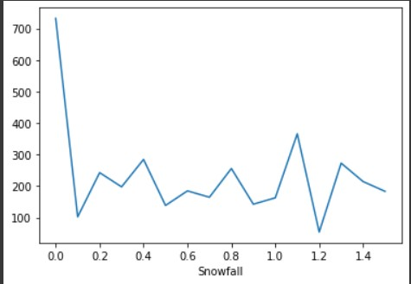
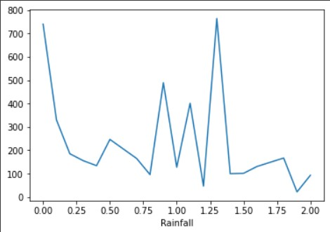
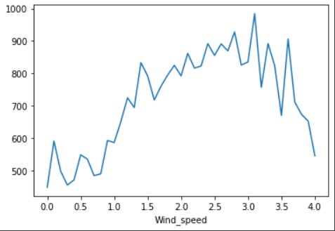
NUMERICAL VS RENTED BIKE COUNT
The above graph for 'Snowfall' represents that the number of rented bikes is very low, especially
in the 4 cm range.
The above graph for 'Rainfall' shows that during heavy rainfall, the demand for rented bikes does not decrease. Here, for example, even if we have 20 mm of rain, there is a big peak for rented bikes.
In the 'Wind_speed' graph, the demand for rented bikes is uniformly distributed, but when the
wind speed is 7 m/s, the demand for bikes increases.

Slide 20
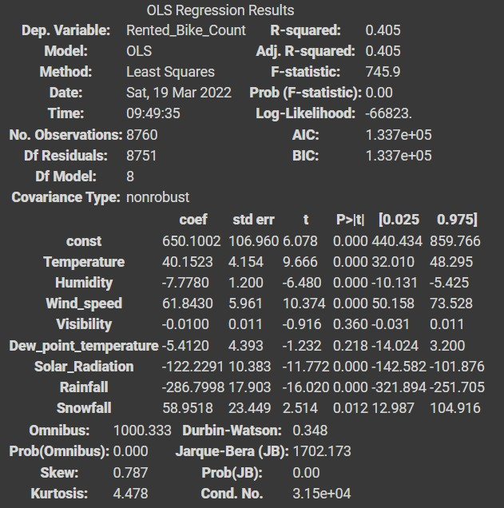
OLS REGRESSION MODEL
R-Squared and Adj. R-Squared are near each other. 40% of the variance in the rented bike count is explained by the model.
The P values for 'Dew_point_temperature' and 'Visibility' are very high, hence they are not significant to the model.
The OLS model concludes that the 'Dew_point_temperature' and 'Visibility' columns are not necessary for the model.

Slide 21
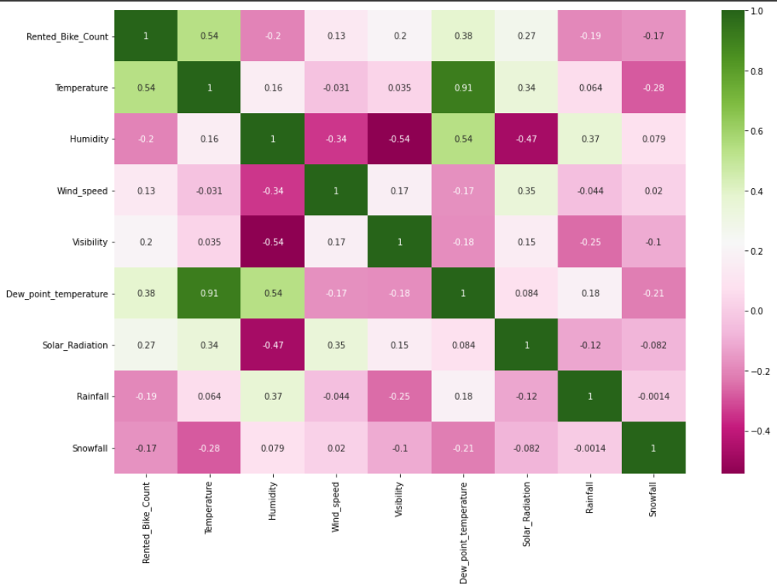
CORRELATION HEATMAP
Variables like Dew Point Temperature, and Temperature are highly correlated.

Slide 22
MODEL BUILDING
LINEAR REGRESSION
LASSO REGRESSION
RIDGE REGRESSION

Slide 23
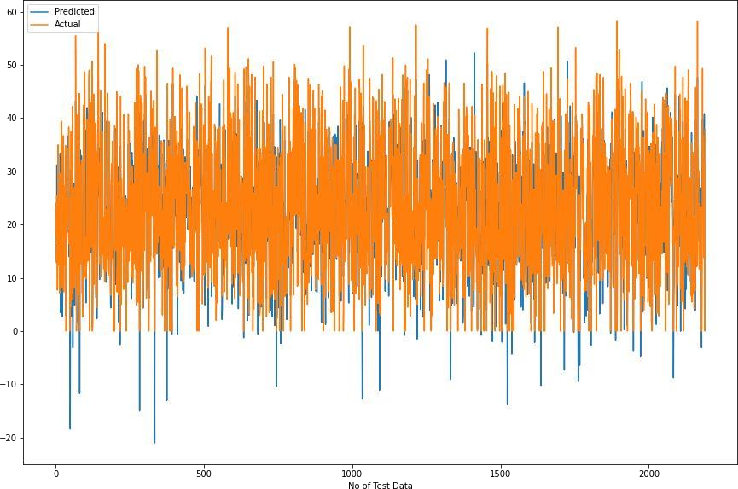
LINEAR REGRESSION
Train Set Results
Test Set Results

Slide 24
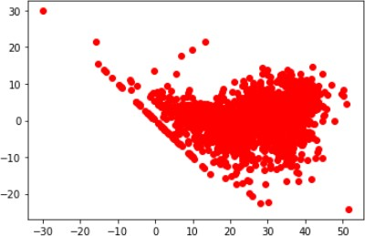
Heteroscedasticity
In this linear regression model, we can see that the model is able to capture most of the data and variance, and hence the data is less and randomly scattered, and the errors are not forming any pattern.
So, this model is suitable for the given dataset.

Slide 25
LASSO REGRESSION
Train Set Results
Test Set Results

Slide 26
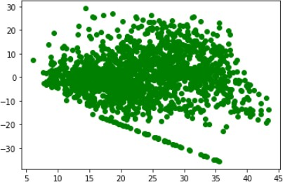
Heteroscedasticity
In this Regularised lasso regression model, we can see that the model is not able to capture most of the data and variance, and hence the data is more randomly scattered and the errors are trying to form a pattern.
So, this model is not suitable for this dataset.

Slide 27
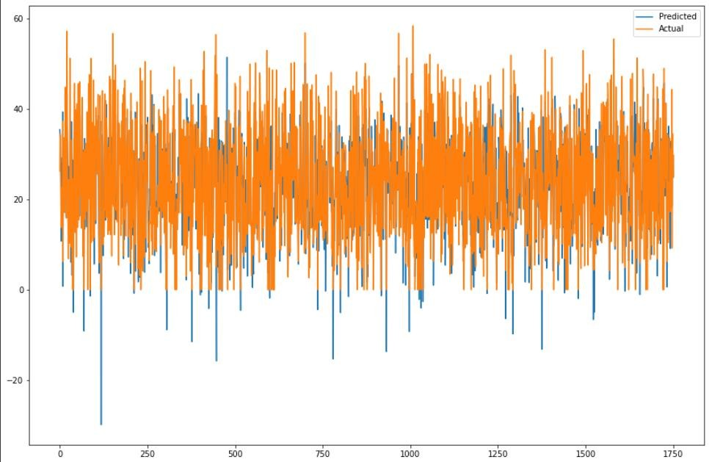
RIDGE REGRESSION
Train Set Results
Test Set Results

Slide 28
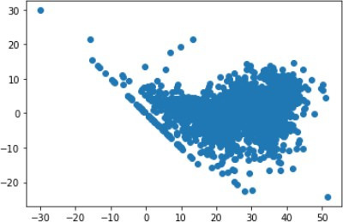
Heteroscedasticity
In this Regularised Ridge regression model, we can see that the model is able to capture most of the data and variance, and hence the data is less and randomly scattered, and the errors are not forming any pattern.
So, this model is also suitable for the given dataset.

Slide 29
CHALLENGES
Large dataset to handle.
Required to plot different graphs for better
analysis.
Outliers detection.
Treatment of Outliers.
Optimising the model for better accuracy.
Understanding the evaluation matrix.

Slide 30
CONCLUSION
The 'Hour’ of a day holds the most important feature.
The bike rental count is mostly correlated with the time of the day, as it peaks at 10 am in the morning and 8 pm in the evening.
We observed that the bike rental count is higher during working days, especially
between 7 am and 9 am and 5 pm and 7 pm, than on non-working days.
We see that people prefer to ride in temperatures ranging from moderate to high, as well as in light winds.
It is observed that the highest number of rental bikes is counted in the autumn and summer seasons, and the lowest in the winter season.
We observed that the highest number of bike rentals was on a normal day, and the
lowest on a snowy and rainy day.
We observed that with increasing humidity, the number of bike rental counts decreases.

Slide 31
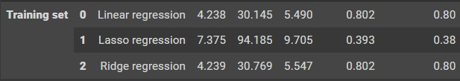
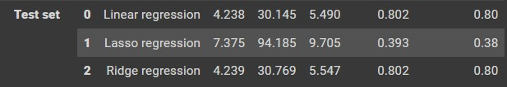
CONCLUSION CONT.
When we compare the root mean squared error and the mean absolute error of all the models, we can see that we have very minimal errors. Finally, this model is best for predicting the bike rental count on a daily basis.
Train Set Results
TEST Set Results

