Slide 1
4. EVOLUTION
Evolution Means “Gradual And Continuous change”.
-BY KANIKA MEHTA

Slide 2
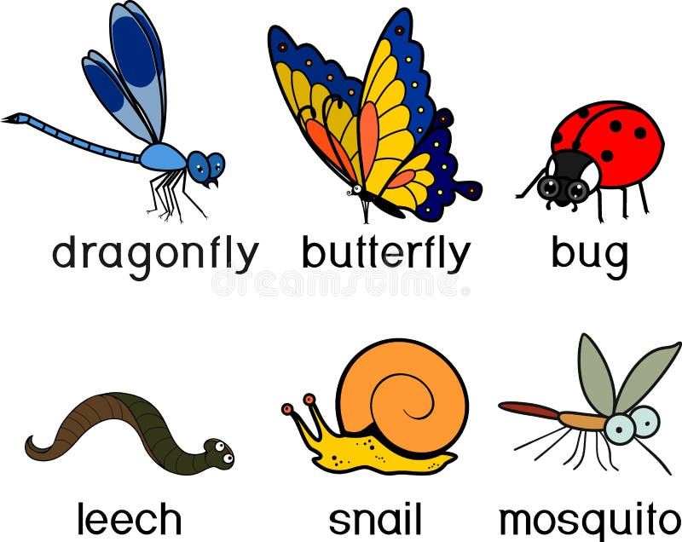
Invertebrates- animals without a BACKBONE.
-BY KANIKA MEHTA

Slide 3
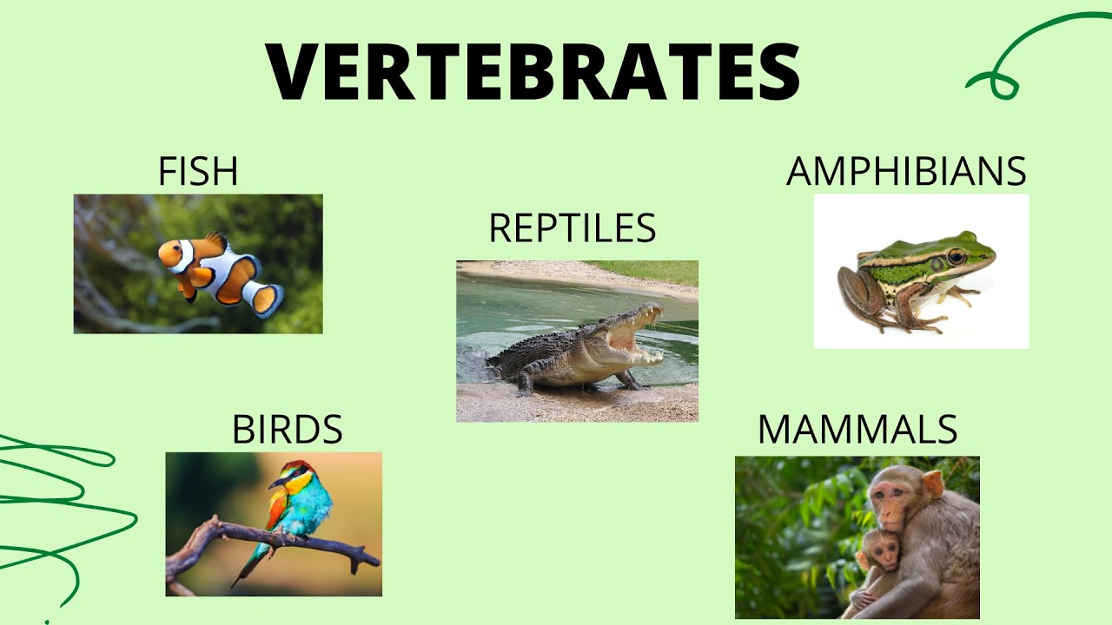
Vertebrates – animals with Backbone.
-BY KANIKA MEHTA

Slide 4
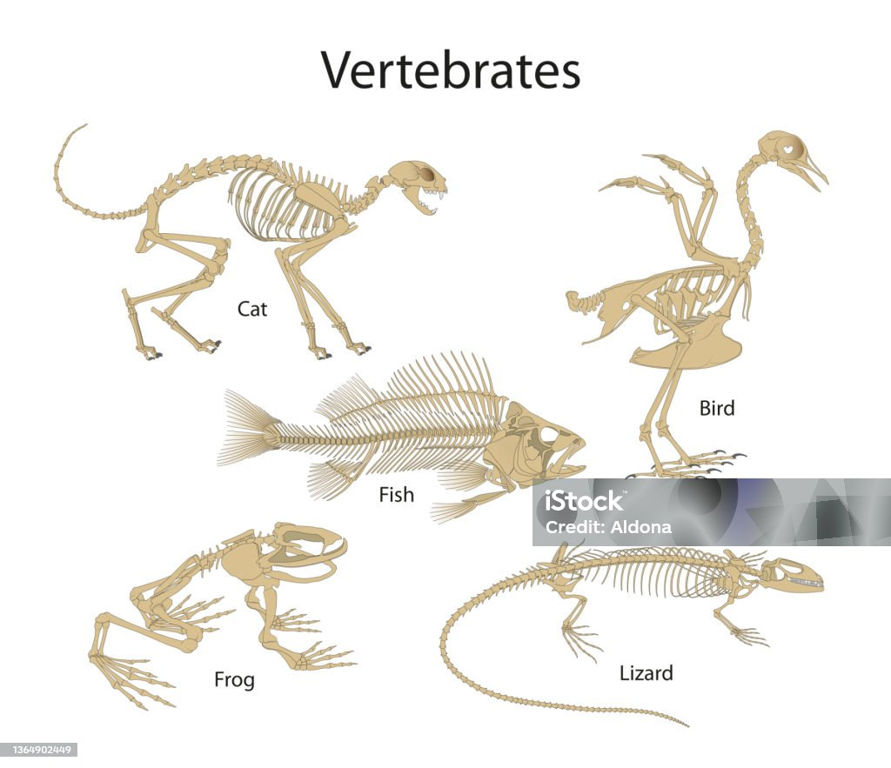
-BY KANIKA MEHTA

Slide 5
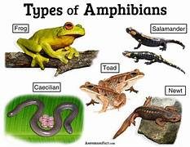
-BY KANIKA MEHTA

Slide 6
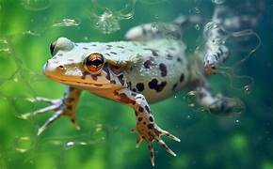
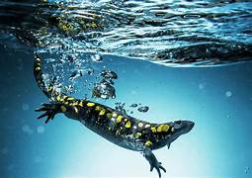
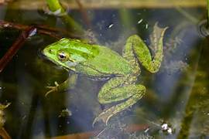
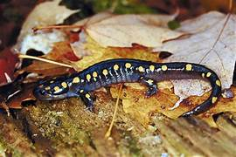
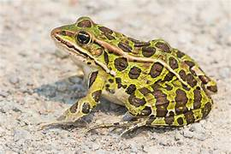
-BY KANIKA MEHTA
Amphibians lives in water as well as on Land.

Slide 7
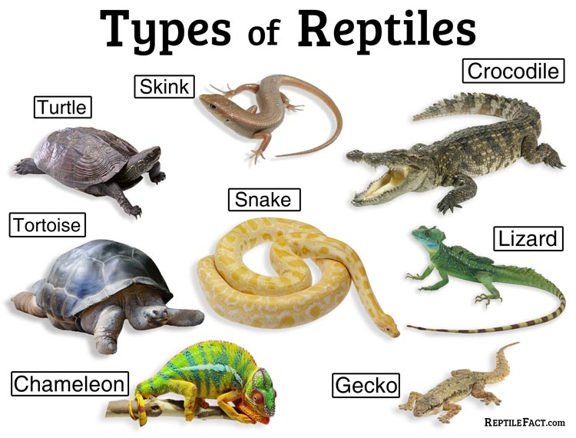
-BY KANIKA MEHTA

Slide 8
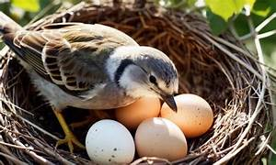
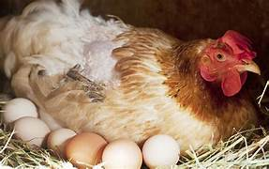
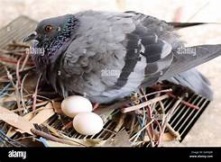
-BY KANIKA MEHTA

Slide 9
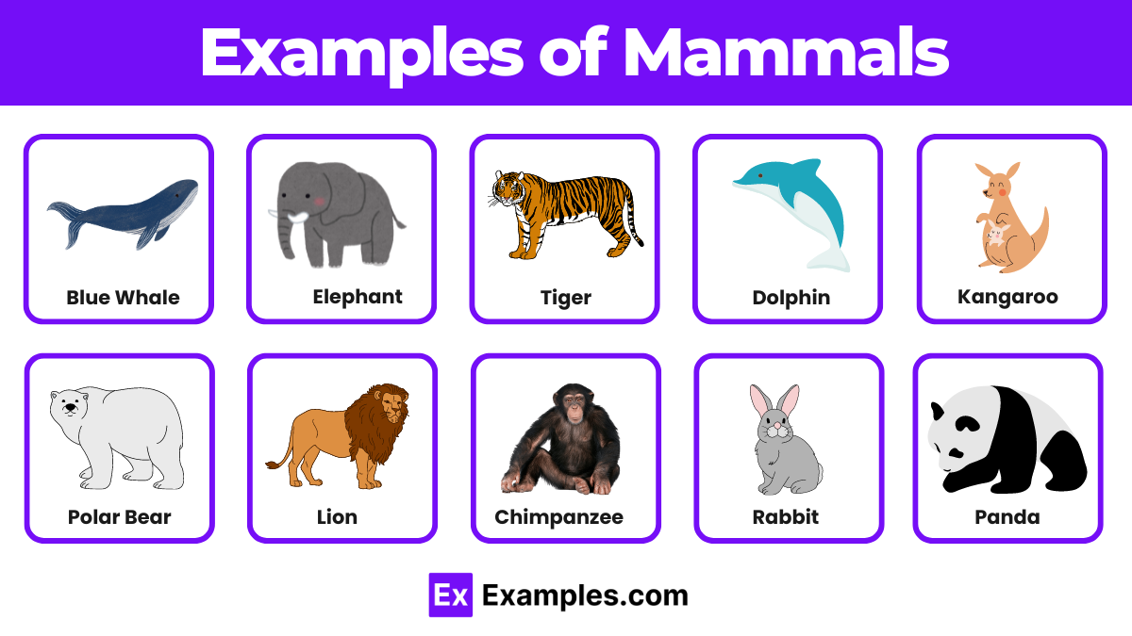
-BY KANIKA MEHTA

Slide 10
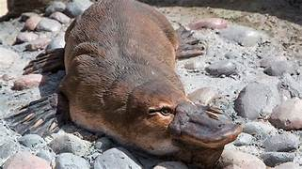
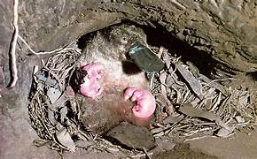
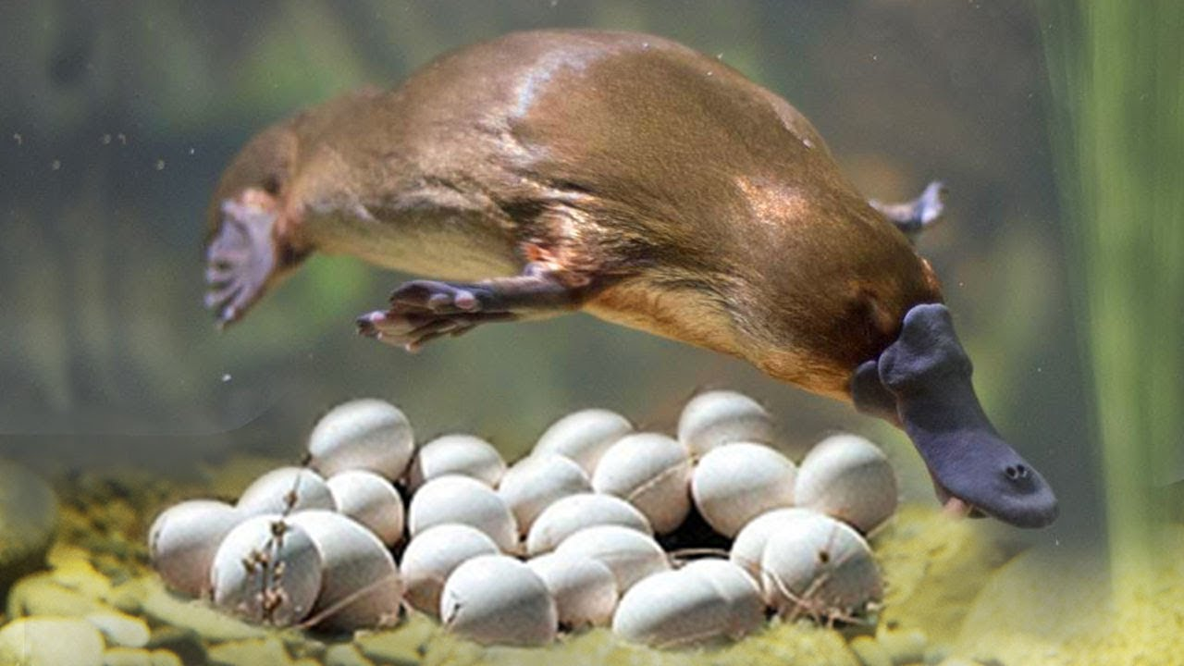
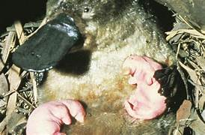
-BY KANIKA MEHTA

Slide 11
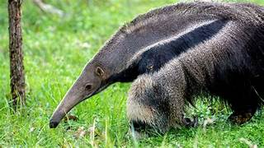
-BY KANIKA MEHTA

Slide 12
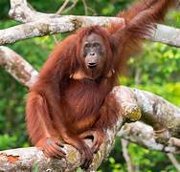
-BY KANIKA MEHTA

Slide 13
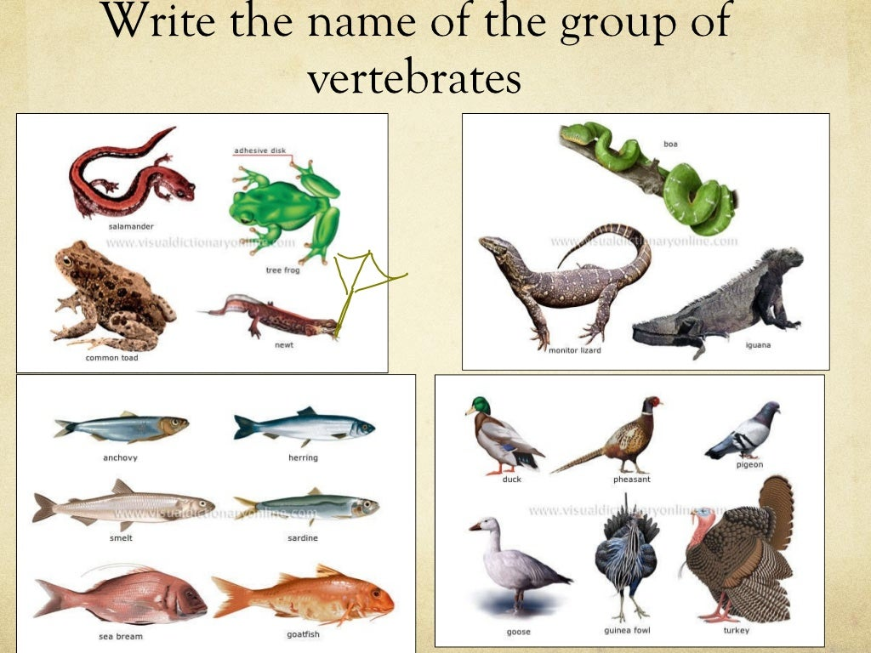
-BY KANIKA MEHTA

Slide 14
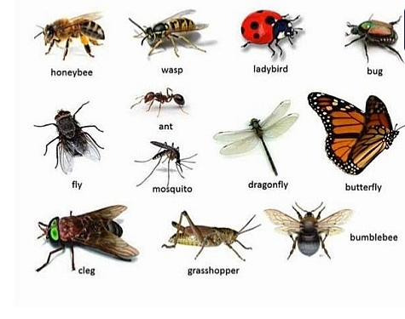
-BY KANIKA MEHTA

Slide 15
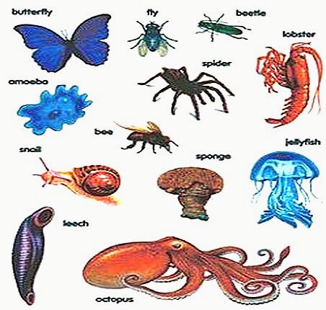
-BY KANIKA MEHTA

