Slide 1
FlyAway
Developed by : Kanika Gupta

Slide 2
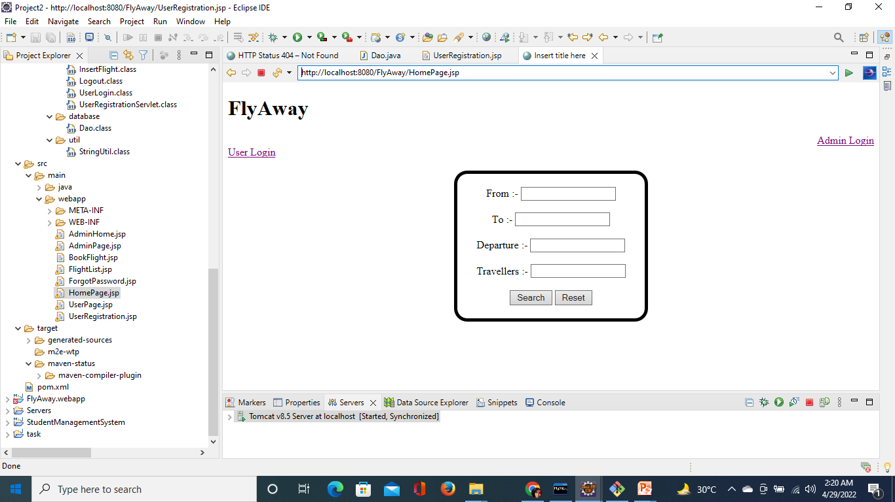
HomePage.jsp

Slide 3
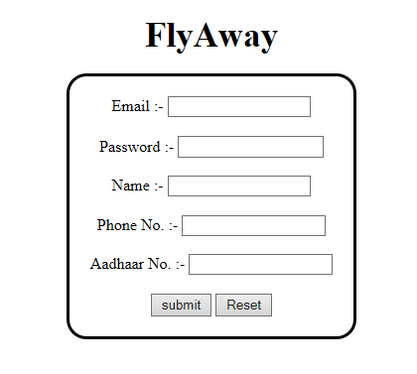
UserRegistration.jsp

Slide 4
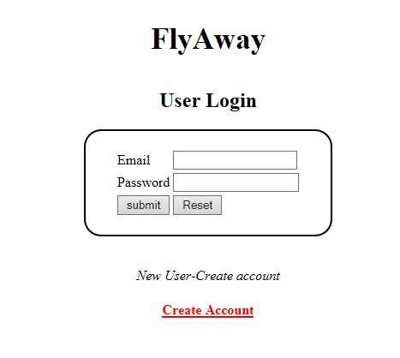
UserPage.jsp

Slide 5
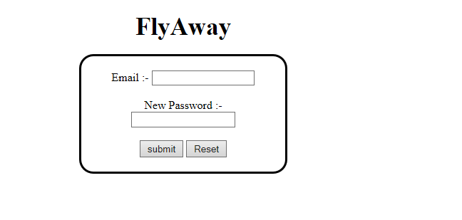
ForgotPassword.jsp

Slide 6
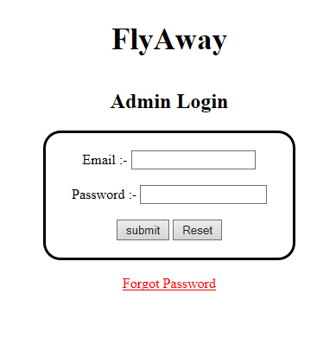
AdminPage.jsp

Slide 7
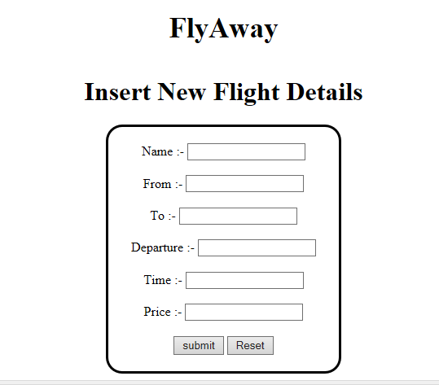
AdminHome.jsp

