Slide 1


Datastage Basics Training - Overall Architecture
Mihir kumar, Sr. Lead Data Engineer
Sumit Jain, Sr. Data Engineer
Sudipta Sarkar, Sr. Data Engineering Specialist
Neha Chaudhari, Data Engineering Specialist
22-Feb-2021

Slide 2

Module Objectives
The Traditional Data warehouse
Teradata UDA Architecture
ETL/ELT Process
IBM InfoSphere Architecture
IBM InfoSphere Datastage
2
© 2014 Teradata

Slide 3
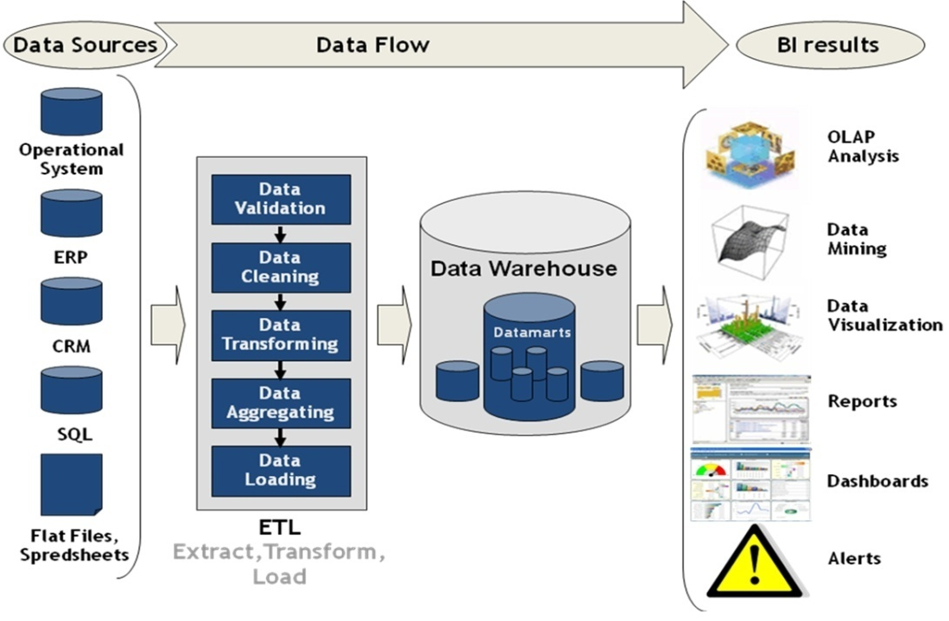
The Traditional Data warehouse
A central enterprise wide database that contains information extracted from operational systems

Slide 4
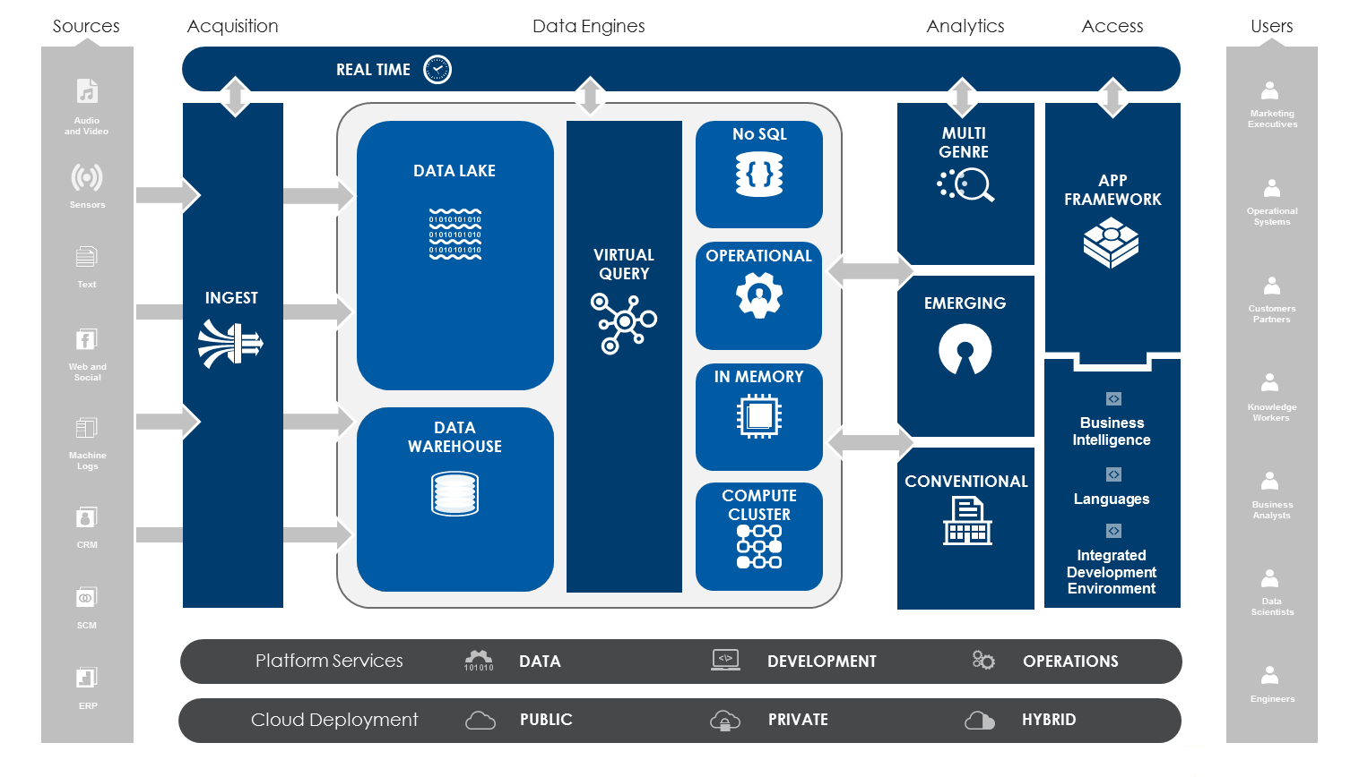
Teradata UDA Architecture

Slide 5
ETL/ELT Process
Extracting the data from source systems (SAP, ERP, other oprational systems), data from different source systems is converted into one consolidated data warehouse format which is ready for transformation processing
Transforming the data may involve the following tasks:
applying business rules (so-called derivations, e.g., calculating new measures and dimensions),
cleaning (e.g., mapping NULL to 0 or "Male" to "M" and "Female" to "F" etc.),
filtering (e.g., selecting only certain columns to load),
splitting a column into multiple columns and vice versa,
Loading the data into a data warehouse or data repository for other reporting applications

Slide 6
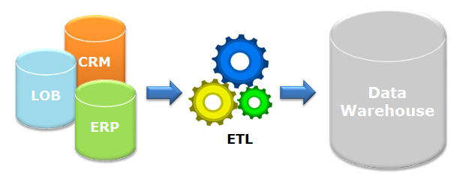
Data Integration(DI) Provided Features
Graphical data flow definition interfaces for easy development
ODBC connectivity to standard databases
Metadata import & export from standard databases
Inbuilt standard functions & transformations – e.g. date, aggregate, sort, etc.
Options for sharing or reusing developed components
Facility to call external routines or write custom code for complex requirement
Run-time support for monitoring the data flow and reading message logs
Scheduling options

Slide 7
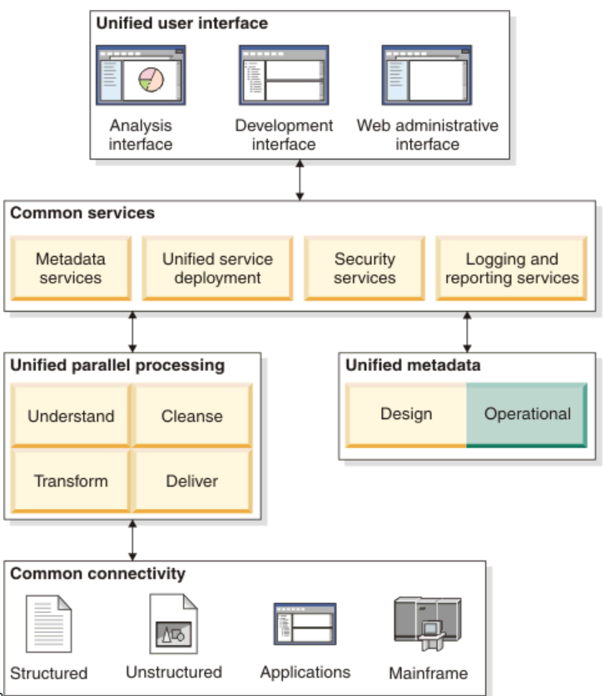
Architecture of IS 11.7

Slide 8
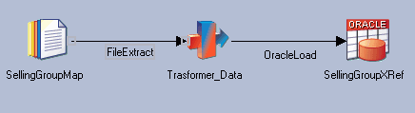
IBM InfoSphere DataStage
Design jobs for Extraction, Transformation, and Loading (ETL)
Ideal tool for data integration projects – such as, data warehouses, data marts, and system migrations
Import, export, create, and manage metadata for use within jobs
Schedule, run, and monitor jobs all within DataStage
Administer your DataStage development and execution environments
Create batch (controlling) jobs

Slide 9

InfoSphere DataStage Clients
Designer – interface used to create DataStage applications (jobs)
Director – interface used to validate, schedule, run and monitor DataStage sequences
Administrator –interface used for administrative tasks (setting up users; logging, creating and moving projects; setting up criteria for purging records)

Slide 10
Client Tier
IBM InfoSphere DataStage and QualityStage clients
Administrator, Designer, and Director
Administrative clients
Project defaults, add/delete project
User and group privileges
User clients
creating, managing, and designing jobs
validating, running, scheduling and monitoring jobs
Server tiers
Services tier
includes both common and product-specific services
Repository tier
store all IBM Information Server product module objects
Engine tier
This is the parallel runtime engine that executes the IBM Information Server tasks

Slide 11
Key DataStage Components
Project
Usually created for each application (or version of an application, e.g. Test, Dev, etc.)
Multiple projects can exist on a single server box
Consists of DataStage Server & Parallel Jobs
Pre-built components (Stages, Functions, etc.)
User-defined components
User Roles & Privileges set at this level
Job
Design objects and compiled program elements that connect to sources
Extract and transform data and then output it to a target
Job types include parallel jobs, sequence jobs, server jobs

Slide 12
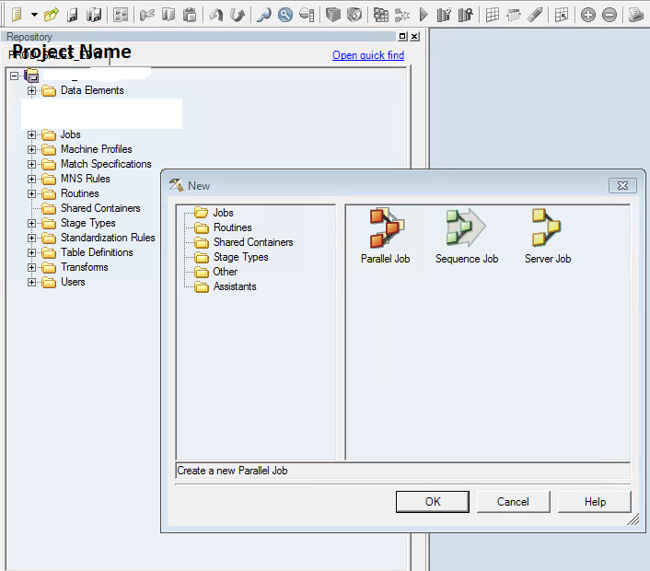
Project & Jobs

Slide 13
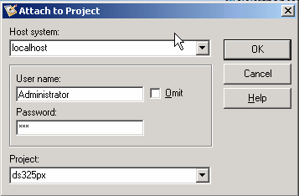
Client Logon

Slide 14
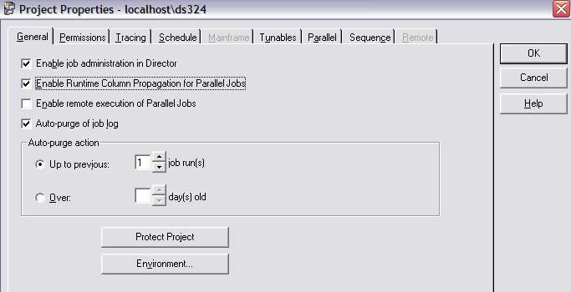
DataStage Administrator

Slide 15
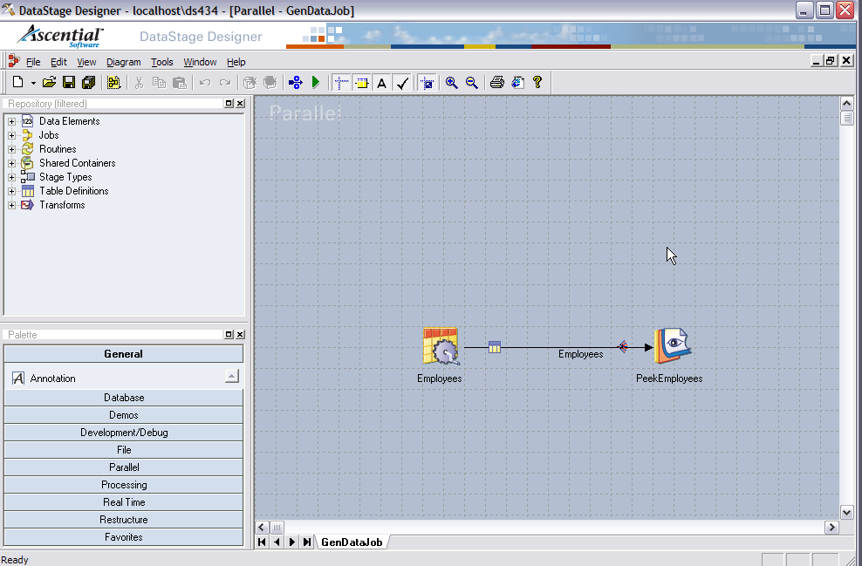
DataStage Designer

Slide 16
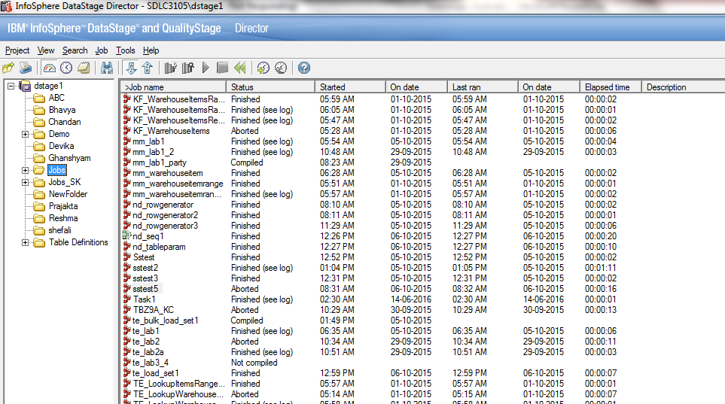
Director Client Overview
Job Status view
Job Log view
Run selected job
Select a job to view

Slide 17


