Slide 1

Datastage Basics Training - File Processing Stages
Sudipta Sarkar, GDC Consultant
21-Dec-2018

Slide 2

Agenda
Parallel Job Stages
Group 1-> File Stages
Group 2-> Processing Stages
2
© 2014 Teradata

Slide 3
PARALLEL JOB STAGES
Parallel jobs have a large number of stages available which are arranged in groups in the tool palette.
File
Processing
Development/Debug
Restructure
Real Time
Database

Slide 4
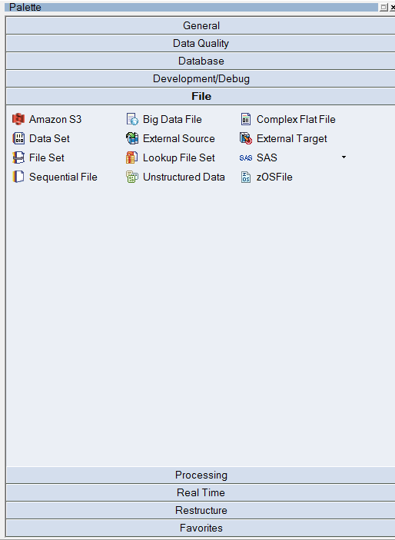
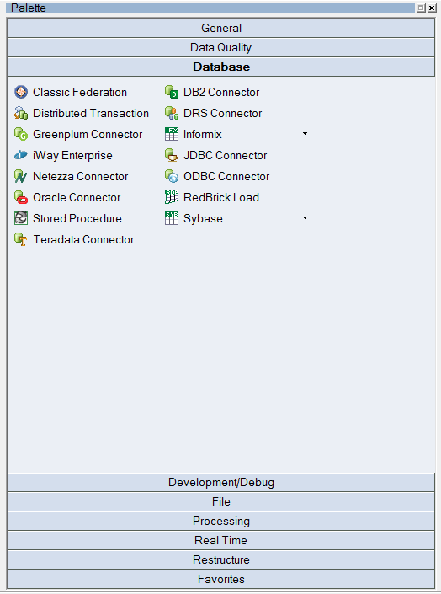
Snapshot of Palette

Slide 5
Group 1 -> File Stages
Dataset
Sequential File Stage
5
© 2014 Teradata

Slide 6

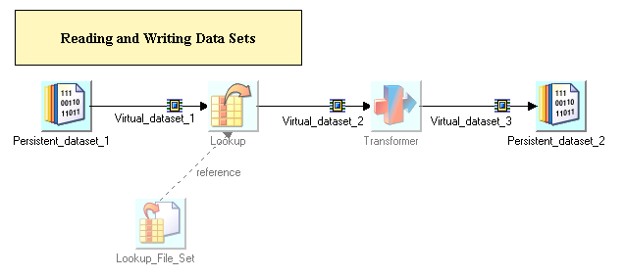
DATASET
Stage Type : File Stage
Input Link Count : Single
Output Link Count : Single

Slide 7
Dataset
Operating system (Framework) file
Preserves partitioning
Component dataset files are written to on each partition
Suffixed by .ds
Referred to by a header file
Managed by Data Set Management utility from GUI (Manager, Designer, Director)
Represents persistent data
Key to good performance in set of linked jobs
No import / export conversions are needed
No repartitioning needed

Slide 8
Persistent Dataset
Accessed using DataSet Stage.
Two parts:
Descriptor file:
contains metadata, data location, but NOT the data itself
record (
partno: int32;
description: string;
)
Data file(s)
contain the data
multiple Unix files (one per node), accessible in parallel
node1:/local/disk1/…
node2:/local/disk2/…

Slide 9
Data Translation
Occurs on import
From sequential files or file sets
From RDBMS
Occurs on export
From datasets to file sets or sequential files
From datasets to RDBMS
DataStage engine is most efficient when processing internally formatted records (i.e. datasets)

Slide 10

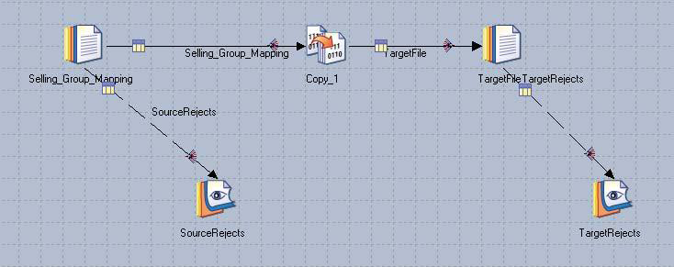
SEQUENTIAL FILE
Stage Type : File Stage
Input Link Count : Single
Output Link Count : Single
Reject Link Count : Single

Slide 11
Framework and Sequential Data
The EE Framework processes only datasets
For files other than datasets, such as sequential flat files, import and export operations are done
Import and export OSH operators are generated by Sequential and Complex Flat File stages
During import or export DataStage performs format translations
into, or out of, the EE internal format
Internally, the format of data is described by schemas
Like Table Definitions

Slide 12
Features of Sequential File Stage
Normally executes in sequential mode
Executes in parallel when reading multiple files
Can use multiple readers within a node
Reads chunks of a single file in parallel
The stage needs to be told:
How file is divided into rows (record format)
How row is divided into columns (column format)

Slide 13
Sequential File Stage Rules
One input link
One stream output link
Optionally, one reject link
Will reject any records not matching metadata in the column definitions
Example: You specify three columns separated by commas, but the row that`s read had no commas in it

Slide 14
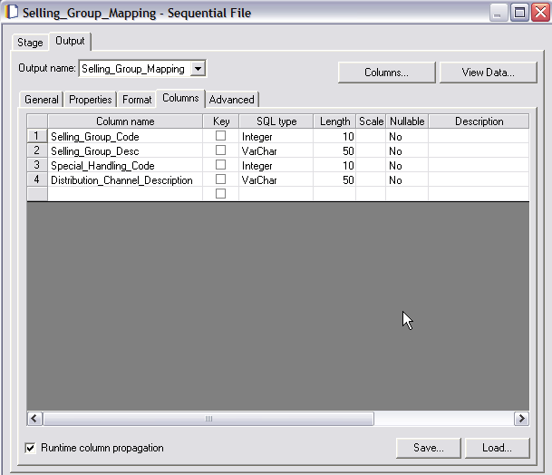
Sequential Source Columns Tab
View Data
View Table Definition
Save as a New Table Definition

Slide 15
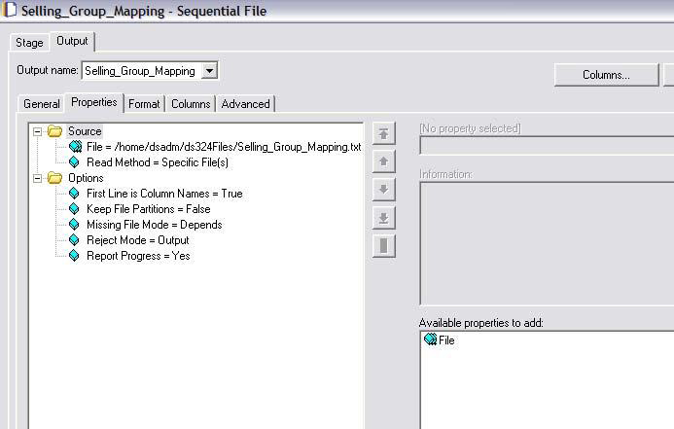
Input Sequential Stage Properties
File to Access
Output Tab
Column Name First Row
Click to add more file having same format

Slide 16
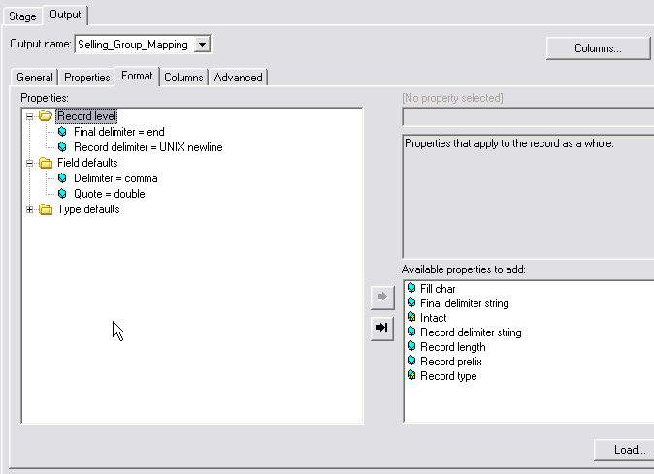
Format Tab
Record Format
Column Format

Slide 17
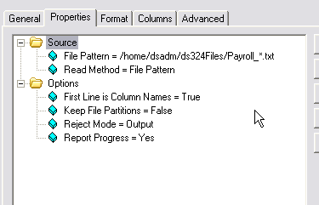
Reading using a File Pattern
Use wild cards
Select File pattern

Slide 18
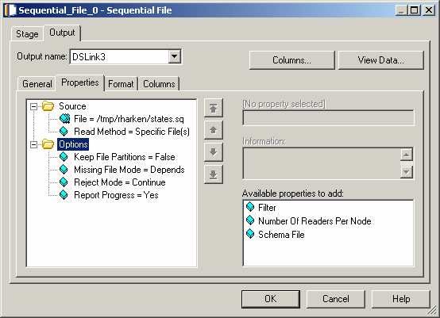
Properties – Multiple Readers
Multiple readers option allow you to set number of readers per node

Slide 19
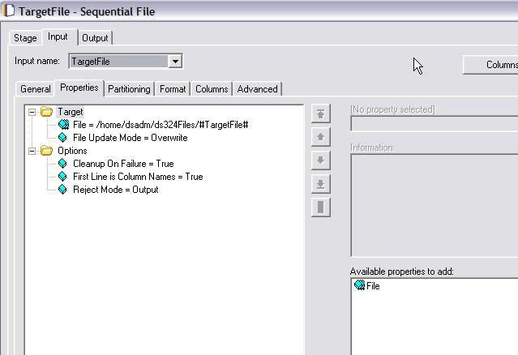
Sequential Stage as Target
Input
Append / Overwrite

Slide 20
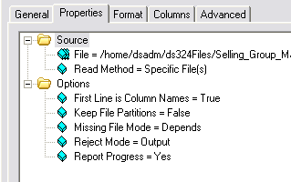
Reject Link
Reject mode =
Continue: Continue reading records
Fail: Abort job
Output: Send down output link
In a source stage
All records not matching the metadata (column definitions) are rejected
In a target stage
All records that fail to be written for any reason
Rejected records consist of one column, datatype = raw
Reject Mode Property

Slide 21
Metadata Import
Import format and column definitions from sequential files
Import relational table column definitions
Imported as “Table Definitions”
Table definitions can be loaded into job stages

Slide 22
Sequential File Import Procedure
In Manager, click Import>Table Definitions>Sequential File Definitions
Select directory containing sequential file and then the file
Select Manager category
Examined format and column definitions and edit is necessary

Slide 23
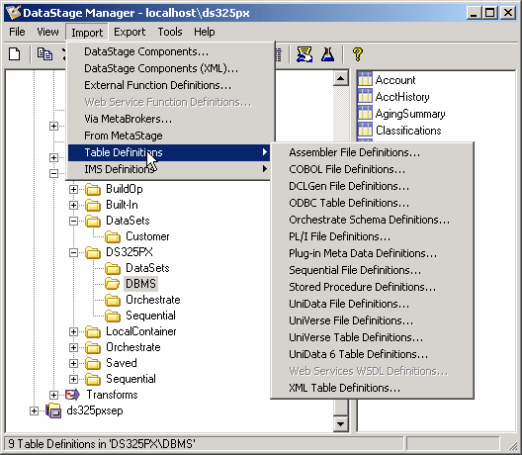
Importing Sequential Metadata

Slide 24
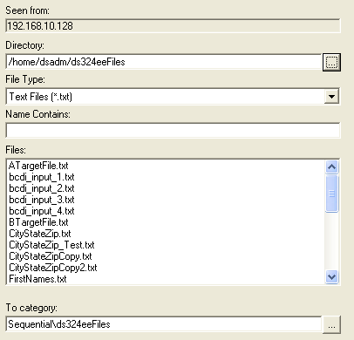
Sequential Import Window

Slide 25
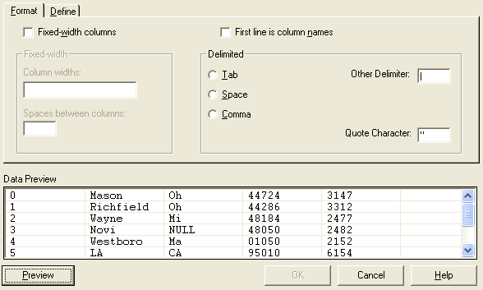
Specify Format

Slide 26
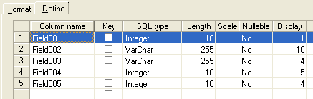
Specify Column Name and Types
Double Click to define extended properties

Slide 27
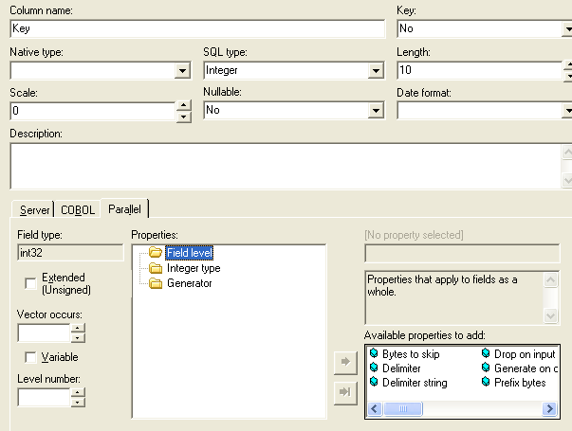
Extended Properties Window
Properties Category
Available Properties

Slide 28
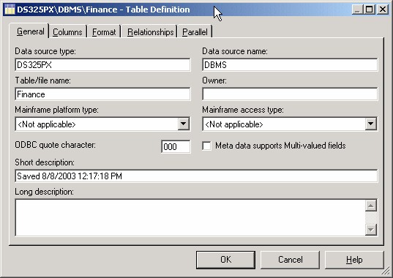
Table Definition General Tab
Secondary Level
Category
Top Level Category

Slide 29
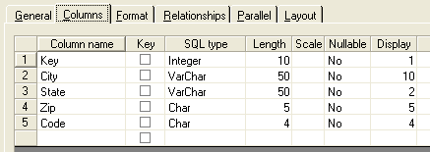
Tab Definition Column Tab

Slide 30
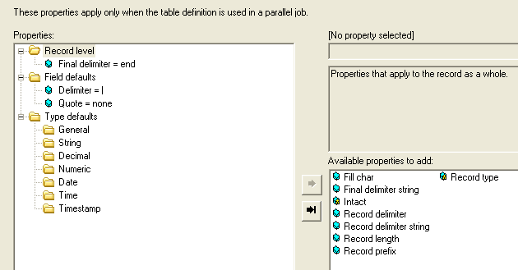
Tab Definition Parallel Tab

Slide 31
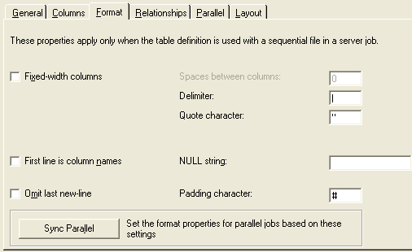
Tab Definition Format Tab

