Slide 1

Datastage Basics Training - File Processing Stages
Sudipta Sarkar, GDC Consultant
21-Dec-2018

Slide 2

Agenda
Parallel Job Stages
Group 1-> File Stages
Group 2-> Processing Stages
2
© 2014 Teradata

Slide 3
PARALLEL JOB STAGES
Parallel jobs have a large number of stages available which are arranged in groups in the tool palette.
File
Processing
Development/Debug
Restructure
Real Time
Database

Slide 4
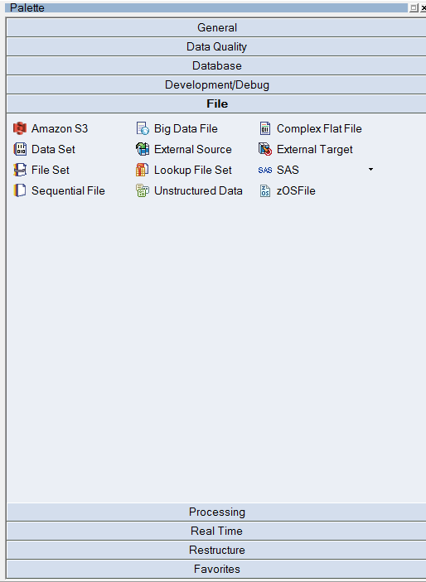
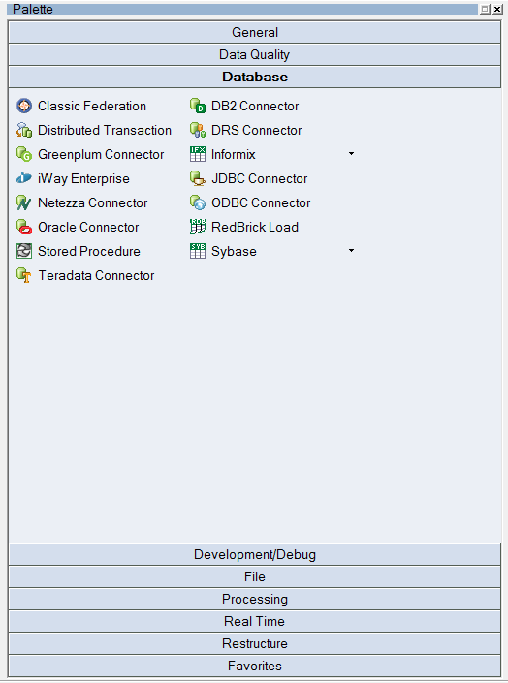
Snapshot of Palette

Slide 5
Group 1 -> File Stages
Dataset
Sequential File Stage
5
© 2014 Teradata

Slide 6

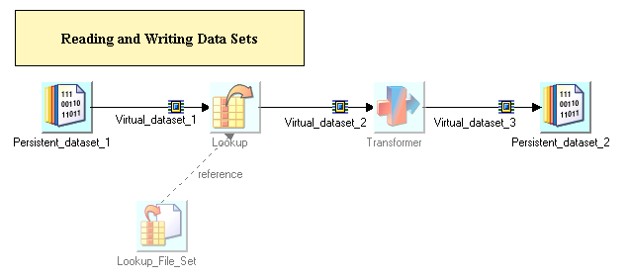
DATASET
Stage Type : File Stage
Input Link Count : Single
Output Link Count : Single

Slide 7
Dataset
Operating system (Framework) file
Preserves partitioning
Component dataset files are written to on each partition
Suffixed by .ds
Referred to by a header file
Managed by Data Set Management utility from GUI (Manager, Designer, Director)
Represents persistent data
Key to good performance in set of linked jobs
No import / export conversions are needed
No repartitioning needed

Slide 8
Persistent Dataset
Accessed using DataSet Stage.
Two parts:
Descriptor file:
contains metadata, data location, but NOT the data itself
record (
partno: int32;
description: string;
)
Data file(s)
contain the data
multiple Unix files (one per node), accessible in parallel
node1:/local/disk1/…
node2:/local/disk2/…

Slide 9
Data Translation
Occurs on import
From sequential files or file sets
From RDBMS
Occurs on export
From datasets to file sets or sequential files
From datasets to RDBMS
DataStage engine is most efficient when processing internally formatted records (i.e. datasets)

Slide 10

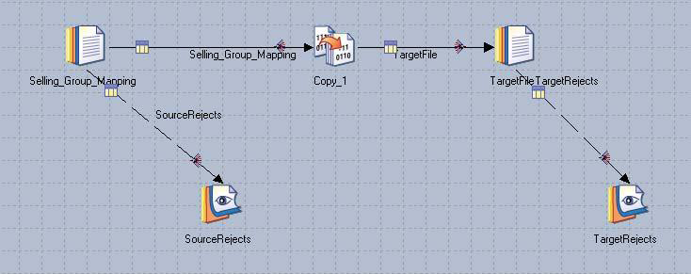
SEQUENTIAL FILE
Stage Type : File Stage
Input Link Count : Single
Output Link Count : Single
Reject Link Count : Single

Slide 11
Framework and Sequential Data
The EE Framework processes only datasets
For files other than datasets, such as sequential flat files, import and export operations are done
Import and export OSH operators are generated by Sequential and Complex Flat File stages
During import or export DataStage performs format translations
into, or out of, the EE internal format
Internally, the format of data is described by schemas
Like Table Definitions

Slide 12
Features of Sequential File Stage
Normally executes in sequential mode
Executes in parallel when reading multiple files
Can use multiple readers within a node
Reads chunks of a single file in parallel
The stage needs to be told:
How file is divided into rows (record format)
How row is divided into columns (column format)

Slide 13
Sequential File Stage Rules
One input link
One stream output link
Optionally, one reject link
Will reject any records not matching metadata in the column definitions
Example: You specify three columns separated by commas, but the row that`s read had no commas in it

Slide 14
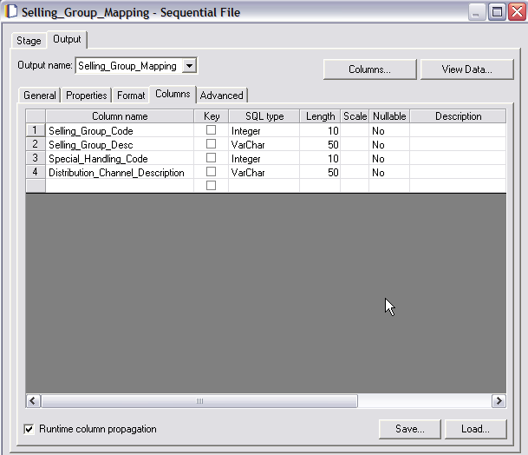
Sequential Source Columns Tab
View Data
View Table Definition
Save as a New Table Definition

Slide 15
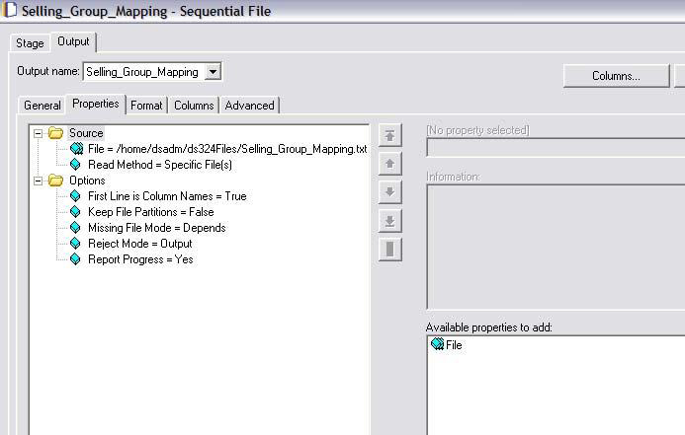
Input Sequential Stage Properties
File to Access
Output Tab
Column Name First Row
Click to add more file having same format

Slide 16
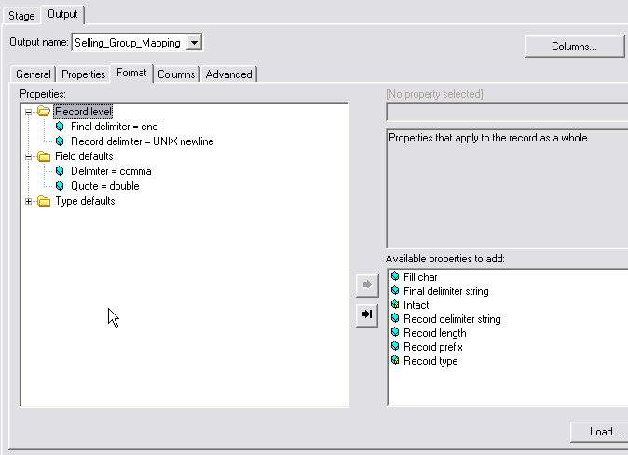
Format Tab
Record Format
Column Format

Slide 17
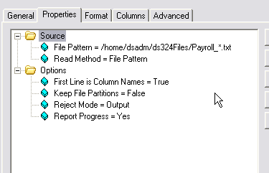
Reading using a File Pattern
Use wild cards
Select File pattern

Slide 18
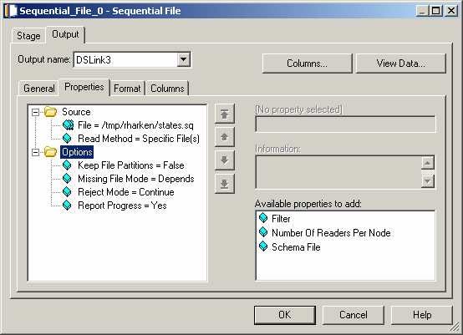
Properties – Multiple Readers
Multiple readers option allow you to set number of readers per node

Slide 19
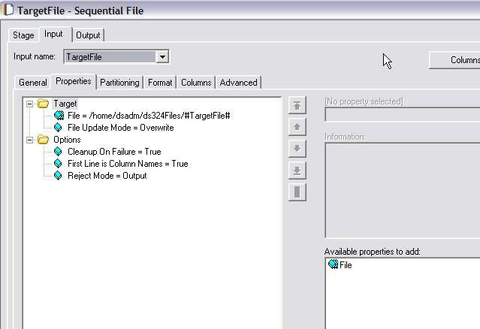
Sequential Stage as Target
Input
Append / Overwrite

Slide 20
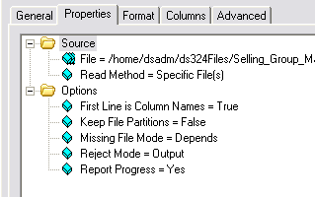
Reject Link
Reject mode =
Continue: Continue reading records
Fail: Abort job
Output: Send down output link
In a source stage
All records not matching the metadata (column definitions) are rejected
In a target stage
All records that fail to be written for any reason
Rejected records consist of one column, datatype = raw
Reject Mode Property

Slide 21
Metadata Import
Import format and column definitions from sequential files
Import relational table column definitions
Imported as “Table Definitions”
Table definitions can be loaded into job stages

Slide 22
Sequential File Import Procedure
In Manager, click Import>Table Definitions>Sequential File Definitions
Select directory containing sequential file and then the file
Select Manager category
Examined format and column definitions and edit is necessary

Slide 23
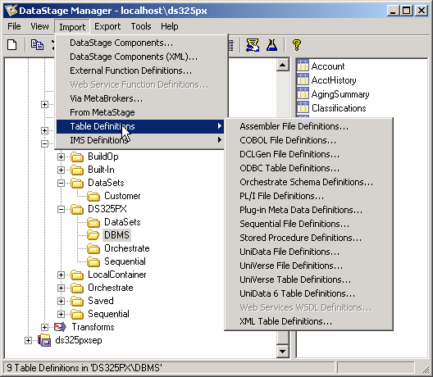
Importing Sequential Metadata

Slide 24
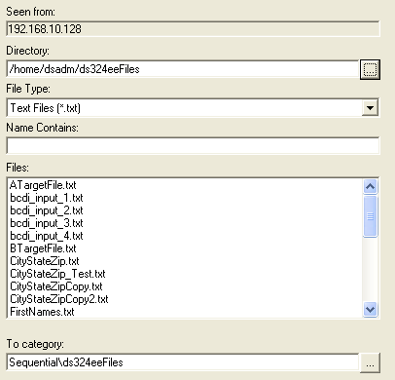
Sequential Import Window

Slide 25
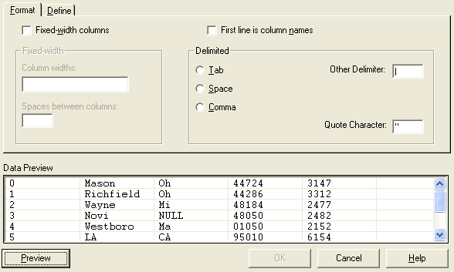
Specify Format

Slide 26
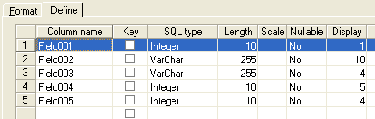
Specify Column Name and Types
Double Click to define extended properties

Slide 27
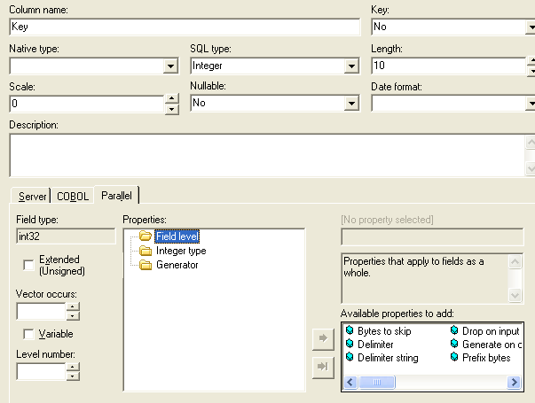
Extended Properties Window
Properties Category
Available Properties

Slide 28
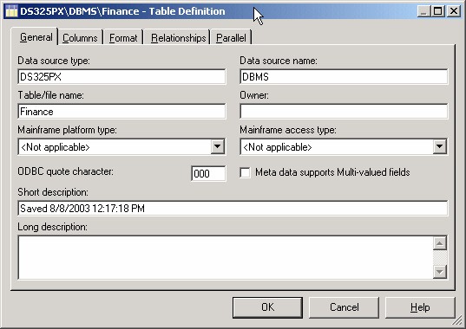
Table Definition General Tab
Secondary Level
Category
Top Level Category

Slide 29
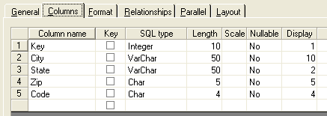
Tab Definition Column Tab

Slide 30
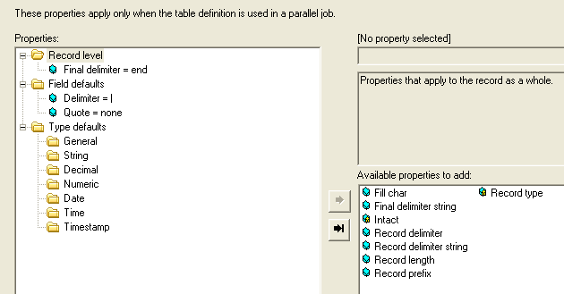
Tab Definition Parallel Tab

Slide 31
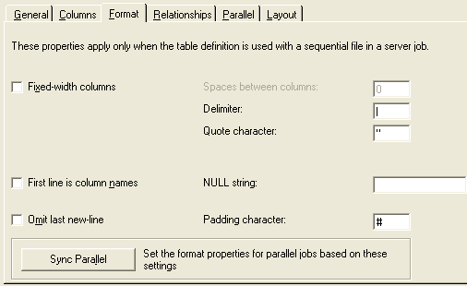
Tab Definition Format Tab

Slide 32
Group 2 -> Processing Stages
Transformer
Aggregator
Join
Merge
Copy
Funnel
Filter
Remove Duplicates
Sort
32
© 2014 Teradata

Slide 33

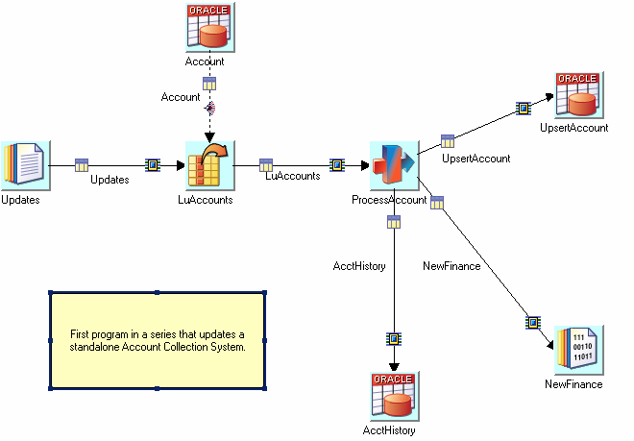
TRANSFORMER
Stage Type : Processing
Input Link Count : Single
Output Link Count : Multiple
Reject Link Count : Single

Slide 34
Transformer Stage
The Transformer Editor enables you to perform the following operations on a Transformer stage:
Create new columns on a link
Delete columns from within a link
Move columns within a link
Edit column meta data
Define output column derivations
Define link constraints and handle rejects
Specify the order in which links are processed
Define local stage variables

Slide 35
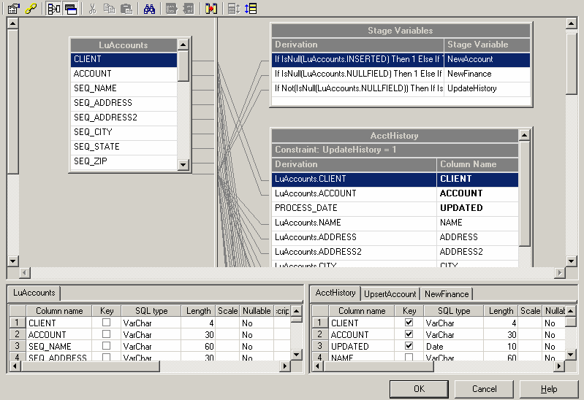
Inside the Transformer Stage
Input Columns
Stage Variables
Output Columns
Constraints
Derivation / Mappings
Input / Output Column defs

Slide 36
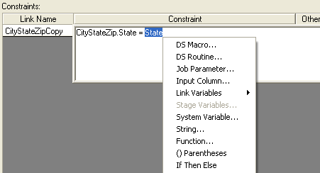
Defining a Constraint
Input Column
Job Parameter

Slide 37
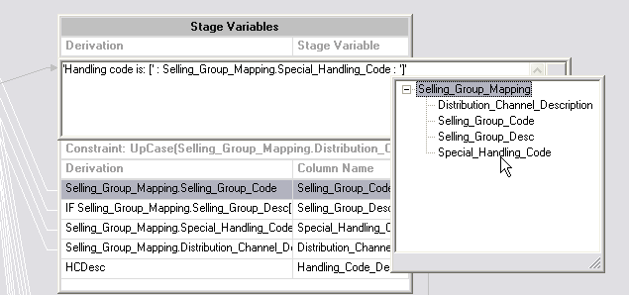
Defining a Derivation
Input Column
String in Quotes
Concatenation operator (:)

Slide 38
If Then Else Derivation
Use IF THEN ELSE to conditionally derive a value
Format:
IF <condition> THEN <expression1> ELSE <expression1>
If the condition evaluates to true then the result of expression1 will be copied to the target column or stage variable
If the condition evaluates to false then the result of expression2 will be copied to the target column or stage variable
Example:
Suppose the source column is named In.OrderID and the target column is named Out.OrderID
Replace In.OrderID values of 3000 by 4000
IF In.OrderID = 3000 THEN 4000 ELSE Out.OrderID

Slide 39
String Functions and Operators
Substring operator
Format: “String” [loc, length]
Example:
Suppose In.Description contains the string “Orange Juice”
InDescription[8,5] -> “Juice”
UpCase(<string>) / DownCase(<string>)
Example: UpCase(In.Description) -> “ORANGE JUICE”
Len(<string>)
Example: Len(In.Description) -> 12

Slide 40
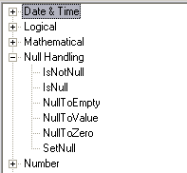
Checking for Nulls
Nulls can be introduced into the data flow from lookups
Mismatches (lookup failures) can produce nulls
Can be handled in constraints, derivations, stage variables, or a combination of these
NULL functions
Testing for NULL
IsNull(<column>)
IsNotNull(<column>)
Replace NULL with a value
NullToValue(<column>, <value>)
Set to NULL: SetNull()
Example: IF In.Col = 5 THEN SetNull() ELSE In.Col

Slide 41
More Transformer Functions
Date & Time
Logical
Null Handling
Number
String
Type Conversion

Slide 42
Transformer Execution order
Derivations in stage variables
Constraints are executed before derivations
Column derivations in earlier links are executed before later links
Derivations in higher columns are executed before lower columns

Slide 43
Transformer Stage Variables
Derivations execute in order from top to bottom
Later stage variables can reference earlier stage variables
Earlier stage variables can reference later stage variables
These variables will contain a value derived from the previous row that came into the Transformer
Multi-purpose Counters
Store values from previous rows to make comparisons
Store derived values to be used in multiple target field derivations
Can be used to control execution of constraints

Slide 44
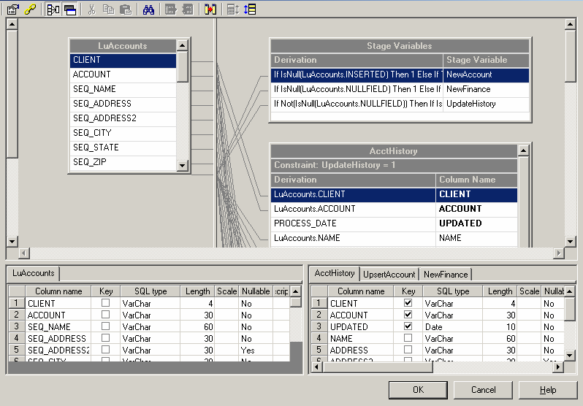
Stage Variable Toggle
Show / Hide Button

Slide 45
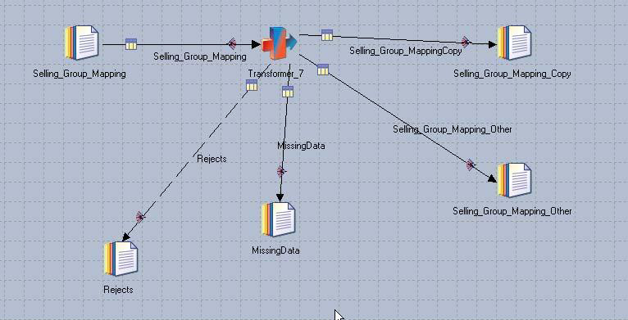
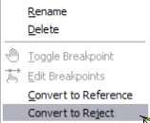
Transformer Reject Links
Reject Link
Convert Link to a Reject Link

Slide 46
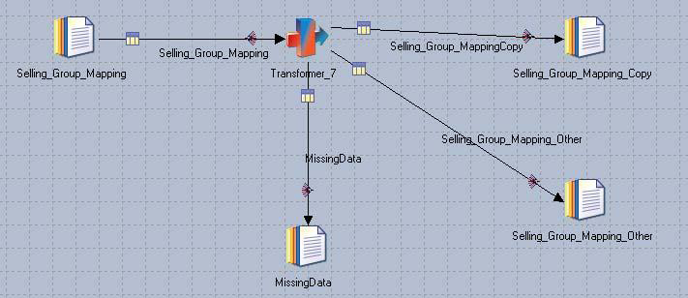
Otherwise Link
Otherwise Link

Slide 47
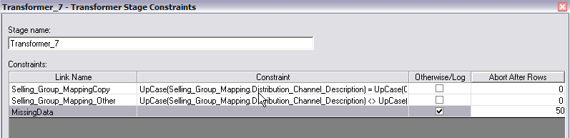
Defining a Otherwise Link
Check to create otherwiswe Link
Can specify abort condition

Slide 48
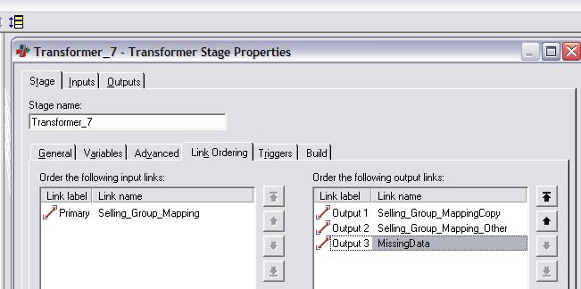
Transformer Execution order
Link ordering Toolbar icon
Last in Order

Slide 49
Transformer Stage Variables
Suggestions -
Include reject links
Test for NULL values before using a column in a function
Use RCP (Runtime Column Propogation)
Map columns that have derivations (not just copies).
More on RCP later.
Be aware of column and stage variable data types.
Often developers do not pay attention to stage variable types.
Avoid type conversions.
Try to maintain the data type as imported.

Slide 50

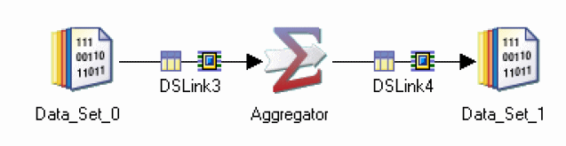
AGGREGATOR
Stage Type : Processing
Input Link Count : Single
Output Link Count : Single

Slide 51
Aggregator Functions
Aggregation type = Count rows
Count rows in each group
Put result in a specified output column
Aggregation type = Calculation
Select column
Put result of calculation in a specified output column
Calculations include:
Sum
Count
Min, max
Mean
Missing value count
Non-missing value count
Percent coefficient of variation

Slide 52
Grouping Methods
Hash (default)
Intermediate results for each group are stored in a hash table
Final results are written out after all input has been processed
No sort required
Use when number of unique groups is small
Running tally for each group’s aggregate calculations needs to fit into memory.
Sort
Only a single aggregation group is kept in memory
When a new group is seen, the current group is written out
Requires input to be sorted by grouping keys
Can handle unlimited numbers of groups

Slide 53
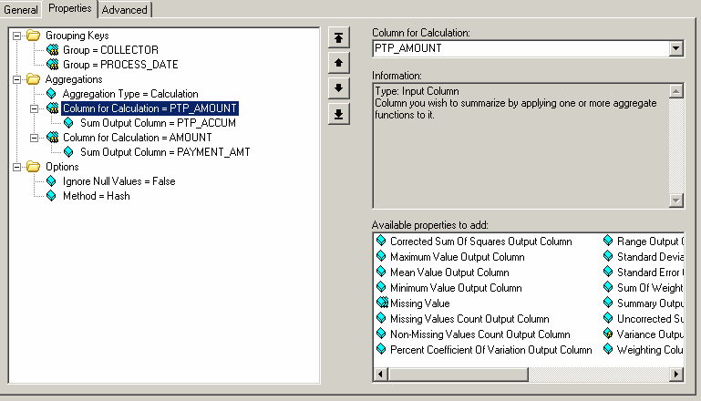
Aggregation Types
Calculation Types

Slide 54

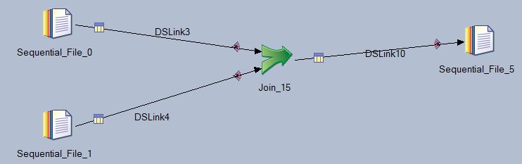
JOIN
Stage Type : Processing
Input Link Count : Single
Output Link Count : Multiple

Slide 55
The Join Stage
Four types:
Inner
Left outer
Right outer
Full outer
2 or more sorted input links, 1 output link
"left" on primary input, "right" on secondary input
Pre-sort make joins "lightweight": few rows need to be in RAM
Follow the RDBMS-style relational model
Cross-products in case of duplicates
Matching entries are reusable for multiple matches
Non-matching entries can be captured (Left, Right, Full)
No fail/reject option for missed matches

Slide 56
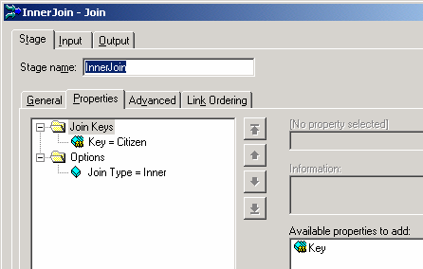
Join Stage Editor
Link order immaterial for Inner and Outer Join, Very Important for Left / Right Outer joins
One of Four Variants
Inner
Left Outer
Right Outer
Full Outer
Multiple Key columns allowed

Slide 57
Join Stage Behavior
We shall first use a simplest case, optimal input:
two input links: "left" as primary, "right" as secondary
sorted on key column (here "Citizen"),
without duplicates on key
Left link (primary input) Right link (secondary input)
Revolution | Citizen
1789 | Lefty
1776 | M_B_Dextrous
Citizen | Exchange
M_B_Dextrous | Nasdaq
Righty | NYSE

Slide 58
Inner Join
Transfers rows from both data sets whose key columns contain equal values to the output
Treats both inputs symmetrically link
Output of inner join on key Citizen
Revolution | Citizen | Exchange
1176 | M_B_DEXTROUS | Nasdaq
Same output as lookup/reject and merge/drop

Slide 59
Left Outer Join
Transfers all values from the left link and transfers values from the right link only where key columns match.
Revolution | Citizen | Exchange
1789 | Lefty
1176 | M_B_DEXTROUS | Nasdaq
Same output as lookup/continue and merge/keep

Slide 60
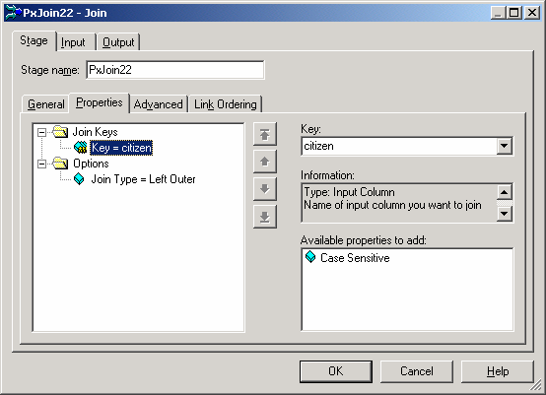
Left Outer Join
Check Link Ordering Tab to make sure intended Primary is listed first

Slide 61
Right Outer Join
Transfers all values from the right link and transfers values from the left link only where key columns match.
Revolution | Citizen | Exchange
1176 | M_B_DEXTROUS | Nasdaq
Null or 0 | Righty | NYSE

Slide 62
Full Outer Join
Transfers rows from both data sets, whose key columns contain equal values, to the output link.
It also transfers rows, whose key columns contain unequal values, from both input links to the output link.
Treats both input symmetrically.
Creates new columns, with new column names!
Revolution | LeftRec_Citizen | RightRec_Citizen | Exchange
1789 | Lefty
1176 | M_B_DEXTROUS | M_B_DEXTROUS | Nasdaq
0 |  | Righty | NYSE

Slide 63

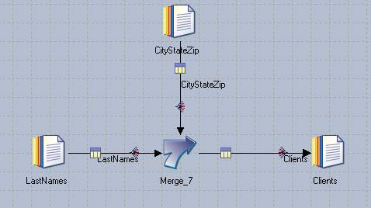
MERGE
Stage Type : Processing
Input Link Count : Multiple
Output Link Count : Single
Reject Link Count : Multiple

Slide 64

The Merge Stage
Allows composite keys
Multiple update links
Matched update rows are consumed
Unmatched updates in input port n can be captured in output port n
Lightweight:
Master
One or more Updates
0
1
2
0
Merge
2
Output
Rejects

Slide 65
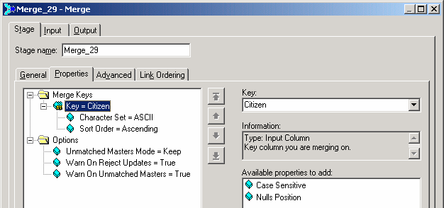
Merge Stage Editor
Unmatched Master rows
One of two options:
Keep [default]
Drop
(Capture in reject link is NOT an option)
Unmatched Update rows option:
Capture in reject link(s).
Implemented by adding outgoing links

Slide 66

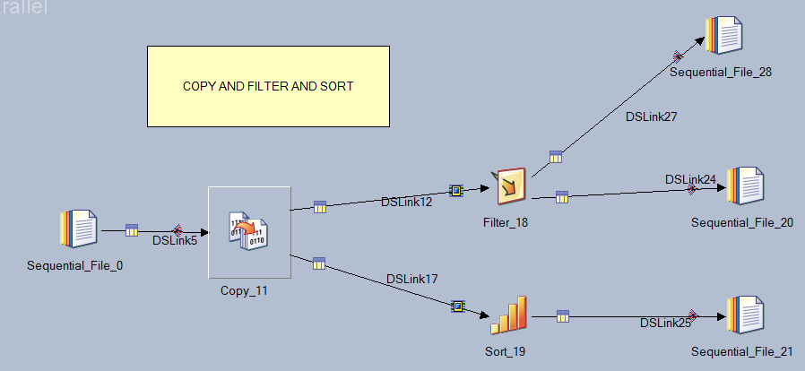
COPY STAGE
Stage Type : Processing
Input Link Count : Single
Output Link Count : Multiple

Slide 67
Properties of Copy Stage
The Copy stage copies a single input data set to a number of output data sets.
Records can be copied without modification or you can drop or change the order of columns.
USE: Copy stage is useful when we want to make a backup copy of a data set on disk while performing an operation on another copy.
TIP: Copy stage with a single input and a single output, needs Force set to be TRUE. This prevents DataStage from deciding that the Copy operation is superfluous and optimizing it out of the job.

Slide 68

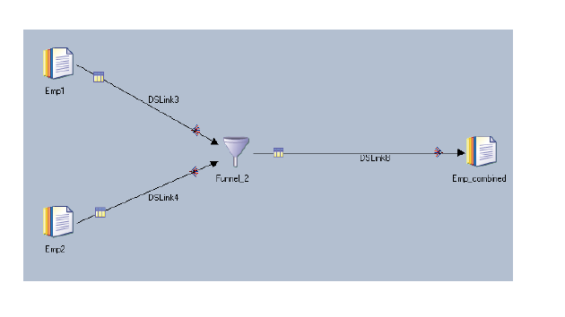
FUNNEL STAGE
Stage Type : Processing
Input Link Count : Multiple
Output Link Count : Single

Slide 69
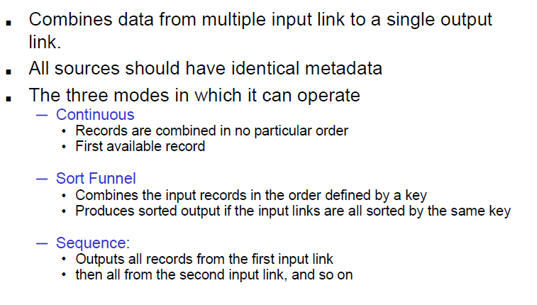
Properties of Funnel Stage
Notes:
It copies multiple input data sets to a single output data set.
This operation is useful for combining separate data sets into a single large data set.
The stage can have any number of input links and a single output link.
The Funnel stage can operate in one of three modes:
1] Continuous Funnel : combines the records of the input data in no guaranteed order. It takes one record from each input link in turn. If data is not available on an input link, the stage skips to the next link rather than waiting.
2] Sort Funnel : combines the input records in the order defined by the value(s) of one or more key columns and the order of the output records is determined by these sorting keys.
3] Sequence : copies all records from the first input data set to the output data set, then all the records from the second input data set, and so on.

Slide 70
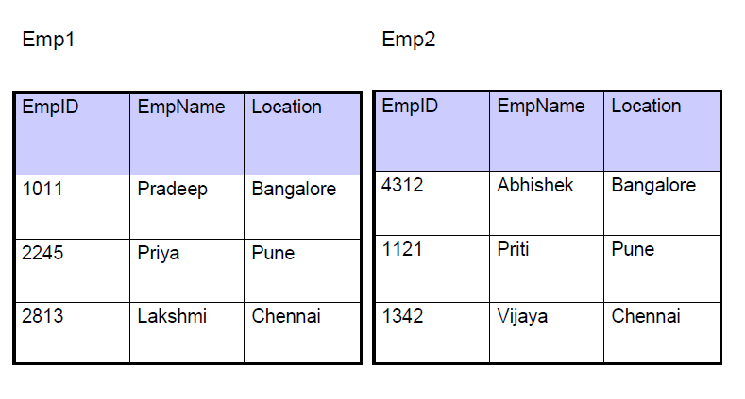
Input for Funnel Stage

Slide 71
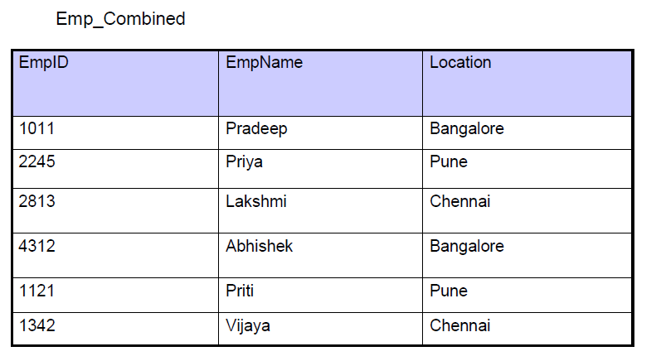
Output of Funnel Stage

Slide 72

FILTER STAGE
Stage Type : Processing
Input Link Count : Single
Output Link Count : Multiple
Reject Link Count : Single

Slide 73
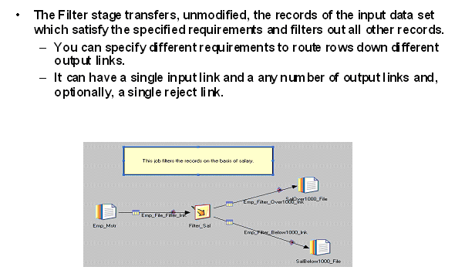
Properties of Filter Stage

Slide 74

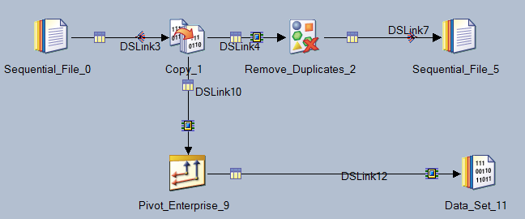
REMOVE DUPLICATES STAGE
Stage Type : Processing
Input Link Count : Single
Output Link Count : Single

Slide 75
Properties of Remove Duplicates
It takes Single Sorted Data as Input, Removes the duplicates and writes the result data to the Output.
Duplicate Records are removed on the basis of a Key Field.
Input Data must be Sorted.
TIP: Sort the data before sending it to Remove Duplicate Stage.

Slide 76
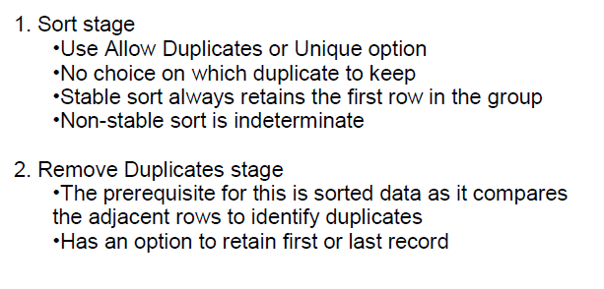
Methods of Duplicates Elimination

Slide 77
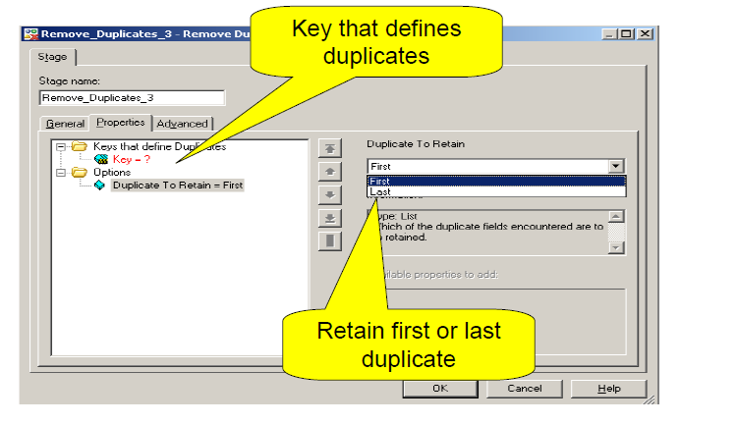
Remove Duplicates Stage Properties

Slide 78

SORT STAGE
Stage Type : Processing
Input Link Count : Single
Output Link Count : Single

Slide 79
Properties of Sort Stage
It has a Single Input Link and a Single Output Link carrying Sorted Data. Sorting is based on the defined Sort Key Column(s).
Sorting can be done in Sequential mode to sort Entire Data or in Parallel mode to sort within Partitions.
Sort Stages use Temporary disk space when performing sort.

Slide 80
Properties of Sort Stage (Continued)
Use same partitioning in case there is a possibility of the data sort order getting destroyed due to repartitioning.
Specify Primary Sort Key and Secondary Sort Key(s).
Specify the Sort Order as Ascending or Descending.
Specify the Sort as Case Sensitive or not.

Slide 81
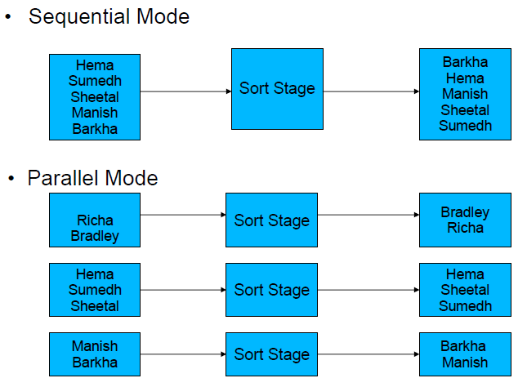
SORT Example

Slide 82
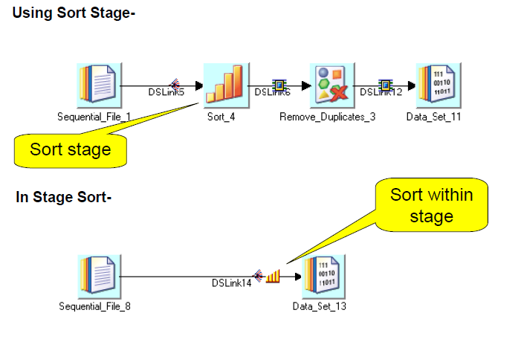
SORTING Alternatives

Slide 83
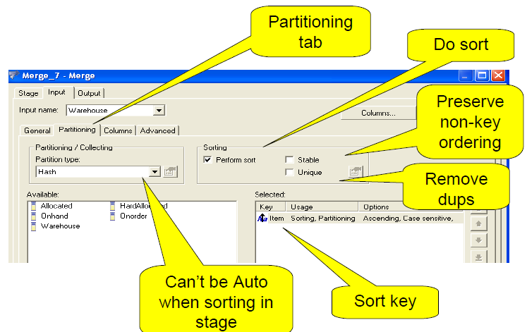
Within SORT Stage

Slide 84

Within SORT Stage (Continued)

Slide 85

SORT Options

Slide 86

Using Sort Option ‘Stable’

Slide 87

Using Sort Option ‘Create Key Change Column’

