Slide 1

Datastage Basics Training - Processing & Other Stages
Abhishek A. Bagarka, GDC Consultant
13-Dec-2016

Slide 2
Agenda
Group 2 -> Processing Stages Contd.
Group 3 -> Restructure Stages
Group 4 -> Development/Debug
Group 4 -> Database Stages
2
© 2014 Teradata

Slide 3
Group 2 -> Processing Stages Contd.
Lookup
Surrogate Key
Change Data Capture
Change Apply Stage
3
© 2014 Teradata

Slide 4

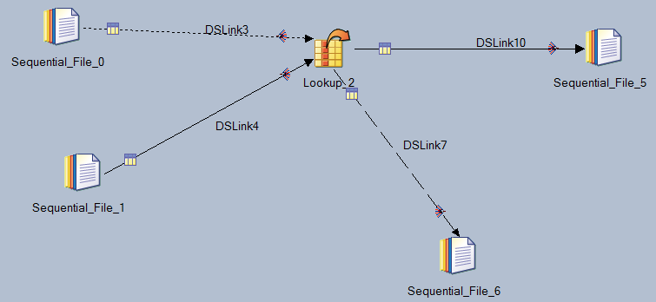
LOOKUP STAGE
Stage Type : Processing
Input Link Count : Multiple
(Single Primary Input Stream &
Multiple Secondary Input Streams
i.e. Reference Links)
Output Link Count : Single
Reject Link Count : Single

Slide 5
Properties of Lookup Stage
Lookup matches records in its Primary Input Stream with records in its Secondary Input Stream(s) i.e. Reference Link.
Records are matched on the basis of a Key Field.
USE:
1] To Map short codes in the input dataset onto expanded information from a lookup table which is joined to the incoming data and output.
2] Lookups can also be used for validation of a row. If there is no corresponding entry in a lookup table to the key’s values, the row is rejected.

Slide 6
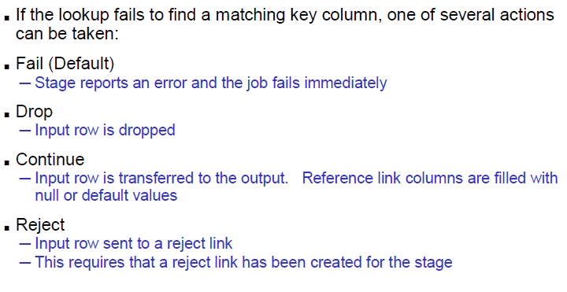
LOOKUP Failure Actions

Slide 7
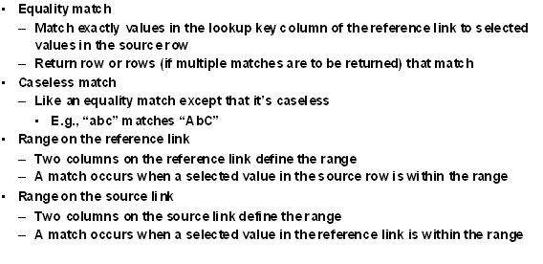
LOOKUP Types

Slide 8
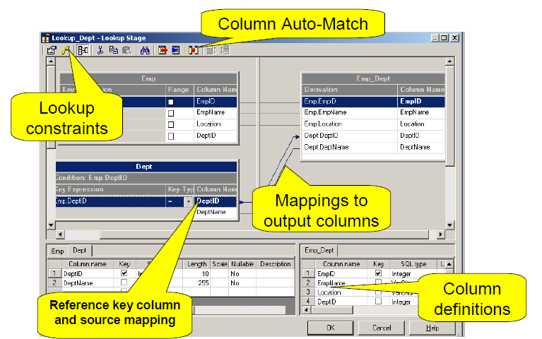
Lookup Stage with EQUALITY Match

Slide 9
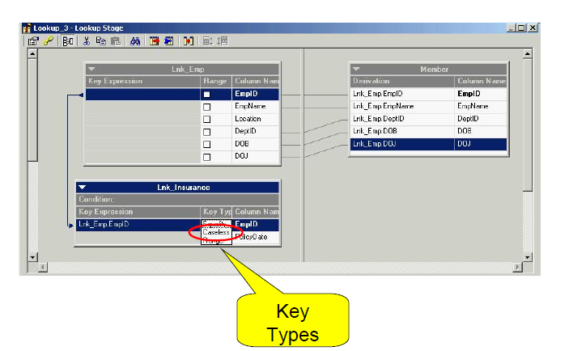
Lookup Stage with Caseless Match

Slide 10

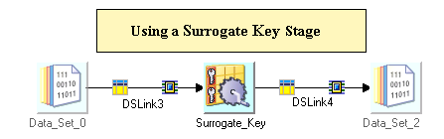
SURROGATE KEY STAGE
Stage Type : Processing
Input Link Count : Single
Output Link Count : Single

Slide 11
WHAT IS IT USED FOR?
The Surrogate Key Generator stage is a processing stage that generates surrogate key columns and maintains the key source.
A surrogate key is a unique primary key that is not derived from the data that it represents, therefore changes to the data will not change the primary key.
In a star schema database, surrogate keys are used to join a fact table to a dimension table.
The Surrogate Key Generator stage can have a single input link, a single output link, both an input link and an output link, or no links.

Slide 12

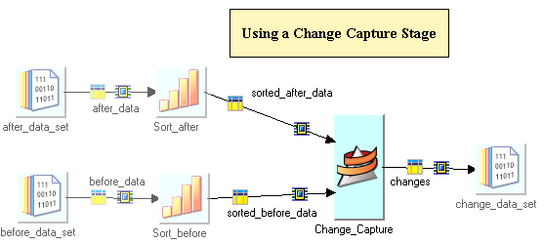
CHANGE DATA CAPTURE STAGE
Stage Type : Processing
Input Link Count : Multiple
Output Link Count : Single

Slide 13
WHAT IS IT USED FOR?
The stage compares two data sets and makes a record of the differences.
The Change Capture stage takes two input data sets, denoted before and after, and outputs a single data set whose records represent the changes made to the before data set to obtain the after data set.
The stage produces a change data set, whose table definition is transferred from the after data set’s table definition with the addition of one column: a change code with values encoding the four actions: insert, delete, copy, and edit.
The preserve-partitioning flag is set on the change data set.
The compare is based on a set of key columns, rows from the two data sets are assumed to be copies of one another if they have the same values in these key columns.

Slide 14
Continues…..
We can also optionally specify change values. If two rows have identical key columns, we can compare the value columns in the rows to see if one is an edited copy of the other.
The stage assumes that the incoming data is key-partitioned and sorted in ascending order. The columns the data is hashed on should be the key columns used for the data compare. We can achieve the sorting and partitioning using the Sort stage or by using the built-in sorting and partitioning abilities of the Change Capture stage.
We can use the companion Change Apply stage to combine the changes from the Change Capture stage with the original before data set to reproduce the after data set.

Slide 15

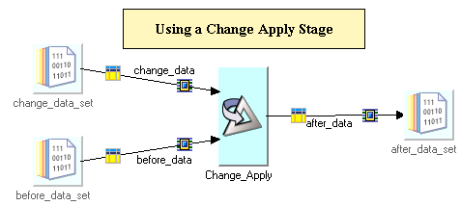
CHANGE APPLY STAGE
Stage Type : Processing
Input Link Count : Multiple
Output Link Count : Single

Slide 16
WHAT IS IT USED FOR?
It takes the change data set, that contains the changes in the before and after data sets, from the Change Capture stage and applies the encoded change operations to a before data set to compute an after data set.
The before input to Change Apply must have the same columns as the before input that was input to Change Capture, and an automatic conversion must exist between the types of corresponding columns.
In addition, results are only guaranteed if the contents of the before input to Change apply are identical (in value and record order in each partition) to the before input that was fed to Change Capture, and if the keys are unique.
The Change Apply stage reads a record from the change data set and from the before data set, compares their key column values, and acts accordingly.

Slide 17
Group 3 -> Restructure Stage
Column Import
Column Export
17
© 2014 Teradata

Slide 18
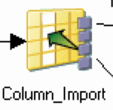
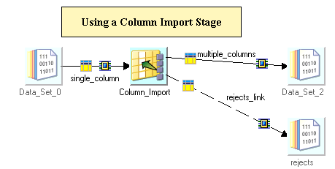
COLUMN IMPORT STAGE
Stage Type : Restructure
Input Link Count : Single
Output Link Count : Single
Reject Mode : Single

Slide 19
WHAT IS IT USED FOR?
Column Import stage is a restructure stage
The Column Import stage imports data from a single column and outputs it to one or more columns
Typically use it to divide data arriving in a single column into multiple columns
The data would be structured (fixed-width or delimited) in some way to tell the Column Import stage where to make the divisions
The input column must be a string or binary data, the output columns can be any data type
Information about the format of the incoming column (for example, how it is delimited) must be provided.
In addition to importing a column you can also pass other columns straight through the stage.

Slide 20

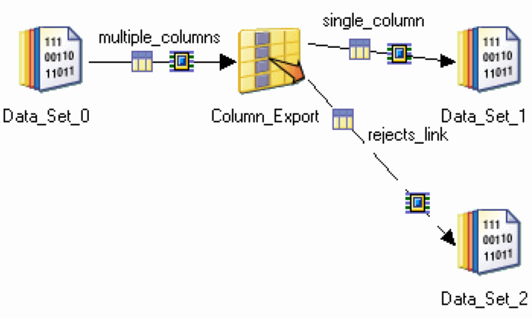
COLUMN EXPORT STAGE
Stage Type : Restructure
Input Link Count : Single
Output Link Count : Single
Reject Mode : Single

Slide 21
WHAT IS IT USED FOR?
Column Export stage is a restructure stage
The Column Export stage exports data from a number of columns of different data types into a single column of data type string or binary.
It is the complementary stage to Column Import
The input data column definitions determine the order in which the columns are exported to the single output column.
You must provide information about how the single column being exported is structured.
You can optionally save reject records whose export was rejected.
In addition to exporting a column, you could pass a key column straight through.

Slide 22
Group 4 -> Development/Debug Stage
Head
Sample
Peek
Row Generator
Column Generator
22
© 2014 Teradata

Slide 23

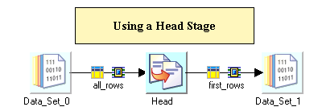
HEAD STAGE
Stage Type : Development/Debug
Input Link Count : Single
Output Link Count : Single

Slide 24
WHAT IS IT USED FOR?
Head Stage provides you sample data.
The Head Stage selects the first N rows from each partition of an input data set and copies the selected rows to an output data set. We determine which rows are copied by setting properties which allow you to specify:
The number of rows to copy
The partition from which the rows are copied
The location of the rows to copy
The number of rows to skip before the copying operation begins
This stage is helpful in testing and debugging applications with large data sets.
This stage is helpful in testing and debugging applications with large datasets. For example, the Partition property lets you see data from a single partition to determine if the data is being partitioned as you want it to be. The Skip property lets you access a certain portion of a data set.

Slide 25

SAMPLE STAGE
Stage Type : Development/Debug
Input Link Count : Single (Percent or Period mode)
Output Link Count : Single (Period mode)
Multiple (Percent mode)
Operation Mode : Percent or Period
The sample stage Samples data.
Sampling is concerned with the selection of a subset of data from the entire dataset

Slide 26

PEEK STAGE
Stage Type : Development/Debug
Input Link Count : Single
Output Link Count : Multiple
It helps in the monitoring of the application or to diagnose a bug in the application.
It lets you print the column values of a record either to a job log or an output link.

Slide 27

ROW GENERATOR STAGE
Stage Type : Development/Debug
Input Link Count : None
Output Link Count : Single
It produces a set of mock data fitting the specified metadata.
Most useful when you want to test the job you have developed and have no data available for testing.

Slide 28

COLUMN GENERATOR STAGE
Stage Type : Development/Debug
Input Link Count : Single
Output Link Count : Single
It adds columns to incoming data and generates mock data for these columns for each data row processed.
Similar to the Row Generator stage, it is useful when your data is not available for a field logic to be tested.

Slide 29
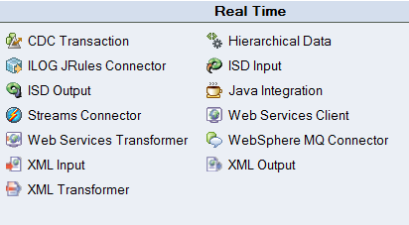
Group 5 -> Real Time Stages
29
© 2014 Teradata

Slide 30
Group 6 -> Database Stages
TD Connector
30
© 2014 Teradata

Slide 31
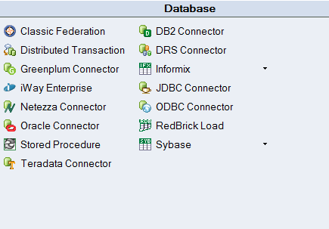
DATABASE STAGES OPTIONS

Slide 32
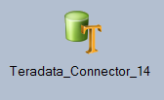
TERADATA CONNECTOR STAGE - tcon
Stage Type : Database
Input Link Count : Single(No output link in this case)
Output Link Count : Single(No input link in this case)
Reject Link Count : Single(Used in Input mode)
Reference Link Count : Single(Used in Output mode)
It allows us to read data from a Teradata database or write into it.
It also can be used in conjunction with a Lookup stage to access a lookup table hosted by an Teradata database.
It allows to perform Inserts, Updates and Deletes to a Teradata table.

Slide 33
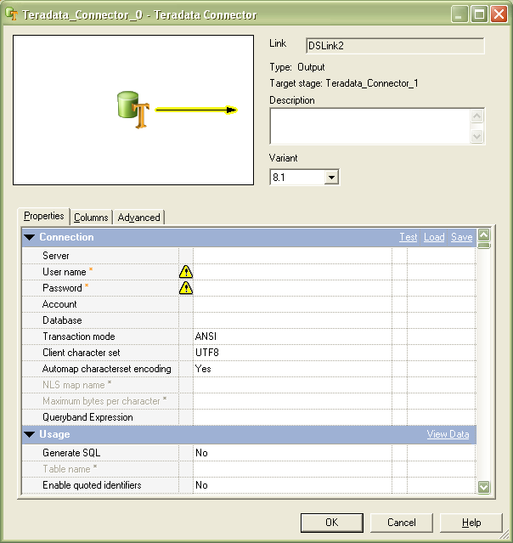
Properties of TD Connector Stage
TD Connector Stage when data is read from it.
Credentials such as the Server details, userID, password and Database name need to be provided for connecting to the TD database
The SQL can be Auto generated by providing the Table name or query can be built by SQL builder or manually provided

Slide 34
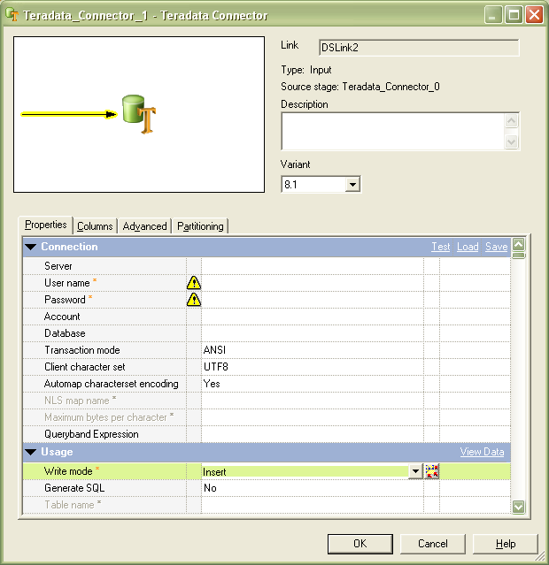
Properties Continued..
TD Connector Stage when Data is written to it
Provide the connection details similar to those provided while data was being read from the TD connector
Select the operation to be performed. Insert, update, delete, etc.
Provide the SQL for the operation to be performed

