Slide 1

Datastage Basics Training - Developer Guide
Abhishek A. Bagarka, GDC Consultant
15-Dec-2016

Slide 2

Agenda
Shared Containers
Sequencers
Routines
Slowly Changing Dimension
ETL Control Framework
GCFR & Datastage
2
© 2014 Teradata

Slide 3

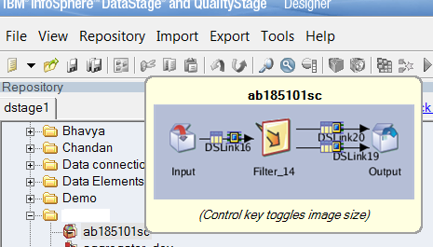
SHARED CONTAINERS
Stage Type : Processing
Input Link Count : Multiple
(Single Primary Input Stream &
Multiple Secondary Input Streams
i.e. Reference Links)
Output Link Count : Single
Reject Link Count : Single

Slide 4
WHAT IS IT USED FOR?
Shared containers help you to simplify your design by making a common logic be shared across multiple jobs
Pre-configured stage available for other jobs
Server shared container can be inserted into a parallel job as a way of making server job functionality available in that parallel job
Shared containers comprise groups of stages and links and are stored in the Repository like IBM® InfoSphere® DataStage® jobs

Slide 5

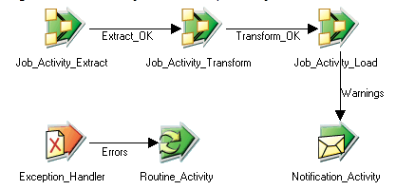
SEQUENCERS
Combines job into a sequence to synchronize the control flow
Multiple jobs in sequence to integrate programming control
Different action can be triggered based on whether a job has executed successfully or encountered failure
Checkpoint restart, notification & exception handling capability

Slide 6

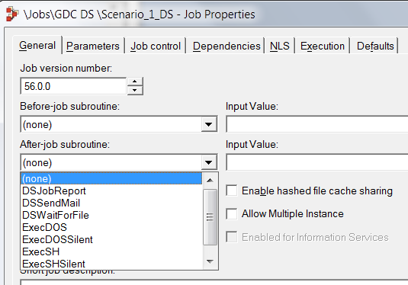
ROUTINES
Used for pre or post processing in Datastage jobs
Can execute an external code snippet or command for additional processing logic outside Datastage
Routines are stored in the Routines branch of the DataStage Repository, where you can create, view or edit.
The different types of routines:
Transform functions
Before-after job subroutines
Job Control routines

Slide 7

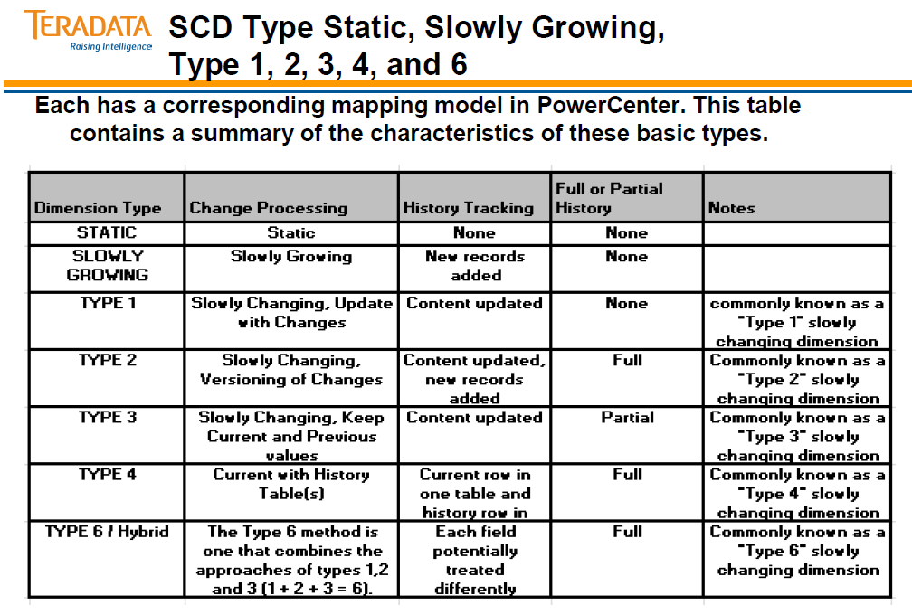
SLOWLY CHANGING DIMENSIONS

Slide 8
Slowly Changing Dimensions
Stage Type : Processing
Input Link Count : Single
Output Link Count : Single
Dimension Reference Link Count : Single
Dimension Update Count : Single
The SCD stage
reads source data on the input link
performs a dimension table lookup on the reference link
writes data on the output link i.e. to another SCD stage, other processing stage or fact table
The dimension update link is a separate output link that carries changes to the dimension
SCD stages support both SCD Type 1 and SCD Type 2 processing:
SCD Type 1
Overwrites an attribute in a dimension table
SCD Type 2
Adds a new row to a dimension table

Slide 9
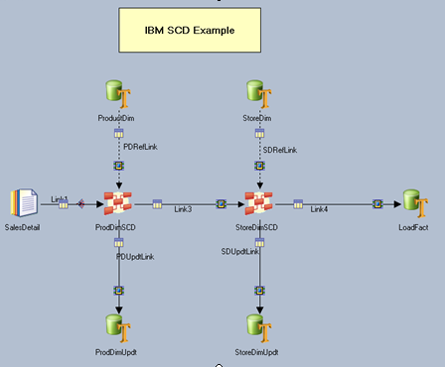
Slowly Changing Dimensions

Slide 10
ETL CONTROL FRAMEWORK
Reporting infrastructure capable of capturing job metrics in a relational database
Capable of storing DataStage runtime information suitable for auditing and reporting
Methodology for capturing all DataStage job metrics

Slide 11
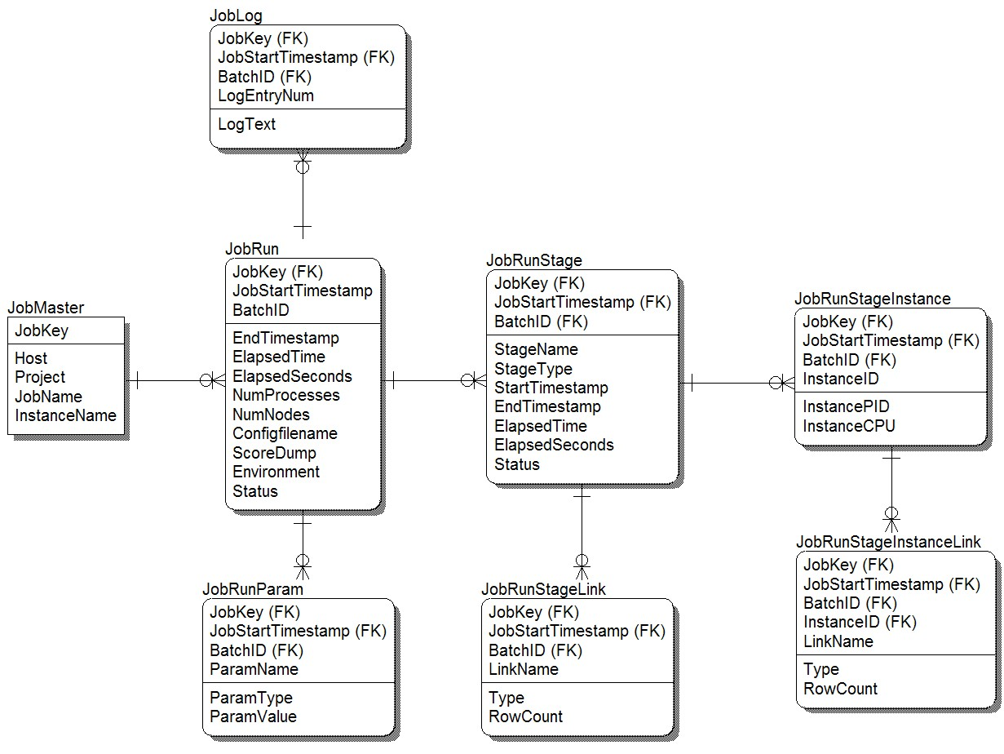
DATA MODEL SAMPLE FOR CONTROL FRAMEWORK

Slide 12
GCFR - Global Control Framework Repository
Is a set of architectural standards
And a code library of standard APIs
And other reusable components
To control and manage the process of data integration for the integrated data warehouse, including time-variant data.
Includes capture, maintenance and reporting of operational metadata.
Allows project teams to quickly implement DI patterns in their tool of choice, or use prebuilt processing patterns from the GCFR library

Slide 13
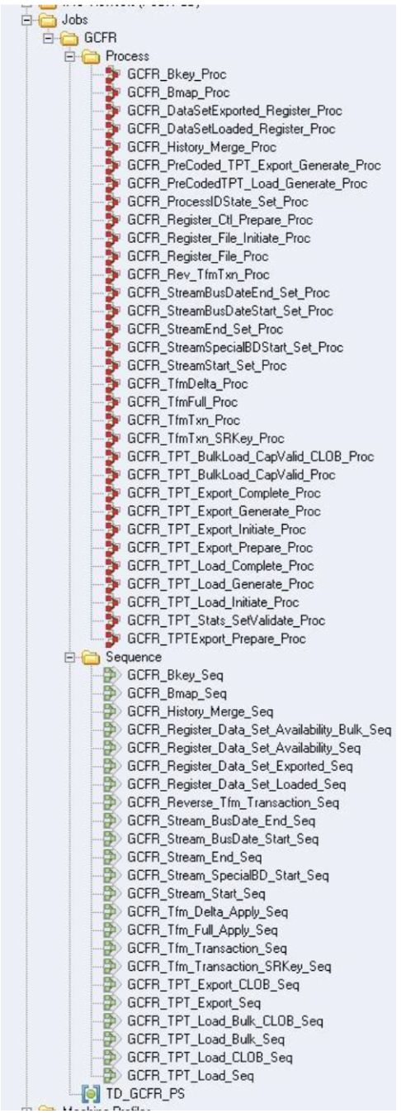
Data Stage GCFR Integration

Slide 14
Data Stage GCFR Integration
Common DataStage multi-instance job sequences for the GCFR are present in the DataStage Project. These Job Sequences have been developed using IBM DataStage v8.1 and are compatible with IBM DataStage 8.5, 8.7, 9.1 and 11.3.
These job sequences are used to call Teradata stored procedures to execute GCFR ETL/ELT processes and Control processes. These are parameter driven jobs.
Clients may develop their own ELT Process Flow Job Sequences that will call GCFR DataStage job sequences in a specific order based on their custom ELT data-flow requirements.
Further details are available in GCFR Data Stage Development Guide which comes with GCFR Package.

