Slide 1


GenSearch: Revolutionizing Search Through AI and RAG
MICROSOFT
HACKATHON INNOVATION CHALLENGE DECEMBER 2024
Powered by

Slide 2
The Challenge of Modern Information Retrieval
Limited Relevance: Traditional search engines often fail to understand user intent, leading to irrelevant results.
Lack of Context Awareness: Current systems can't adapt to evolving search queries or provide personalized results.
Static Search Results: Relying on static keyword matching, current technologies struggle with dynamic, complex information.
Increased Data: As the volume of data grows, it's harder to search efficiently without a deeper understanding of context.
Powered by

Slide 3
The Solution: GenSearch
GenSearch leverages AI to understand the context behind search queries for more accurate results.
Tailors search outputs based on user history and preferences.
Built to handle large-scale data operations, ensuring smooth performance across industries.
Supports text, image, and voice inputs, broadening search possibilities and improving accessibility.

Slide 4








TECH STACK
Frontend and Backend
HTML
CSS
Python
Flask
Aure Services Used
Azure OpenAI
Search Cognitive service
Azure AI Services
Translator
Document intelligence
Powered by
Storage account

Slide 5
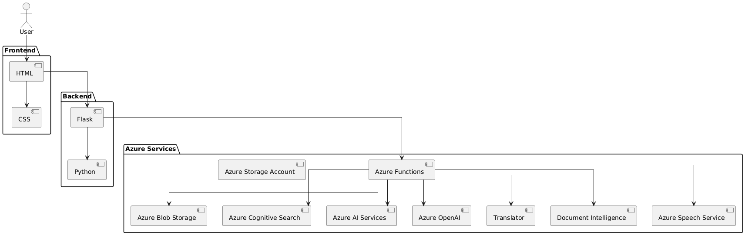
Architecture diagram for GenSearch
Powered by

Slide 6
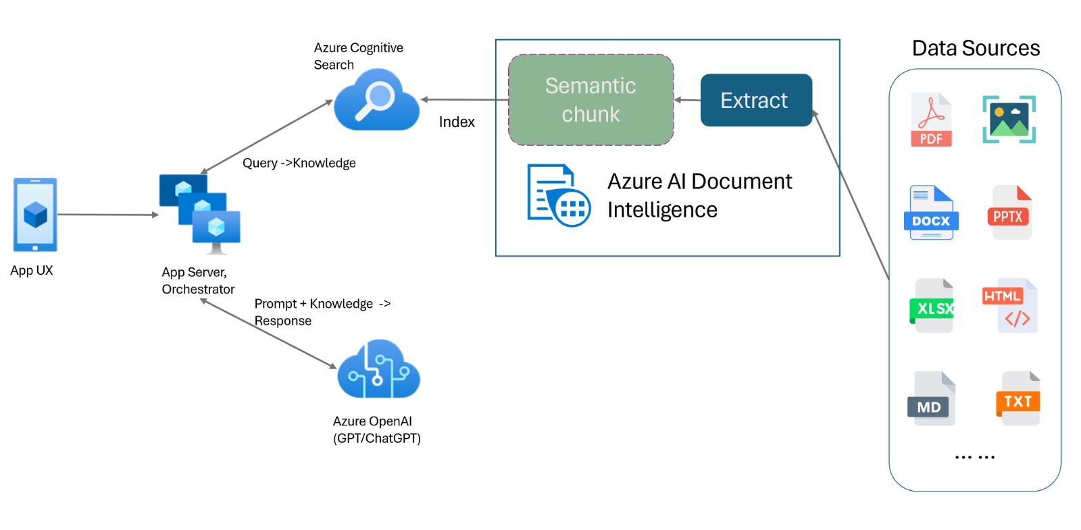
Powered by

Slide 7
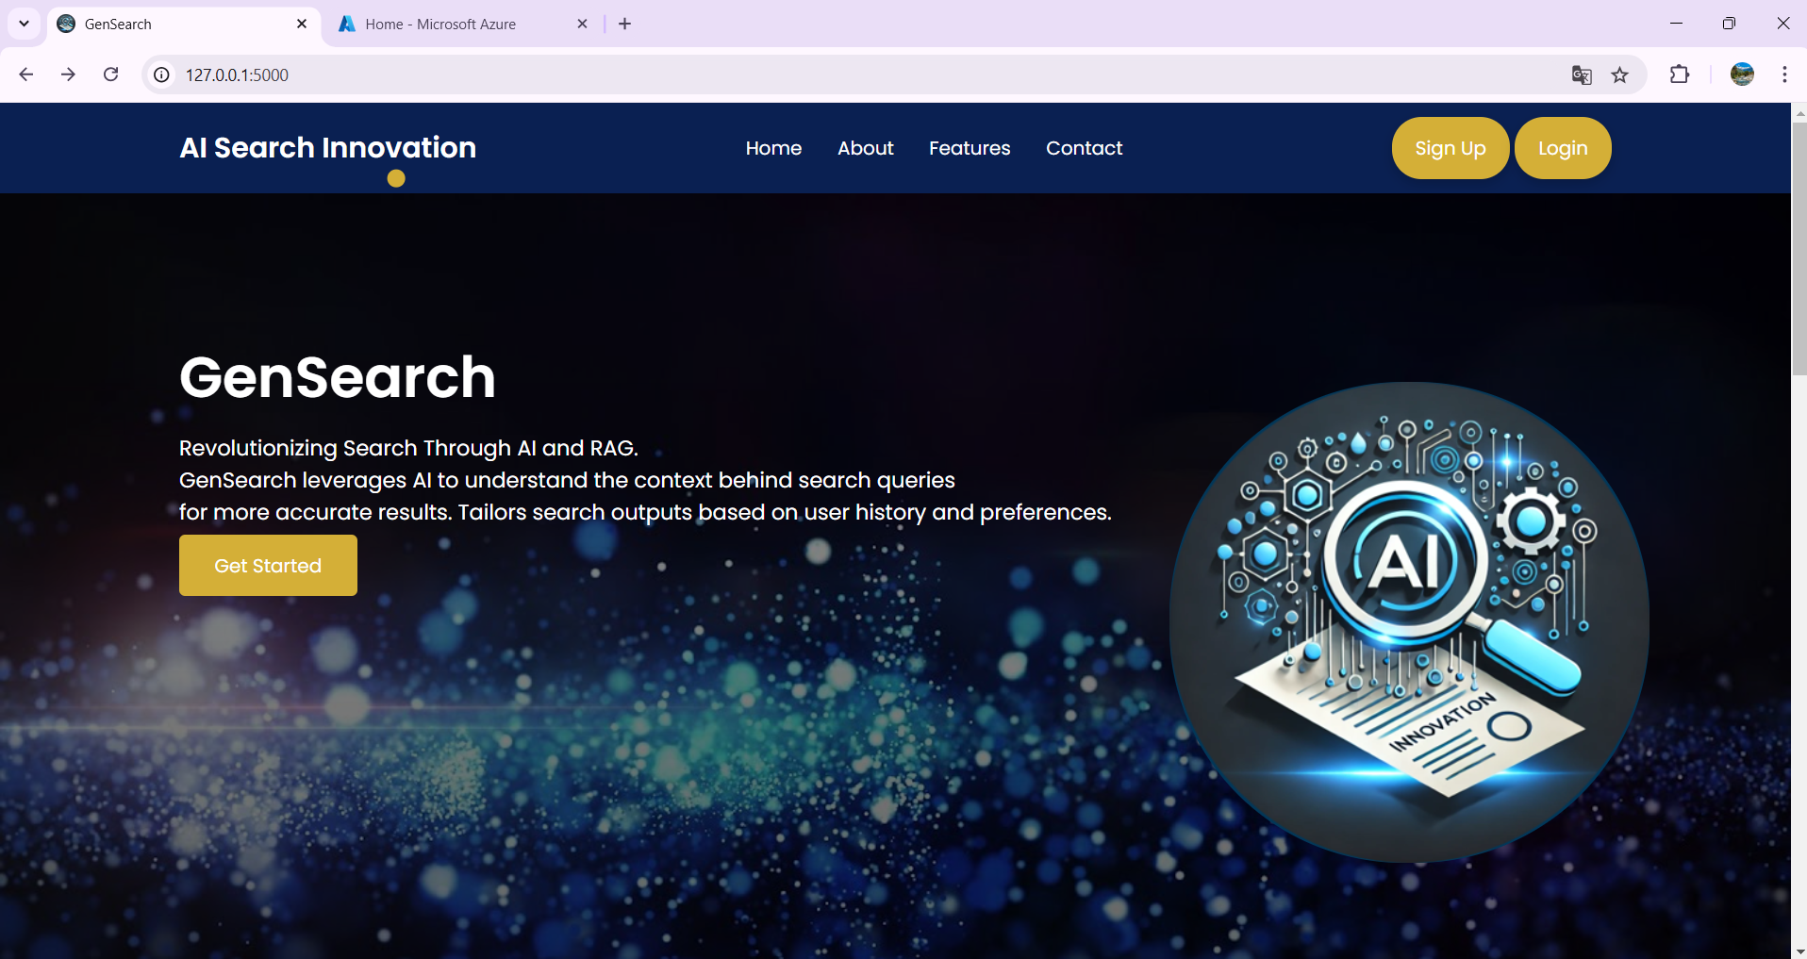
Live Demo
Powered by

Slide 8
Future Vision and Closing Remarks
Key Takeaways:
GenSearch will expand its platform integration (mobile, desktop, voice assistants) and refine personalization algorithms to better adapt to user behavior for a more seamless and intuitive experience
Implement machine learning models that predict search intent before users finish typing.
Strengthen privacy protocols to ensure secure handling of sensitive data in search results.
Future Enhancements:
Future versions of GenSearch will include multilingual support, more AI models, and improved integration with IoT devices.
Leveraging user feedback and data to improve search algorithms, enhancing user satisfaction.
Powered by

Slide 9



Hackers
Kanika Baskar
DEVESH S B
kanikabaskar13@gmail.com
devesh.22cse@sonatech.ac.in
Powered by

