Slide 1
Kashmir Sentiment Analysis
PLSC 31101 – Final Project
Kanika S. Sisodia

Slide 2
Key Points
For my final project submission I have performed a sentiment analysis using tweets from the Twitter website
Scraped 10,000 tweets on December 8th, 2019 with the hashtag #Kashmir .
Removed any unnecessary qualities in the data which would make the dataset a poor generalizer.
Converted the data into a corpus and then into a document term matrix.
Plotted the 10 most frequent terms and created a word cloud of 150 most frequent words.
Performed a sentiment analysis using the ’nrc’ dictionary and plotting it.

Slide 3
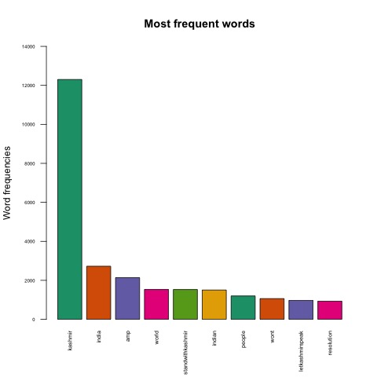
Notes:
Barplot of the 10 most frequent words

Slide 4
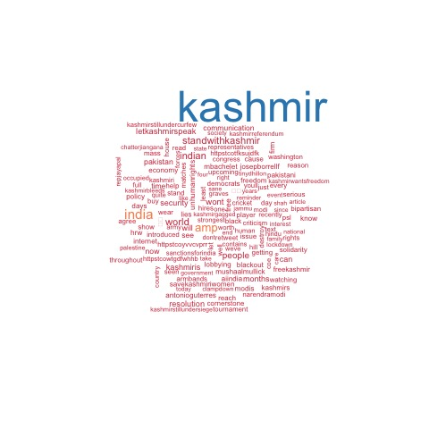
Notes:
Word cloud of the 150 most frequent words

Slide 5
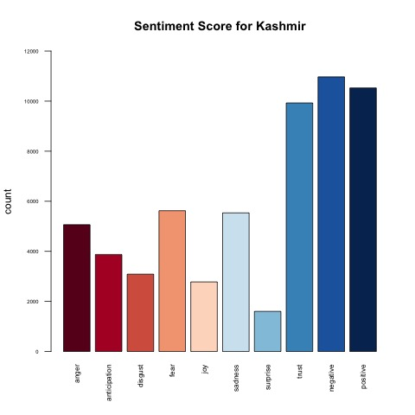
Notes:
Sentiment score for Kashmir

