Slide 1
A W S C L O U D & D E V O P S P R O J E C T
Cloud-Based Smart Home Monitoring & Automation Platform
A serverless, cloud-native platform for real-time monitoring and remote control of smart home devices — built entirely on AWS managed services.
S3
DynamoDB
API Gateway
Lambda
CloudWatch
IAM
GitHub Actions
S U B M I T T E D B Y
Kesanapalli Poojitha
Kondreddy Nikhitha Dhanamjaya
Kodakatla Chomeswari
Donthamsetti Devi
Kanikineedi Tejaswi
Group Project • Summer Internship Program on AWS • APSSDC • Batch 1

Slide 2
Project Summary
A B S T R A C T
The Cloud-Based Smart Home Monitoring & Automation Platform lets users monitor and control home appliances remotely, using Amazon Web Services (AWS) and DevOps practices.
6
AWS services orchestrated
Device status and live sensor readings — lights, fans, doors, an air conditioner, temperature, humidity, gas, and motion — are shown through a web-based dashboard, backed entirely by managed AWS services.
4
Device types controlled
Device data is stored in Amazon DynamoDB, the dashboard is hosted as a static site on Amazon S3, Amazon API Gateway exposes secure REST endpoints, AWS Lambda runs the automation logic, and Amazon CloudWatch monitors performance — all secured with AWS IAM.
3
Lambda functions
24/7
Cloud monitoring via CloudWatch
DevOps practices — Git, GitHub, and GitHub Actions — automate source control and deployment, delivering a scalable, secure, and continuously deployed smart-home ecosystem.

Slide 3

Why This Project?
P R O B L E M S T A T E M E N T
Traditional home-automation systems often require expensive hardware, complex installation, and limited remote accessibility. Managing multiple devices manually is inefficient and time-consuming — there is a clear need for a secure, scalable, cloud-based platform that users can monitor and control from anywhere.
The Core Problem
Manual, hardware-heavy home monitoring means no centralized visibility — a device left on, a gas leak, or a door
left unlocked can go unnoticed until it's too late, with no easy way to check or act remotely.

Slide 4

E X I S T I N G I S S U E S
Problems with Current Approaches
No remote visibility into device status or sensor conditions
Manual, hardware-based automation is costly and complex to install
No centralized dashboard for controlling multiple appliances
Abnormal conditions (e.g., gas leaks) go undetected without alerts
Limited scalability and no built-in monitoring or logging
No automated, repeatable deployment process for updates

Slide 5






A Cloud-Native Answer
P R O P O S E D S O L U T I O N
The platform is a cloud-based, serverless system built entirely on AWS. It monitors live sensor data and lets users control lights, fans, doors, and an air conditioner from a single web dashboard — with automation logic, storage, and monitoring fully managed in the cloud.
DASHBOARD
API
COMPUTE
DATA
MONITOR
Static site on Amazon S3
Amazon API Gateway
AWS
Lambda
Amazon DynamoDB
Amazon CloudWatch

Slide 6




What Is the Platform?
P R O J E C T O V E R V I E W
A cloud-hosted dashboard that lets a user monitor live sensor data and remotely control smart home devices — powered end-to-end by AWS managed services.
Device Control
Live Sensor Feed
Automated Backend
Toggle lights, fans, doors, and the air conditioner from one dashboard
Real-time temperature, humidity, gas, and motion readings
AWS Lambda processes every request behind API Gateway
Persistent State
Activity Logging
Secure by Design
Device status and sensor history stored in DynamoDB
Live-updating temperature chart and recent activity log
IAM least-privilege access across every AWS service

Slide 7



S Y S T E M D E S I G N
End-to-End Architecture
A serverless, event-driven flow — from the browser dashboard through API Gateway, Lambda, and into AWS storage & monitoring.
User Browser
Dashboard (Amazon S3)
API Gateway (SmartHomeAPI)
AWS Lambda (3 functions)
DynamoDB (device data)
GitHub Actions CI/CD Deploy
CloudWatch Monitoring & Logs
Steps: dashboard access → static hosting on S3 → HTTPS request to API Gateway → Lambda automation logic → DynamoDB read/write → CloudWatch logging, with GitHub
Actions handling CI/CD deployment.

Slide 8
Built on Managed AWS Services
T E C H N O L O G Y S T A C K
Layer | Service | Detail
Frontend | HTML, CSS, JavaScript | Responsive dashboard with live device & sensor cards
API Layer | Amazon API Gateway | Secure REST endpoints (SmartHomeAPI)
Compute | AWS Lambda | Automation & data-processing logic
Data Storage | Amazon DynamoDB | Device status & sensor readings (NoSQL)
Hosting | Amazon S3 | Static website hosting for the dashboard
Security | AWS IAM | Role-based, least-privilege access control
Monitoring | Amazon CloudWatch | Logs, metrics & performance monitoring
DevOps | Git, GitHub, GitHub Actions | Version control & CI/CD automation

Slide 9
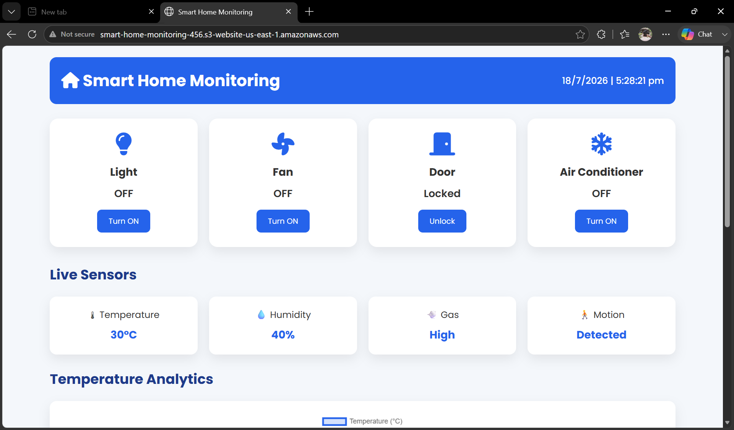
I M P L E M E N T A T I O N
Smart Home Dashboard
Live controls for lights, fans, doors, and the air conditioner
Real-time sensor cards: temperature, humidity, gas, motion
Interactive JavaScript toggles update device status instantly
Live-updating temperature chart
and recent activity log

Slide 10
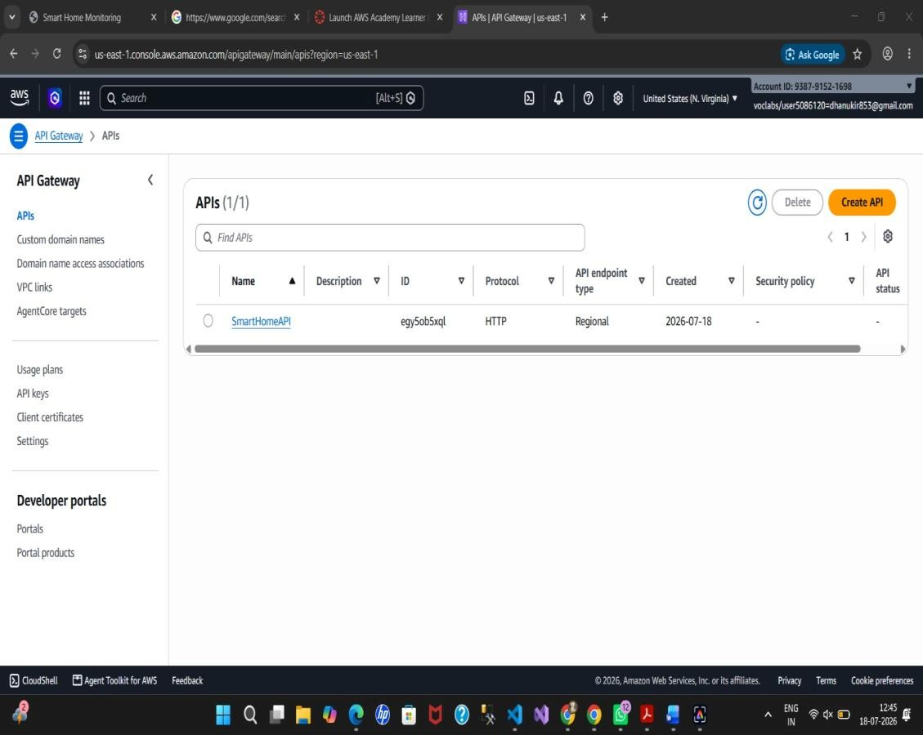
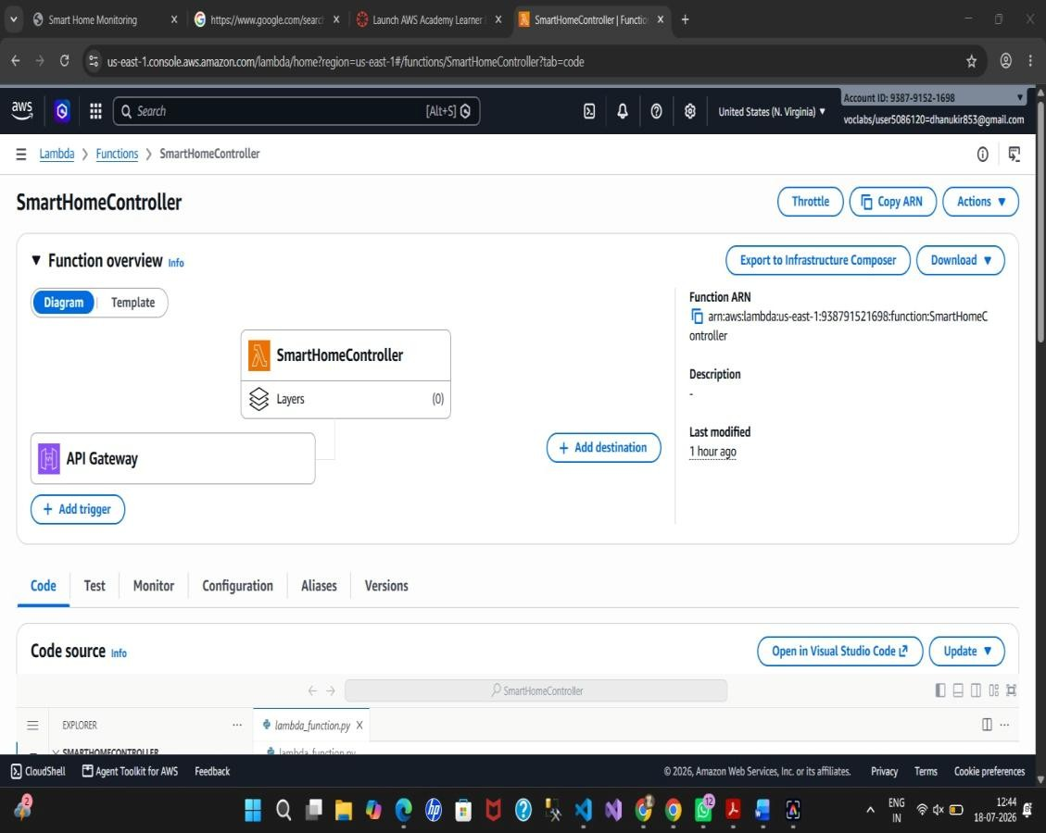
B A C K E N D I M P L E M E N T A T I O N
API Gateway & Lambda
SmartHomeAPI registered in Amazon API Gateway
Lambda functions: SmartHomeController, GetSmartHomeData,
MainMonitoringFunction

Slide 11
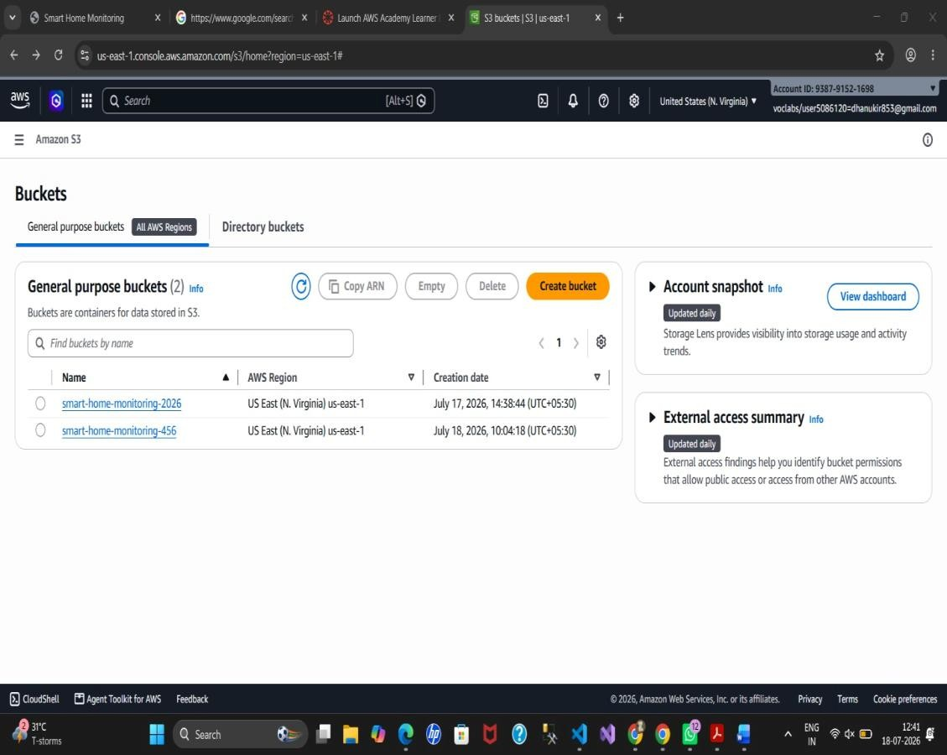
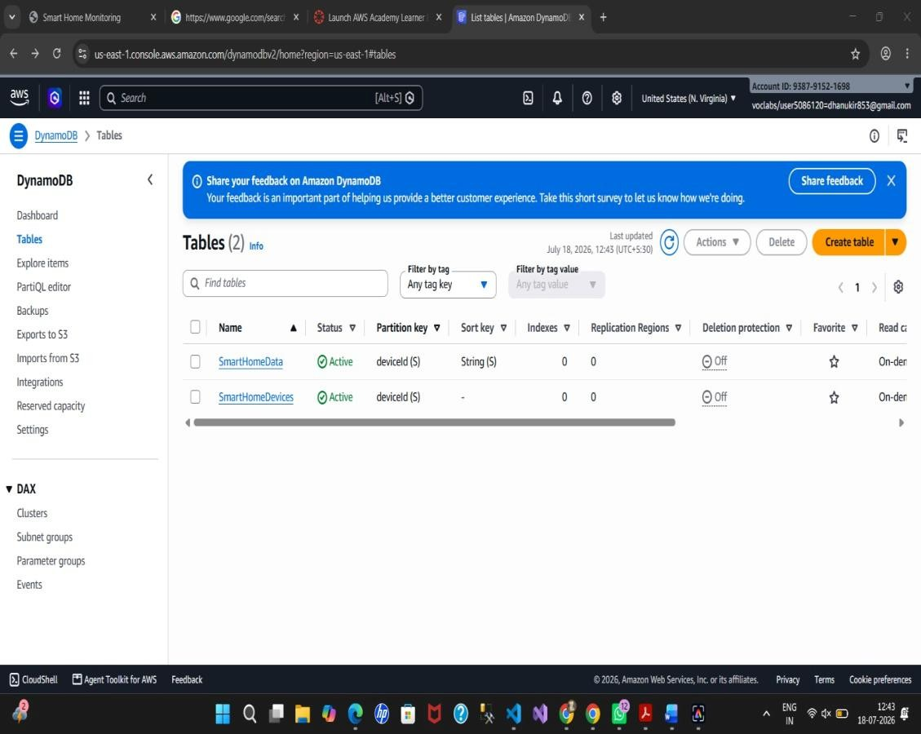
Storage: S3 & DynamoDB
B A C K E N D I M P L E M E N T A T I O N
S3 bucket “smart-home-monitoring-456” hosts the dashboard
DynamoDB tables: SmartHomeData & SmartHomeDevices

Slide 12
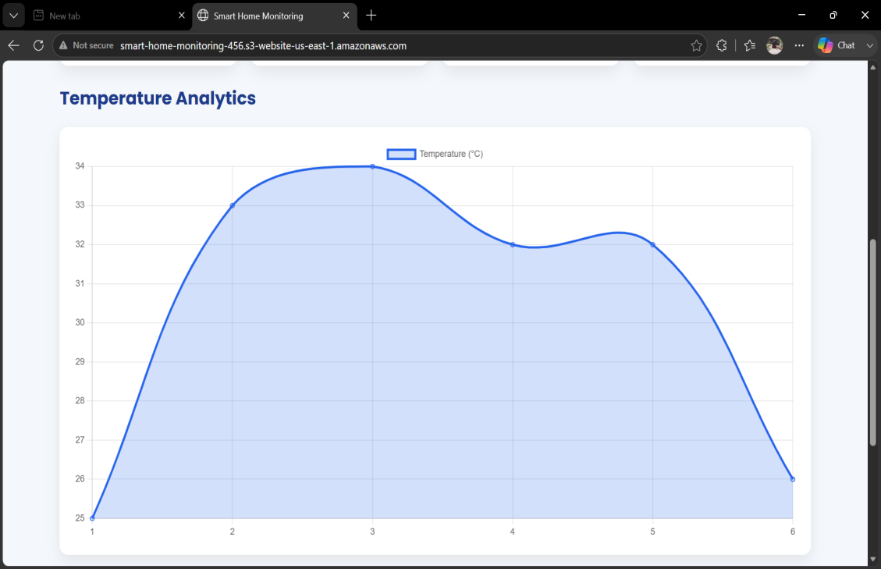
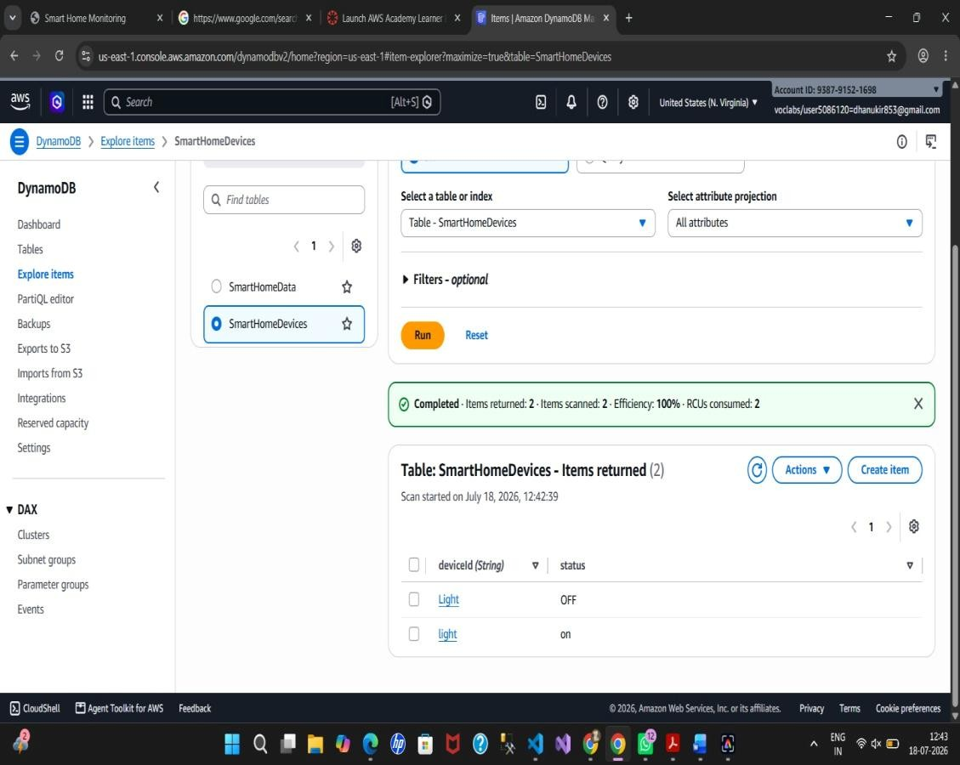
Verified in Practice
T E S T I N G & M O N I T O R I N G
Temperature analytics chart & recent activity log during testing
DynamoDB scan confirms device records are persisted correctly

Slide 13
What We Achieved
R E S U L T S
100%
3
Core Lambda Functions
Real-time
Device & Sensor Sync
Secure
Serverless
IAM by Design
No servers provisioned or managed
Control, data retrieval & monitoring
Instant status updates on the dashboard
Least-privilege access on every service
The system handled repeated device toggles, live sensor updates, and gas-level alerts without downtime — confirming the architecture is stable and ready for real-world use.

Slide 14






F U T U R E E N H A N C E M E N T S
Where This Goes Next
Mobile App Integration
Voice Assistant Support
AI-Based Energy Optimization
Native control from a companion mobile application
Hands-free control via voice commands
Smarter automation using usage pattern analysis
Smart Security Cameras
Predictive Maintenance
Real IoT Device Connectivity
Integrated live video monitoring
Analytics to flag issues before they occur
Extending beyond simulated sensor data

Slide 15
A Production-Style Cloud Architecture on AWS
C O N C L U S I O N
The Cloud-Based Smart Home Monitoring & Automation Platform demonstrates serverless compute, structured data storage, secure REST API design, and operational monitoring — core skills for cloud and DevOps development, with room to grow into real IoT connectivity, mobile support, and AI-based automation.
Thank You

