Slide 1
INTELLIGENT BATTERY MONITORING SYSTEM USING VERILOG HDL

Slide 2

INTRODUCTION
This project is a Battery Monitoring System designed using Verilog HDL. It checks the voltage and temperature of a battery in real-time to ensure safe operation.
The system detects three main fault conditions: undervoltage, overvoltage, and overtemperature. If any of these conditions occur, it activates a system fault signal.
Verilog is used to model the logic, and simulation confirms that the system responds correctly to changes in input values. This kind of monitoring is important for devices like electric vehicles, drones, and portable electronics.

Slide 3
OBJECTIVES OF THE BATTERY MONITORING SYSTEM
Monitor battery voltage and temperature in real-time using digital logic.
⚠️ Detect fault conditions such as:
Undervoltage
Overvoltage
Overtemperature
🚨 Generate system fault signals to ensure battery protection and system safety.
💡 Implement the logic using Verilog HDL for simulation and future FPGA deployment.
🧪 Validate functionality through testbench simulation in a digital environment.

Slide 4
BLOCK DIAGRAM
Battery Monitor
(Voltage & Temp Check)
Voltage Input
Temperature Input
System Fault Output

Slide 5
Verilog Implementation
Module: battery_monitor
Inputs:
clk: Clock signal
voltage [7:0]: 8-bit voltage input
temperature [7:0]: 8-bit temperature input
Outputs:
undervoltage: High when voltage < 50
overvoltage: High when voltage > 200
overtemperature: High when temperature > 80
system_fault: High when any of the above conditions are true
Key Features:
Uses parameterized thresholds for easy adjustment
Evaluates conditions on the rising edge of the clock
Combines fault conditions to generate a comprehensive system fault signal

Slide 6
TESTBENCH OVERVIEW
Purpose: To verify the functionality of the battery_monitor module through simulation.
Components:
Clock Generator: Produces a square wave with a 10ns period using forever #5 clk = ~clk;.
Test Inputs: Varying values of voltage and temperature are applied to simulate normal and fault conditions.
Expected Behaviors Checked:
Normal operation: All outputs are 0.
Undervoltage: undervoltage = 1
Overvoltage: overvoltage = 1
Overtemperature: overtemperature = 1
Multiple faults: Combination of the above, system_fault = 1

Slide 7
SIMULATION RESULTS
The battery monitoring system was tested using a Verilog testbench that simulates various voltage and temperature conditions.
Test Cases & Observed Outputs:
Voltage | Temperature | Undervoltage | Overvoltage | Overtemperature | System Fault
100 | 30 | 0 | 0 | 0 | 0
40 | 45 | 1 | 0 | 0 | 1
210 | 50 | 0 | 1 | 0 | 1
150 | 90 | 0 | 0 | 1 | 1
30 | 100 | 1 | 0 | 1 | 1

Slide 8
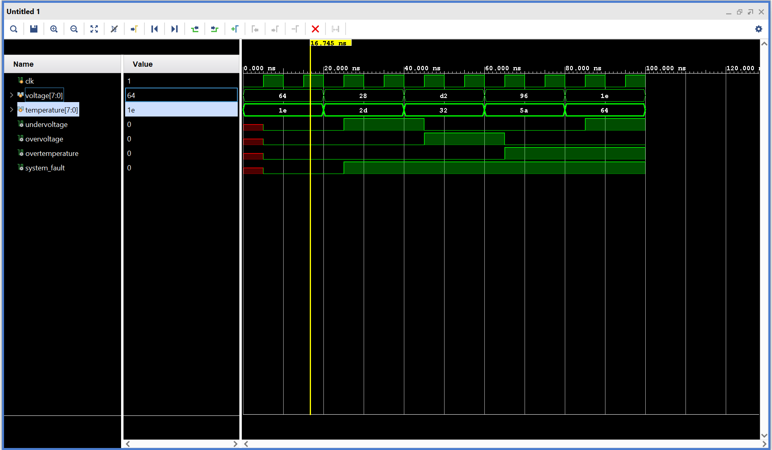

Slide 9
APPLICATIONS OF BATTERY MONITORING SYSTEM
Why It's Important: Battery safety and reliability are critical in modern electronic systems. Monitoring helps prevent failures, fires, or damage due to overcharge, deep discharge, or overheating.
Key Application Areas:
🔋 Electric Vehicles (EVs): Ensures safe battery operation and prolongs battery life.
📱 Portable Electronics: Prevents battery-related hazards in smartphones, tablets, and laptops.
📡 IoT Devices: Maintains reliable operation in remote, battery-powered systems.
🛰 Aerospace and Defense: Critical safety for drones, satellites, and high-reliability systems.

Slide 10
CONCLUSION & FUTURE ENHANCEMENTS
Conclusion:
✅ A reliable battery monitoring system was successfully designed and simulated using Verilog HDL. ✅ It accurately detects undervoltage, overvoltage, and overtemperature conditions. ✅ The system_fault output ensures unified signaling for any critical fault.
Future Enhancements:
🚀 Fault Latching: Add memory to retain fault status until reset.
📈 Data Logging: Include counters or registers to record fault history.
🧠 Smart Thresholds: Use programmable thresholds for adaptive battery management.
🛠 FPGA Implementation: Deploy the design on hardware for real-world testing and faster response times.

Slide 11


