Slide 1


K. RAMAKRISHNAN COLLEGE OF ENGINEERING (AUTONOMOUS), SAMAYAPURAM - TRICHY
DEPARTMENT OF ARTIFICIAL INTELLIGENCE AND DATA SCIENCE
CGB1122 – DATA STRUCTURES
A REAL-TIME CHAT APPLICATION SYSTEM
PRESENTED BY KANIKSHA M 8115U25AM020
SUPERVISOR
Mrs.ASHA G..,
Assistant Professor / AI&DS
9/6/2025

Slide 2
PRESENTATION OVERVIEW
1. Project Introduction 2. Objective
Problem Statement
Data structures Used
Flow chart
Modules Used
Output Screenshots 8. Conclusion
9. Future Scope 10. References

Slide 3
PROJECT INTRODUCTION
“A REAL-TIME CHAT APPLICATION SYSTEM “enables instant communication between users over the internet. It supports one to one and group messaging with minimal latency using persistent connections such as websockets.

Slide 4
OBJECTIVE
To study and understand real time communication technologies. To design a client-server architecture for efficient message routing. To integrate user authentication and authorization mechanisms.
To store and manage chat data using a data base system.
To ensure data consistency and message delivery acknowledgement. To optimize system performance for high concurrency

Slide 5
PROBLEM STATEMENT
Many existing communication systems do not provide efficient real-time interaction or are too complex and costly for small-scale implementation. There is a need to develop a lightweight, user-friendly chat application that allows instant messaging, secure authentication, message storage, and reliable data transmission. The system should also handle multiple users simultaneously while maintaining performance and security standards.
9/6/2025

Slide 6
Data structures USED
Map/Dictionary
Stores active users Map uses IDs to Websocket connections Fast lookup of users.
Example
user_id->socket_connection
Array
1.Stores usernames and passwords.
2.Stores sender, receiver, and message text.
3.Chat History

Slide 7
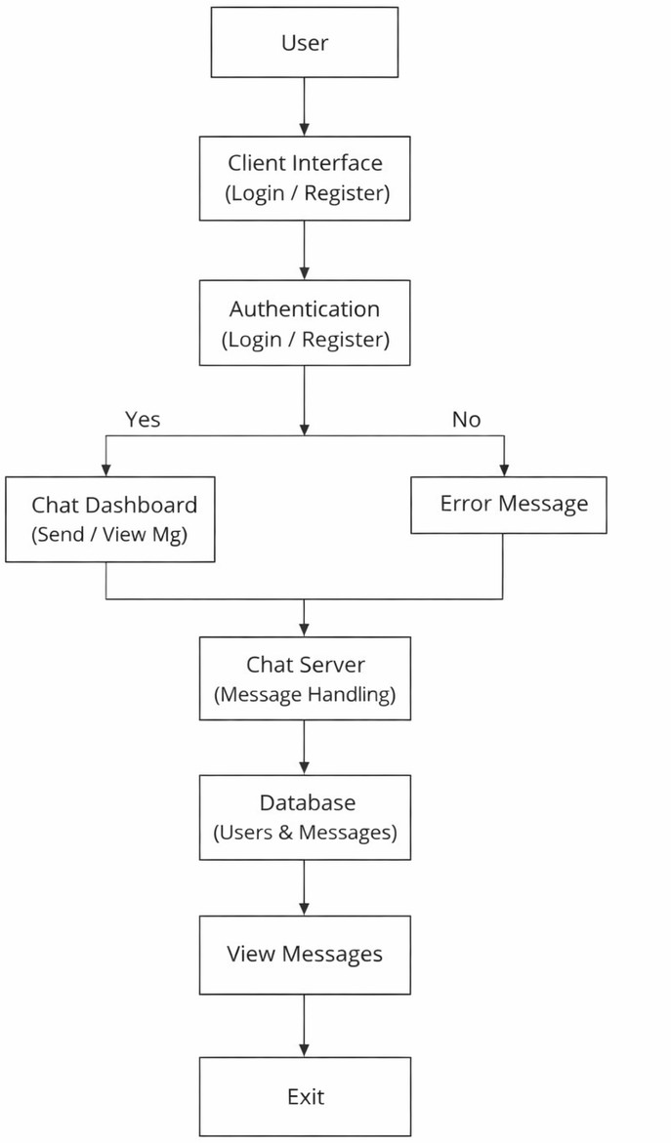
Architecture Diagram

Slide 8
MODULES USED
User Authentication Module
User Management
Real – Time Messaging Module
Chat Room/Group Module

Slide 9
MODULE 1 – USER AUTHENTICATION
MODULE
Purpose:
Handle user registration and login
Functions
User registration, Login and logout, Password encryption, JWT/Session management, Role-based access control

Slide 10
MODULE 2 – USER MANAGEMENT
MODULE
Purpose:
Manages user profiles and status
Functions:
View and edit profile, Upload profile picture, Track online/offline status, Maintain friend/contact

Slide 11
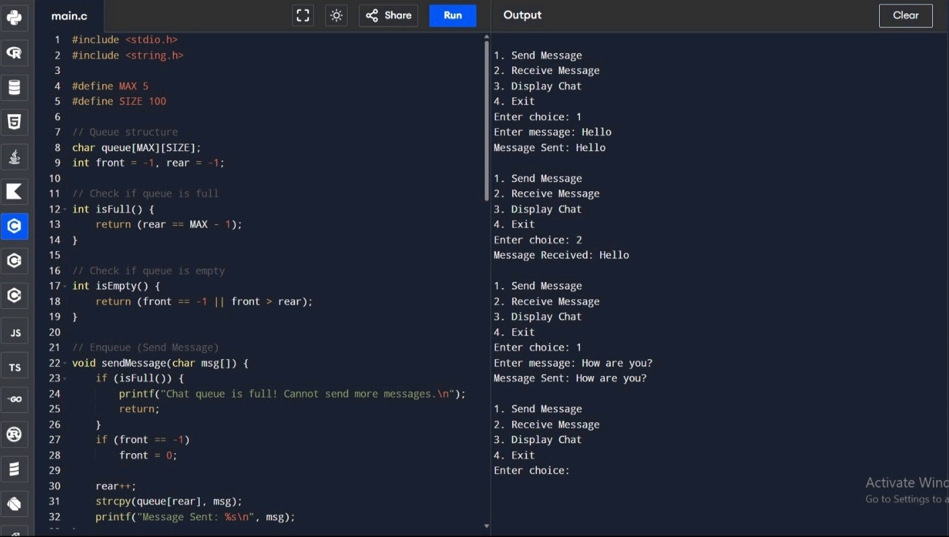
PROGRAM

Slide 12
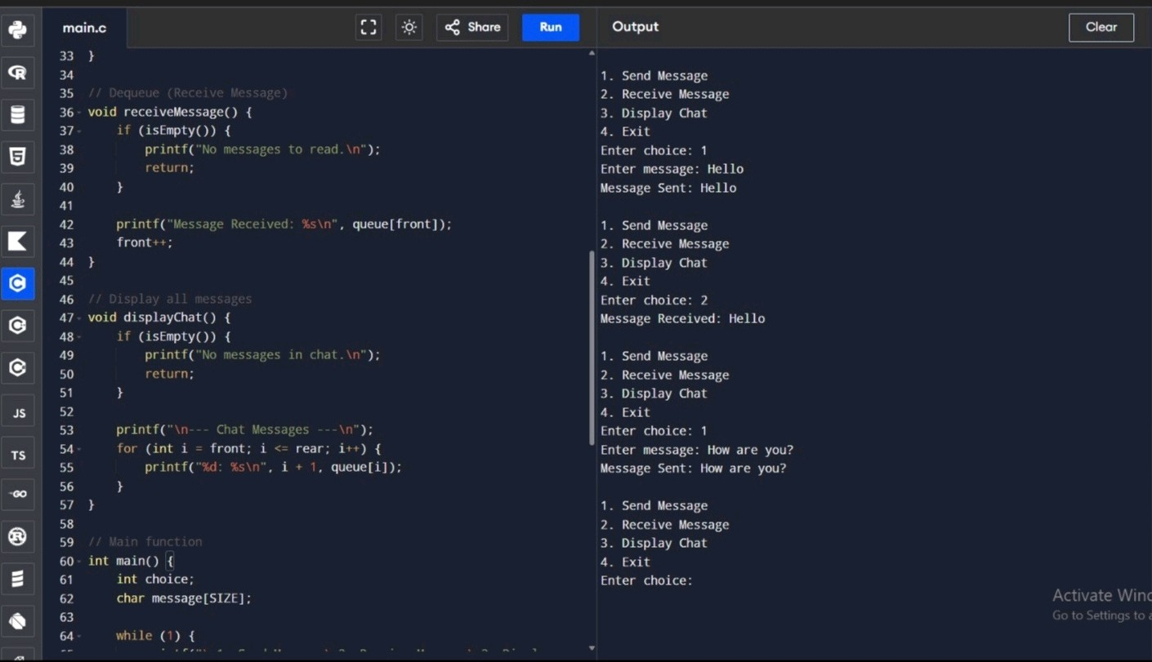
PROGRAM

Slide 13
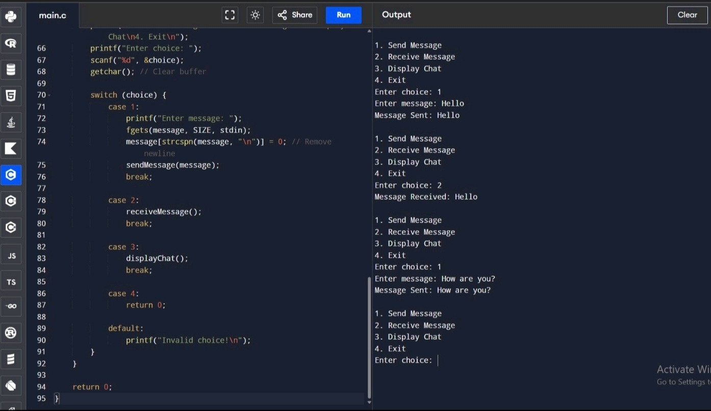
PROGRAM

Slide 14
OUTPUT EXPLANATION
Three messages are inserted using enqueue()
All messages are displayed
One message is removed using dequeue() 4. Remaining messages are displayed
How This Connects to Chat Application: When user sends message → enqueue() When receiver reads message → dequeue() First message sent → First delivered

Slide 15
ADVANTAGE
Maintains message order using FIFO principle
Simple and easy to implement in C
Ensures smooth and organized communication 4.Processes messages efficiently one by one 5.Simulates real-time chat system behavior

Slide 16
CONCLUSION
The Real-Time Chat Application System successfully demonstrates the design
and Implementation of an instant messaging platform that enables seamless communication between users. By utilizing real-time communication technologies such as WebSockets and a client-server architecture, the system ensures low latency and efficient message delivery

Slide 17
FUTURE SCOPE
The Real-Time Chat Application System can
integrating advanced features and modern functionality, scalability, and user experience.
be further
technologies
enhanced by
to improve

Slide 18
REFERENCES
WebRTC Documentation, Google Developers.
Available at: https://webrtc.org
MongoDB Documentation, MongoDB Inc.
Available at: https://www.mongodb.com/docs

Slide 19


