Slide 1
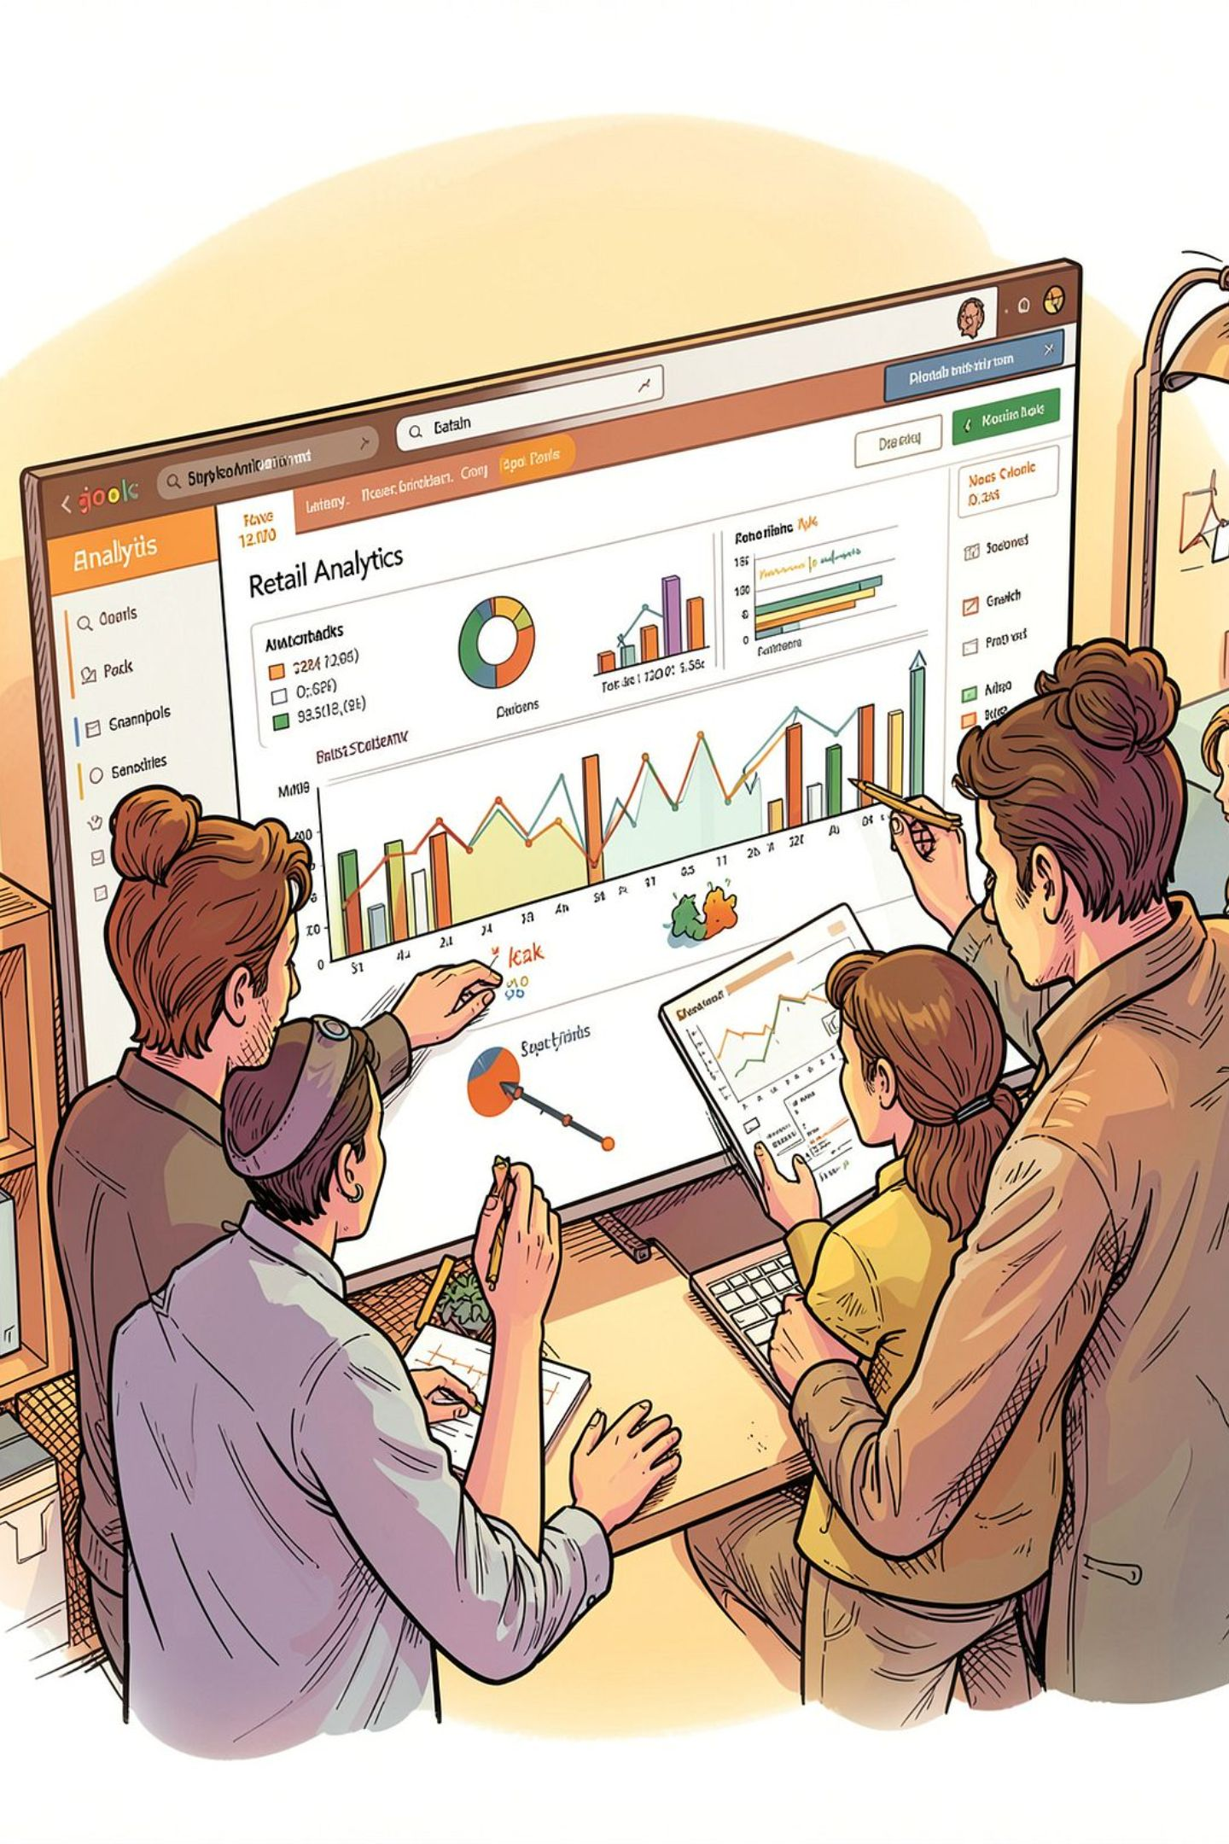
Customer Shopping Behavior — Overview
3,900 purchases | 18 features | Goal: uncover spending patterns, segments, preferences, subscriptions

Slide 2
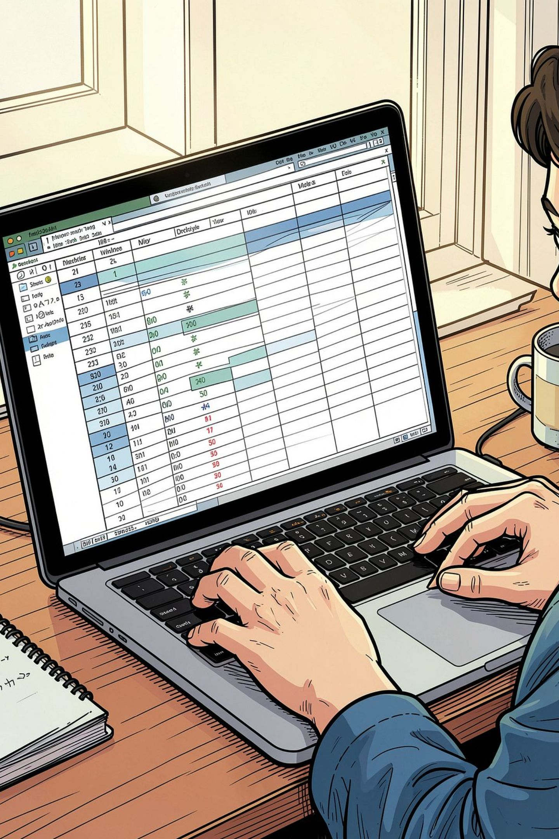
Dataset Summary
Size
Key Features
Rows: 3,900 · Columns: 18
Age, Gender, Location, Item, Category, Amount, Season, Rating, Subscription
Missing
0 missing values

Slide 3

EDA & Preparation (Python)
01
Load & Inspect
pandas, df.info(), describe()
02
Clean
Impute Review Rating by category median
03
Standardize
Rename to snake_case
04
Feature Eng.
age_group, purchase_frequency_days

Slide 4

SQL Analysis — Business Questions
MySQL used for structured queries and aggregations
Revenue by gender
High-spending discount users
Top products by rating

Slide 5
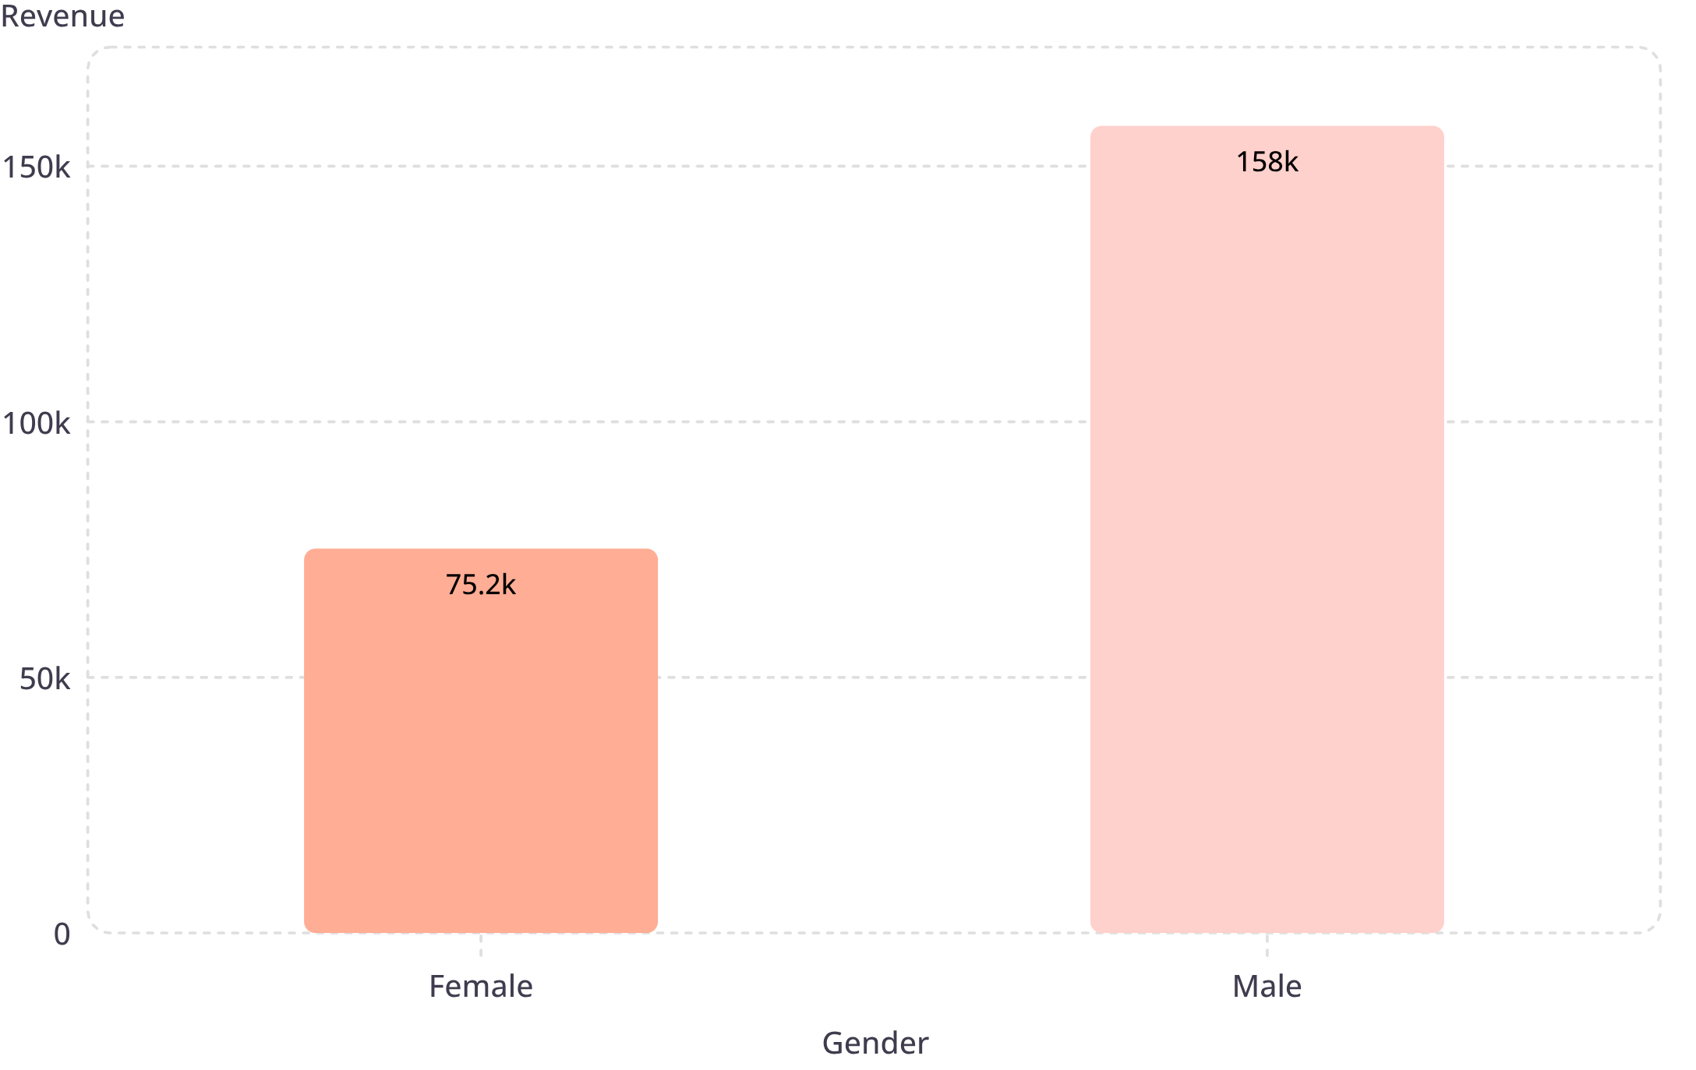
Revenue by Gender
Female
75,191
Male
157,890
Male revenue notably higher

Slide 6

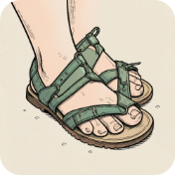
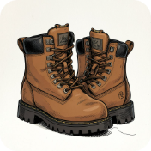
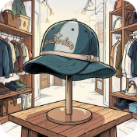
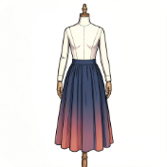
Top Products & Ratings
Gloves
Sandals
Boots
Hat
Avg rating 3.86
Avg rating 3.84
Avg rating 3.82
Avg rating 3.80
Skirt
Avg rating 3.78

Slide 7
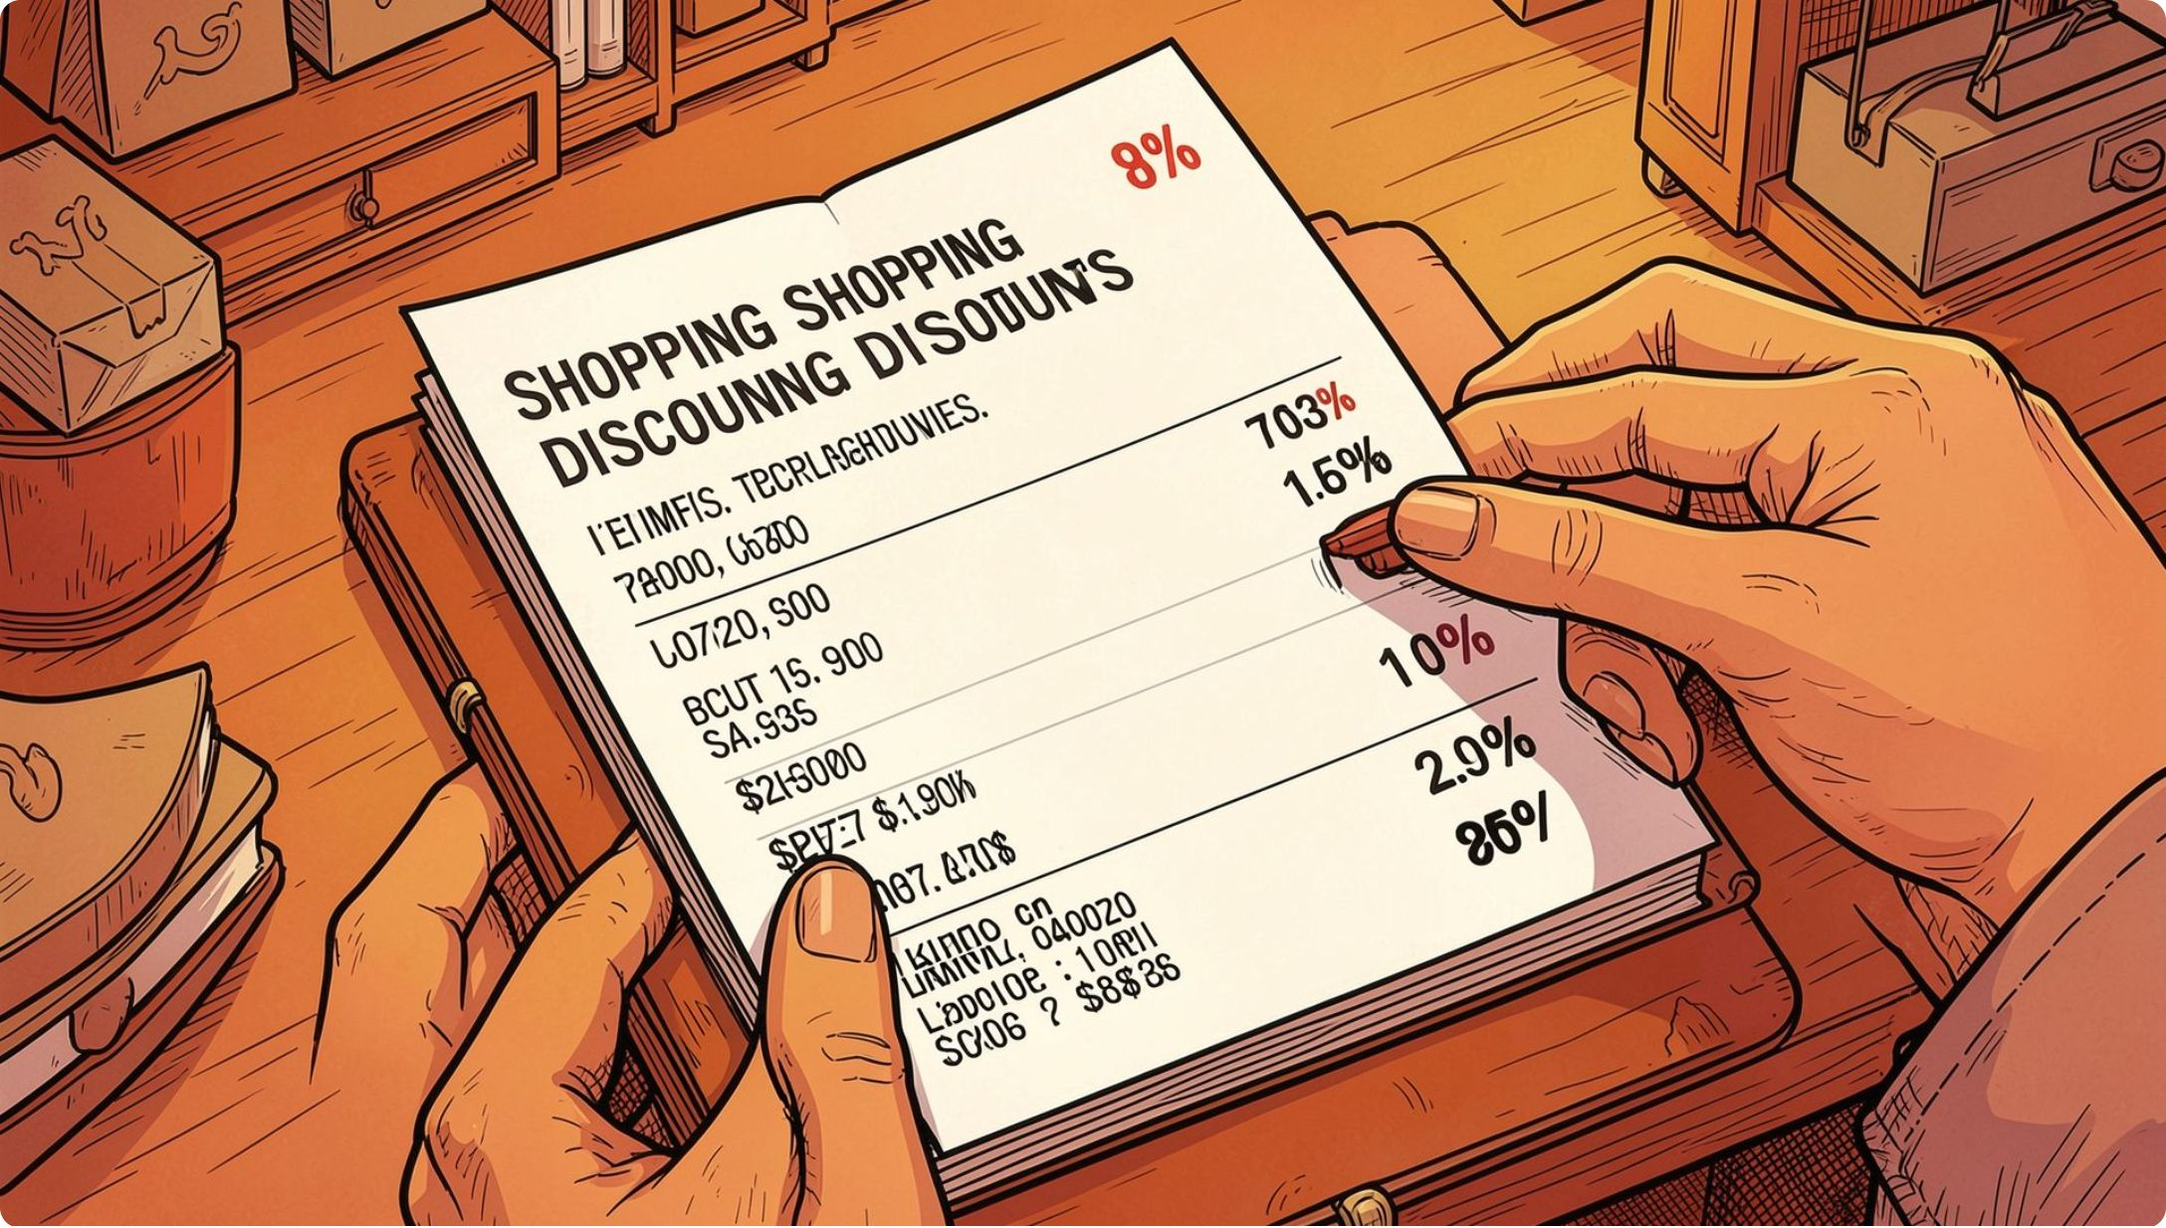
Discounts & High-Spenders
Identified customers using discounts but spending above average
Sample rows
Customer IDs with purchase_amounts: 64,73,90,... (total rows: 839)
Discount-dependent items
Top: Hat 50% · Sneakers 49.66% · Coat 49.07% · Sweater 48.17% · Pants 47.37%

Slide 8
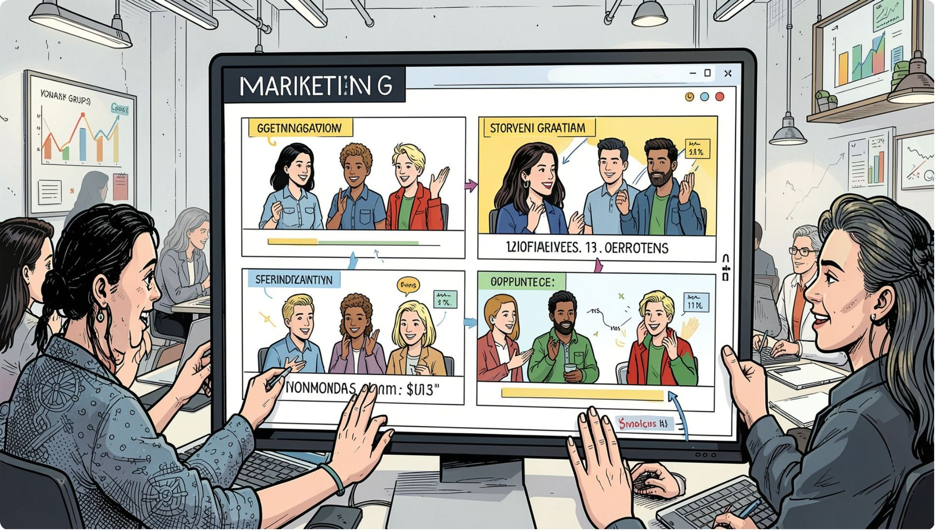



Segments & Subscriptions
Loyal
3,116 customers
New
83 customers
Returning
701 customers
Subscription: Yes 1,053 (27%) · No 2,847 (73%)

Slide 9
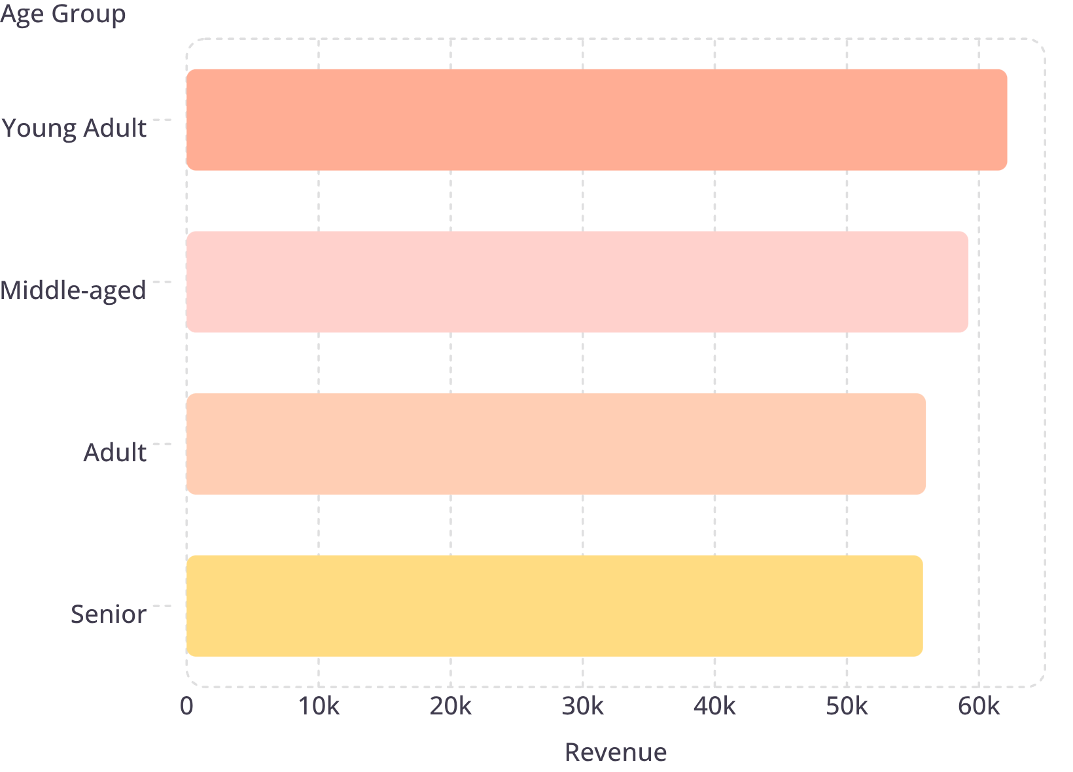
Revenue & Sales by Age Group
Young Adult leads revenue and sales
Sales counts (approx): Young Adult 1,000 · Middle-aged ~950 · Senior ~850 · Adult ~850

Slide 10

Recommendations & Next Steps
Boost Subscriptions
Customer Loyalty
Review Discounts
Promote exclusive benefits for subscribers
Reward repeat buyers to grow Loyal segment
Balance promotion lifts with margin control
Product Positioning
Targeted Marketing
Highlight top-rated & best-selling items in campaigns
Focus on high-revenue age groups & express-shipping users

