Slide 1
Retail Sales Analytics Dashboard
End-to-End Data Analytics Project using Python, SQL, and Power BI

Slide 2

Business Objective
Analyze retail sales performance across regions and time periods
Identify sales trends, seasonality, and growth patterns
Compare regional performance to optimize resource allocation
Understand customer purchasing behavior and preferences
Improve profitability using data-driven insights and recommendations

Slide 3
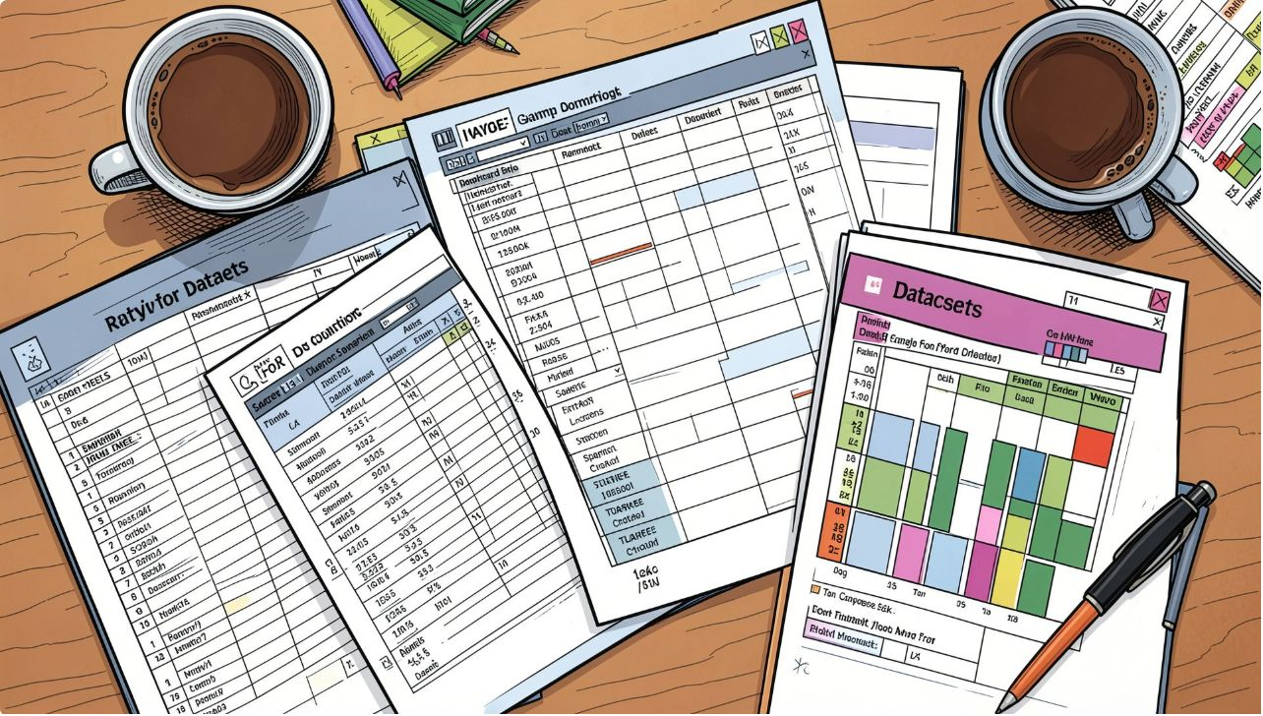
Dataset Overview
Source: Kaggle
Records: 51,290
Columns: 26
Orders, Customers, Products
Sales, Profit, Order Date
Region, Segment, Category

Slide 4

Data Preparation
Data Quality Assessment
Missing Value Handling
Duplicate Removal
Data Type Conversion
Data Cleaning using Python (Pandas)

Slide 5

SQL Analysis
Regional Sales Analysis
Monthly Sales Trends
Top Customers by Revenue
Category Performance
KPI Calculations

Slide 6
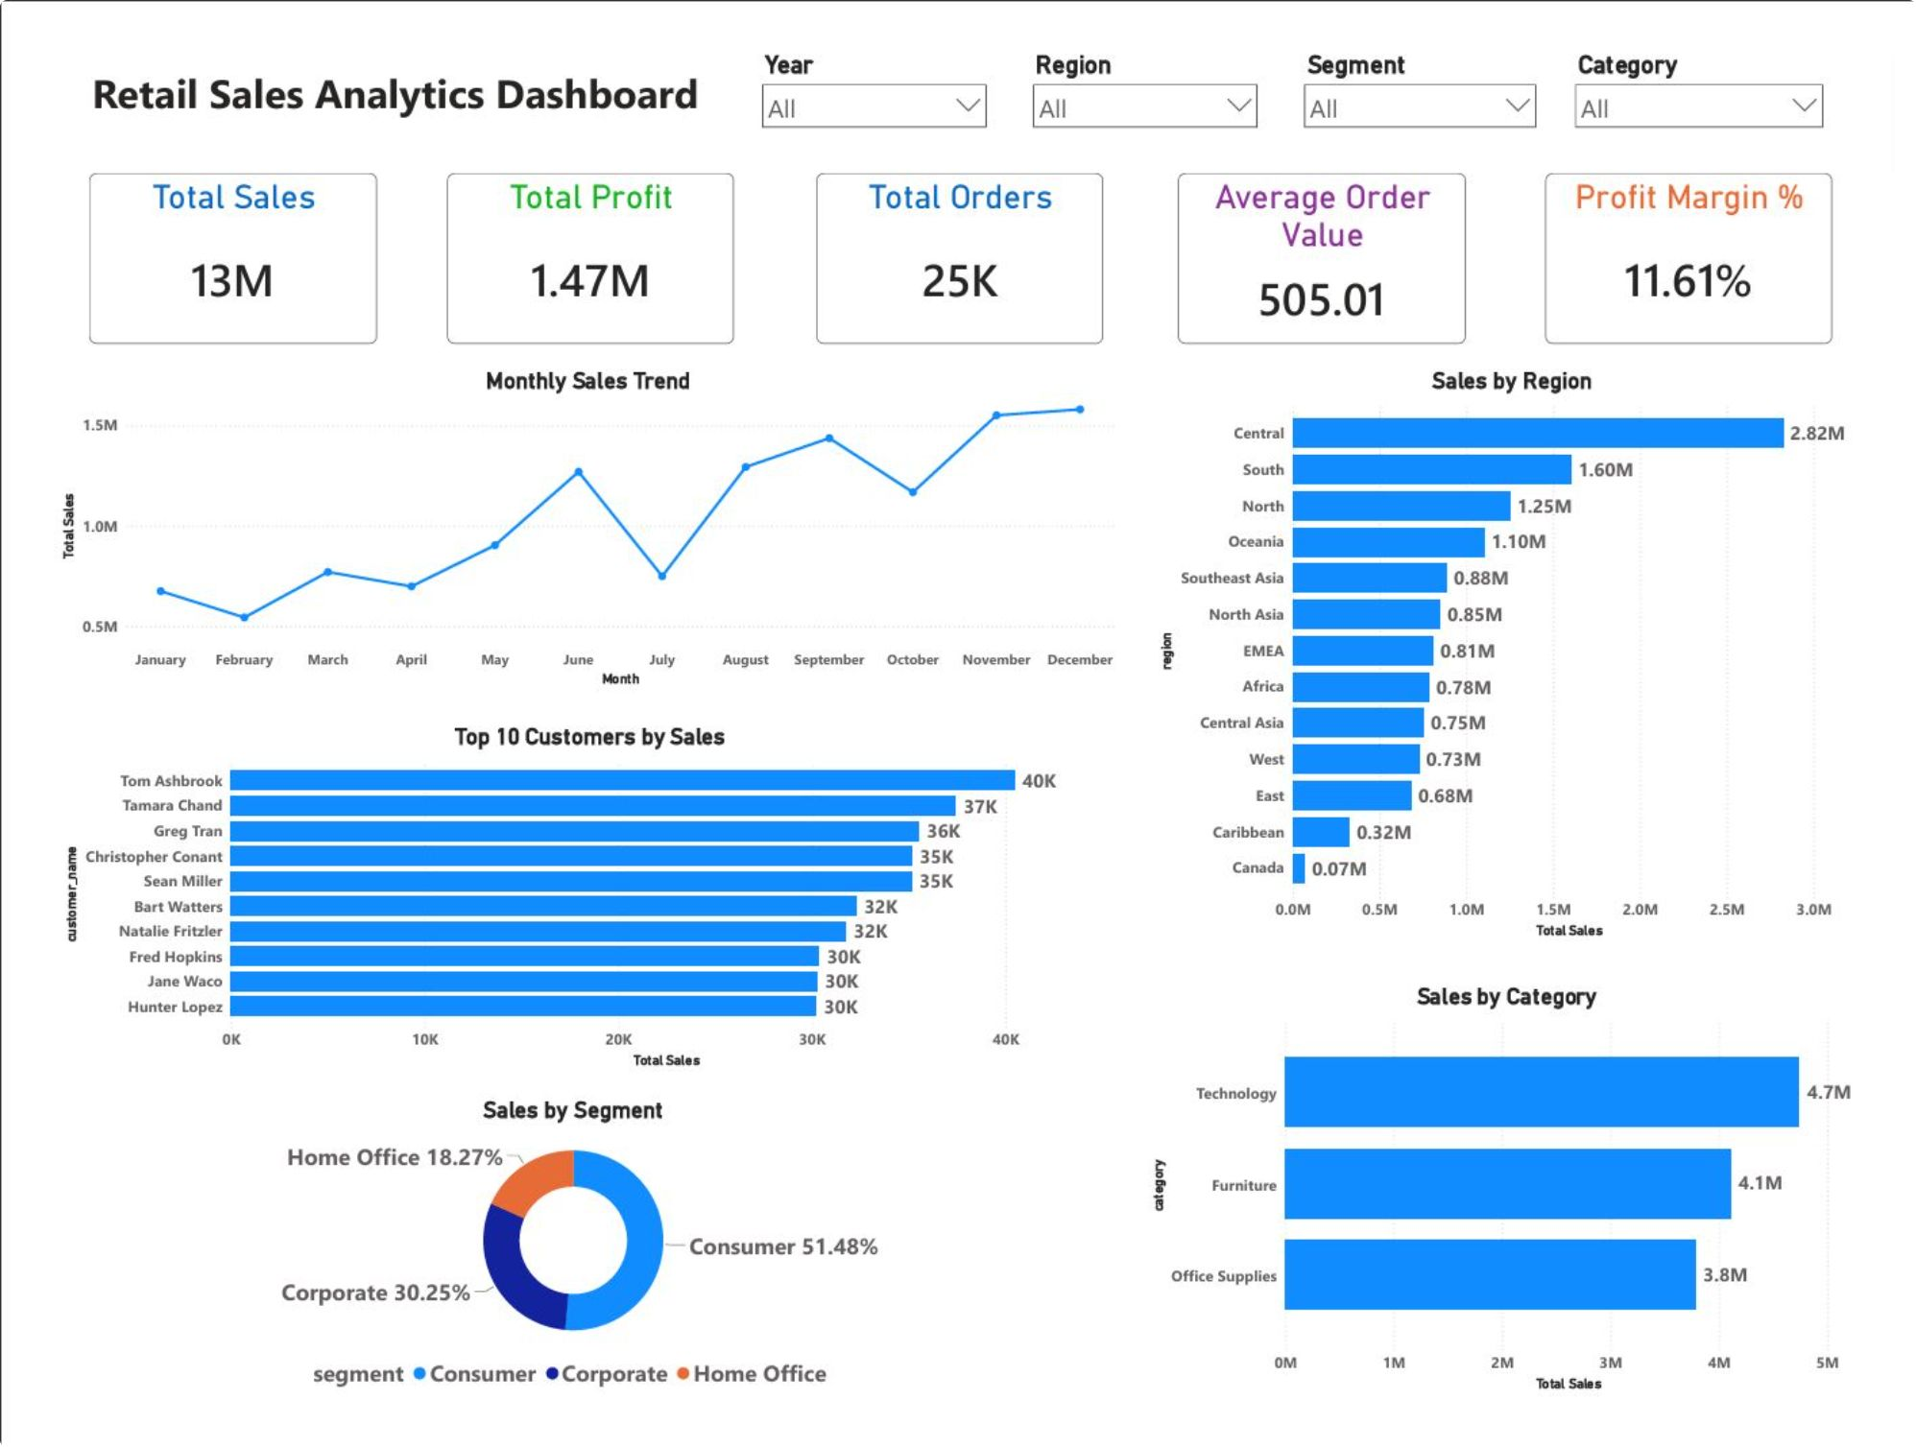
Power BI Dashboard
Interactive Dashboard
KPI Cards
Sales Trend Analysis
Regional Performance
Customer & Category Analysis

Slide 7
Key Business Insights
Highest-performing Region: Central Region generated the highest sales (2.82M).
Best-selling Category: Technology was the highest-selling category (4.7M).
Most Profitable Segment: Consumer Segment contributed the highest share of profit (51.06%).
Peak Sales Month(s): Sales peaked in December, with another strong peak in November.
Business Recommendation: Increase investment in high-performing regions and Technology products while improving performance in lower-performing regions.

Slide 8

Conclusion & Next Steps
Completed an end-to-end Retail Sales Analytics project
Performed data cleaning using Python
Solved business problems using SQL
Built an interactive Power BI dashboard
Improved analytical and visualization skills
Thank You
Questions?

