Slide 1
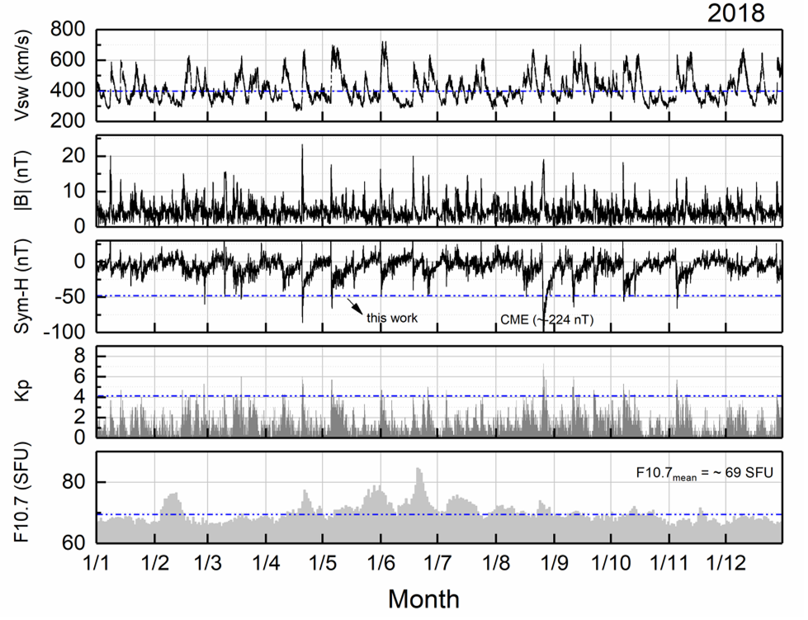
Solar and geomagnetic activity in 2018
RESULTS
From top to bottom panels:
Vsw: Solar Wind Speed, in km/s;
|B|: Interplanetary Magnetic Field, |B|, in nT;
Sym H: the Ring Current index, in nT;
Kp: geomagnetic index kp;
F10.7: solar flux in Wm−2s−1.
Indices and parameters taken from measurements at the L1 point, at 1 AU, by the satellite ACE and available in https://omniweb.gsfc.nasa.gov/

