Slide 1
Docker
Container Management Tool

Slide 2
Docker overview
Docker is an open source platform for developing, shipping, and running applications. Docker enables you to separate your applications from your infrastructure so you can deliver software quickly. With Docker, you can manage your infrastructure in the same ways you manage your applications. By taking advantage of Docker’s methodologies for shipping, testing, and deploying code quickly, you can significantly reduce the delay between writing code and running it in production.

Slide 3
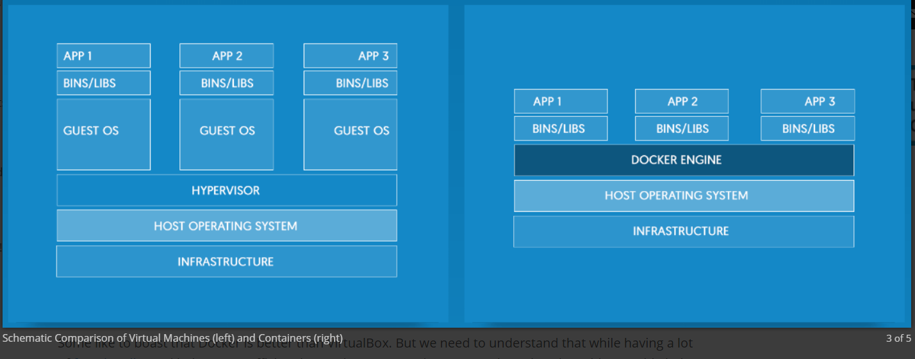
Virtualization vs Containerization

Slide 4
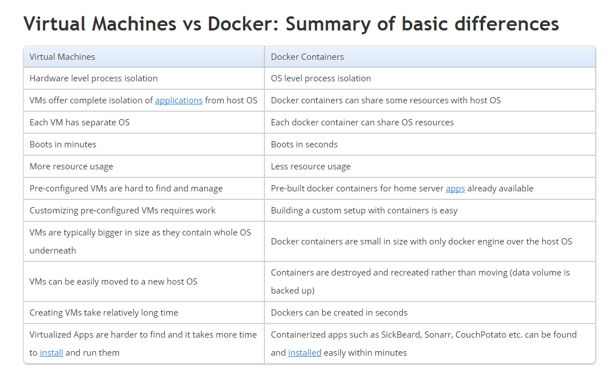

Slide 5
The Docker platform
Docker provides the ability to package and run an application in a loosely isolated environment called a container. The isolation and security allow you to run many containers simultaneously on a given host. Containers are lightweight because they don’t need the extra load of a hypervisor, but run directly within the host machine’s kernel. This means you can run more containers on a given hardware combination than if you were using virtual machines. You can even run Docker containers within host machines that are actually virtual machines!

Slide 6
Docker provides tooling and a platform to manage the lifecycle of your containers:
Develop your application and its supporting components using containers.
The container becomes the unit for distributing and testing your application.
When you’re ready, deploy your application into your production environment, as a container or an orchestrated service. This works the same whether your production environment is a local data center, a cloud provider, or a hybrid of the two.

Slide 7
Docker Engine
Docker Engine is a client-server application with these major components:
A server which is a type of long-running program called a daemon process (the dockerd command).
A REST API which specifies interfaces that programs can use to talk to the daemon and instruct it what to do.
A command line interface (CLI) client (the docker command).

Slide 8
What can I use Docker for?
Fast, consistent delivery of your applications
Docker streamlines the development lifecycle by allowing developers to work in standardized environments using local containers which provide your applications and services. Containers are great for continuous integration and continuous development (CI/CD) workflows.
Consider the following example scenario:
Your developers write code locally and share their work with their colleagues using Docker containers.
They use Docker to push their applications into a test environment and execute automated and manual tests.
When developers find bugs, they can fix them in the development environment and redeploy them to the test environment for testing and validation.
When testing is complete, getting the fix to the customer is as simple as pushing the updated image to the production environment.

Slide 9
Responsive deployment and scaling
Docker’s container-based platform allows for highly portable workloads. Docker containers can run on a developer’s local laptop, on physical or virtual machines in a data center, on cloud providers, or in a mixture of environments.
Docker’s portability and lightweight nature also make it easy to dynamically manage workloads, scaling up or tearing down applications and services as business needs dictate, in near real time.
Running more workloads on the same hardware
Docker is lightweight and fast. It provides a viable, cost-effective alternative to hypervisor-based virtual machines, so you can use more of your compute capacity to achieve your business goals. Docker is perfect for high density environments and for small and medium deployments where you need to do more with fewer resources.

Slide 10
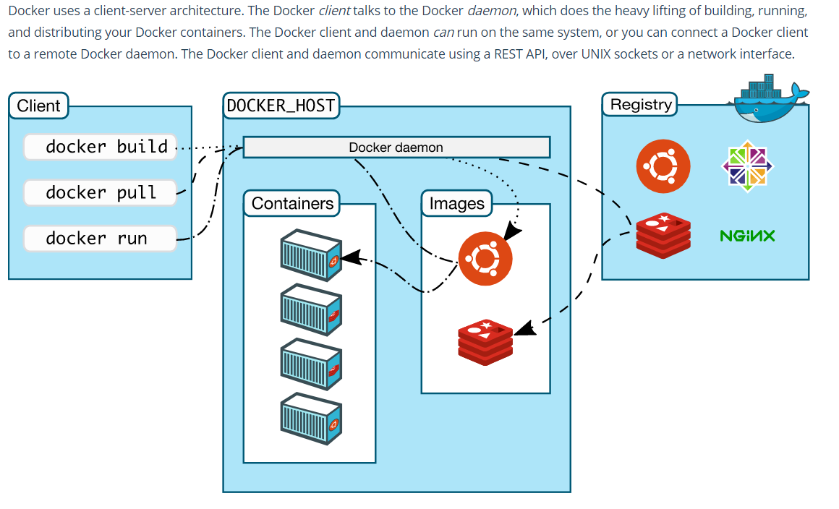
Docker architecture

Slide 11
The Docker daemon
The Docker daemon (dockerd) listens for Docker API requests and manages Docker objects such as images, containers, networks, and volumes. A daemon can also communicate with other daemons to manage Docker services.
The Docker client
The Docker client (docker) is the primary way that many Docker users interact with Docker. When you use commands such as docker run, the client sends these commands to dockerd, which carries them out. The docker command uses the Docker API. The Docker client can communicate with more than one daemon.

Slide 12
Docker registries
A Docker registry stores Docker images. Docker Hub and Docker Cloud are public registries that anyone can use, and Docker is configured to look for images on Docker Hub by default. You can even run your own private registry. If you use Docker Datacenter (DDC), it includes Docker Trusted Registry (DTR).
When you use the docker pull or docker run commands, the required images are pulled from your configured registry. When you use the docker push command, your image is pushed to your configured registry.
Docker store allows you to buy and sell Docker images or distribute them for free. For instance, you can buy a Docker image containing an application or service from a software vendor and use the image to deploy the application into your testing, staging, and production environments. You can upgrade the application by pulling the new version of the image and redeploying the containers.

Slide 13
Docker objects
When you use Docker, you are creating and using images, containers, networks, volumes, plugins, and other objects. This section is a brief overview of some of those objects.
IMAGES
An image is a read-only template with instructions for creating a Docker container. Often, an image is based on another image, with some additional customization. For example, you may build an image which is based on the ubuntu image, but installs the Apache web server and your application, as well as the configuration details needed to make your application run.
CONTAINERS
A container is a runnable instance of an image. You can create, run, stop, move, or delete a container using the Docker API or CLI. You can connect a container to one or more networks, attach storage to it, or even create a new image based on its current state.

