Slide 1

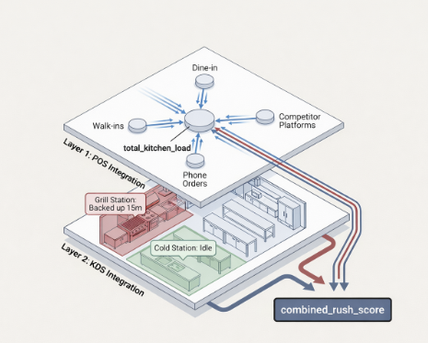

Slide 2


Slide 3
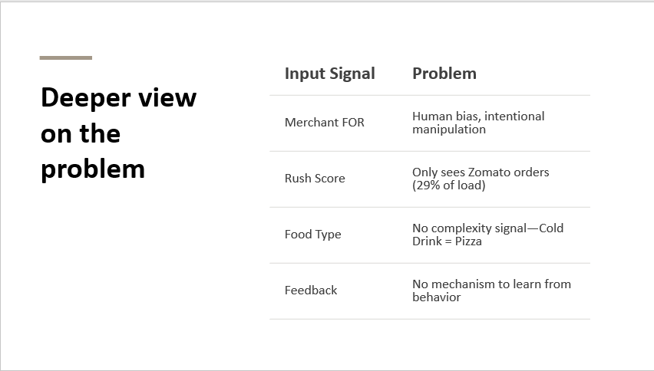

Slide 4
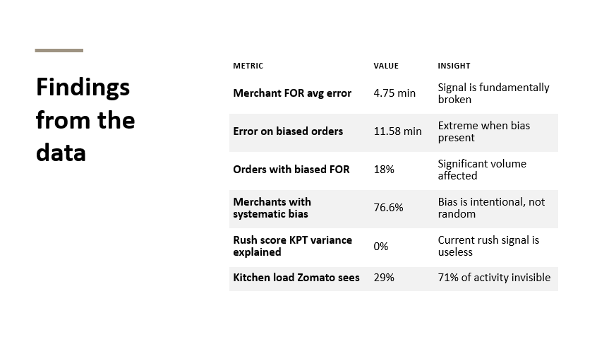

Slide 5
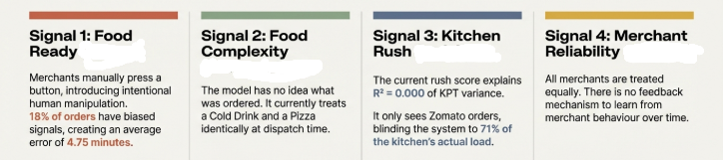
Current Model : Flaws
Signal 5:
Rider matching skill
Not all riders are same, some know the area better than others

Slide 6
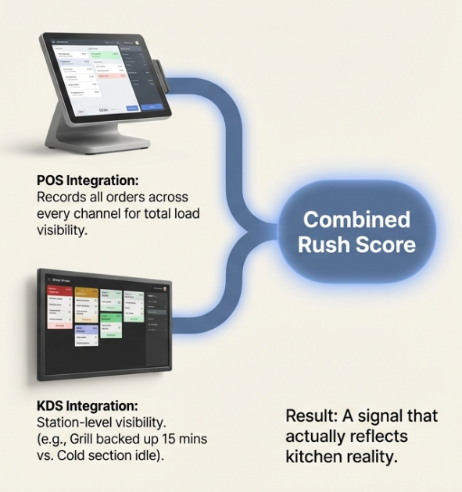
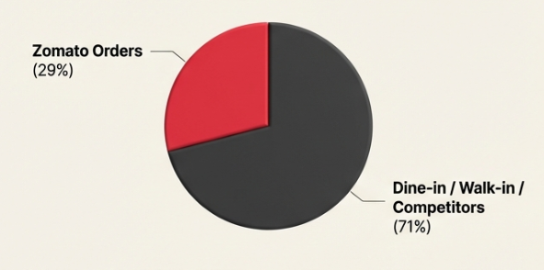
POS(POINT OF SALE) INTEGRATION WITH KDS(KITCHEN DISPLAY SYSTEM)
POS calculates actual transaction volume, ticket times, order counts
It captures real kitchen throughput, not perceived busyness
Walk-ins and dine-in orders are entered directly by the cashier or server into the terminal
KDS tells you orders actively being cooked right now tickets on screen, time each ticket has been open, which station is backed up

Slide 7
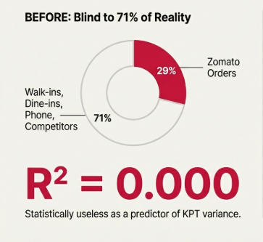
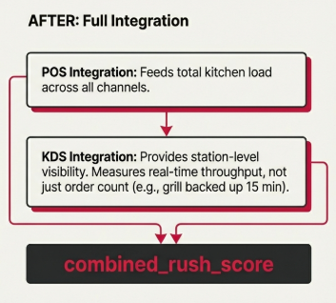
what is KPT actually doing ?

Slide 8
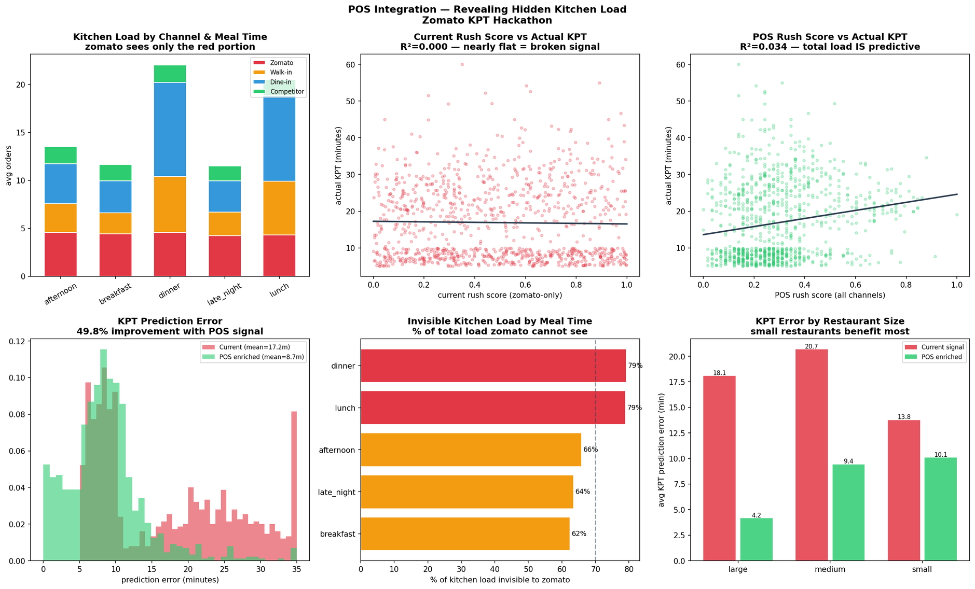
POS integration

Slide 9
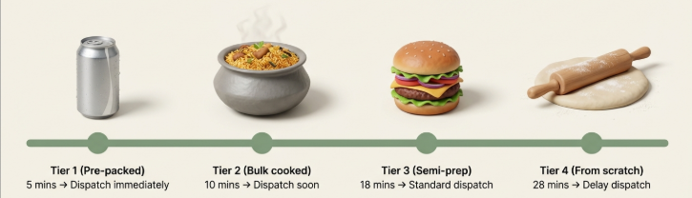
FOOD COMPLEXITY
Giving the model eyes to see the complexity of preparation
Modeling tuning mapped food order complexity into 4 different tires

Slide 10
CLASSIFICATION
TIER 1:
TIER 2:
Pre-packed / Ready to go
Cold Drink, Bottled Water, Energy Bar, Cookies, Fruit Bowl
KPT baseline : 5 min
Sensor mode : weight only (no heat expected)
Confidence : MEDIUM (packing errors possible)
Dispatch : immediately at acceptance
Bulk cooked, needs packing
Biryani, Dal, Rajma, Halwa, Khichdi
KPT baseline : 10 min
Sensor mode : temperature + weight (both)
Confidence : HIGH (but BATCH_EMPTY risk)
Dispatch : soon after acceptance
Special case : BATCH_EMPTY → auto upgrade to tier 4
TIER 3:
TIER4:
Semi-prepared, cook to order
Dosa, Fried Rice, Egg Bhurji, Noodles, Stuffed Paratha
KPT baseline : 18 min
Sensor mode : temperature sensor
Confidence : HIGH
Dispatch : standard delay
Made from scratch
Risotto, Thai Curry, Pre-made Wrap*
KPT baseline : 28 min
Sensor mode : temperature sensor
Confidence : HIGH but wider variance
Dispatch : delayed — rider held until close to ready

Slide 11
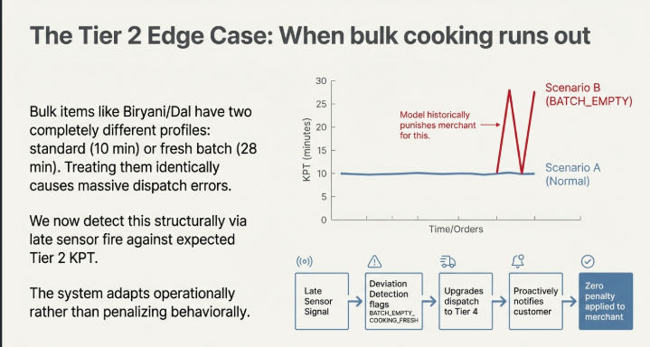

Slide 12
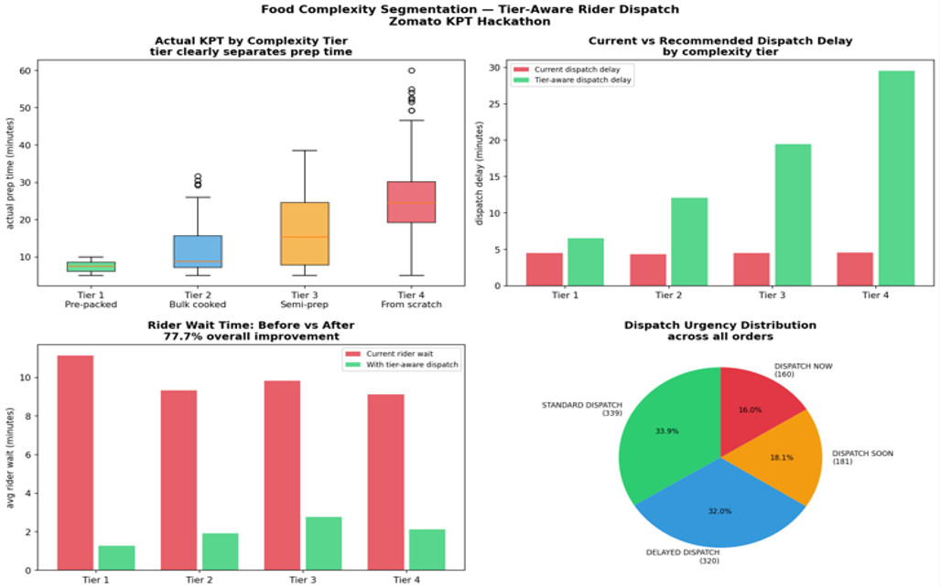

Slide 13
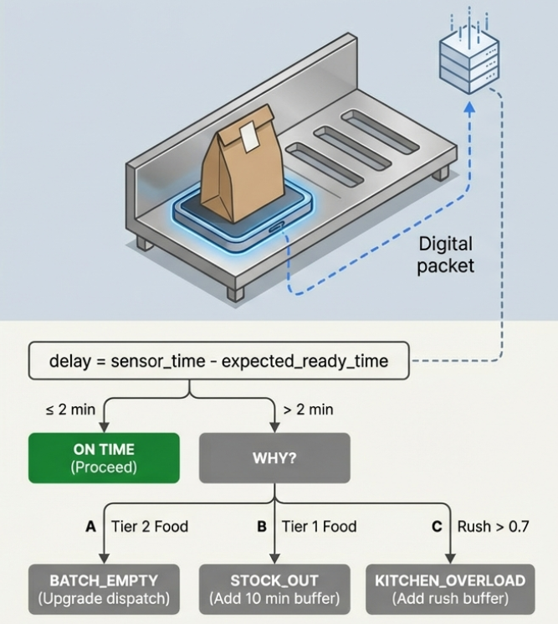
IOT SENSORS : REPLACING HUMAN BIAS
Problem faced:
the merchants press the food ready(FOR) button
early to avoid penalties feeding the model the wrong information
causing biased orders
The result:
96.5% reduction in FOR error. The average error drops from 4 minutes approx to 0.17 minutes
Solution :
IoT temperature and weight sensors installed on the pick up shelves will detect that the order is completed.
Zero merchant
invlovement required

Slide 14
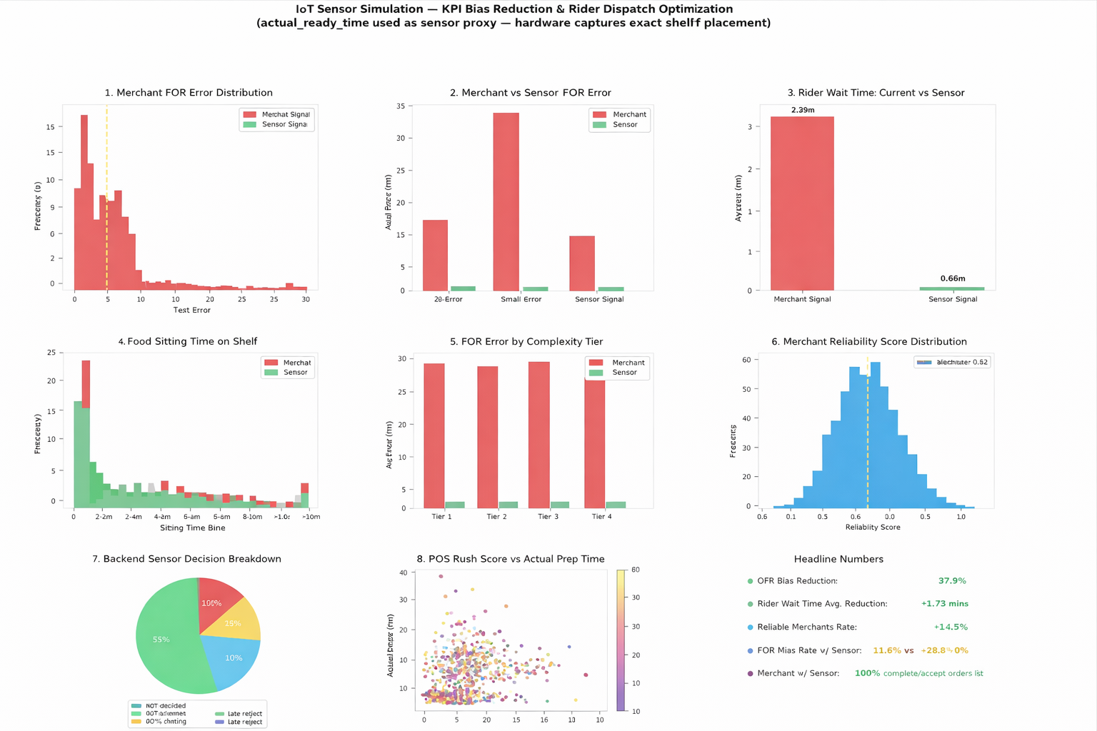

Slide 15
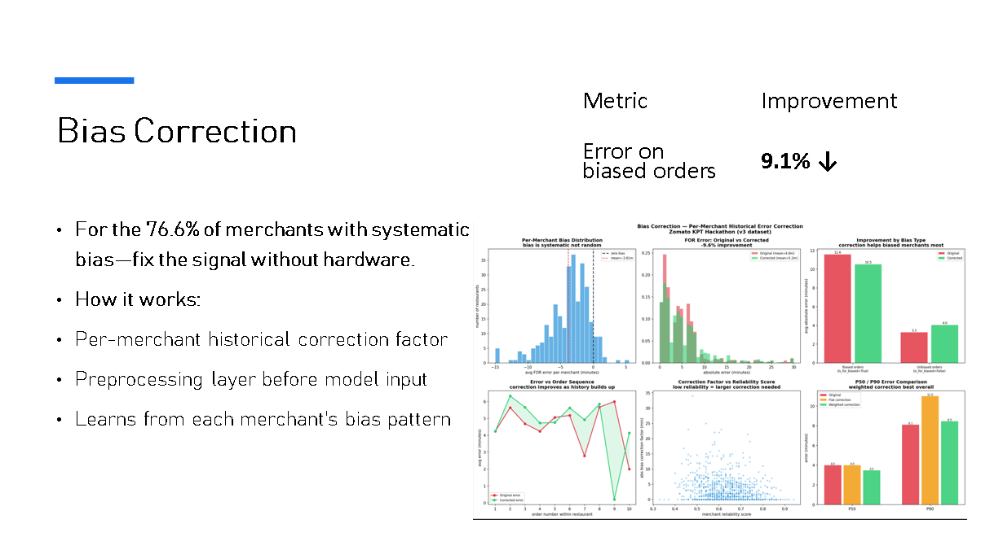

Slide 16
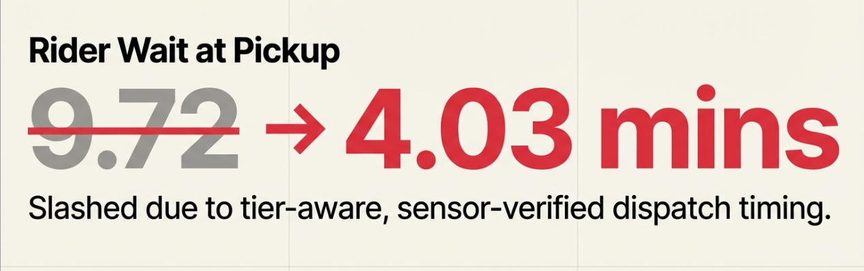
Once the food package hits the pickup shelf, it is notified that food is ready to be picked up
The rider assigned-picks up the order by accepting the package in the app and starts off to deliver the food
ETA P50/P90 Accuracy
Order Delay Rate
Rider assignment
Rider idle between orders
False precision is eliminated. KPT+confidence scores predict the accurate time by classifying the food and displaying the rider order dispatch
Overloaded kitchens are caught by the kitchen_rush_score and any delay in delivery would update the ETA time so the customers would know that their order will be delayed
The riders are assigned by collecting their pre=historical data and the familiarity of the area ensuring fast delivery
When the rider is almost nearing to the drop location, an other order to be picked up nearby will be assigned to the rider, making them less idle

Slide 17
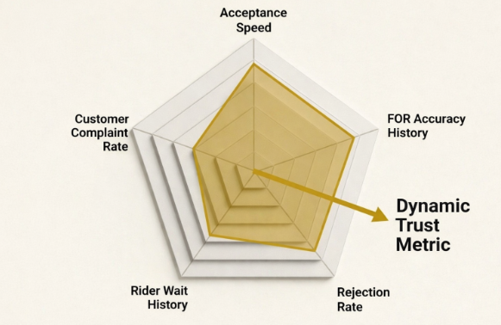
Establishing a feedback loop for merchant reliablity:
we built a 5 component merchant reliability score to scale correction strength
Acceptance speed : How fast the orders are acknowledged.
FOR accuracy history : how objective were their past signals.
Rider wait history : actual wait times at the premises
Rejection rate : cancellation frequency.
Customer complaint rate : quality and accuracy issues.

Slide 18
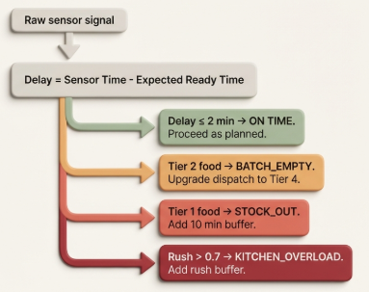
When do we need buffer
For merchants without hardware :
a bias correction layer maps the 76.6% of merchants with systhematic, correctable bias, applying historical error correction factors before the signal reaches the model reducing noice- 9.1% improvement

Slide 19
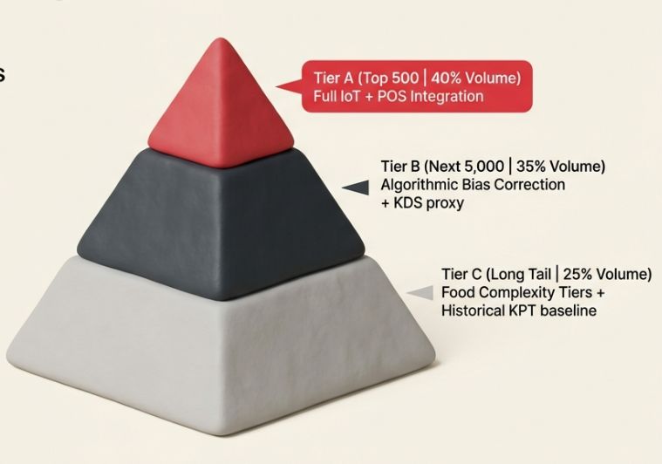
SCALABILITY ACROSS RESTAURANTS: OUR MAIN CONCERN
IoT hardware and POS integration cannot scale to 300,000+ merchants overnight.
we designed a tiered development based on order volume impact.
no merchant os left on a broken signal. Total ecosystem coverage immediately.

Slide 20
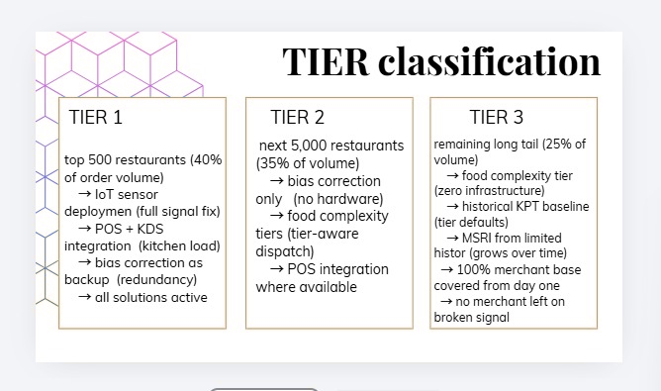

Slide 21
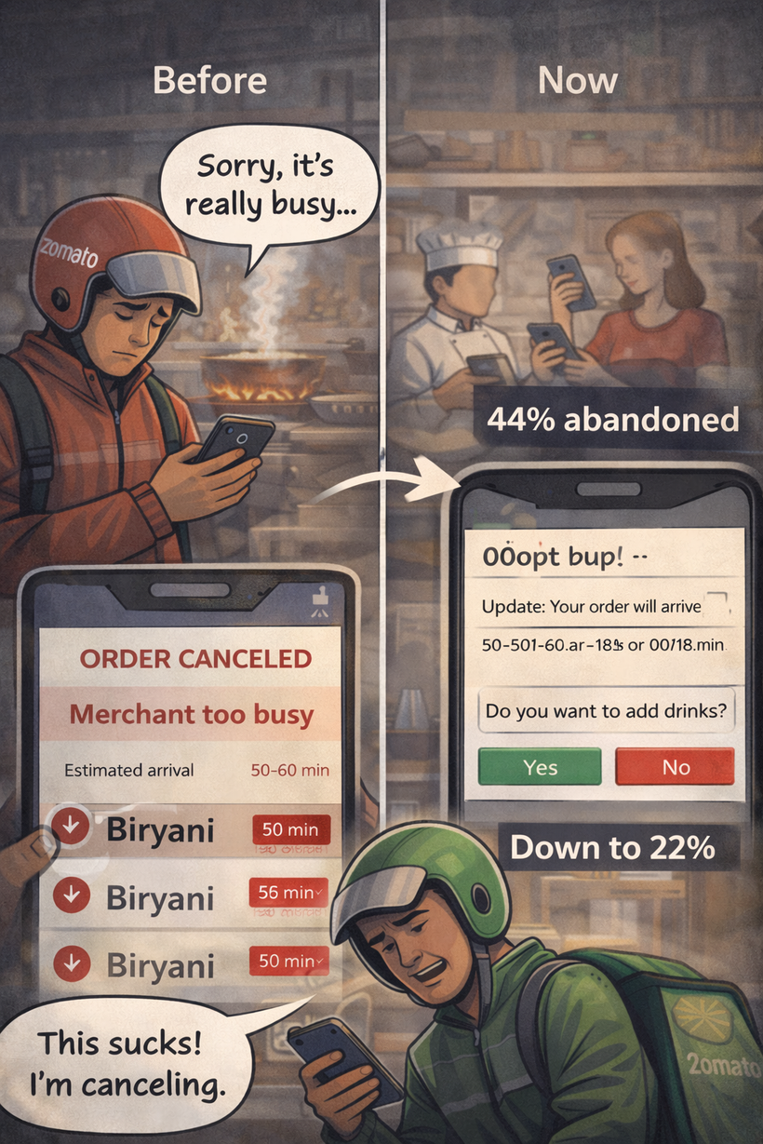


How we avoid cancellation rates
Honest, Tight ETA’s
IoT+better KPT inputs cut ETA P50 error from 5.28 ⟶ 1.38 mins.
Dispatch Exactly on Time
IoT sensor fires when food hits the shelf and the rider is dispatched at that exact moment. 9.72 min wait collapses to 0.42 min

Slide 22
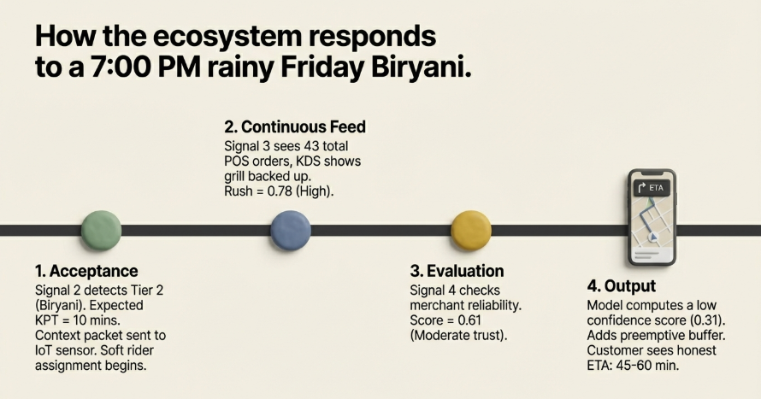

Slide 23
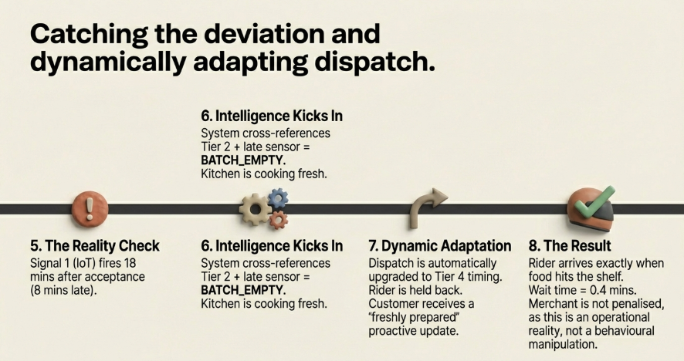

Slide 24
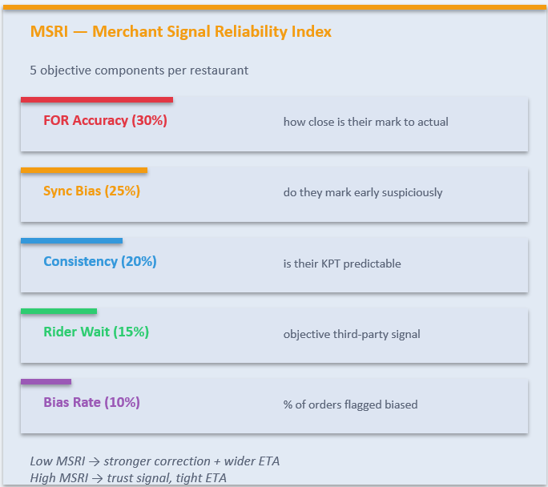
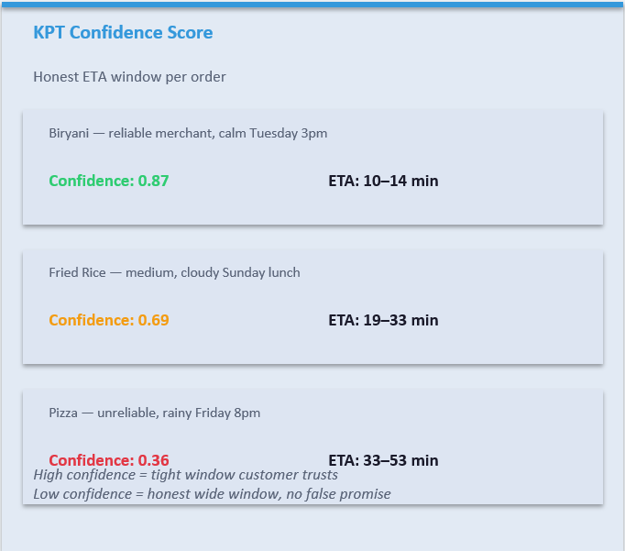

Slide 25


TO CONCLUDE
BEFORE | AFTER
Biased FOR signal - 4.75 min error | objective IoT sensor signal (0.17 min error)
No food complexity - All food looks the same | 4- Tier classification assigned at acceptance
Broken rush score R² = 0.000 | Combined POS + KDS score across all channels
No reliability signal - All merchants equal | 5- component merchant trust score scaling correction
Signal KPT number - False precision | KPT + confidence score (Honest uncertainty range)

Slide 26
