Slide 1


KIT-KALAIGNARKARUNANIDHI INSTITUTE OF TECHNOLOGY
COIMBATORE - 641402
Approved by AICTE Affiliated to Anna University, Chennai Accredited With ‘A’ Grade
by NAAC & by NBA
DEPARTMENT OF ELECTRICAL AND ELECTRONICS ENGINEERING
SMART AI BASED DEGRADATION CONVERTER CONTROL FOR EV BATTERY CHARGING
TEAM MEMBERS:
KANISH R - 711523BEE026
DINESH A - 711523BEE013
JOYAL GOODWIN S - 711523BEE024
SUPERVISOR:
DR.M.P.MOHANDASS
ASSOCIATE PROFESSOR/EEE
KIT-Electrical and Electronics Engineering

Slide 2
ABSTRACT
The degradation of EV batteries is usually higher when fast-charging methods are used consistently over time.
Most charging systems overlook the battery's aging, which leads to thermal stress, rising temperatures, and a shorter expected lifespane.
Here we introduces a smart AI-assisted charging system that adjusts the charging method based on the battery's health in real-time.
Aging batteries switch to a slower and safer charging mode, which lessens stress and thermal effects.
A simple LED indication system makes this setup easy to use. A green LED lights up when the battery is in good condition, while a red LED shows that the battery is old or degraded and needs slow charging to extend its life and ensure safety.
KIT-Electrical and Electronics Engineering

Slide 3
INTRODUCTION
Electric vehicle (EV) batteries lose their performance faster when they are charged using the same fast-charging method throughout their life.
Most existing battery charging systems do not consider the battery aging condition, which leads to high temperature, extra stress, and shorter battery life.
The system measures battery voltage, charging current, and battery temperature. An AI model analyzes this data to identify the battery degradation level.
Based on the AI output, the converter controller automatically selects fast charging for healthy batteries and slow, safe charging for aged batteries.
The proposed method helps reduce battery heating, lower charging stress, and extend battery lifetime compared to conventional charging systems.
KIT-Electrical and Electronics Engineering

Slide 4
Objective
Monitor battery voltage, current, and temperature in real time.
Estimate battery degradation using health indicators.
Automatically switch between fast and slow charging modes.
Reduce thermal stress during charging.
Provide user-friendly LED-based battery health indication.
KIT-Electrical and Electronics Engineering

Slide 5
EXISTING SYSTEM
The existing EV charging system mainly uses a fixed charging method without considering the battery’s actual condition.
This may lead to overheating, faster battery aging, and reduced efficiency.
Lack adaptive charging mechanisms.
Battery Life Lower due to stress and overcharging
KIT-Electrical and Electronics Engineering

Slide 6
Literature Survey
TITLE | AUTHOR | YEAR | METHODOLOGY | SUMMARY
Early prediction of lithium-ion battery degradation with a generative pre-trained transformer | Sara Sattarzadeh, Shanthan K. Padisala, Ying Shi, Partha P. Mishra, Kandler Smith, Satadru Dey | 2023 | Developed a closed-loop feedback control system using electro-thermal battery aging models. Applied optimal control theory to adjust charging current based on degradation state. | Proposed a health-adaptive fast charging strategy that reduces aging while maintaining performance. Demonstrated improved battery safety and lifetime compared to fixed charging.
Adaptive Safe Reinforcement Learning-Enabled Optimization of Battery Fast-Charging Protocols | Myisha A. Chowdhury, Saif S. S. Al-Wahaibi, Qiugang Lu | 2024 | Used reinforcement learning with safety constraints to dynamically optimize charging current. The model learns battery behavior and adapts charging to minimize degradation. | Showed that AI-based adaptive charging can safely reduce charging time while limiting battery aging and thermal stress
KIT-Electrical and Electronics Engineering

Slide 7
Literature Survey
TITLE | AUTHOR | YEAR | METHODOLOGY | SUMMARY
EV battery charging system via reconfigurable boost converter with solar PV and grid. | M.A. Eissa, P. Chen | 2022 | Designed an aging-aware charging framework that adjusts depth-of-discharge and charging thresholds based on battery health modeling. | Demonstrated that considering battery aging during charging significantly improves cycle life and overall efficiency.
Degradation path prediction of lithium-ion batteries under dynamic operating sequences | Radhika Swarnkar, Harikrishnan Ramachandran, et al. | 2023 | Compared machine learning models such as neural networks and regression algorithms for SOH estimation using voltage and current datasets. | Highlighted the importance of accurate health estimation as the foundation for intelligent charging and battery management systems.
KIT-Electrical and Electronics Engineering

Slide 8
PROPOSED SYSTEM
The proposed system uses ESP32, sensors, and AI logic to continuously monitor battery voltage, current, and temperature.
Based on battery health, it automatically changes charging speed. Healthy batteries receive faster charging, while aged batteries receive slower and safer charging.
This reduces heat generation, improves safety, and increases battery life.
KIT-Electrical and Electronics Engineering

Slide 9
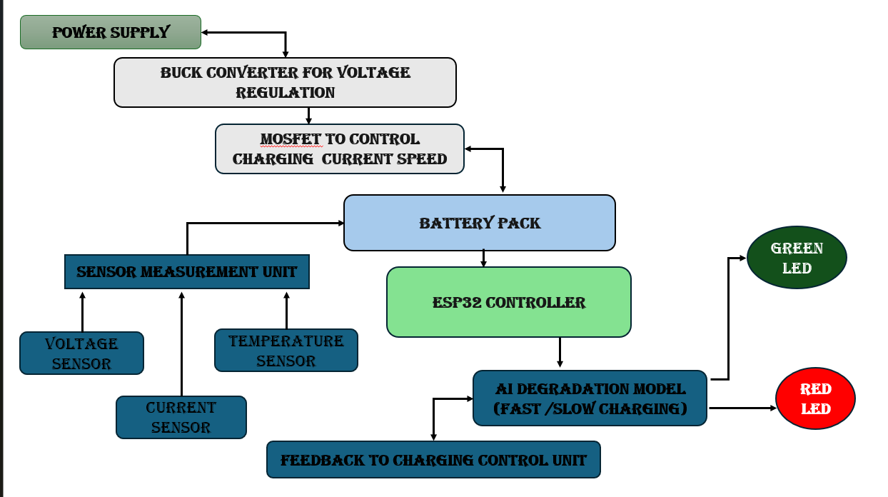
BLOCK DIAGRAM
KIT-Electrical and Electronics Engineering

Slide 10
MATHEMATICAL ANALYSIS AND CALCULATIONS
These formulas are used for battery monitoring, AI input parameters, and converter control.
Battery State of Health (SoH):
SOH = (C_current / C_rated) × 100 → (1)
Where:
C_current = Current battery capacity
C_rated = Original battery capacity.
Temperature Rise of Battery:
Q = (I*I)*R*t → (2)
Where:
Q = Heat generated I = Current
R = Internal resistance t = Time
KIT-Electrical and Electronics Engineering

Slide 11
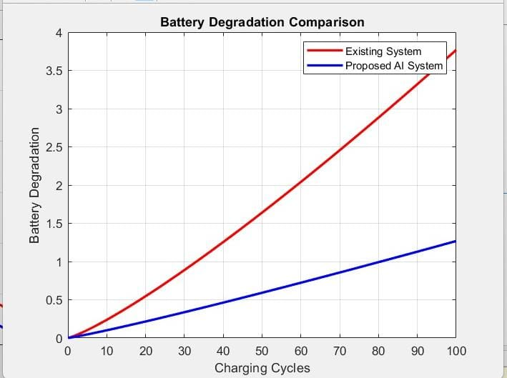
RESULT
The Red line indicates,
Degradation increases rapidly.
At 100 charging cycles, degradation reaches approximately 3.8 units.
Indicates higher thermal stress and faster battery aging.
The Blue line indicates ,
Degradation increases much more slowly.
At 100 charging cycles, degradation is only about 1.3 units.
Battery remains healthier for a longer period.
KIT-Electrical and Electronics Engineering

Slide 12
CONCLUSION
With AI, there is health-based adaptive monitoring and charging to ensure safer battery life with less degradation for longer life, and also a simple LED indication for better interaction.
This is a practical, efficient intelligent solution for next generation EV charging.
The experimental results demonstrate enhanced thermal management, efficiency and longevity over conventional EV charging methods by utilizing AI
KIT-Electrical and Electronics Engineering

Slide 13
REFERENCE
[1] Hu, Jincheng, Pengyu Fu, Zhongbao Wei, Yanjun Huang, Juliana Early, Ashley Fly, and Yuanjian Zhang. "Early prediction of lithium-ion battery degradation with a generative pre-trained transformer." Nature Communications (2025).
[2] Youness, Hakam, Tabaa Mohamed, Gaga Ahmed, Ahessab Hajar, and EL Hadadi Benachir. " Adaptive Safe Reinforcement Learning-Enabled Optimization of Battery Fast-Charging Protocols." In 2024 International Conference on Microelectronics (ICM), pp. 1-5. IEEE, 2024.
[3] Priya, Kumari, Rajesh Gupta, and Manas Kumar. "EV battery charging system via reconfigurable boost converter with solar PV and grid." In 2023 11th National Power Electronics Conference (NPEC), pp. 1-6. IEEE, 2023.
[4] Kim, Inwoo, Hyunjae Kim, Seongha An, Jihoon Oh, Minsoo Kim, and Jang Wook Choi. "Degradation path prediction of lithium-ion batteries under dynamic operating sequences." Energy & Environmental Science 18, no. 8 (2025): 3784-3794.
KIT-Electrical and Electronics Engineering

Slide 14
THANK YOU
KIT-Electrical and Electronics Engineering

