Slide 1



Building a serverless application
CLOUDSCAPE

Slide 2
Table of contents
01
02
03
04
05
06
Frontend
Backend logic
Serverless
Containerization
Integration
Final deployment

Slide 3

Description of the project
Basic AI Application with following features:
Answers any text query
Can upload a pdf and ask questions on its content
Can view the history of queries.
Will have a server-less backend.

Slide 4

01
Frontend

Slide 5
Frontend Development
- Everything you can see in the browser.
- Buttons, text, input, scrolling e.t.c.
- User Interface and User Experience (UI/UX)
- Tech stack used:
HTML, CSS, Javascript (and its frameworks)

Slide 6



Technology stack

Slide 7
Technology Stack
Structure
Add a button below

Slide 8
Technology Stack
Style
Let that button have blue color

Slide 9
Technology stack
Logic
When I click the button, it should do this action

Slide 10
HTML PROGRAMMING
Client/index.html

Slide 11
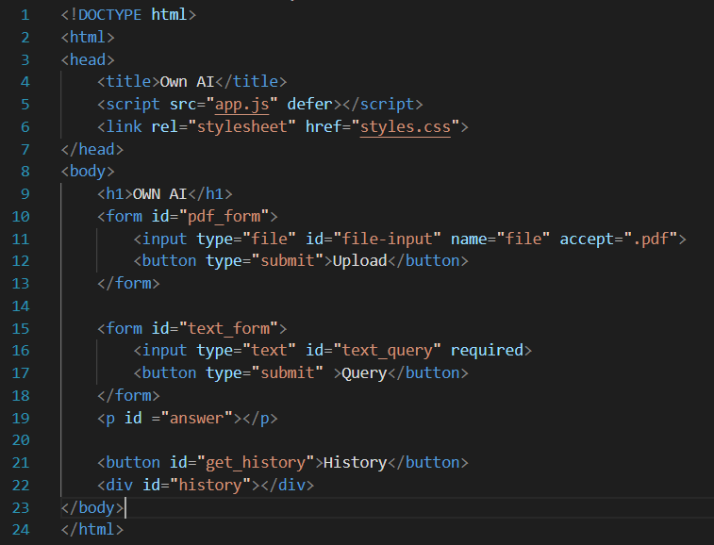
HTML PROGRAMMING
DOCTYPE html : Specifies that this is a html document.
<html>: Root element. Contains all other elements
<head> : Metadata, info that is not displayed
<body> :All visible content of the page

Slide 12
HTML PROGRAMMING
<h1> : Heading
<p> : Paragraph
<div> : Division. Like a container.
<form> : Input data and submit features
IDs : To use them later for styles and logic
Input types : text, file, password e.t.c.
Submit button: Submits all the info we gave in form tag

Slide 13
CSS PROGRAMMING
Client/styles.css

Slide 14
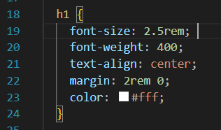
CSS PROGRAMMING

Slide 15
JS PROGRAMMING

Slide 16
JS PROGRAMMING
Before we dive in,

Slide 17
JS PROGRAMMING
var, const:
declare a variable
var name="rohith“
const c=300000000
function:
Does a given task
function add(a,b){
return a+b;
}
var c=add(1,2);

Slide 18
JS PROGRAMMING
event:
Some happening in html page
Clicking, hovering, touch, keyboard press
JSON:
JavaScript Object Notation
{
“name” : “rohith”,
“age” : 95,
“address” : “Visakhapatnam”
}

Slide 19
JS PROGRAMMING
event:
Some happening in html page
Clicking, hovering, touch, keyboard press
JSON:
JavaScript Object Notation
{
“name” : “rohith”,
“age” : 95,
“address” : “Visakhapatnam”
}

Slide 20
02
LOGIC

Slide 21
The most popular and convenient language used for handling files and implementing ML is ?
🐍

Slide 22
The most popular and convenient language used for handling files and implementing ML is ?
Python
🐍

Slide 23
Logic Programming
If we want to ask something to a bot like chat-gpt, what all you should tell the bot?

Slide 24
Logic Programming
If we want to ask something to a bot like chat-gpt, what all you should tell the bot?
Query
Can a cat eat chocolate

Slide 25
Logic Programming
If we want to ask something to a bot like chat-gpt, what all you should tell the bot?
Query
Context
Why was antony searching for leo
Leo Movie

Slide 26
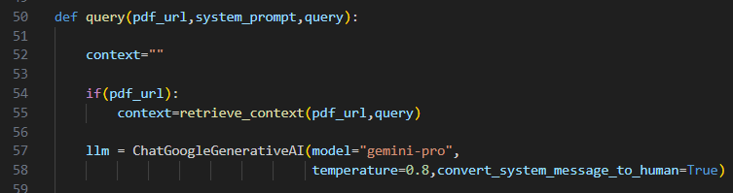
Logic Programming
# Create empty context for text inputs
# Will be discussed later
# Creates an instance of Google’s gemini-pro LLM

Slide 27
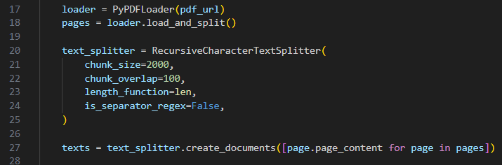
Logic Programming
# Loads pdf from link

Slide 28
Logic Programming
# Loads pdf from link
# Split pdf into pages

Slide 29
Logic Programming
# Loads pdf from link
# Split pdf into pages
# Extracts text, divides into chunks, creating document with each chunk

Slide 30
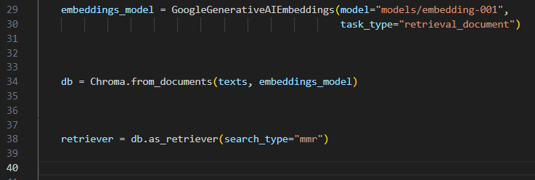
Logic Programming

Slide 31
Logic Programming
# Converts docs into numericals. Use case: retrieval

Slide 32
Logic Programming
# Converts docs into numericals. Use case: retrieval
# Stores embeddings

Slide 33
Logic Programming
# Converts docs into numericals. Use case: retrieval
# Stores embeddings
# Transforms that db into retrival system. Fetches relevant text very fast

Slide 34
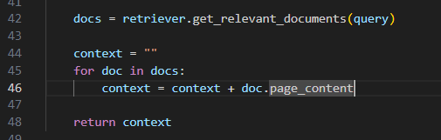
Logic Programming

Slide 35
Logic Programming
# Get docs (text) related to the question we ask

Slide 36
Logic Programming
# Get docs (text) related to the question we ask
# Add that text from docs to context

Slide 37
Logic Programming
# Get docs (text) related to the question we ask
# Add that text from docs to context
# This context is the text in the pdf that is relevant to the question we asked
We can send this to the LLM and it will generate ans according to the pdf

Slide 38
FRONTEND
BACKEND

Slide 39
FRONTEND
BACKEND
Need to run js code.
Browsers can display HTML and run JS

Slide 40
FRONTEND
BACKEND
Needs to run code of variety of languages.
Needs compilers & runtime environments
Run in another computer (server)

Slide 41
How to host a server
- Go and buy a physical server

Slide 42
How to host a server
- Go and buy a physical server
☺
Expensive
Cannot scale
Managing is hard

Slide 43
How to host a server
- Go and buy a physical server
- Run in a server in the cloud
☺
Expensive
Cannot scale
Managing is hard

Slide 44
How to host a server
- Go and buy a physical server
- Run in a server in the cloud
☺
Expensive
Cannot scale
Managing is hard
Pay per time
Flexible, scalable
Ideal for most large scale applications

Slide 45
How to host a server
- Go and buy a physical server
- Run in a server in the cloud
☺
Expensive
Cannot scale
Managing is hard
Pay per time
Flexible, scalable
Ideal for most large scale applications
Managing is still hard

Slide 46
03
Serverless

Slide 47
Serverless Application
“SERVERLESS”
No server?

Slide 48
Serverless Application
“SERVERLESS”
No server?
Server is necessary to run
But we need not manage server

Slide 49
Serverless Application
“SERVERLESS”
No server?
Server is necessary to run
But we need not manage server
No start-stop.
No software management.
Runtime already provided

Slide 50
Serverless Application
The most popular service used to run serverless applications
AWS LAMBDA

Slide 51

Serverless Application
Contains python code
And runtime environment

Slide 52
Serverless Application
Response
Trigger
Runs code and returns

Slide 53
Serverless Application
?
Response
Trigger
Runs code and returns

Slide 54

Serverless Application
Response
API Gateway
Runs code and returns

Slide 55
Serverless Application
Response
API Gateway
Runs code and returns
Bridge b/w frontend and lambda
Gives you a link
Requesting that url triggers lambda

Slide 56
Serverless Application
Request
Trigger
Response
Response
GET http:/dnfskjdf/default
http:/dnfskjdf/default
def func:
Return a+b

Slide 57
Serverless Application
Request
Trigger
Response
Response
GET http:/dnfskjdf/default
http:/dnfskjdf/default
def func:
Return a+b
Hey {link}, Can you give me these details
Ok. Hey Lambda please compute and give me these
Sure, here are the details

Slide 58
Serverless Application
Limitations of lambda
Dependencies (packages) should also be given along with code.
Can support only total size of around 50MB

Slide 59
Serverless Application
Limitations of lambda
Dependencies (packages) should also be given along with code.
Can support only total size of around 50MB
Our dependencies are more than 300mb

Slide 60
Serverless Application
There is a way
Lambda supports containers of upto a size of 10GB

Slide 61
03
Containerization

Slide 62
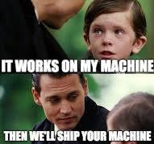

Slide 63
Containers
- Just like physical containers.
- Contains everything that an app needs to run
Code, runtime, packages, compilers, OS etc.
- Anyone can use on any system

Slide 64
Containers
- Just like physical containers.
- Contains everything that an app needs to run
Code, runtime, packages, compilers, OS etc.
- Anyone can use on any system
- Images are like objects in container containing all mentioned resources.

Slide 65
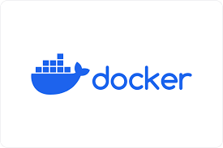
Containers
Most used system to create and store containers and images

Slide 66
Serverless Application
Request
Trigger
Response
Response
GET http:/dnfskjdf/default
http:/dnfskjdf/default
def func:
Return a+b

Slide 67
Serverless Application
Request
Trigger
Response
Response
GET http:/dnfskjdf/default
http:/dnfskjdf/default
Has my container image with all necessary things

Slide 68

Serverless Application
Backend code
Make image with OS, python, code, dependencies
Upload the image to ECR

Slide 69
Serverless Application
Backend code
Make image with OS, python, code, dependencies
Upload the image to ECR
Request
Trigger
Response
Response
GET http:/dnfskjdf/default
http:/dnfskjdf/default
Use that image here instead of direct code

Slide 70
Serverless Application
POST /query
POST /query
answer
answer
http://url

Slide 71
Serverless Application
POST /query
POST /query
answer
answer
POST /geturl
POST /geturl
url
url
http://url

Slide 72
Serverless Application
POST /query
POST /query
answer
answer
GET /history
GET /history
history
history
http://url
POST /geturl
POST /geturl
url
url

Slide 73
Serverless Application
POST /query
POST /query
answer
answer
GET /history
GET /history
history
history
http://url
POST /geturl
POST /geturl
url
url

Slide 74
03
Integration

Slide 75
Integration
- Now we have our frontend and backend.
- Lets integrate them using:

Slide 76
Integration
- Now we have our frontend and backend.
- Lets integrate them using:
API requests

Slide 77
Integration
API requests in js
Using fetch()

Slide 78
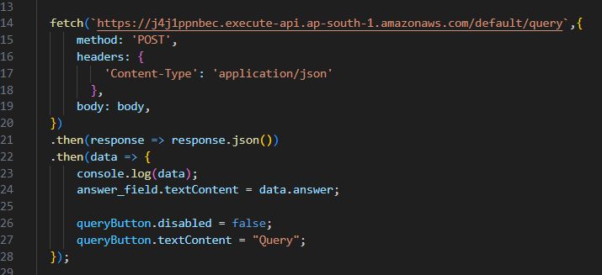
Integration
API requests in js
Using fetch()
url, options (method, headers body e.t.c)

Slide 79
Integration
API requests in js
Using fetch()
url, options (method, headers body e.t.c)
# then Convert response into json

Slide 80
Integration
API requests in js
Using fetch()
url, options (method, headers body e.t.c)
# then Convert response into json
# then what to do with data

Slide 81
Hosting Frontend
- We are running frontend using index.html, styles.css, app.js

Slide 82
Hosting Frontend
- We are running frontend using index.html, styles.css, app.js
- How do we make them available to everyone?

Slide 83
Hosting Frontend
- We are running frontend using index.html, styles.css, app.js
- How do we make them available to everyone?
- Thankfully, easy process.

Slide 84

Hosting Frontend
Index.html, styles.css, app.js
Put these in an s3 bucket

Slide 85

Hosting Frontend
Index.html, styles.css, app.js
Put these in an s3 bucket
Use AWS Cloudfront to make them available for everyone
https://sndf.cloudfront

Slide 86
06
Conclusion

Slide 87
What did we learn today?

Slide 88
What did we learn today?
- How to build simple websites :
Frontend, Backend, API

Slide 89
What did we learn today?
- How to build simple websites :
Frontend, Backend, API
- Using a handful of cloud services:
AWS Lambda
AWS API Gateway
AWS S3
AWS Cloudfront e.t.c.

Slide 90
What did we learn today?
- How to build simple websites :
Frontend, Backend, API
- Using a handful of cloud services:
AWS Lambda
AWS API Gateway
AWS S3
AWS Cloudfront e.t.c.
- Building a serverless application using these

Slide 91
See you on the cloud

