Slide 1


Major Project
Autonomous Research Report Agent
An Evidence-Driven Multi-Agent Framework for Automated Research
Presented by:
500121743 - Kanishk Vikram Singh
500119592 - Yash Thakur
500119644 - Sumit Kumar
500119031 - Devansh Saini
Mentored By
Dr. Anish Kumar Vishwakarma

Slide 2
Content
Introduction
Literature Review
Objectives
System Architecture
Methodology
Working Model
Results
Future work
References

Slide 3
Introduction
Technical Background: The project focuses on an LLM-powered multi-agent framework that automates the research process by coordinating specialized agents for planning, information retrieval, evidence analysis, and report generation.
Technical Concepts: The framework integrates a Information Retrieval Engine using tokenization, stop-word removal, Porter stemming, inverted indexing, and Robertson–Spärck Jones BM25 scoring. It employs Hybrid Dense-Sparse Matching, combining Gemini 3072-dimensional embeddings (gemini-embedding-001) with BM25 lexical precision. Deep PDF Passage Chunking uses sliding-window segmentation (350 words, 50-word overlap) to prevent context dilution in long documents.
Motivation: Traditional research requires considerable time and manual effort to explore literature, verify information, and organize findings. This project aims to streamline these activities while maintaining transparency, source traceability, and evidence-based conclusions.
Problem Statement: Conventional AI-generated summaries may lack adequate citations, overlook contradictory evidence, or present unsupported claims. The challenge is to develop an automated system that generates structured research reports grounded in verifiable evidence rather than relying on one-shot LLM responses.
Applications: The framework can support literature reviews, technical research, scientific exploration, evidence synthesis, comparative analysis, and early-stage investigation across diverse domains.
Input and Output: The system accepts a user-defined research topic or question as input and produces a structured research plan, collected and validated evidence records, and a comprehensive report with citations and source references.

Slide 4
Literature Review
Related Work:
Wang et al. (2024): Surveyed LLM-based autonomous agents, including planning, tool use, and agent architectures.
Singh et al. (2025): Explored Agentic RAG, highlighting adaptive retrieval, reflection, and multi-agent collaboration.
Li et al. (2025): Reviewed RAG-reasoning systems that combine iterative retrieval with multi-step reasoning.
Yao et al. (2023): Introduced ReAct, integrating reasoning and tool-based actions.
Inference: Recent research highlights the shift from static LLM pipelines toward agentic systems capable of planning, iterative retrieval, tool use, and evidence-grounded reasoning. Our project applies these principles to structured research report generation with traceable evidence.
Identified research Gap
Existing LLM-based research workflows often emphasize information retrieval and summary generation, while challenges remain in ensuring systematic, evidence-driven research.
Research Planning: Explicitly defining research questions, evidence requirements, and search strategies.
Counter-Evidence Exploration: Actively retrieving contradictory findings to reduce confirmation bias.
Source Evaluation and Retrieval Depth: Deduplicating sources and extracting focused passages to avoid context dilution in long papers.
Evidence Traceability: Establishing clear mappings between generated claims and their supporting sources.
Iterative Validation: Identifying evidence gaps and triggering additional retrieval when the available evidence is insufficient.
Proposed Contribution: An integrated multi-agent framework that combines research planning, multi-source retrieval, evidence validation, and iterative re-search to generate structured, citation-supported research reports.
SWOT Analysis:
Strengths: Modular multi-agent workflow, multi-source retrieval, traceable evidence, and iterative research.
Weaknesses: Dependence on external APIs, inconsistent source quality, and potential extraction errors.
Opportunities: Academic database integration, automated citation verification, expert review, and benchmark-based evaluation.
Threats: Retrieval bias, outdated or contradictory sources, hallucinations, and over-reliance on generated summaries.

Slide 5
Objective
Main Objective
To develop an autonomous, evidence-driven research agent that systematically plans research, retrieves and validates information, and generates structured reports with traceable citations.
Sub-Objectives :
Research Planning: Decompose open-ended research topics into structured research questions, hypotheses, and evidence requirements.
Multi-Source Retrieval: Retrieve and rank candidate sources from Tavily, OpenAlex, and Semantic Scholar using a semantic indexing pipeline (BM25 + vector embeddings) and sliding-window PDF passage chunking.
Evidence Organization and Validation: Extract and organize evidence into structured records, assess source credibility, map claims to supporting evidence, and identify contradictions.
Evidence Sufficiency: Evaluate the adequacy of collected evidence and trigger additional retrieval when necessary.
Report Generation: Generate readable, well-structured research reports with evidence-supported conclusions and traceable citations.

Slide 6
System Architecture
👤
PHASE 1: RESEARCH PLANNER
PHASE 2: RESEARCHER
PHASE 3: EVIDENCE VALIDATOR
PHASE 4: REPORT GENERATOR
USER
Research Question / Topic
Planning Agent (LLM)
Research Agent Pipeline
Validation & Reasoning Agent
Report Generation Agent
Working Hypothesis
Competing Hypotheses
Research Questions
Evidence Requirements
Search Strategy
Source Quality Policy
Stopping Criteria
Multi-Query Generation
Tri-Provider Search
Multi-Key Deduplication
Semantic Indexing
Dense Vector Embeddings & Cosine Re-ranking
Two-Stage Filtering
Deep PDF Passage Chunking
Evidence Quality Assessment
Claim ↔ Evidence Mapping
Source Reliability Scoring
Contradiction Detection
Hypothesis Evaluation
Evidence Sufficiency Check
Autonomous Re-search Trigger
Scientific Report Generation
Executive Summary
Evidence-Based Conclusions
Claim Support Tables
Citations & References
Confidence Presentation
Structured Report (PDF/MD/HTML)
JSON
JSON
JSON
JSON
research_plan.json
research_evidence.json
validated_evidence.json
research_report.pdf / .md / .html
Contract between Phase 1 & Phase 2
Structured findings, evidence, sources, gaps, summary
Validated claims, confidence scores, conflicts, gaps
Complete evidence-backed research report

Slide 7
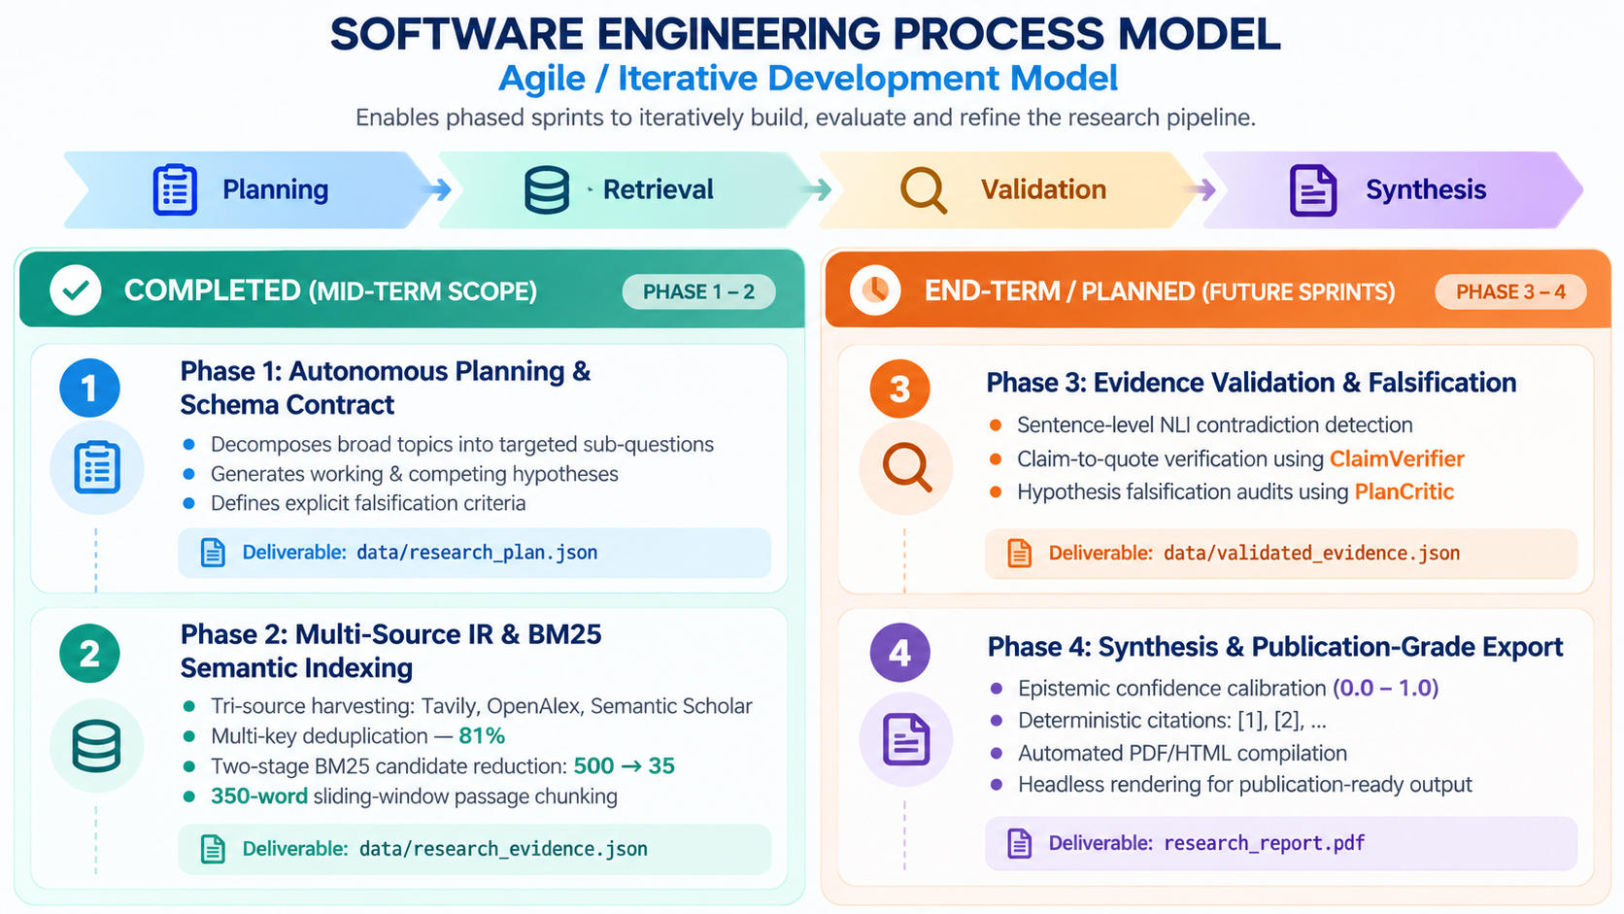
Methodology

Slide 8
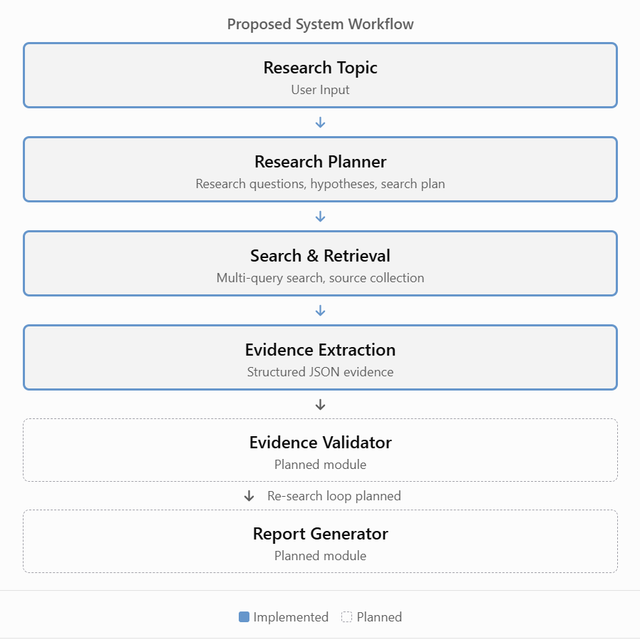
Working Model
1. Requirement Analysis
The system is designed to accept user-defined research topics, configure LLM and search APIs, retrieve information from multiple sources, and organize research evidence. The overall requirements also include evidence validation, citation traceability, and report generation.
2. System Architecture
The proposed architecture follows a modular, multi-agent workflow:
Research Planner → Search & Retrieval → Evidence Extraction → Evidence Validator ↔ Re-search Loop → Report Generator
Each module is responsible for a specific stage of the research process, enabling structured information flow and future integration of validation and reporting capabilities.
3. Working Module
The system is implemented in Python using an orchestration pipeline that integrates LLM-based research planning with external search providers. It generates structured JSON artifacts to preserve research plans and retrieved evidence for subsequent processing.
4. Attained Deliverables
Research Planning: Autonomous question decomposition and hypothesis generation in research_plan.json .
Tri-Provider Discovery: Integrated Tavily, OpenAlex, and Semantic Scholar .
Semantic Indexing: Hybrid BM25 and Gemini vector embeddings with 2-stage filtering.
Deep PDF Retrieval: Sliding-window passage chunking to prevent context loss.
System Verification & CI: 177 automated unit tests passing (100% pass rate) with continuous GitHub Actions CI.
Next Steps: Evidence validation, iterative re-search, and automated cited report generation.

Slide 9
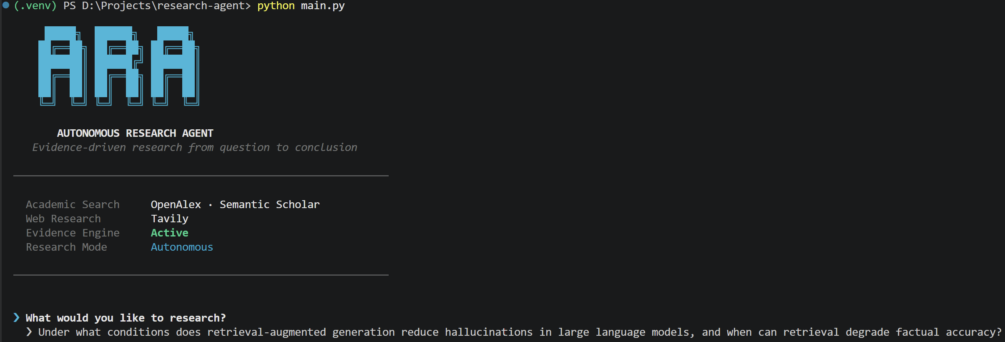
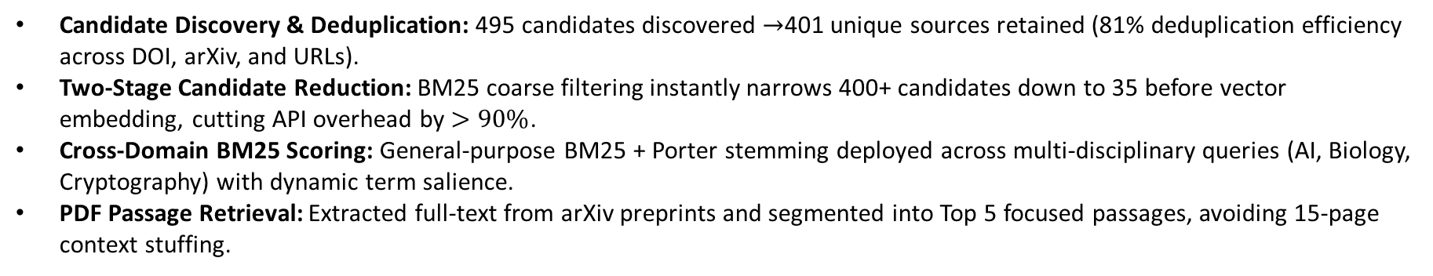
Results: Candidate Retrieval & Semantic Indexing
Candidate Discovery & Deduplication: 495 candidates discovered $→$401 unique sources retained (81% deduplication efficiency across DOI, arXiv, and URLs).
Two-Stage Candidate Reduction: BM25 coarse filtering instantly narrows 400+ candidates down to 35 before vector embedding, cutting API overhead by $>90\%$.
Cross-Domain BM25 Scoring: General-purpose BM25 + Porter stemming deployed across multi-disciplinary queries (AI, Biology, Cryptography) with dynamic term salience.
PDF Passage Retrieval: Extracted full-text from arXiv preprints and segmented into Top 5 focused passages, avoiding 15-page context stuffing.

Slide 10
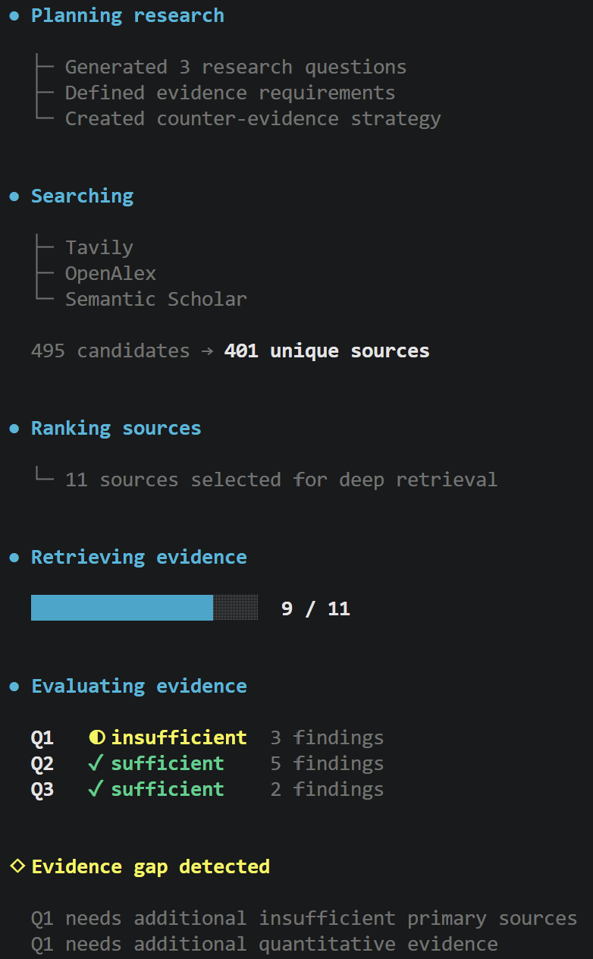
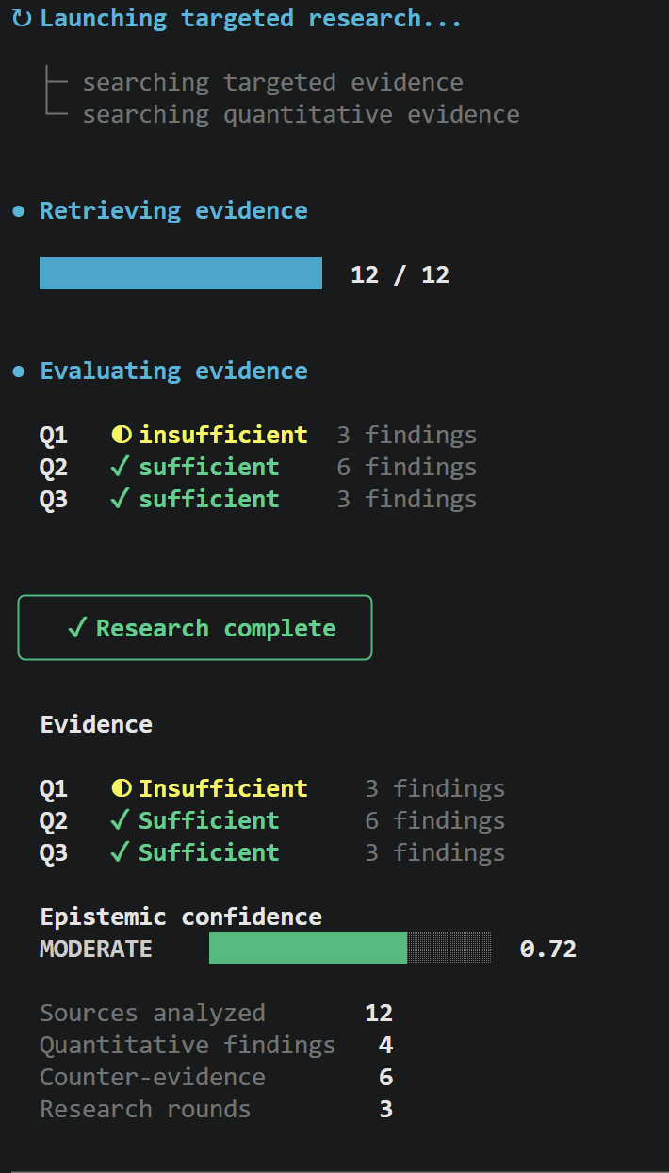
Results: Evidence Evaluation & Iterative Loop

Slide 11
Future Work
The next phase of the project will focus on extending the existing research planning and retrieval modules into a complete evidence-driven research framework.
1. Evidence Validation Layer
Extend the Mid-Term auditing modules (ClaimVerifier & PlanCritic) into sentence-level NLI contradiction detection and automated claim grounding.
2. Automated Iterative Re-Search
Automate sufficiency gap detection to trigger multi-round targeted re-search queries.
3. Calibrated Report Generation
Generate structured academic reports with explicit epistemic confidence levels and deterministic citations [1], [2].
4. Headless PDF Compilation
Integrate WeasyPrint to directly export publication-grade .pdf files alongside .html.
5. Citation Graph Traversal
Expand references multi-hop forward and backward using Semantic Scholar's academic graph API.
Expected Outcome: A fully integrated, autonomous research agent capable of generating structured, evidence-supported reports with improved reliability and transparency.

Slide 12
Reference
References
Research Papers
Wang, L., et al. (2024). A Survey on Large Language Model Based Autonomous Agents. Frontiers of Computer Science, 18, Article 186345. https://doi.org/10.1007/s11704-024-40231-1
Liu, N. F., et al. (2024). Lost in the Middle: How Language Models Use Long Contexts. Transactions of the ACL. https://arxiv.org/abs/2307.03172
Robertson, S., & Zaragoza, H. (2009). The Probabilistic Relevance Framework: BM25 and Beyond. Foundations and Trends in Information Retrieval. https://doi.org/10.1561/1500000019
Singh, A., Ehtesham, A., Kumar, S., Khoei, T. T., & Vasilakos, A. V. (2025). Agentic Retrieval-Augmented Generation: A Survey on Agentic RAG. arXiv:2501.09136. https://arxiv.org/abs/2501.09136
Li, Y., et al. (2025). A Survey of RAG-Reasoning Systems in Large Language Models. Findings of the Association for Computational Linguistics: EMNLP 2025, pp. 12120–12145. https://doi.org/10.18653/v1/2025.findings-emnlp.648
Foundational Work
Yao, S., et al. (2023). ReAct: Synergizing Reasoning and Acting in Language Models. International Conference on Learning Representations (ICLR).
Project References
GitHub Repository: https://github.com/kanishk-16/research-agent

Slide 13
Thank You

