Slide 1
Face recognition system
Real-time face recognition and detection

Slide 2
overview
Components of the System:
Image Processing:
Utilizes OpenCV for capturing and processing video frames from a webcam.
Image frames are captured in real-time and processed to detect faces.
Face Encoding:
Uses the face_recognition library to convert detected faces into numerical face encodings.
Encodings are unique numerical representations of facial features.
Matching with Known Faces:
Known face encodings are preloaded from a specified directory.
Real-time face encodings are compared with known encodings to identify individuals.
User Interface with Tkinter:
Tkinter is used to create a graphical user interface (GUI).
The GUI displays the video feed, recognized names, and lists of all recognized faces.

Slide 3
WORKFLOW
Image Capture:
The system captures video frames from the webcam using OpenCV.
Frames are processed and flipped for a natural viewing experience.
Face Detection:
Faces in the video frames are detected using face_recognition library.
Bounding boxes are drawn around detected faces for visualization.
Face Encoding:
Detected faces are encoded into numerical vectors.
Each face encoding is compared against a database of known encodings.
Matching:
If a match is found, the system identifies the person and displays their name.
If no match is found, the person is labeled as "Unknown".
Display:
The GUI updates to show the video feed with recognized faces.
Lists of current and all-time recognized faces are displayed and updated in real-time.

Slide 4
Diagram of workflow
Image capture
Webcam
OpenCV
Face Detection
OpenCV
Face Recognition
Face Encoding
face_recognition
face_recognition
Display
Matching
Tkinter GUI

Slide 5
get_face_encoding(image_path)
LOAD IMAGE FILE
The function uses face_recognition.load_image_file(image_path) to load the image from the specified file path.
This function reads the image file and converts it into a format that the face_recognition library can process.
DETECT AND ENCODE FACES
face_recognition.face_encodings(image) is used to detect faces in the loaded image and encode them.
This function returns a list of encodings for all detected faces in the image.
RETRIEVE FIRST ENCODING
The function returns the first face encoding found in the image using face_recognition.face_encodings(image).
This ensures that only the first detected face's encoding is considered, which is useful when there is only one person in the image.
RETURN THE ENCODING
The face encoding, a numerical vector representing the facial features, is returned by the function.
This encoding can then be used to compare with other face encodings to recognize the person.

Slide 6
update_video()
CAPTURE FRAME FROM WEBCAM:
The function captures a frame from the webcam using ret, frame = video_capture.read().
The frame is then flipped horizontally using frame = cv2.flip(frame, 1) for a mirror-like view.
DETECT FACE LOCATIONS:
face_locations = face_recognition.face_locations(frame) is used to detect all faces in the current frame.
This function returns the coordinates of bounding boxes around detected faces.
ENCODE DETECTED FACES:
face_encodings = face_recognition.face_encodings(frame, face_locations) computes face encodings for all detected faces in the frame.
These encodings are numerical representations of the detected faces' features.
INITIALIZE RECOGNIZED NAMES LIST:
An empty list recognized_names is initialized to store names of recognized faces in the current frame.

Slide 7
MATCH DETECTED FACES WITH KNOWN FACES:
The function loops through each detected face and its encoding.
matches = face_recognition.compare_faces(known_face_encodings, face_encoding) checks if the detected face matches any known faces.
If a match is found, the corresponding name from person_ids is added to recognized_names.
DRAW BOUNDING BOXES AND LABELS:
For each detected face, a rectangle is drawn around the face using cv2.rectangle().
A label with the name (or "Unknown" if no match) is drawn below the face using cv2.putText().
CONVERT FRAME FOR TKINTER:
The frame is converted from BGR to RGB using cv2.cvtColor().
The frame is then converted to a format suitable for Tkinter using Image.fromarray() and ImageTk.PhotoImage().
UPDATE GUI:
The video label in the GUI is updated with the new frame using video_label.config(image=img) and video_label.image = img.
The names listbox is updated with the recognized names in the current frame.
The all recognized names listbox is updated with names stored in all_recognized_names_set.
REPEAT THE PROCESS:
The function schedules itself to be called again after 10 milliseconds using window.after(10, update_video) for continuous video feed and face recognition.

Slide 8
__main__ BLOCK
INITIALIZE WEBCAM:
The video_capture = cv2.VideoCapture(0) line initializes the webcam for capturing video.
0 is the index for the default webcam on the computer.
This step is essential for getting the video feed from the webcam.
CREATE TKINTER WINDOW:
A Tkinter window is created using window = tk.Tk().
The window title is set to "Face Recognition System" with window.title("Face Recognition System").
The window size is defined as 800x600 pixels using window.geometry("800x600").
SET UP VIDEO DISPLAY LABEL:
A label widget video_label = Label(window) is created to display the video feed.
This label is packed into the window using video_label.pack(side="left", fill="both", expand=True).
SET UP NAMES DISPLAY LABELS AND LISTBOXES:
Labels:
names_label = Label(window, text="IN FRAME FACES", font=("Arial", 14)) for faces currently in the frame.
all_names_label = Label(window, text="ALL RECOGNIZED FACES", font=("Arial", 14)) for all recognized faces.

Slide 9
Listboxes:
names_listbox = tk.Listbox(window, font=("Arial", 12), bg="white", fg="black") for current frame faces.
all_names_listbox = tk.Listbox(window, font=("Arial", 12), bg="white", fg="black") for all recognized faces.
INITIALIZE SET FOR RECOGNIZED NAMES:
A set all_recognized_names_set = set() is created to keep track of all recognized names over time.
CREATE STOP BUTTON:
A button stop_button = Button(window, text="Stop", command=window.quit, font=("Arial", 12)) is created to stop the application.
This button is packed into the window using stop_button.pack(side="bottom", padx=10, pady=10).
START VIDEO UPDATE LOOP:
The update_video() function is called to start the video update loop.
This ensures that the video feed and face recognition process start immediately.
RUN TKINTER MAIN LOOP:
The Tkinter main loop is started with window.mainloop() which keeps the window open and responsive
RELEASE WEBCAM AND CLOSE WINDOWS:
After the Tkinter main loop ends, the webcam is released with video_capture.release().
All OpenCV windows are closed with cv2.destroyAllWindows() to free up resources.

Slide 10
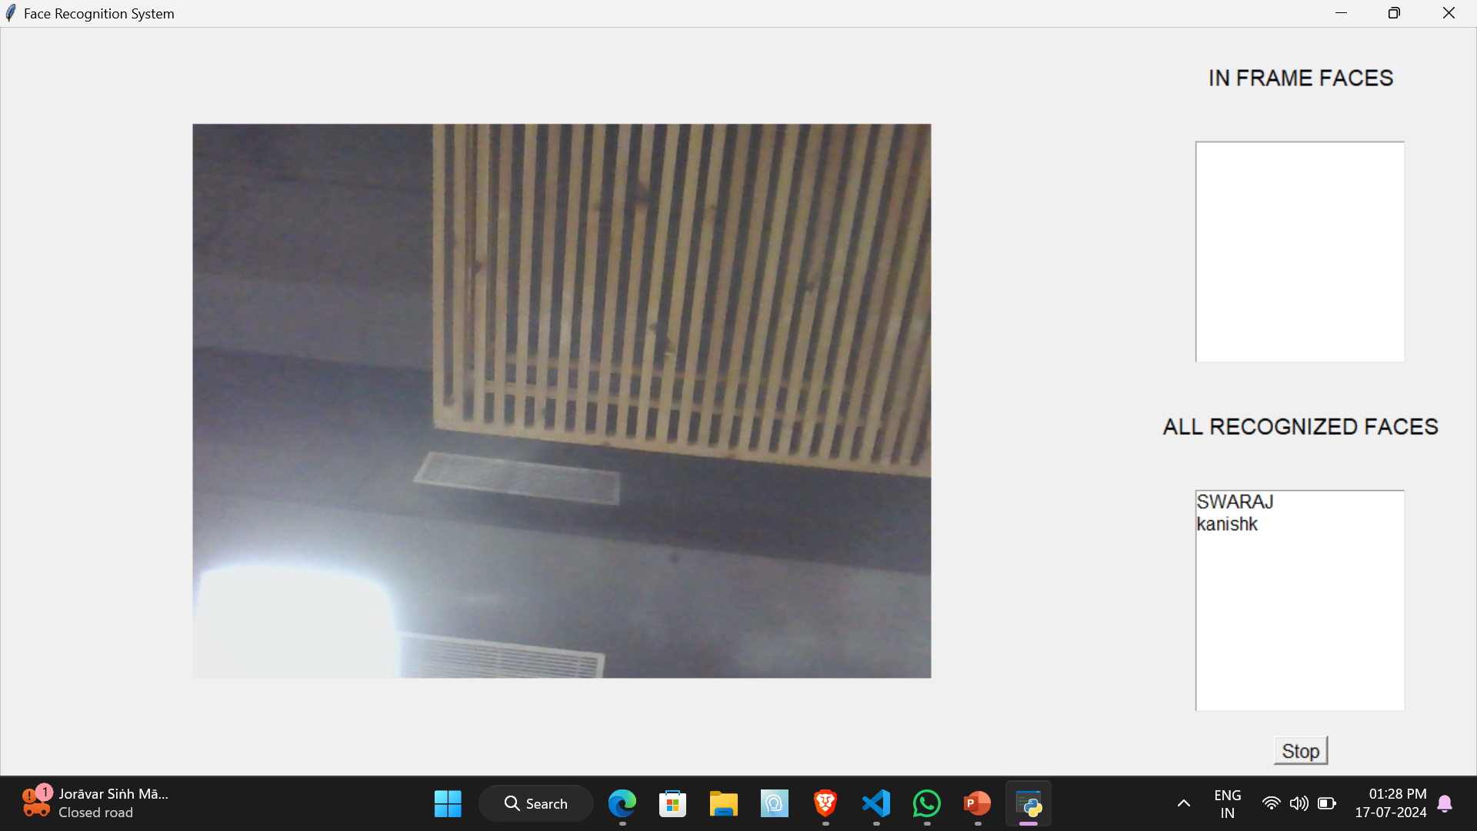
demonstration
Open python file and run the program.
A window will appear having two boxes i.e. In-frame faces and All recognized faces respectively.

Slide 11
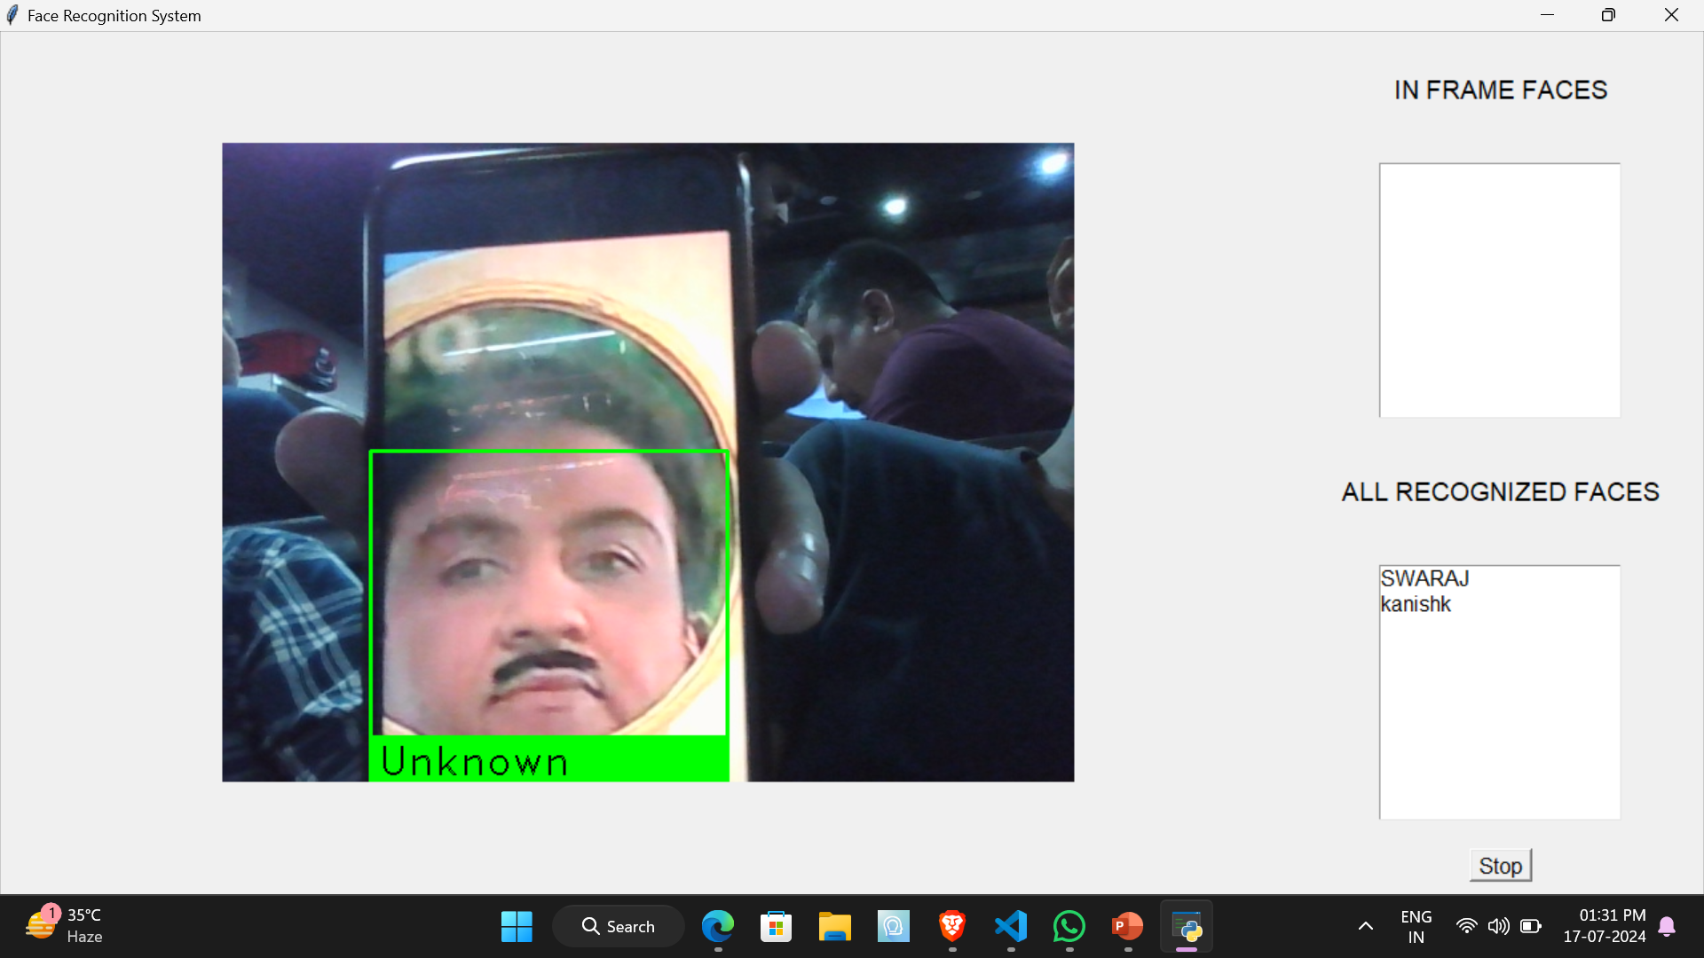
The “In-frame faces” box will record the face which are currently present in front of the camera.
The “All recognized faces” will record the faces which have been detected and recognized by program.
It will show “unknown” for the faces which have not been recognized.

Slide 12
Thank you

