Slide 1
NAME:kanish K
REGISTER NO:2426J0481
NMID:7A1BB39D7BF7297AA374EB53C99EF73F
DEPARTMENT: INFORMATION TECHNOLOGY
COLLEGE:Sri Krishna Adithya College of Arts and Science/Bharthiyar University

Slide 2
PROJECT TITLE:
WEB-BASED
COLLEGE REGISTRATION FORM

Slide 3
AGENDA
Problem Statement
2.Project Overview
3.End Users
4.Tools and Technologies
5.Portfolio design and Layout
6.Features and Functionality
7.Results and Screenshots
8.Conclusion

Slide 4
PROBLEM STATEMENT
The admission process in most colleges is often manual and time-consuming, requiring students to fill in paper-based forms and administrators to handle large volumes of physical data. This results in:
Errors in data entry
Duplication of work
Increased processing time
Difficulty in record management
To address these challenges, a web-based admission form is developed that enables students to fill in their details online and ensures faster, more accurate, and secure data collection.

Slide 5
PROJECT OVERVIEW:
This project is a College Admission Form Web Application designed using HTML, CSS, and JavaScript. It allows students to apply online by entering their personal, academic, and contact details. The system validates user input to prevent errors and ensures smooth data submission.
The main goal of this project is to digitize the admission process for colleges and provide a user-friendly, secure, and efficient solution.

Slide 6
WHO ARE THE END USERS?
Students: To apply for admission online without paperwork.
College Administration: To collect and manage applicant data efficiently.
Parents/Guardians: To easily help students apply for admission.

Slide 7
TOOLS AND TECHNIQUES:
HTML5 → Structure of the form
CSS3 → Styling and layout design
JavaScript → Form validation and interactivity
Browser: Any modern browser (Chrome, Edge, Firefox, etc.)

Slide 8
FORM DESIGN AND LAYOUT
The admission form is designed with a clean, modern UI to ensure usability:
Responsive Design → Works on desktop, tablet, and mobile.
Form Layout → Divided into labeled input fields (Name, Email, Phone, Course, Address).
Validation Feedback → Error messages shown below each field.
Submit Confirmation → A success popup confirms submission.

Slide 9
FEATURES AND FUNCTIONALITY
✅ User-friendly online admission form
✅ Input validation for Name, Email, Phone, Course, and Address
✅ Dropdown menu for course selection
✅ Real-time error display (red warning text)
✅ Reset form after successful submission
✅ Secure data entry (basic client-side validation)
✅ Attractive, professional UI design

Slide 10
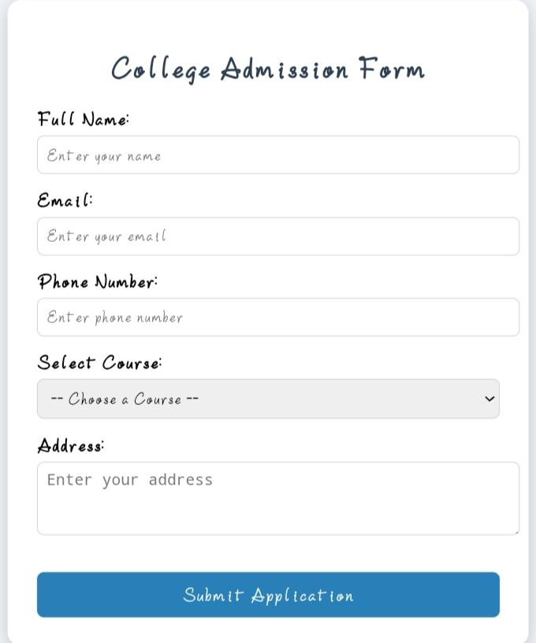
This is my result

Slide 11
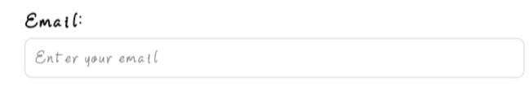
E-MAIL :

Slide 12
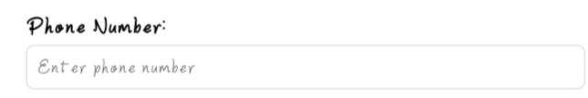
PHONE NUMBER :

Slide 13
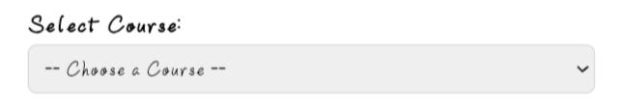
SELECT COURSE :

Slide 14
CONCLUSION:
The College Admission Form project successfully demonstrates how a digital solution can replace traditional paper-based admission processes. It simplifies student data collection, reduces errors, and improves efficiency.
In the future, this project can be enhanced by:
Storing data in a database (MySQL, Firebase, MongoDB).
Adding an admin dashboard for managing applications.
Sending email confirmations after successful submission.

Slide 15
GITHUB LINK :
https://github.com/kanishk007-leo/TNSDC_FWD-DIGITAL_PORTFOLIO.git

Slide 16
THANK YOU

