Slide 1

SQL Fundamentals

Slide 2
Agenda
Database – RDBMS
Types of Databases
SQL (Structured Query Language)
DDL, DML, DCL, DTL commands
Basic SQL Queries

Slide 3
Database
Database is an organized collection of structured data stored in a computer system so that data can be easily accessed, managed and updated.
DBMS(Database Management System) is a software that allows to perform various operations on databases like
Creation of databases
Storing data in databases
Retrieving data
Updating data
Provides security
Data integrity

Slide 4
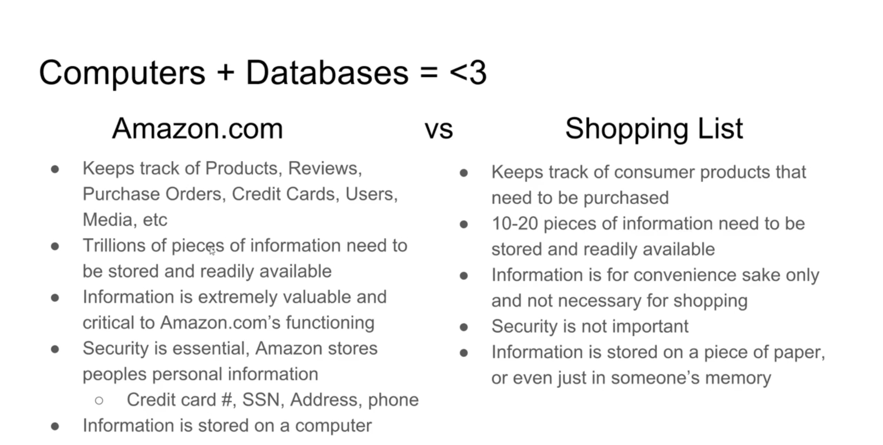
Computers + Databases = <3

Slide 5
C.R.U.D.
Create Read Update Delete

Slide 6
RDBMS
RDBMS stands for Relational Database Management System.
RDBMS is a type of DBMS that store data in a row-based table structure which connects related data elements.
Dr. E. F. Codd proposed the relational model for database systems in 1970
The relational model consists of the following :
Collection of objects and relations
Set of operations to act on the relations
Data integrity for accuracy and consistency

Slide 7


RDBMS
Database
Table name: EMPLOYEES
Table name: DEPARTMENTS
…
…

Slide 8
Types of Databases
There are different types of databases, but we focus on
Structured Databases
Structured Databases are table based and uses SQL to perform DB operations
MySQL
Oracle
Microsoft SQL Server
PostgreSQL
Unstructured Databases
Unstructured (NoSQL) databases are either document based, key-value pairs, graph databases.
MongoDB
Cassandra
Neo4J
Redis

Slide 9
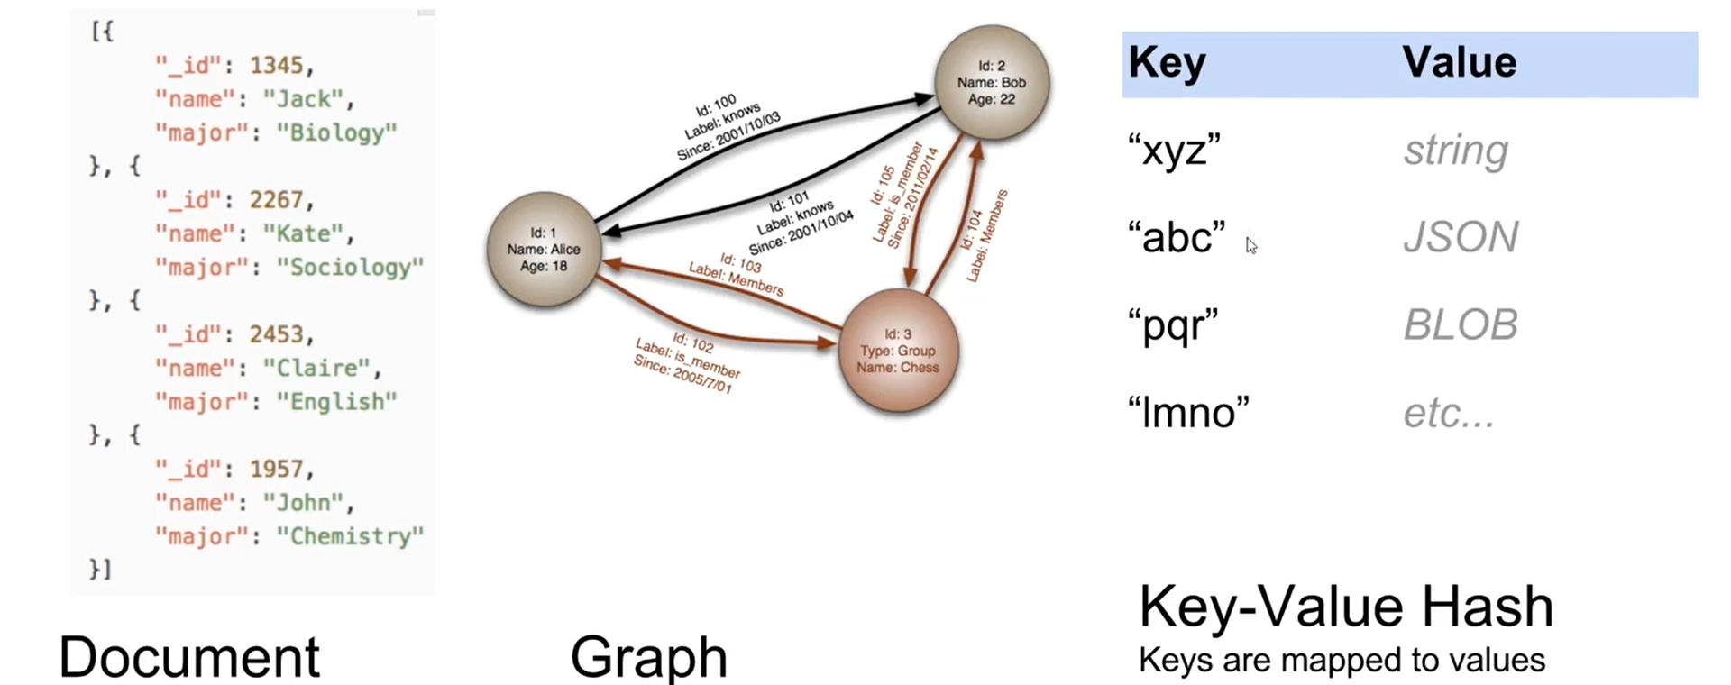
Non-Relational Databases(noSQL/no just SQL)

Slide 10
Database – Table, Primary Key, Foreign Key
PersonID | LastName | FirstName | Age
1 | Hansen | Ola | 30
2 | Svendson | Tove | 23
3 | Pettersen | Kari | 20
"Persons" table
OrderID | OrderNumber | PersonID
1 | 77895 | 3
2 | 44678 | 3
3 | 22456 | 2
4 | 24562 | 1
"Orders" table

Slide 11
DBMS Keys: Candidate, Super, Primary, Foreign
KEYS in DBMS is an attribute or set of attributes which helps you to identify a row(tuple) in a relation(table). They allow you to find the relation between two tables. Keys help you uniquely identify a row in a table by a combination of one or more columns in that table. Key is also helpful for finding unique record or row from the table. Database key is also helpful for finding unique record or row from the table.

Slide 12
DBMS Keys: Candidate, Super, Primary, Foreign
Super Key - A super key is a group of single or multiple keys which identifies rows in a table.
Primary Key - is a column or group of columns in a table that uniquely identify every row in that table.
Candidate Key - is a set of attributes that uniquely identify tuples in a table. Candidate Key is a super key with no repeated attributes.
Alternate Key - is a column or group of columns in a table that uniquely identify every row in that table.
Foreign Key - is a column that creates a relationship between two tables. The purpose of Foreign keys is to maintain data integrity and allow navigation between two different instances of an entity.
Compound Key - has two or more attributes that allow you to uniquely recognize a specific record. It is possible that each column may not be unique by itself within the database.
Composite Key - An artificial key which aims to uniquely identify each record is called a surrogate key. These kind of key are unique because they are created when you don't have any natural primary key.
Surrogate Key - An artificial key which aims to uniquely identify each record is called a surrogate key. These kind of key are unique because they are created when you don't have any natural primary key.

Slide 13
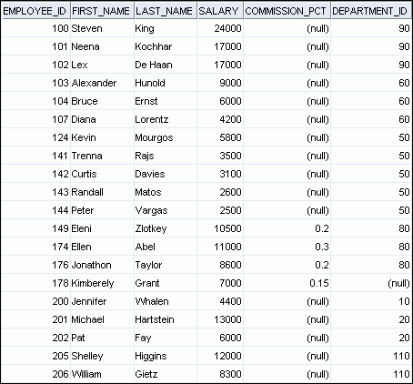
RDBMS Terminology
3
2
4
1
Row / Record / Tuple
2
Primary Key
3
Column
5
4
Foreign Key
5
null value
1

Slide 14
Entity Relationship Model
Entity Relationship Model (ER Model) describes the structure of a database with the help of the ER diagram.
In terms of databases, ER diagram shows entities (tables ) and their relationships
EMPLOYEE
#* number
* name
o job title
DEPARTMENT
#* number
* name
o location
assigned to
composed of

Slide 15
ER Model Conventions
Entity
Singular, Unique name
Uppercase
Soft box
Synonym in parenthesis
Attribute
Single Name
Lowercase
Mandatory marked with ‘*’
Optional marked with ‘o’
EMPLOYEE
#* number
* name
o job title
DEPARTMENT
#* number
* name
o location
assigned to
composed of
Unique Identifier (UID)
Primary marked with “#”
Secondary marked with “(#)”

Slide 16
Database Schema
Database schema is the skeleton structure that represents the logical view of the entire database.
Database schema defines its entities and the relationship among them
The process of creating a database schema is called data modelling.
There are two kinds of database schemas
Logical Database Schema – The schema defines all the logical constraints that need to be applied on the data stored. It defines tables, views, and integrity constraints
Physical Database Schema – The schema lays out how data is stored physically on a storage system in terms of files and indices.

Slide 17
Example : HR Schema
DEPARTMENTS
department_id
department_name
manager_id
location_id
LOCATIONS
location_id
street_address
postal_code
city
state_province
country_id
JOB_HISTORY employee_id
start_date
end_date
job_id
department_id
EMPLOYEES
employee_id
first_name
last_name
email
phone_number
hire_date
job_id
salary
commission_pct
manager_id
department_id
COUNTRIES
country_id
country_name
region_id
JOBS job_id
job_title
min_salary
max_salary
REGIONS
region_id
region_name

Slide 18
SQL
Stands for Structured Query Language.
The ANSI standard language for operating relational databases
SQL lets you access and manipulate databases
SQL uses SQL statements (queries) to perform database operations
With SQL queries, you can
Create databases and tables
Insert data in tables
Retrieve , update and delete data in tables ( CRUD operations )
Create stored procedures in databases
Create views in databases
Create users, set permissions on tables, procedures and view

Slide 19
SQL Statements
SQL statements are not case-sensitive.
SQL statements can be entered on one or more lines
Keywords cannot be abbreviated or split across lines
Clauses are usually placed on separate lines
Indents are used to enhance readability
Create databases and tables
Insert data in tables
Retrieve , update and delete data in tables ( CRUD operations )
Create stored procedures in databases
Create views in databases
Create users, set permissions on tables, procedures and view

Slide 20
SQL Statements
SELECT
INSERT
UPDATE
DELETE
MERGE
CREATE
ALTER
DROP
RENAME
TRUNCATE
COMMENT
GRANT
REVOKE
COMMIT
ROLLBACK
SAVEPOINT
Data manipulation language (DML)
Data definition language (DDL)
Data control language (DCL)
Transaction control

Slide 21
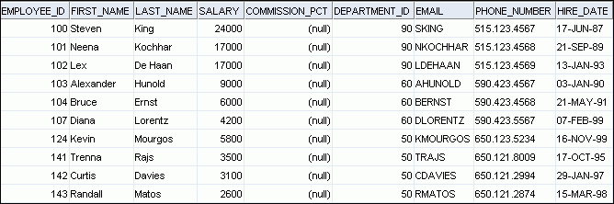
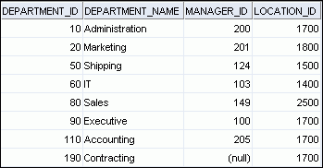
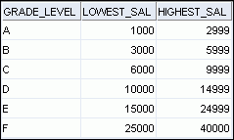
Sample Database
EMPLOYEES
DEPARTMENTS
JOB_GRADES

Slide 22
DDL Statements
DDL stands for Data Definition Language.
DDL Statements are used to define the database structure or schema
Statement | Description
CREATE | To create new database, table, view of table, or other objects in database
ALTER | Modifies an existing database object, such as table
DROP | Deletes an entire table, a view of table, or other objects in the database.

Slide 23
DML Statements
DML stands for Data Manipulation Language.
DML Statements are used to managing data within schema objects
Statement | Description
SELECT | Retrieve data from the database
INSERT | Inserts data into the table
UPDATE | Updates existing data within a table
DELETE | Deletes all records from a table , the space for all records remain
CALL | Call a PL/SQL or Java Sub program

Slide 24
DCL Statements
DCL stands for Data Control Language.
DCL Statements are used to control access to data stored in database (Authorization)
Statement | Description
GRANT | To allow specified users to perform specified tasks
REMOVE | To remove the user accessibility to database object

Slide 25
TCL Statements
TCL stands for Transaction Control Language.
TCL Statements are used to manage transactions in the database
Statement | Description
COMMIT | To permanently save any transaction to the database
ROLLBACK | To restores database to last committed state
SAVEPOINT | To temporarily save a transaction to a logical state so that you can rollback to that point whenever necessary

