Slide 1

SQL Queries

Slide 2
Agenda
Select Statements
Where clauses
GROUPBY
ORDER BY
Operators
Aggregate Functions

Slide 3
Basic SELECT Statement
SELECT statement is used to fetch the data from the table
SELECT identifies the columns to be displayed
Creation of databases
Storing data in databases
Retrieving data
Updating data
Provides security
Data integrity

Slide 4
SELECT statement
SELECT identifies the columns to be displayed.
FROM identifies the table containing those columns
SELECT *|{[DISTINCT] column|expression [alias],...}
FROM table;

Slide 5
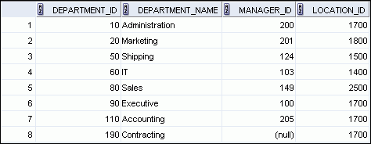
Selecting all columns
SELECT *
FROM departments;

Slide 6
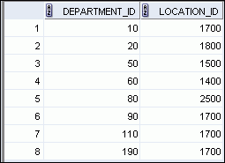
Selecting specific columns
SELECT department_id, location_id
FROM departments;

Slide 7
Arithmetic Expressions
Operator | Description
+ | Add
- | Subtract
* | Multiply
/ | Divide

Slide 8
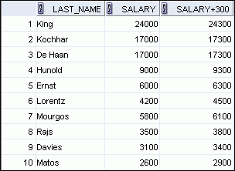
Using arithmetic Expressions
SELECT last_name, salary, salary + 300
FROM employees;
…

Slide 9


Operator Precedence
SELECT last_name, salary, 12*salary+100
FROM employees;
1
…
SELECT last_name, salary, 12*(salary+100)
FROM employees;
2
…

Slide 10
Defining Column Alias
A column alias is
Renames a column heading
Is useful with calculations
Immediately follows the column name (There can also be the optional AS keyword between the column name and alias.)
Requires double quotation marks if it contains spaces or special characters, or if it is case-sensitive

Slide 11


Using column aliases
SELECT last_name AS name, commission_pct comm
FROM employees;
…
SELECT last_name "Name" , salary*12 "Annual Salary"
FROM employees;
…
…

Slide 12
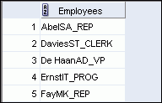
Concatenation Operator
A concatenation operator:
Links columns or character strings to other columns
Is represented by two vertical bars (||)
Creates a resultant column that is a character expression
SELECT last_name||job_id AS "Employees"
FROM employees;
…

Slide 13
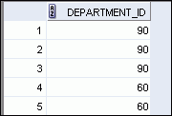
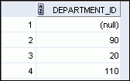
Duplicate Rows
The default display of queries is all rows, including duplicate rows.
SELECT department_id
FROM employees;
1
…
SELECT DISTINCT department_id
FROM employees;
2
…

Slide 14
WHERE clause
WHERE clause is used to restrict the rows that are returned by SELECT statement.
WHERE clause follows FROM clause
SELECT *|{[DISTINCT] column|expression [alias],...}
FROM table
[WHERE condition(s)];

Slide 15

Using WHERE clause
SELECT employee_id, last_name, job_id, department_id
FROM employees
WHERE department_id = 90 ;

Slide 16
Character Strings and Dates
Character strings and date values are enclosed with single quotation marks Renames a column heading
Character values are case-sensitive and date values are format-sensitive
The default date display format is DD-MON-YY
SELECT last_name, job_id, department_id
FROM employees
WHERE last_name = 'Whalen' ;
SELECT last_name
FROM employees
WHERE hire_date = '17-FEB-96' ;

Slide 17
Comparison Operator
Operator
Meaning
=
Equal to
>
Greater than
>=
Greater than or equal to
<
Less than
<=
Less than or equal to
<>
Not equal to
BETWEEN ...AND...
Between two values (inclusive)
IN(set)
Match any of a list of values
LIKE
Match a character pattern
IS NULL
Is a null value

Slide 18

Using comparison operator
SELECT last_name, salary
FROM employees
WHERE salary <= 3000 ;

Slide 19
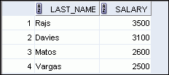
Range conditions using BETWEEN operator
Use the BETWEEN operator to display rows based on a range of values
SELECT last_name, salary
FROM employees
WHERE salary BETWEEN 2500 AND 3500 ;
Lower limit
Upper limit

Slide 20
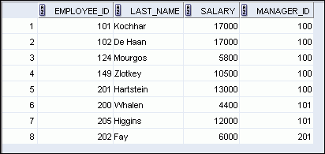
Membership Condition Using the IN Operator
Use the IN operator to test for values in a list:
SELECT employee_id, last_name, salary, manager_id
FROM employees
WHERE manager_id IN (100, 101, 201) ;

Slide 21
Pattern Matching Using the LIKE Operator
Use the LIKE operator to perform wildcard searches of valid search string values
Search conditions can contain either literal characters or numbers
% denotes zero or many characters
_ denotes one character
SELECT first_name
FROM employees
WHERE first_name LIKE 'S%' ;

Slide 22

Combining Wildcard Characters
You can combine the two wildcard characters (%, _) with literal characters for pattern matching
You can use the ESCAPE identifier to search for the actual % and _ symbols
SELECT last_name
FROM employees
WHERE last_name LIKE '_o%' ;

Slide 23

Using the NULL Conditions
Test for nulls with the IS NULL operator
SELECT last_name, manager_id
FROM employees
WHERE manager_id IS NULL ;

Slide 24
Defining Conditions Using the Logical Operators
Operator
Meaning
AND
Returns TRUE if both component conditions are true
OR
Returns TRUE if either component condition is true
NOT
Returns TRUE if the condition is false

Slide 25

Using the AND Operator
AND requires both the component conditions to be true
SELECT employee_id, last_name, job_id, salary
FROM employees
WHERE salary >= 10000
AND job_id LIKE '%MAN%' ;

Slide 26
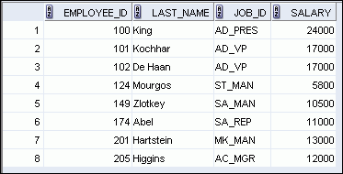
Using the OR Operator
OR requires either component condition to be true
SELECT employee_id, last_name, job_id, salary
FROM employees
WHERE salary >= 10000
OR job_id LIKE '%MAN%' ;

Slide 27
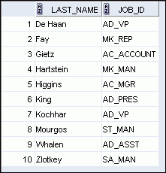
Using the NOT Operator
SELECT last_name, job_id
FROM employees
WHERE job_id
NOT IN ('IT_PROG', 'ST_CLERK', 'SA_REP') ;

Slide 28
Rules of operator precedence
Operator
Meaning
1
Arithmetic operators
2
Concatenation operator
3
Comparison conditions
4
IS [NOT] NULL, LIKE, [NOT] IN
5
[NOT] BETWEEN
6
Not equal to
7
NOT logical condition
8
AND logical condition
9
OR logical condition
You can use parentheses to override rules of precedence.

Slide 29
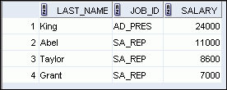

Rules of Precedence
SELECT last_name, job_id, salary
FROM employees
WHERE job_id = 'SA_REP'
OR job_id = 'AD_PRES'
AND salary > 15000;
1
SELECT last_name, job_id, salary
FROM employees
WHERE (job_id = 'SA_REP'
OR job_id = 'AD_PRES')
AND salary > 15000;
2

Slide 30
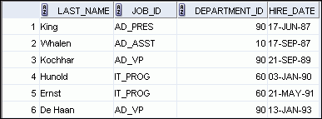
Using the ORDER BY Clause
ORDER BY clause sort the retrieved rows
ASC : Ascending Order : Default
DESC: Descending Order
SELECT last_name, job_id, department_id, hire_date
FROM employees
ORDER BY hire_date ;

Slide 31
Sorting
Sorting in descending order
Sorting by column alias:
SELECT last_name, job_id, department_id, hire_date
FROM employees
ORDER BY hire_date DESC ;
1
SELECT employee_id, last_name, salary*12 annsal
FROM employees
ORDER BY annsal ;
2

Slide 32
Sorting
Sorting by using the column’s numeric position
Sorting by multiple columns :
SELECT last_name, job_id, department_id, hire_date
FROM employees
ORDER BY 3;
3
SELECT last_name, department_id, salary
FROM employees
ORDER BY department_id, salary DESC;
4

