Slide 1

SQL JOINS

Slide 2
Agenda
Joins
Unions
Sub Queries
Ranking Functions

Slide 3

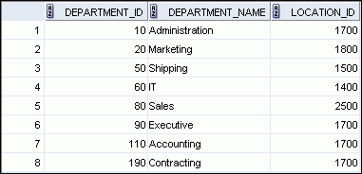

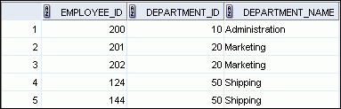

SQL Joins
SQL Joins lets you to obtains data from multiple tables
EMPLOYEES
DEPARTMENTS
…
…

Slide 4
Types of Joins
Joins that are compliant with the SQL:1999 standard include the following:
Natural Joins:
NATURAL JOIN clause
USING clause
ON clause
Outer Joins
LEFT OUTER JOIN
RIGHT OUTER JOIN
FULL OUTER JOIN
Cross Joins

Slide 5
Joining Tables Syntax
Use a join to query data from more than one table
SELECT table1.column, table1.column
FROM table1
[NATURAL JOIN table2] |
[JOIN table2 USING (column_name)] |
[JOIN table2
ON (table1.column_name = table1.column_name)]|
[LEFT|RIGHT|FULL OUTER JOIN table2
ON (table1.column_name = table1.column_name)]|
[CROSS JOIN table2];

Slide 6
Creating Natural Joins
The NATURAL JOIN clause is based on all columns in the two tables that have the same name
It selects rows from the two tables that have equal values in all matched columns
If the columns having the same names have different data types, an error is returned

Slide 7
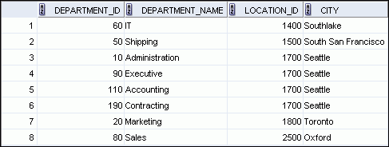
Retrieving Records with Natural Joins
SELECT department_id, department_name,
location_id, city
FROM departments
NATURAL JOIN locations ;

Slide 8
Creating Joins with the USING Clause
If several columns have the same names but the data types do not match, natural join can be applied using the USING clause to specify the columns that should be used for an equijoin
Use the USING clause to match only one column when more than one column matches
The NATURAL JOIN and USING clauses are mutually exclusive

Slide 9
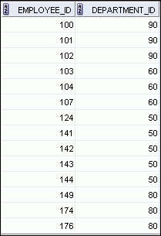
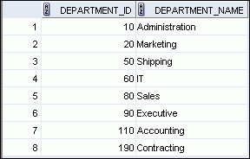
Joining Column Names
EMPLOYEES
DEPARTMENTS
Primary key
…
Foreign key

Slide 10
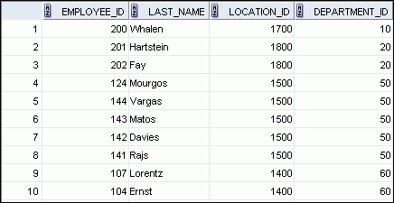
Retrieving Records with the USING Clause
SELECT employee_id, last_name,
location_id, department_id
FROM employees JOIN departments
USING (department_id) ;
…

Slide 11
Creating Joins with the ON Clause
The join condition for the natural join is basically an equijoin of all columns with the same name
Use the ON clause to specify arbitrary conditions or specify columns to join
The join condition is separated from other search conditions
The ON clause makes code easy to understand

Slide 12
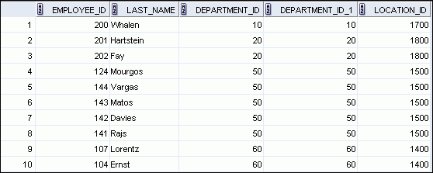
Retrieving Records with the ON Clause
SELECT e.employee_id, e.last_name, e.department_id,
d.department_id, d.location_id
FROM employees e JOIN departments d
ON (e.department_id = d.department_id);
…

Slide 13
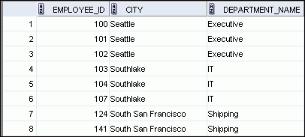
Creating Three-Way Joins with the ON Clause
SELECT employee_id, city, department_name
FROM employees e
JOIN departments d
ON d.department_id = e.department_id
JOIN locations l
ON d.location_id = l.location_id;
…

Slide 14
Applying Additional Conditions to a Join
Use the AND clause or the WHERE clause to apply additional conditions
SELECT e.employee_id, e.last_name, e.department_id,
d.department_id, d.location_id
FROM employees e JOIN departments d
ON (e.department_id = d.department_id)
AND e.manager_id = 149 ;
Or
SELECT e.employee_id, e.last_name, e.department_id,
d.department_id, d.location_id
FROM employees e JOIN departments d
ON (e.department_id = d.department_id)
WHERE e.manager_id = 149 ;

Slide 15
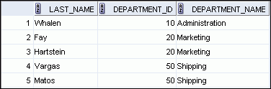

LEFT OUTER JOIN
SELECT e.last_name, e.department_id, d.department_name
FROM employees e LEFT OUTER JOIN departments d
ON (e.department_id = d.department_id) ;
…

Slide 16
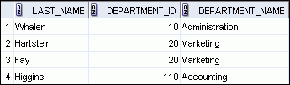

RIGHT OUTER JOIN
SELECT e.last_name, e.department_id, d.department_name
FROM employees e RIGHT OUTER JOIN departments d
ON (e.department_id = d.department_id) ;
…

Slide 17
FULL OUTER JOIN
SELECT e.last_name, d.department_id, d.department_name
FROM employees e FULL OUTER JOIN departments d
ON (e.department_id = d.department_id) ;

