Slide 1


Insights and Predictions from H-1B Dataset
Gaurav Hasija
Kanishka Jain
Bhavesh Bellara
Danish Mir

Slide 2

What is H-1B?
H-1B is a visa category for US-based firms to hire foreign talent.
H-1B visas have been capped at 65,000 a year, 20,000 visas for foreigners with a graduate degree from a U.S. academic institution[source].
For an H-1B you need a bachelor’s degree and the job offered should be under specialized skills category
The company that gives you the job sponsors H-1B

Slide 3

Motivation and Approach
Applying for H1B is a time consuming process in itself
Recruiters often need a trade-off between lower wages and better skills
Predictive Analysis of historic data to gain insight into whether or not the application will be certified
Answering other relevant socio-economic questions

Slide 4
Research Questions
Is the applicant's success with H1B dependent on the selection of agents?
Do chances of getting an H1B visa differ based on the type of job?
Does wage difference beyond the cap limit affect the chances of getting an H1B?
Eg: If a certain database administrator is earning $85k and other DBA is earning $90k annually then are the chances of getting an H1B for the DBA who earns $90k higher than one who earns $85k?
Based on the job domain, which worksite/geographic region should an individual target?
Are H1B employees paid less as compared to native employees for the same job?

Slide 5

State of Art
Are H1B Visa Workers Paid Less than Similarly Employed Natives?” - Sperry, Will
An allotment of H1B work visa in USA using machine learning - Pooja Thakur, Mandeep Singh, Harpreet Singh, Prashant Singh Ranaa
An Exploration of H-1B Visa Applications in the United States - Habeeb Hooshmand, Joseph Martinsen, Jonathan Arauco, Alishah Dholasaniya, Bhavik Bhatt
Predicting the Outcome of H-1B Visa Applications - Beliz Gunel, Onur Cezmi Mutlu
Notes:
We explored four papers related to the topic.
We will extend these studies and the wage data in our dataset with the data present online and answer the research question.
Our work will add to this research in terms of adding temporal components till 2019, as well as adding our specific research question related parameters to analysis.

Slide 6
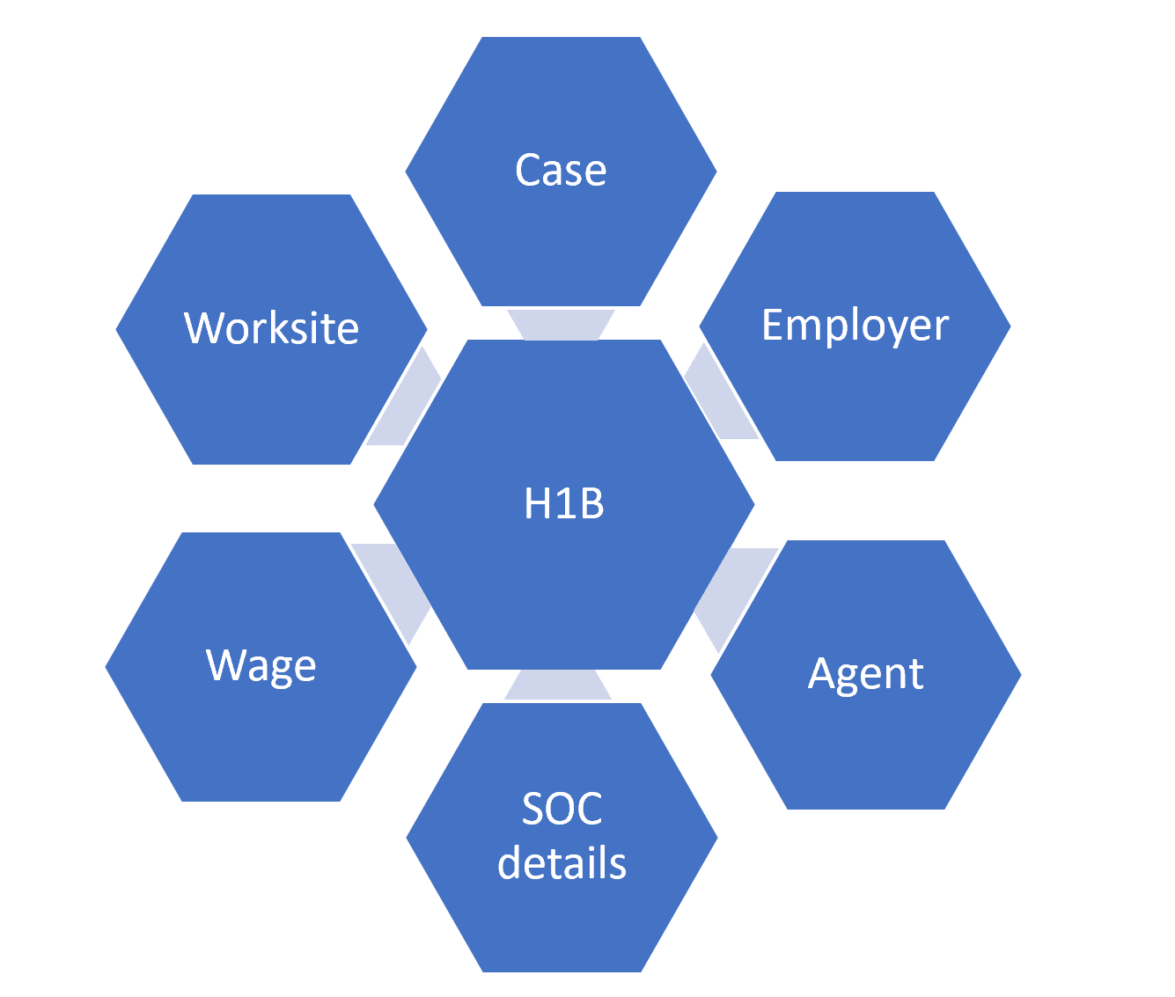
Dataset
Dataset from ”Office of Foreign Labor” (https://www.foreignlaborcert.doleta.gov/performancedata.cfm#dis)
Divided into 6 major categories
Notes:
Case - dependable variable
case number, case status, case filling and decision date
Employer - Employer related information
employer name, location and phone number
Agent - Agents who help individuals file their H1B application
name, city and state they operate at
SOC details - classification of job types
job title, SOC title, SOC code, etc.
Wage - wages wrt jobs
employee’s wage, average pay, level of wage
Worksite - location of employment
city, state, postal code

Slide 7
Data Cleaning
Year | Columns
2015 | 40
2016 | 40
2017 | 52
2018 | 52
2019 | 260
Aggregated dataset from 2015 to 2019
Cleaned, standardized, removed conflicting variables
After cleaning, we had 34 columns in each dataset Across 6 categories
Case, Employer, Agent, SOC details, Wage & Worksite

Slide 8


Other Software Engineering Efforts
Performed cleaning and aggregation
Interviewed people on H1B visa
Notes:
Dataset was inconsistent with number of variables ranging from 40 to 260.
We were able to confirm that the minimum wage for the approval of the H1B visa depends on the job type, worksite location among various other factors. That gave us a solid insight for developing research questions.

Slide 9
THANK YOU

