Slide 1
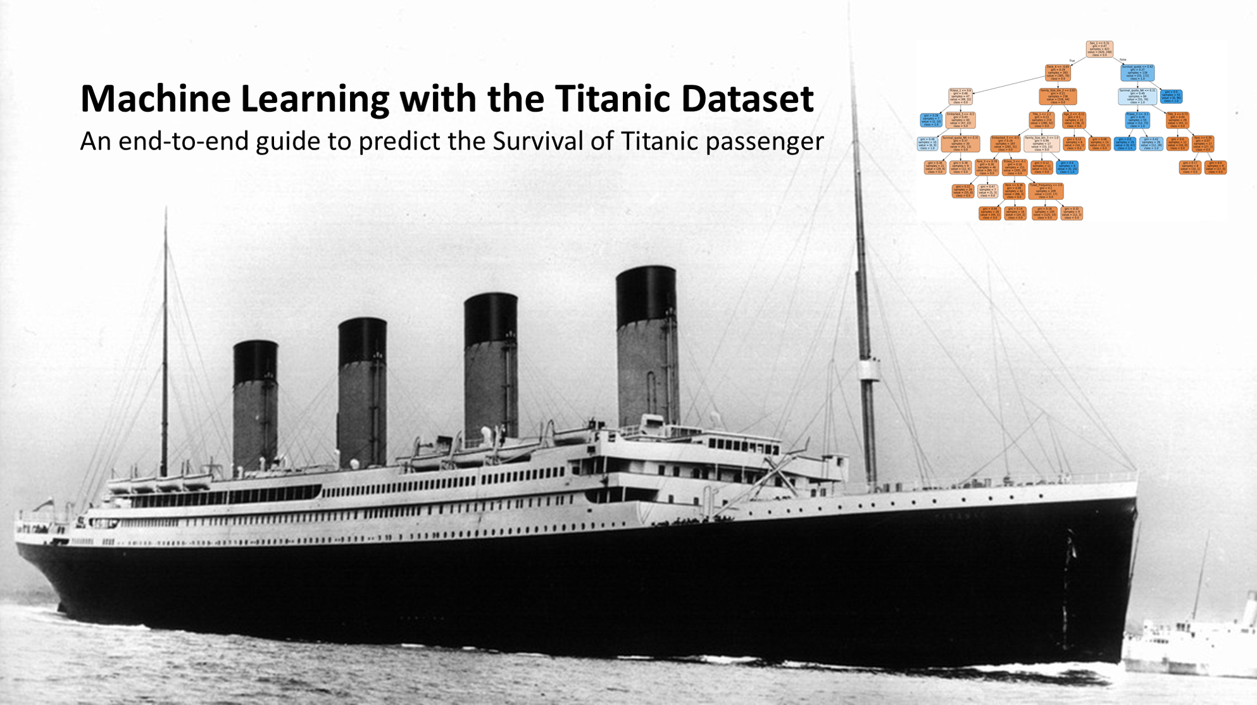
A SUBMISSION
BY KUMAR KANISHK

Slide 2
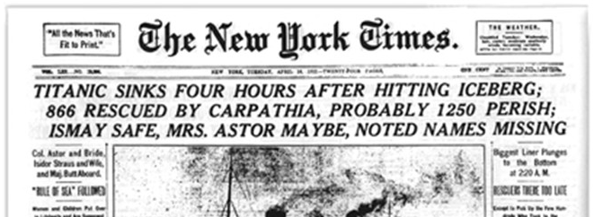
THE TITANIC SANK IN THE EARLY MORNING HOURS OF 15 APRIL 1912 IN THE NORTH ATLANTIC OCEAN, FOUR DAYS INTO THE SHIP'S MAIDEN VOYAGE FROM SOUTHAMPTON TO NEW YORK CITY. THE LARGEST OCEAN LINER IN SERVICE AT THE TIME, TITANIC HAD AN ESTIMATED 2,224 PEOPLE ON BOARD WHEN SHE STRUCK AN ICEBERG AT AROUND 23:40 (SHIP'S TIME)ON SUNDAY, 14 APRIL 1912. HER SINKING TWO HOURS AND FORTY MINUTES LATER AT 02:20 ON MONDAY, 15 APRIL, RESULTED IN THE DEATHS OF MORE THAN 1,500 PEOPLE, MAKING IT ONE OF THE DEADLIEST DISASTER IN HISTORY.

Slide 3
AIM OF THE SUBMISSION
We have to use machine learning to create a model that predicts which passengers survived the Titanic shipwreck.
We have to build a predictive model that answers the question: “what sorts of people were more likely to survive?” using passenger data (i.e name, age, gender, socio-economic class, etc).

Slide 4
THE PROCESS
The whole process is done in a series of steps
EXPLORATORY DATA ANALYSIS
FEATURE ENGINEERING
MODELING
TESTING

Slide 5
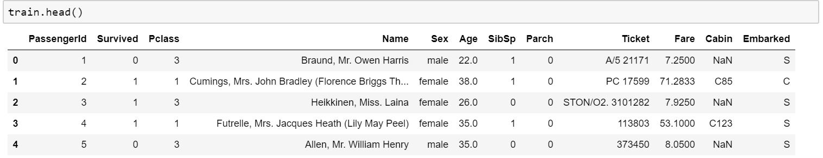
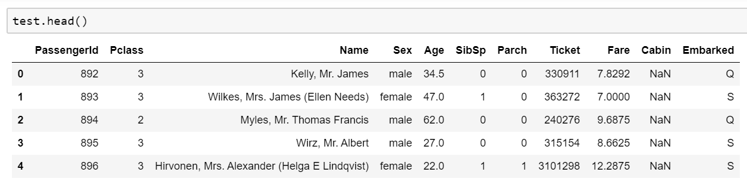
EXPLORATORY DATA ANALYSIS
TRAINING DATA SET
TESTING
DATA SET

Slide 6
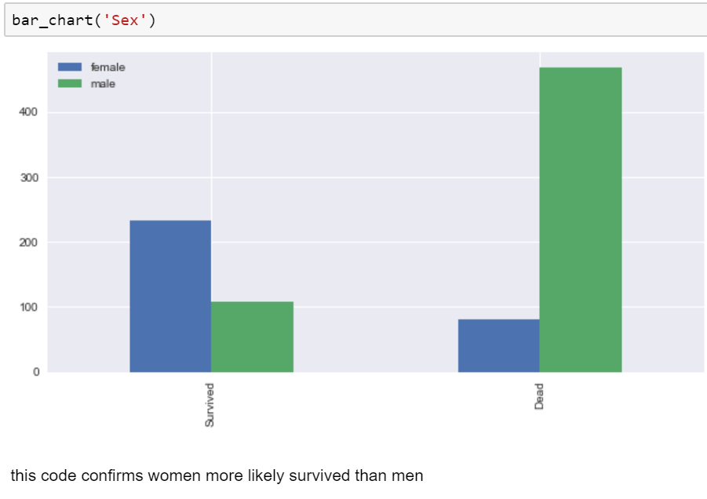
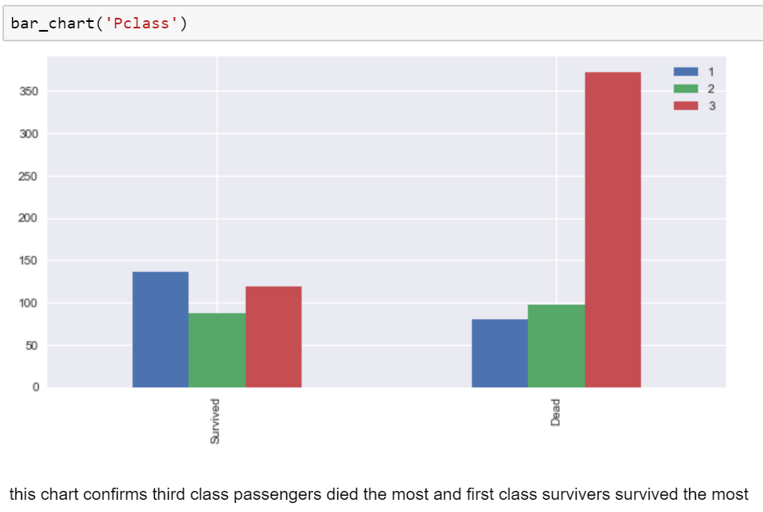
BAR CHART FOR CATEGORICAL FEATURES

Slide 7
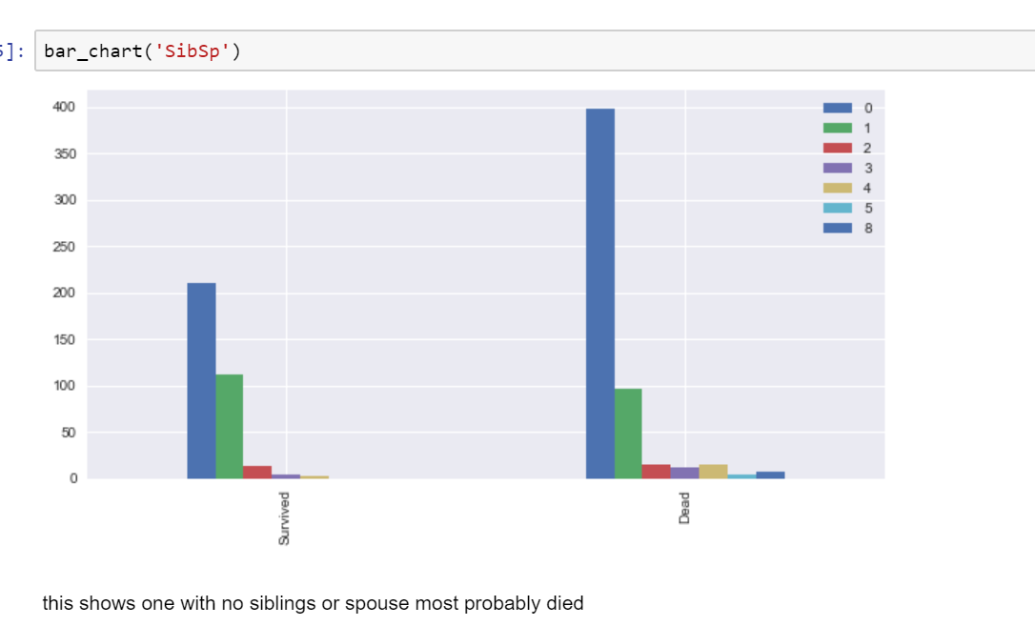
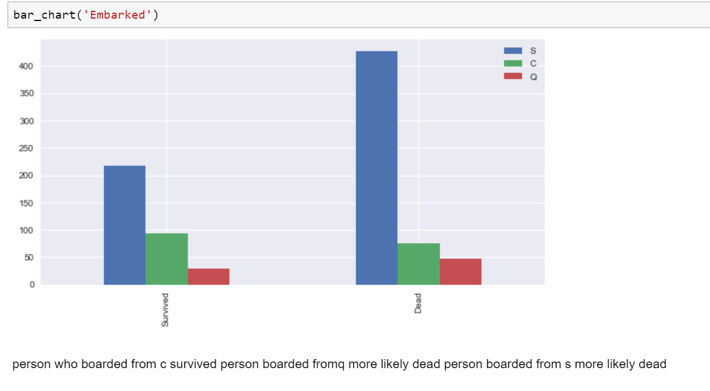
BAR GRAPHS ON CATEGORICAL FEATURES

Slide 8
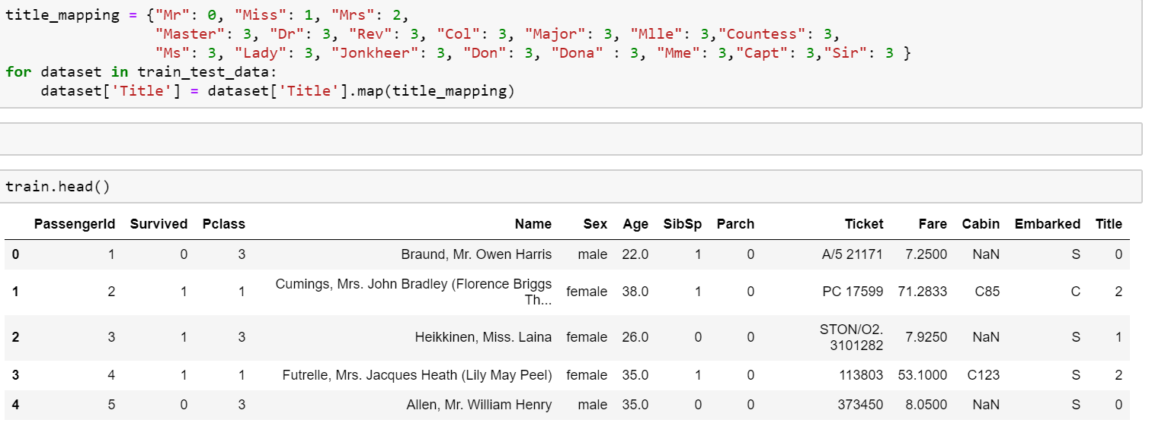
FEATURE ENGINEERING

Slide 9
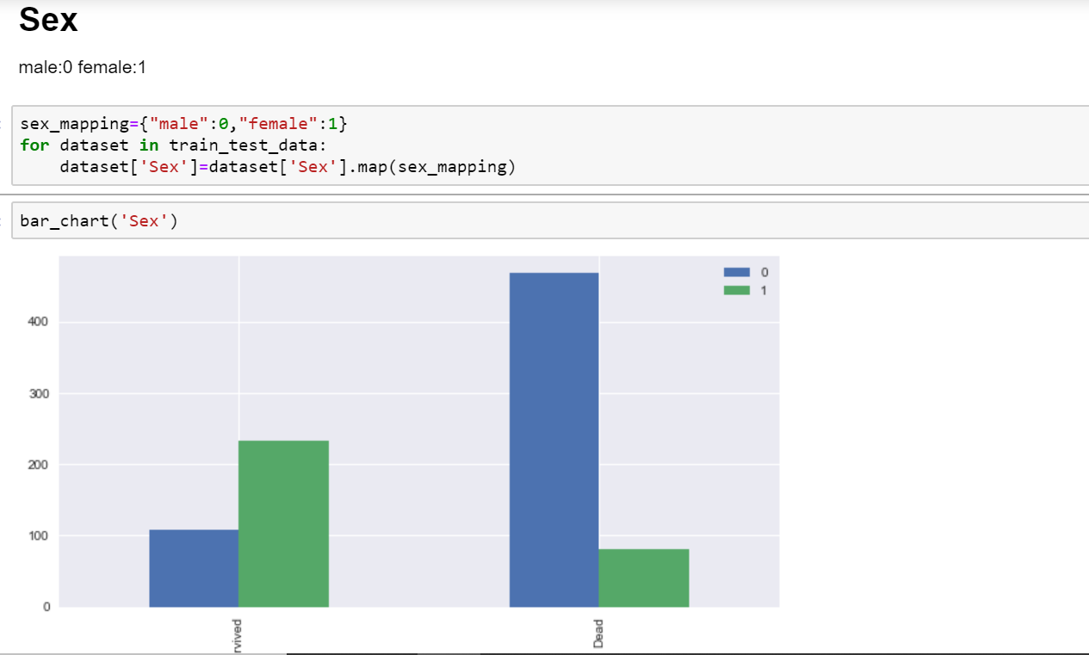
FEATURE ENIGNEERING ON SEX ATTRIBUTE

Slide 10
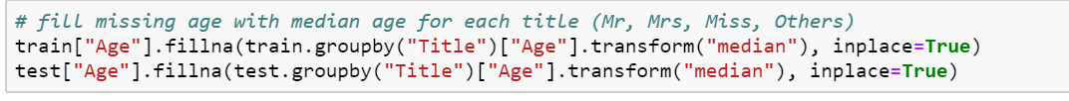
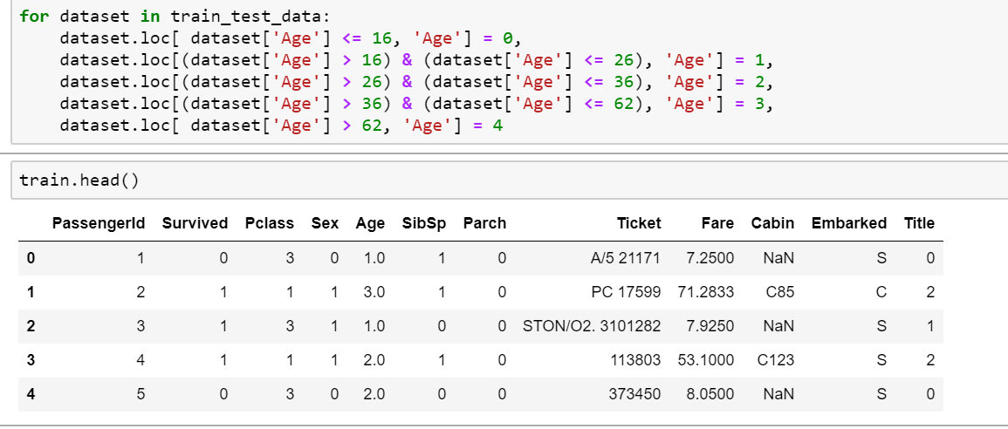
FILLING MISSING VALUES IN AGE

Slide 11
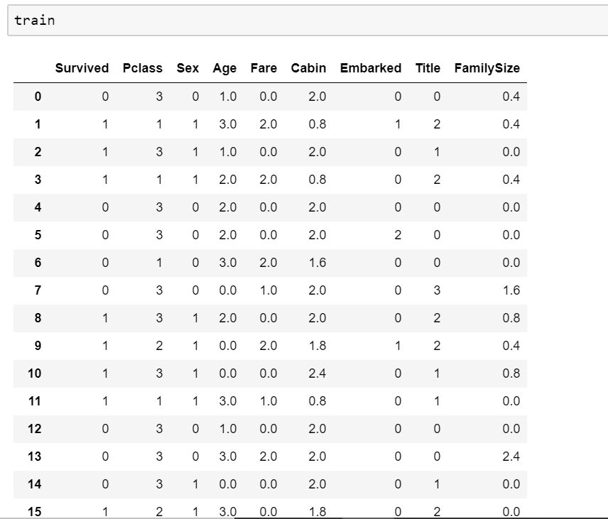
FINAL TRAINING SET AFTER FEATURE ENGINEERING

Slide 12
MODELING
THREE CLASSIFIERS WERE USED
KNEIGHBOURS
NAIVE BAYES
SVM

Slide 13
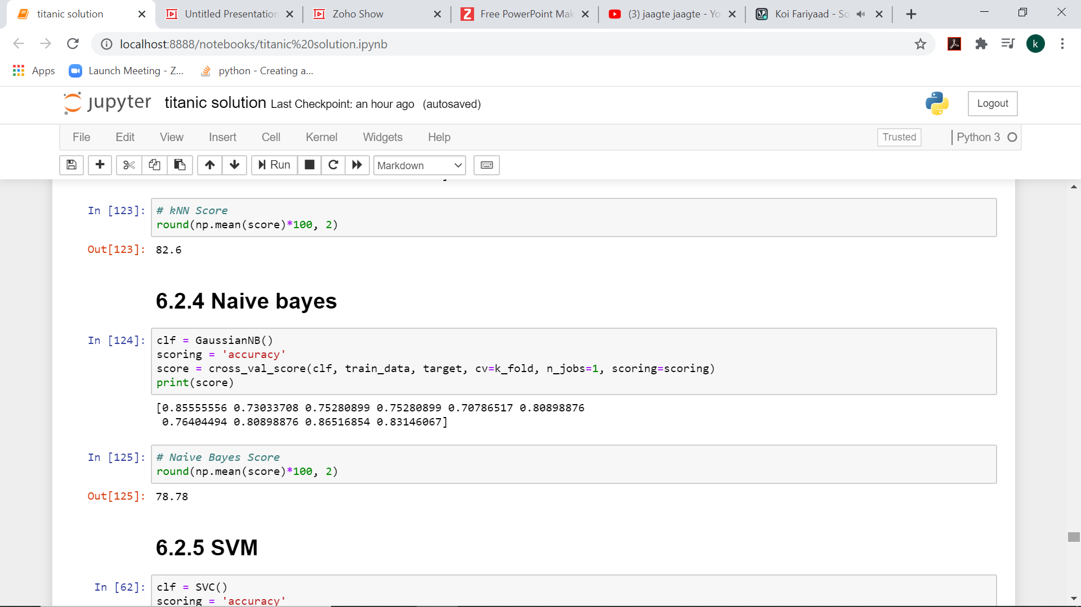
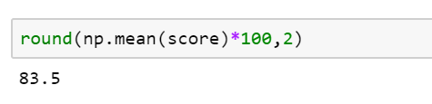
SCORES

Slide 14
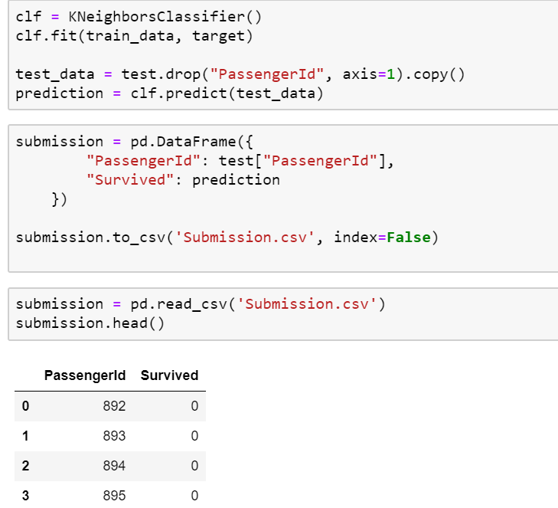
TESTING

Slide 15
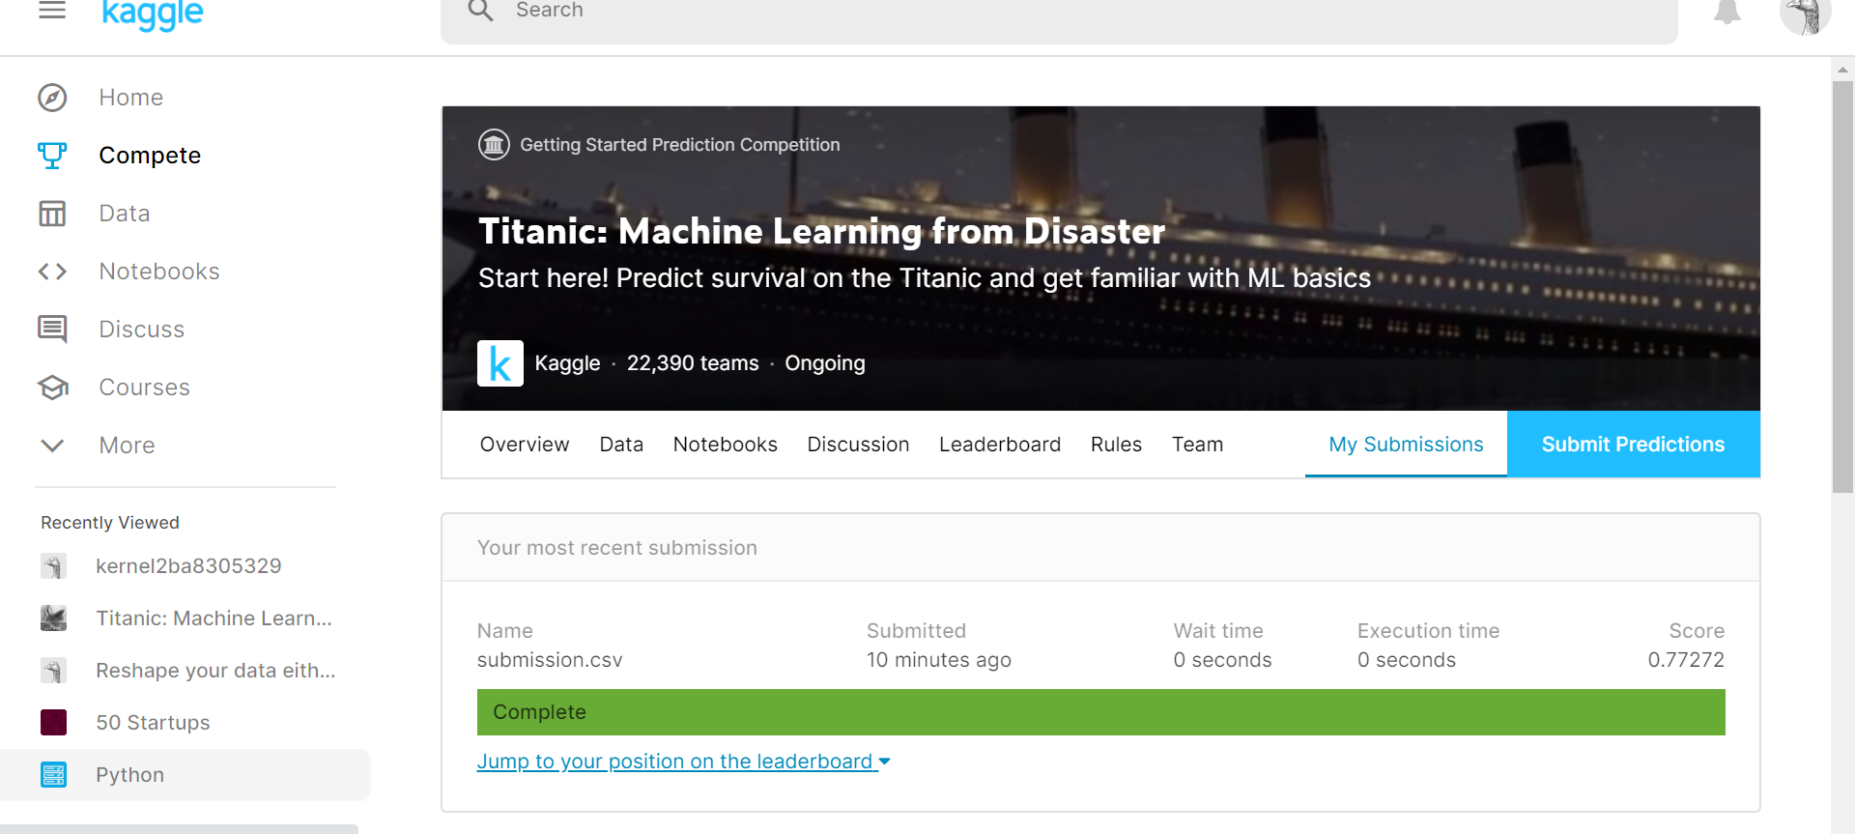
KAGGLE SUBMISSION

Slide 16
ENDING NOTE
Each algorithm gave different results
No algorithm can provide 100 percent accuracy
The most efficient result was given by svm followed by knn followed by naive bayes

