Slide 1
AI/ML PROJECT
Vatsal Goyal - 200020158
Kanishka Mittal - 200050058
Khyati Patel - 200050102
Sanyam Saxena - 200260047

Slide 2
Movie Genre Prediction using Poster

Slide 3
Index
Dataset
Preprocessing
Models
Results
Can movie be judged by its poster?
Can we predict a movie’s success by its poster
Difficulties faced
Conclusion

Slide 4



Dataset
Data-points (in raw dataset) - 41979
Labels - 28 genres
(Action, Adult, Adventure, Animation, Biography, Comedy, Crime, Documentary, Drama, Family, Fantasy, Film-Noir, Game-Show, History, Horror, Music, Musical, Mystery, News, Reality-TV, Romance, Sci-Fi, Short, Sport, Talk-Show, Thriller, War, Western) Each movie can have multiple genres
Following is the link to the raw dataset
https://drive.google.com/drive/folders/1RAntltxcDNvmFkWb2Jxe1FNe4lIDIcVd?usp=sharing

Slide 5
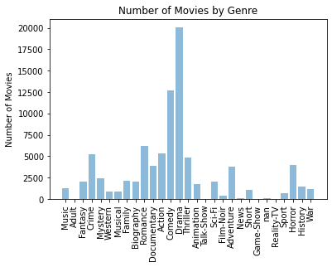
Distribution of 41k dataset
The distribution showing the number of movies available per genre in the original dataset with 41k posters
Drama comes out to be most frequent followed by comedy

Slide 6
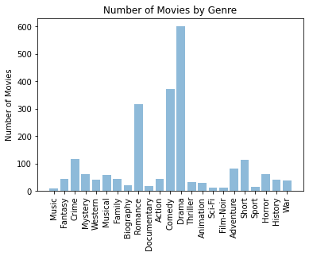
Distribution of 1k dataset
The distribution showing the number of movies available per genre in the original dataset with 1k posters
The distribution resemble the one of the larger dataset
The most frequent genre is Drama followed by Comedy and Romance

Slide 7
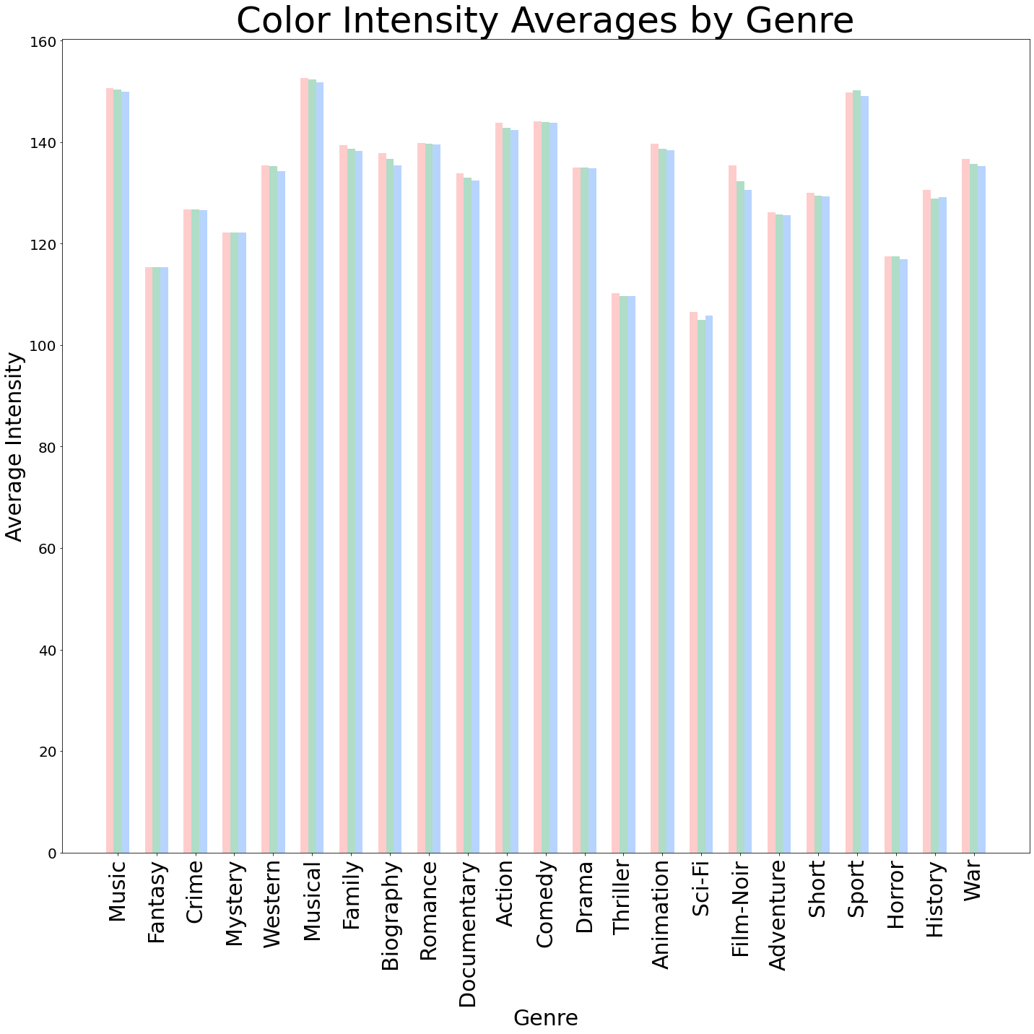
Relation between genre and poster
One way to see the relationship between genre and poster is to see the variation in color schemes of the posters with genres
Genres like Sci-Fi, Thriller, Horror and Crime have low averages of rgb values indicating posters inclined towards darker shades.
On the other hand genres like Musical, Sport, Animation, Comedy have high rgb averages indicating light shaded or bright posters

Slide 8
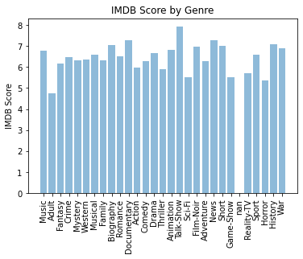
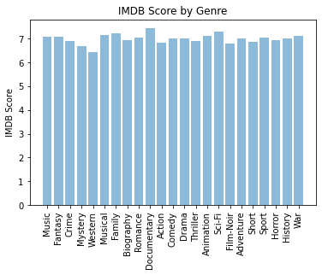
Indifference in IMDb rating with genre variation

Slide 9
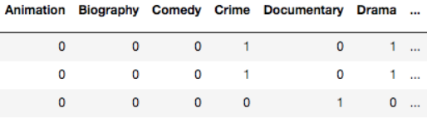
Preprocessing
Cleaning CSV: Dropped empty rows from the CSV file and removed duplicate values.
Removal of corrupt or bad images: Opened each image to check if it was opening and loadable or not. Made a list of IDs and paths of images that were loadable.
Modified CSV: Trimmed CSV to keep only the rows of movies whose poster was available and reduced the number of columns to: ‘imdbId’, ‘Genre’, ‘Title’, ‘Image Paths’.
Multi-hot encoding of labels
If a movie belongs to a genre, the value is 1("hot"), else 0. As an image can belong to multiple genres, here it is a case of multiple-hot encoding

Slide 10
Models
Optimizer, Loss Function and Epochs
Optimizer- Adam optimizer
Loss Function- Binary Cross Entropy
Early stopping- Patience of 10

Slide 11
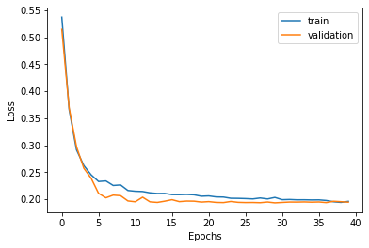
CNN Model 1- Custom Architecture
Hyperparameters
Epochs - 100
Batch Size - 32
Loss function
binary cross-entropy
Split 0.7-0.27-0.03
Validation Accuracy- 57.46 %
Test Accuracy- 65.51 %
Split 0.7-0.15-0.15
Validation Accuracy- 62.16 %
Test Accuracy- 55.03 %
Split 0.8-0.1-0.1
Validation Accuracy- 60.20 %
Test Accuracy- 67.67 %

Slide 12
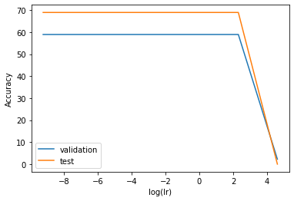
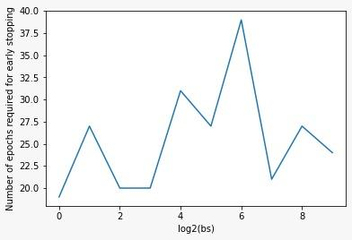
Other results related to CNN Model 1
lr v/s accuracy
Number of epochs required vs batch size

Slide 13
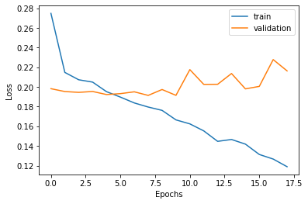
CNN Model 2 - Fine-tuning pre-trained VGG16
Hyperparameters
Epochs - 50
Batch Size - 32
Loss function
binary cross-entropy
Validation Accuracy - 54.85 %
Test Accuracy - 62.06 %

Slide 14
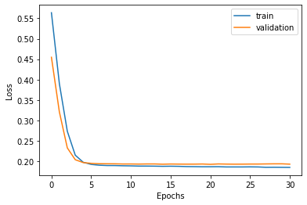
CNN Model 3 - Fine-tuning pre-trained ResNet
Hyperparameters
Epochs - 100
Batch Size - 32
Loss function
binary cross-entropy
Validation Accuracy - 57.46 %
Test Accuracy - 65.51 %

Slide 15
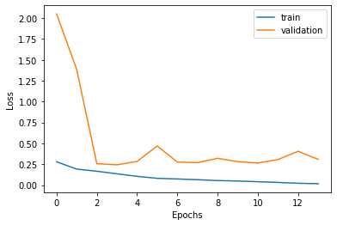
CNN Model 4 - Fine-tuning pre-trained ResNet2
Hyperparameters
Epochs - 100
Batch Size - 32
Loss function
binary cross-entropy
Validation Accuracy - 48.88 %
Test Accuracy - 48.27 %

Slide 16
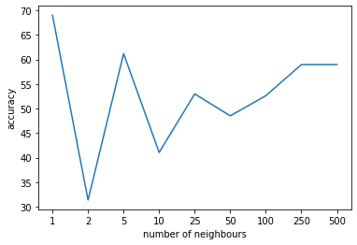
KNN Model
k v/s accuracy
Variation in Accuracy with varying number of neighbours

Slide 17
Can we judge a movie by its poster?

Slide 18

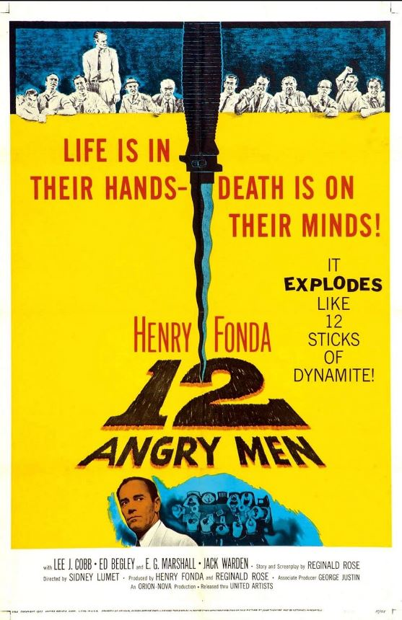
Movie posters and its reviews/ratings seem relatively unrelated as “you can’t judge a book by its cover”. Below we see two of the movie with highest IMDb ratings, The Shawshank Redemption (9.2) and 12 Angry Men (9). However, one can easily observe high difference between their posters.

Slide 19


Now, below we see other two movies, The Lion King (8.5) and Battlefield Earth (2.6). One can see the similarity between the posters again implying no relation between poster and rating.

Slide 20
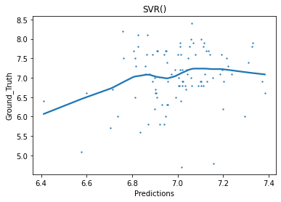
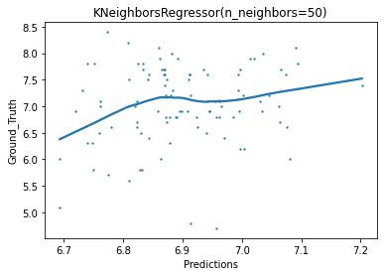
We attempted to use Regression Models for predicting movie rating by its poster. We used SVM and KNNeighbours Regression and both seemed to perform similar. We got an MSE of about 0.5 which is decent. However plotting graphs for prediction vs ground truth seem to have significant issues.

Slide 21
Can we predict a movie’s success by its poster?

Slide 22
Posters are a great marketing tool for a movie, people most often just look at a movie’s poster and trailer before going. Here we try to predict if we can guess whether a movie will be successful or not judging by its poster
Success can be seen as whether the movie is profitable or not
The dataset that has been used has been curated by merging two datasets
Model consists of a pretrained ResNet18 model, we finetune it to perform on our data. Early-stopping has been implemented as well
Validation Accuracy : 71.1%
Epochs : 20(with early stopping implemented)
Learning rate : 0.01
Optimizer : adam
Loss function : Cross Entropy Loss

Slide 23
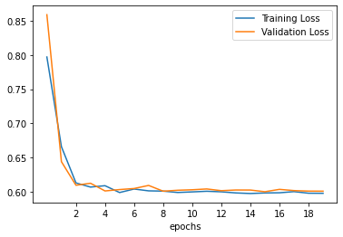
Learning Curve

Slide 24
Difficulties faced
We first tried to train our model on the super dataset with 40,000 data-points, but were unable to train the model on these many points (after train-val-test split) due to limitation of GPU and RAM on google colab, hence we had to stick to the dataset with 1000 data-points.
Generally classification tasks are single labelled while this was a multi-labelled classification problem. Earlier we had used categorical cross-entropy loss function but we didn’t get the expected results hence we had to switch to binary cross-entropy loss function.

Slide 25
Conclusion
The best possible accuracy which could be obtained was 68%. Which leads us to think, what could be causing all the misclassification? How could we further improve its accuracy?
What we realised is that the model is having difficulty differentiating between horror and thriller posters. If you think about it, it is true even for us humans, where we might not be able to tell the difference between horror and thriller posters.
The same result is observed for comedy and romance, as both genres’ posters are in the lighter mood, and contains human and smiling faces.

Slide 26
References
https://drive.google.com/drive/folders/1cXPMqGUR9GrVAwS6pGZY1oiucAhrsndw
https://www.kaggle.com/datasets
https://www.kaggle.com/code/jmurthy/simple-eda/notebook
https://github.com/d-misra/Multi-label-movie-poster-genre-classification
https://towardsdatascience.com/predict-movie-earnings-with-posters-786e9fd82bdc
https://gist.github.com/jinglescode/60b496abfd87b2093da9cf55bde2e944
https://www.analyticsvidhya.com/blog/2021/10/a-comprehensive-guide-on-deep-learning-optimizers/#:~:text=The%20results%20of%20the%20Adam,for%20most%20of%20the%20applications.
https://androidkt.com/choose-cross-entropy-loss-function-in-keras/#:~:text=Categorical%20cross%2Dentropy%20is%20based,Multi%2Dlabel)%20for%20instance%20if

