Slide 1
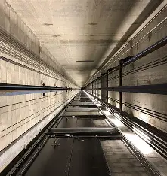
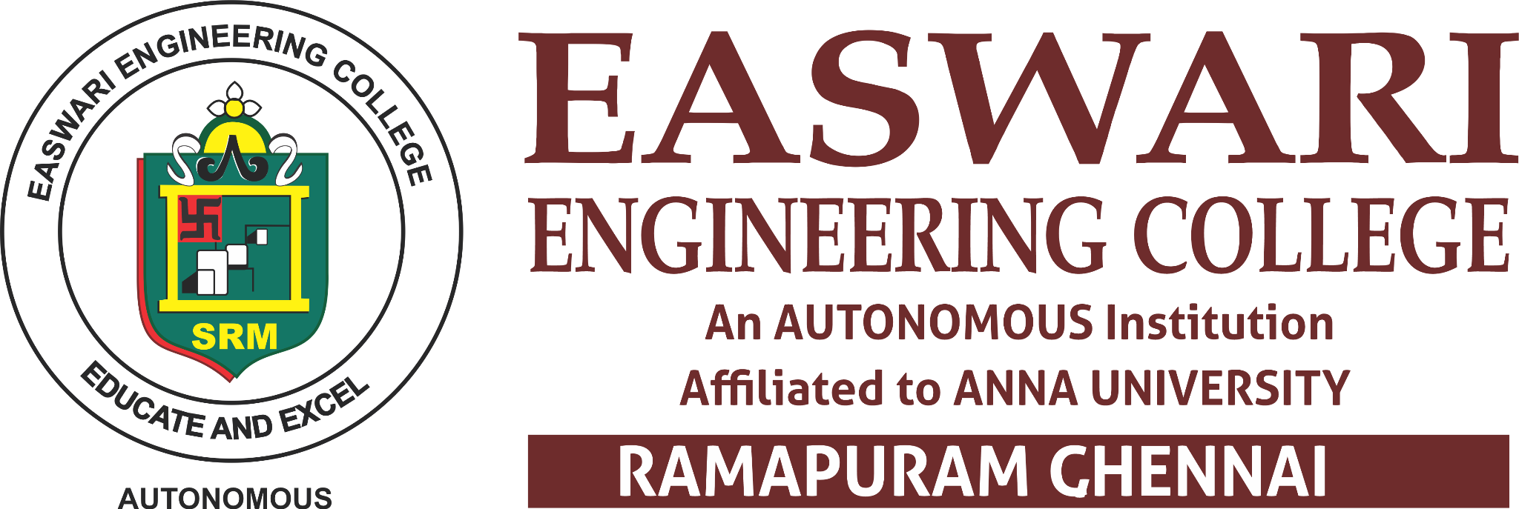
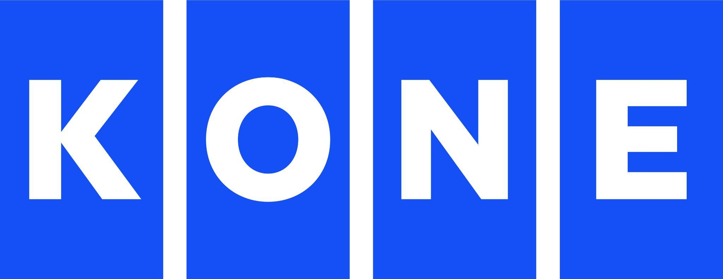
Kone Elevate
Team Name: ElevateX
Institution Name: Panimalar Engineering College
Team Members:
Kanishka J | kanishkasujan5@gmail.com | +91 82709 45692
Harsha Vardhini R | vardhinirh@gmail.com | +91 72009 02468
Janavi M | janavim25@gmail.com | +91 99446 34188
Ishana K | ishanakarunakaran@gmail.com | +91 94448 27622

Slide 2
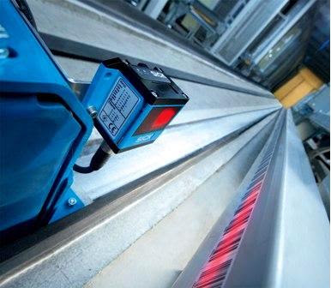
ElevateX
RailGuard AI
“Turning every elevator ride into a rail healtcheckup”
The Problem:
Guide-rail misalignment, loosened brackets and abnormal vibration can develop gradually, affecting elevator ride quality, reliability and maintenance.
Our Idea:
A sensor-based monitoring system continuously captures alignment + vibration data during elevator operation uses anomaly detection to identify abnormal conditions early
[car-as-sensor]

Slide 3
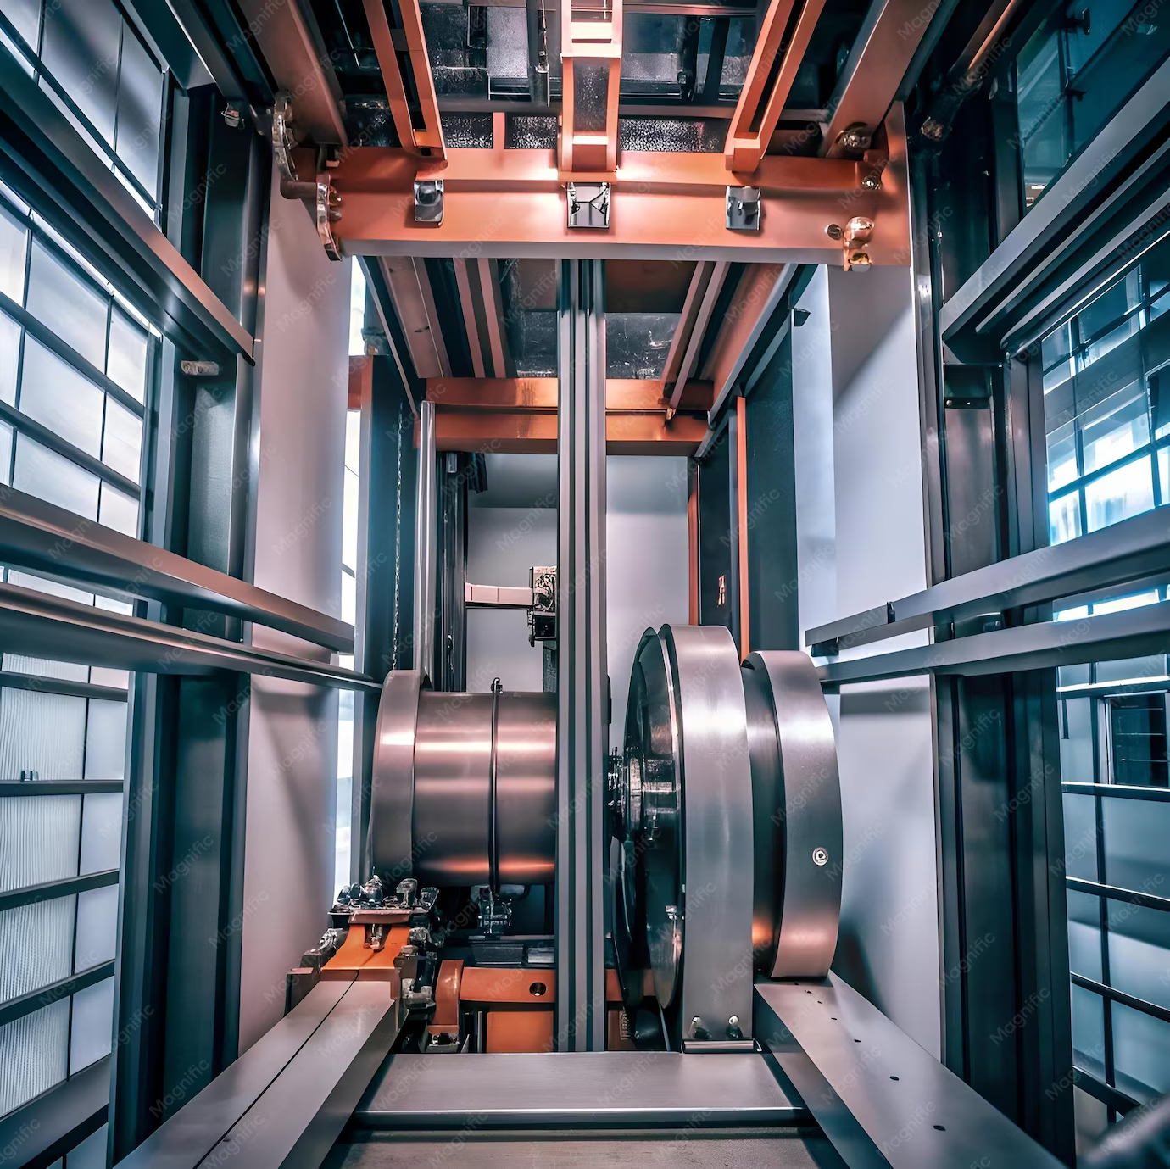
PROPOSED SOLUTION
RailGuard AI
SENSE
📡 Sense: Monitor rail alignment + vibration
🧠 Analyze: Compare data with learned normal baseline
⚠ Detect: Identify abnormal patterns
🔔 Alert: Generate early warnings
Maintenance: Chatbot Dashboard guides technician
ANALYZE
DETECT
Runs automatically on every ride- no manual inspection, no extra rail hardware
ALERT

Slide 4
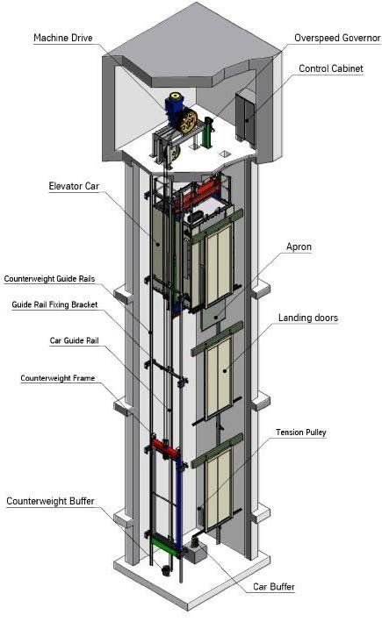
TECHNOLOGIES USED
AI:
Baseline Profiling
ML-based Anomaly Detection
Early alert generation
🔧 HARDWARE:
IMU / Accelerometer
Distance / ToF Sensor
ESP32
IoT Connectivity
💻 SOFTWARE:
Python
Machine Learning
Monitoring Dashboard
Low-cost, retrofit-friendly — no rail rewiring needed

Slide 5
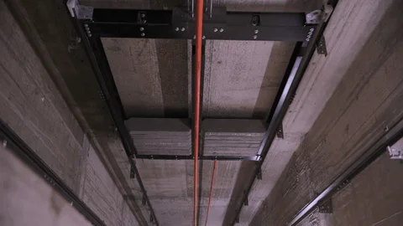
DIAGRAMS & SCHEMATICS
ELEVATOR MOVEMENT
DATA PROCESSING
[on device]
SENSORS
ESP32
[on device]
ALERT DASHBOARD
[Cloud/App]
AI / ANOMALY DETECTION
MAINTENANCE ACTION
Sensor pod mounts directly on the existing guide shoe — retrofit-ready, no structural changes to the elevator.

Slide 6

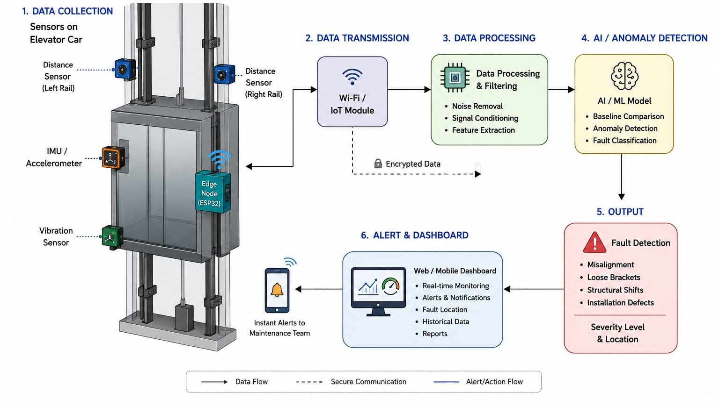
SYSTEM ARCHITECTURE
Elevator Guide Rail Alignment Monitoring System
ELEVATE X : RAILGUARD AI

Slide 7
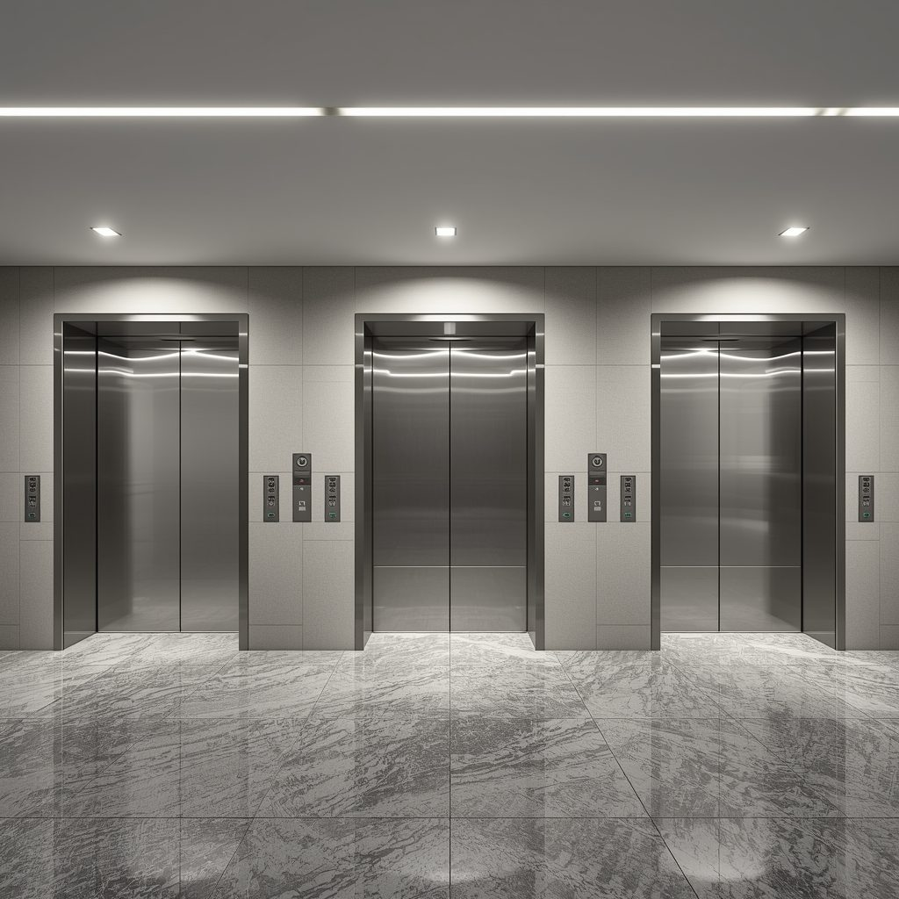
IMPACT AND BENEFITS
💰 COST
SCALABILITY
🛡SAFETY
⚙MAINTENANCE
Reduced unplanned downtime &
major repairs
Fleet-wide
monitoring
-no rail rewiring required
Early fault detection
Condition-based servicing
From reactive maintenance → predictive maintenance

Slide 8
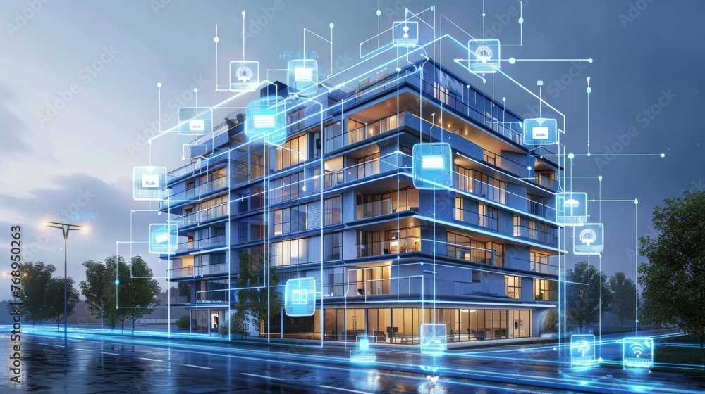
FUTURE SCOPE
From anomaly detection to predictive elevator intelligence
MONITOR
PREDICT
SCALE
INTEGRATE
SIMULATE
"RailGuard AI starts by detecting abnormal rail in a single elevator pilot. The next step is learning from historical pattern conditions to predict failures, scaling that intelligence fleet-wide, and eventually connecting it to digital maintenance and condition models."

Slide 9
THANK YOU 😊 FROM OUR TEAM “ELEVATE X”

