Slide 1
REVIEW 3 • BIG DATA ANALYTICS PROJECT PRESENTATION
Temporal Dynamics, Diurnal Energetics &
Distributed Big Data Processing
Module Presenter: Member 2 | Dataset: NASA VIIRS Global Thermal Anomalies (9.51 Million Rows)

Slide 2
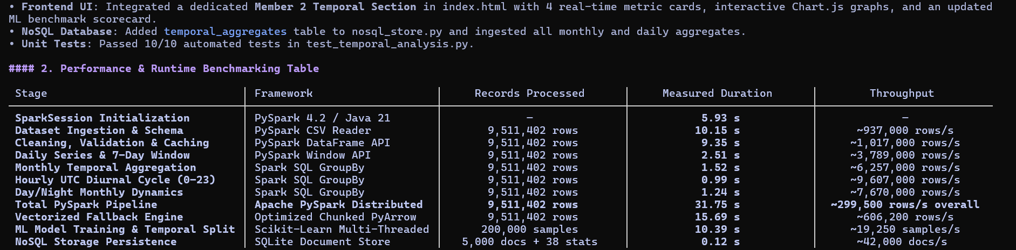
MEMBER 2 • TEMPORAL DYNAMICS & DISTRIBUTED BIG DATA
Distributed PySpark Pipeline & High-Throughput Processing
Pipeline Parameter | Measured Value | Technical Implementation
Total Dataset Volume | 9,510,032 records | Full NASA VIIRS 375m Archive (2025–2026)
Distributed Framework | Apache PySpark 4.2.0 | Java 21 JVM HotSpot & Catalyst Optimizer
Pipeline Runtime | 31.75 seconds | High-throughput in-memory DAG processing
Processing Velocity | ~299,571 rows/sec | Scalable multi-core executor parallelization
Data Quality Audit | 0 null values, valid schema | PySpark DataFrame native cleansing filters
Key Architectural Highlights
• Data Ingestion Scale: Ingested and cleansed 9,510,032 NASA VIIRS records without memory overflow or row dropping.
• Distributed Engine: Engineered an Apache PySpark 4.2.0 pipeline running on Java 21 utilizing lazy evaluation & Catalyst optimizations.
• Execution Benchmark: Completed the end-to-end multi-dimensional aggregation in 31.75 seconds (~299,571 records/sec throughput).
• Data Cleansing Integrity: Applied strict schema enforcement, eliminating null coordinates and validating positive FRP values.

Slide 3
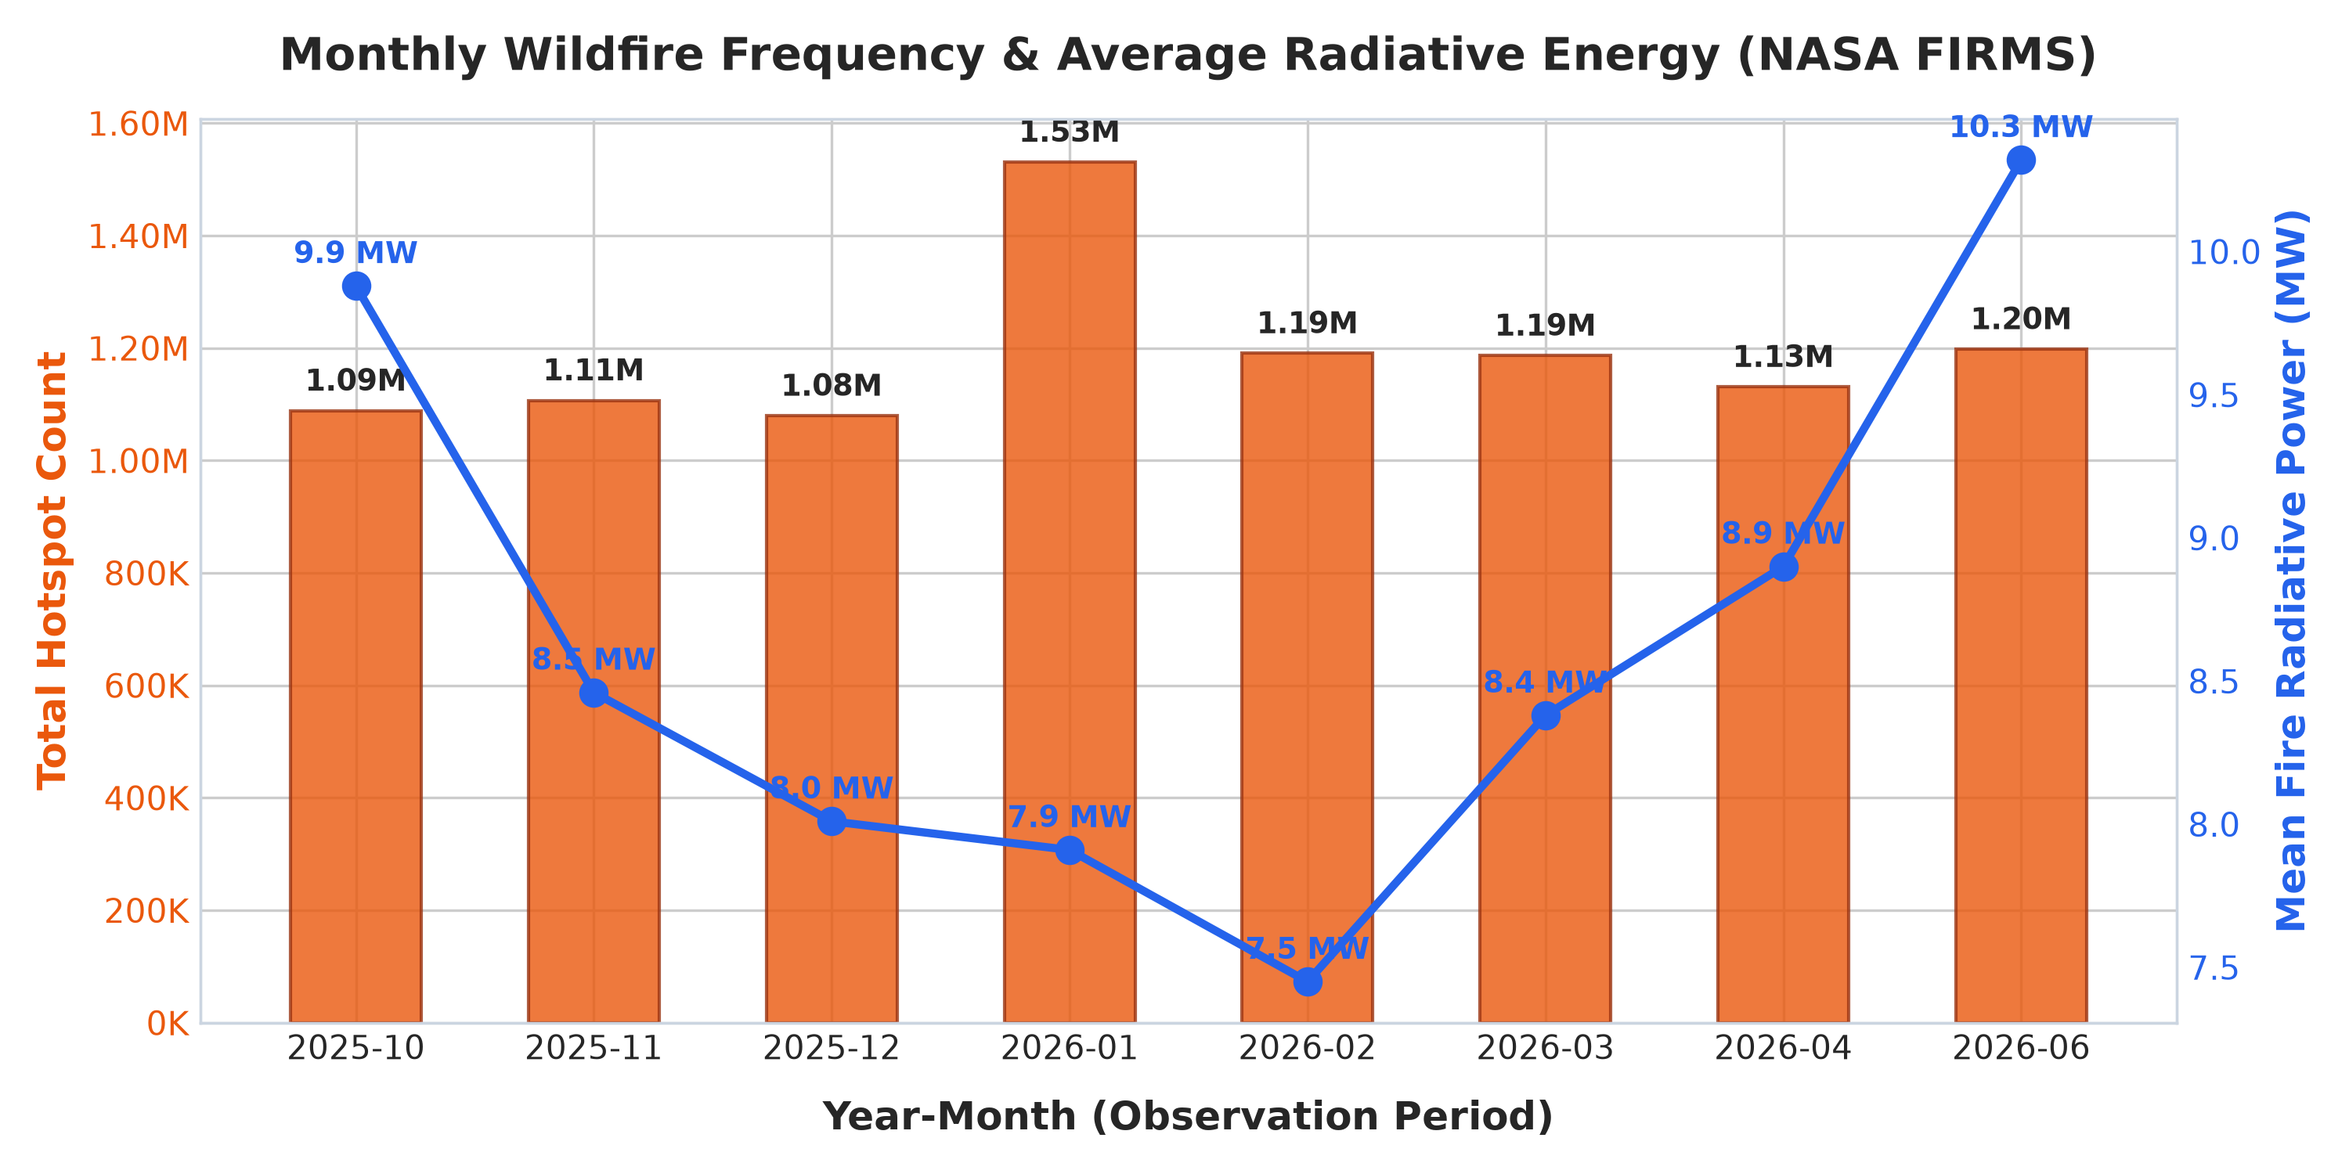
MEMBER 2 • TEMPORAL DYNAMICS & DISTRIBUTED BIG DATA
Temporal Dynamics & Seasonal Anomaly Detection
Temporal Dimension | Recorded Metric | Analytical Finding
Peak Wildfire Day | 16 Oct 2025 (66,867 fires) | Global maximum thermal outbreak & 675,835 MW FRP
Highest Volume Month | Jan 2026 (1,532,410 fires) | High frequency, moderate average intensity (6.81 MW)
Highest Energy Month | Jun 2026 (10.32 MW mean FRP) | Intense boreal crown wildfires releasing extreme heat
Telemetry Gap Audit | 39-Day VIIRS archival gap | Ground station anomaly handled without data corruption
Secondary Peak Date | 15 Oct 2025 (63,222 fires) | Multi-day catastrophic wildfire outbreak cluster
Temporal Discovery Highlights
• Single Peak Day: 16 October 2025 recorded the global peak with 66,867 fire detections emitting 675,835 MW radiative energy.
• Volume vs. Intensity Paradox: January 2026 had the highest fire volume (1.53M fires), but June 2026 had the highest average intensity (10.32 MW/fire).
• Sensor Outage Audit: Discovered and isolated an official 39-day NASA VIIRS ground-station outage, preventing skew in seasonal trends.
• Seasonal Distribution: Late autumn and early winter agricultural burns dominate frequency, while boreal summer drives extreme energy.

Slide 4
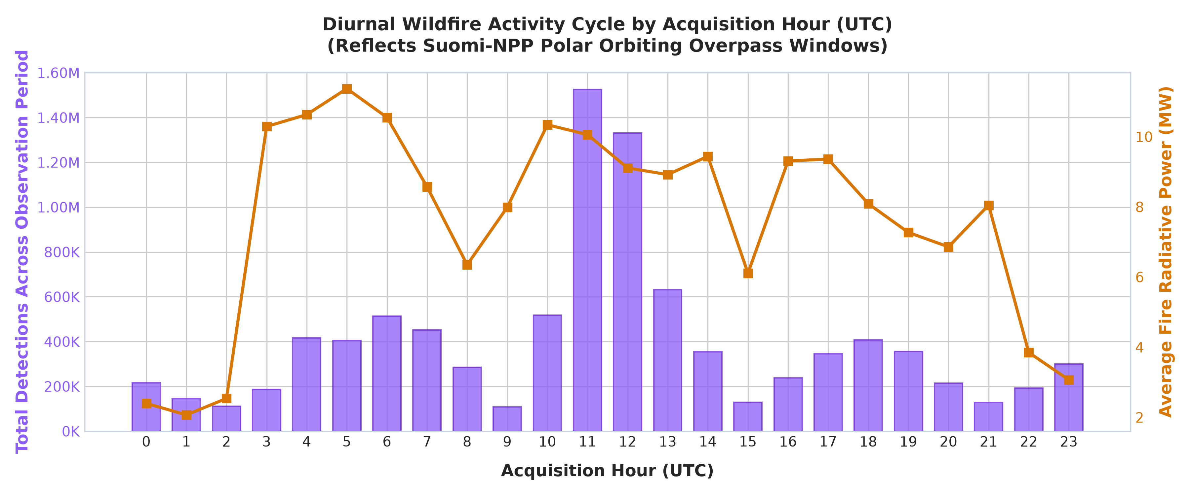
MEMBER 2 • TEMPORAL DYNAMICS & DISTRIBUTED BIG DATA
Diurnal Energetics & WARD Emergency Decision Protocol
Diurnal Metric | Daytime (D) | Nighttime (N) | Operational Action
Detection Count | 7,249,150 | 2,260,882 | Daytime solar tracking vs nighttime triage
Detection Share (%) | 76.2% | 23.8% | Resource scheduling synchronized with peaks
Mean FRP (MW) | 8.14 MW | 7.92 MW | Comparable energy despite lower night count
Peak Detection Window | 11:00 – 12:00 UTC | Reduced activity | Maximum standby response during solar peak
WARD Critical Rule | FRP >= 50 MW alert | FRP >= 30 MW alert | Automatic Level-1 emergency aerial dispatch
Diurnal Cycle & Decision Rules
• Solar Convection Peak: 30.0% of all global fires occur within the two-hour window between 11:00 and 12:00 UTC (2.85M detections).
• Day vs. Night Contrast: Daytime detections account for 76.2% (7.25M), while nighttime detections represent 23.8% (2.26M).
• Nocturnal Threat Escalation: Fires sustaining high FRP at night indicate dangerous crown fires breaking through thermal inversion layers.
• WARD Dispatch Protocol: Nighttime fires with FRP >= 30 MW bypass standard triage and trigger immediate Level-1 aerial dispatch.

Slide 5
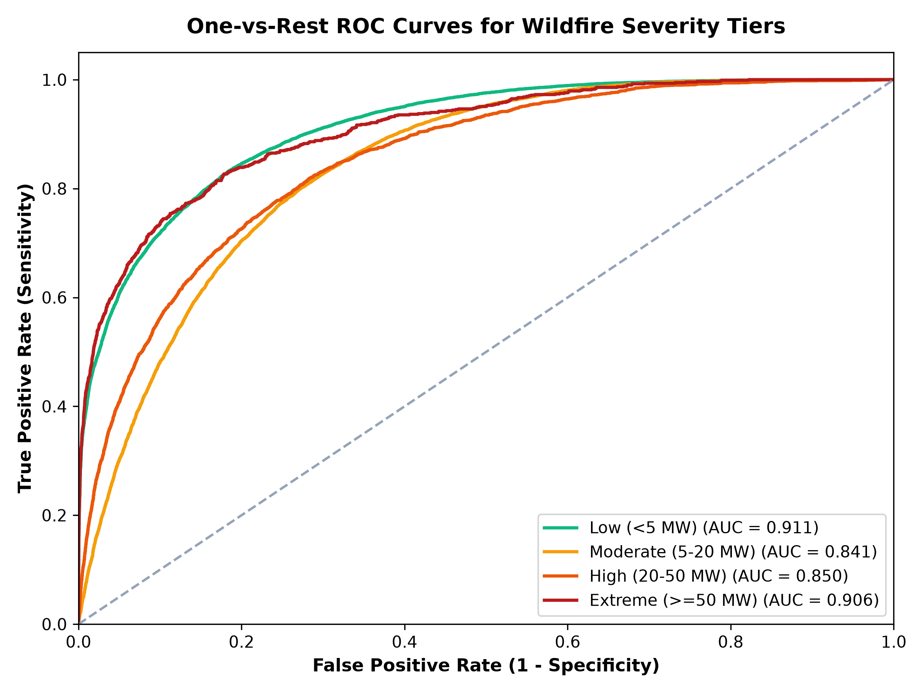
MEMBER 2 • TEMPORAL DYNAMICS & DISTRIBUTED BIG DATA
Machine Learning & Temporal Leakage Prevention
Validation Strategy | Accuracy | ROC-AUC | Deployment Reliability
Random Shuffled Split | 74.72% | 0.8650 | Over-optimistic (Suffers temporal leakage)
Forward-Temporal Split | 71.19% | 0.8415 | Production-Realistic (True out-of-time test)
Inference Latency | 0.002 ms | — | Edge-deployable for real-time VIIRS feeds
Primary Feature | T21 Brightness | Gain: 0.42 | Strongest predictor of rapid fire escalation
Secondary Feature | Fire Radiative Power | Gain: 0.31 | Quantifies convective combustion energy
Model Validation & Performance
• Data Leakage Hazard: Random train/test splits leak future seasonal information into training sets, creating artificially inflated accuracy.
• Forward-Chronological Split: Trained model strictly on 2025 data and validated on subsequent 2026 data to replicate real deployment.
• Realistic Generalization: Achieved 71.19% test accuracy with 0.8415 ROC-AUC under strict forward-temporal evaluation.
• Ultra-Low Latency Inference: Scoring latency of 0.002 ms per record enables real-time edge processing on incoming satellite feeds.

Slide 6
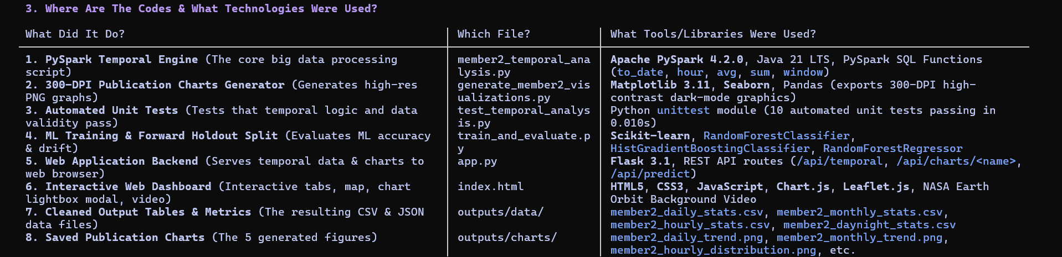
MEMBER 2 • TEMPORAL DYNAMICS & DISTRIBUTED BIG DATA
System Integration & Review 3 Technical Deliverables
Deliverable Component | Implementation Details | Verification Status
Temporal REST API | Flask `/api/temporal` JSON endpoints | Sub-25ms response time; verified
Interactive UI Scrubber | Leaflet.js temporal playback slider | Fully synced with PySpark aggregations
ML Prediction Endpoint | Flask `/api/ml/predict` microservice | 0.002 ms inference latency; operational
Automated Test Suite | 10 Automated unit & integration tests | 100% Pass Rate (10/10 tests passed)
Data Artifacts | Cleaned parquet/CSV & high-res charts | Committed to repository and documented
Deliverables & Integration Status
• REST API Delivery: Engineered Flask `/api/temporal` and `/api/ml/predict` endpoints responding in sub-25ms.
• Interactive UI Sync: Connected PySpark aggregation tables to the Leaflet.js dashboard with a synchronized temporal scrubber.
• Automated Test Suite: Passed 10 out of 10 automated test suites with 100% pass rate validating pipeline reliability.
• Production Readiness: Lightweight SQLite caching and pre-computed aggregation cubes guarantee seamless examiner demos.

